Slide 1
Way-to-WIC Collaborative
NWA Education and Training Conference
Baltimore, md
April 7, 2019

Slide 2
BACKGROUND
Background
Provide all Americans access to a safe, nutritious, and secure food supply in a manner that maximizes customer service
Eligible children between the ages of 2 and 5 were not accessing nutritious foods for the span of their eligibility
Retain children in WIC while also improving access to the Program
Notes:
Welcome to this presentation of the ‘Way to WIC Collaborative’ project!
For more than 40 years the WIC Program has strived to meet its purpose of providing supplemental foods, nutrition education and breastfeeding support to income eligible mothers and their children, but in recent years, there's been a decrease in participation among children between the ages of 2 to 5. One of WIC's purposes is also to serve as an adjunct to good health during critical periods of growth by coordinating with other health related programs. That's where the Way-to WIC Collaborative fits in. While local and State WIC agencies were working individually to ensure children had access to these foods, there was very little to no activity being done as a Region collectively. Therefore, the Southeast Regional Office (SERO) of the Food & Nutrition Service made a decision to establish a collaborative workgroup composed of State and local WIC staff to work to identify strategies to increase the retention of children in WIC while also improving access to the Program. From this, the Way-to-WIC: A federal, State, and local collaborative was formed.

Slide 3
Way-to-WIC Collaborative
Composed of 25 WayMakers from state and local agencies in the Southeast Region and FNS Regional Office staff
WayMakers participated in monthly conference calls for guidance from FNS and to learn more about the group's charge
First face-to-face meeting held July 14-15, 2016
Notes:
Each State Agency was asked to identify a State level WayMaker, or workgroup member, and a local agency WayMaker. This led to 25 Waymakers from Federal, State and local agencies. WayMakers were asked to bring to the effort their expertise on successes, barriers and issues impacting eligible WIC-aged children having access to nutritious foods. Each member was asked to commit 2 – 3 hours per month for conference calls and attend one face-to-face meeting to develop strategies that could be implemented. The first face-to-face meeting was held in July 2016, a follow-up face-to-face meeting was held in July 2017. This presentation represents the efforts of the workgroup.

Slide 4
The Charge from SERO
Make a commitment to improve participation in your clinic, county, district, or state by 5% - customer service is key
Make the WIC prescreening tool more accessible
Find a new way to issue benefits to children and their families
Identify which valuable components to families with children
Create new messages about WIC
Expand your partnerships – make new friends
Notes:
SERO led this collaborative effort, and set fundamental expectations at the outset. Participating agencies all agreed to 6 steps: (1) commitment to improve participation by 5%, with a focus on improving customer service, (2) make the WIC prescreening tool more accessible, (3) find a new way to issue benefits to children and their families, (4) identify which components of WIC are valued by families with children, (5) create new messages about WIC, and (6) expand partnerships – make new friends.

Slide 5
Goal
Develop a toolkit of effective strategies to retain children in the WIC Program while also improving access
Notes:
The expected result of the Collaborative’s effort is the identification of viable strategies for reducing food insecurity through increasing the retention of children in WIC while also increasing access to the Program.

Slide 6
Way-to-WIC Components and Committees
Partnership
Marketing & Advertising
Clinic Environment
Food Package
Notes:
Based upon the charge from SERO, the Waymakers identified key components of the WIC Program that are of the most value to families with children. This brainstorming led us to establish these four committees: Partnership, Marketing & Advertising, Clinic Environment, and Food Package – each of which represents a significant area of opportunity for this project.

Slide 7
Bringing it all together…
Charge from SERO
Partnership
Marketing & Advertising
Clinic Environment
Food Package
Effective Strategies for Toolkit
Notes:
All committees received basic guidelines from SERO with clear expectations of what our outcomes were to be ‘effective strategies for the Way to WIC toolkit’. The final product of this effort was identified early on so we all knew what we were working toward as we began our collaborative teamwork.

Slide 8
…And so the work began!
Committees selected chairpersons, and held monthly conference calls or met as often as deemed necessary
Progress was reported to the full group and to FNS during monthly W2W conference calls
Notes:
Committees spread out to conduct work independently, and report progress to SERO approximately monthly.

Slide 9
Action Plan
Research Phase
Action Phase
Drafting Phase
Final Phase
Notes:
To ensure each committee was on task and that we moved forward as a group, the Collaborative developed an Action Plan – essentially a work plan – with these four phases. During the Research Phase, committees were to research effective strategies currently underway in Southeastern States as well as across the Nation. Based upon this research, committees could consider potential locations to visit to see the strategy in action. Budgetary needs were also determined. Following the research phase, the group moved into the Action Phase. This phase included travel, observations and some face-to-face committee meetings. All WayMakers came together for another Face-to-Face meeting during the drafting phase. During this phase, each committee presented the strategies they identified as effective and the entire Collaborative decided which ones should be included in the toolkit. The Collaborative also decided on the formatting of the toolkit. We determined each strategy will include the following information: Background, Materials/Supplies/Staffing Needs, Implementation Process, Lessons Learned, and Contact Information for the WIC agency. The Way-to WIC Collaborative is now in the Final Phase. Committees are submitting their final strategies for inclusion. This presentation will now identify a couple strategies from one committee that will be included in the final toolkit.
Now, I’ll turn it over to one of the members of the ‘food package’ committee.

Slide 10
Food Package Committee
Notes:
(Introduce myself.)
The members of the food package committee collectively have many decades of experience working in the WIC program. Over the years we had seen many changes to our program, including some significant changes to the WIC food packages. Throughout our time with WIC, we also had many opportunities to hear from participants – many good things but also a multitude of complaints. As seasoned WIC employees, we had a sense of the reasons why the caseload among older children had been declining, and we felt very strongly that effective strategies applied to this area of concern could make a real difference.

Slide 11
RESEARCH Phase
Notes:
For our research, we searched high and low to find any WIC data that pertained to issues and opportunities for our topic. We also determined that our topic ‘food package’ should include any data or study content that addressed ‘shopping’ for WIC foods.

Slide 12
Hypothesis: “The current WIC food packages offered, along with shopping for WIC foods, have various drawbacks that lead to dissatisfaction among participants, resulting in decreased WIC participation, especially among children over the age of one.”
Notes:
As we were conducting our research phase, we developed this hypothesis: “The current WIC food packages offered, along with shopping for WIC foods, have various drawbacks that lead to dissatisfaction among participants, resulting in decreased WIC participation, especially among children over the age of one.”
To test our hypothesis and get feedback from WIC participants, our committee traveled to Knoxville, TN to hold a focus group of current WIC families.

Slide 13
ACTION Phase
Notes:
One of our ‘action’ activities involved talking with WIC participants and asking for their feedback about issues related to the WIC food package and their experience when shopping in this local community.

Slide 14
VIDEO
In April 2017 the committee conducted and filmed interviews in Knoxville, TN
Let’s take a few minutes to hear what the WIC participants had to say about the current WIC food packages…
Notes:
In April 2017 the committee conducted and filmed interviews in Knoxville, Tennessee. Let’s take a few minutes to hear what the WIC participants had to say about the current WIC food packages.

Slide 16
DRAFTING Phase
Notes:
In our Drafting Phase we began shaping our recommendations along with key strategies that will be included in the toolkit.
It’s important to note that not all sections of the toolkit may include ‘recommendations’, but we felt it was necessary to include these in ours since major decisions regarding ‘WIC food packages’ and even ‘shopping for WIC’ are created from the top down, at levels above the local agency.

Slide 17
SOME KEY RECOMMENDATIONS
WIC participants appreciate and value being allowed to make their own food choices for their families
The WIC shopping experience should be a focus of improvement for all levels of WIC program responsibility
Improved consistency among states in the SE region for approved foods, including available sizes and types of food, would increase participant satisfaction
Improved vendor training and communications, including shelf signage, would improve participant satisfaction
Notes:
After searching for and reviewing numerous studies, articles, documents, and publications we arrived at the following: the work on behalf of WIC food packages can be broken down into federal, state, and local levels of responsibility. At each of these levels, these are some of our points to consider. In our toolkit, we will also offer a few retention strategies that we believe are nationally applicable. All together these constitute a ‘wish list’ of recommendations to consider on the topic of maximizing retention through foods available on WIC along with improving the WIC shopping experience.
These recommendations have not been presented to the National Office or any Regional Office for comments.

Slide 18
MORE RECOMMENDATIONS
FMNP
Grocery store tour
WIC Shopper App
Universal Shelf labeling
Advocate for states to allow choices for:
Chocolate/flavored milk
Flexible whole grain pkg sizes
Flexible yogurt pkg sizes
Peanut butter at age 1
All allowed cheese varieties
Local level
LA offering WIC staff education and training including hands-on learning
WIC shopping “hotline” for WIC customers having difficulty shopping
Key vendor staff identified and trained as WIC experts
Advocate for Federal policies to be changed
Milk (participants select fat content)
Consistent flexibility with product sizes
Acknowledge challenges before implementing changes, avoid if possible
Notes:
During the drafting phase, we shared our work up to this point with the other collaborative members during a face-to-face meeting. We then brainstormed about items that should be included in the toolkit – additional key items that were selected are shown here.

Slide 19
Food Package Committee
Include in Toolkit:
Letter of support to encourage food package variety
Focus Group video
White paper proposing flavored milks
Strategies
WIC Shopping “Hotline” or “Textline” for WIC customers having difficulty shopping
Grocery Store Tour
WIC Shopper App
Notes:
We further decided that we would include the following items to build our portion of the toolkit:
A letter of support to encourage food package variety and participant choice. We would ask the SERO Regional Administrator for this letter.
The Video shown earlier would also be included as a background resource.
We would include strategies that: 1) improve the WIC shopping experience; 2) promote variety and more options of approved foods; and recommendations for Federal – National and Regional, State, and local level WIC authorities on how to support each strategy.

Slide 20
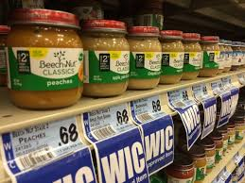
Strategies | STATE level
We recommend State Agencies would:
Be mindful of and proactive about things pertaining to authorized foods and shopping
Examples are:
Create consistent shelf labeling
Produce understandable shopping guides for WIC foods
Develop grocery store tour lesson for nutrition education
Notes:
For consistency within states, the messaging provided to WIC participants not only should be developed at the state level, but should be developed such that participants do in fact have an optimized experience when shopping for their WIC foods. Information we gathered reflects that participants do look for shelf labeling when they shop, which is confusing for them when it is different from store to store. We also found that from state to state, program materials that provide shopper information varied in ease of understanding from the perspective of the WIC shopper. Also for consistent messaging, although we will identify the grocery store tour as a local agency action item, we believe it should fall to the state agency for initial development.

Slide 21
Strategies | LOCAL level
We recommend Local Agencies would:
Conduct participant-centered activities at grocery stores such as:
In-depth WIC staff education and training, including hands-on learning, related to shopping for WIC foods
Robust ways of offering shopping education to participants
A hotline for WIC customers having difficulty with shopping
Notes:
Local agency staff, charged with the primary responsibilities of program eligibility determination and nutrition education, may benefit from training specifically focused on the retail details of WIC foods and the challenges of shopping for WIC. WIC staff participating in ‘scavenger hunt’ or similar experiences that took place within their community retail locations learned valuable firsthand information that they could then pass along to their participants. WIC staff were also more likely to be able to answer questions and troubleshoot problems when contacted by WIC shoppers having difficulty with particular foods or with certain community retail locations.

Slide 22
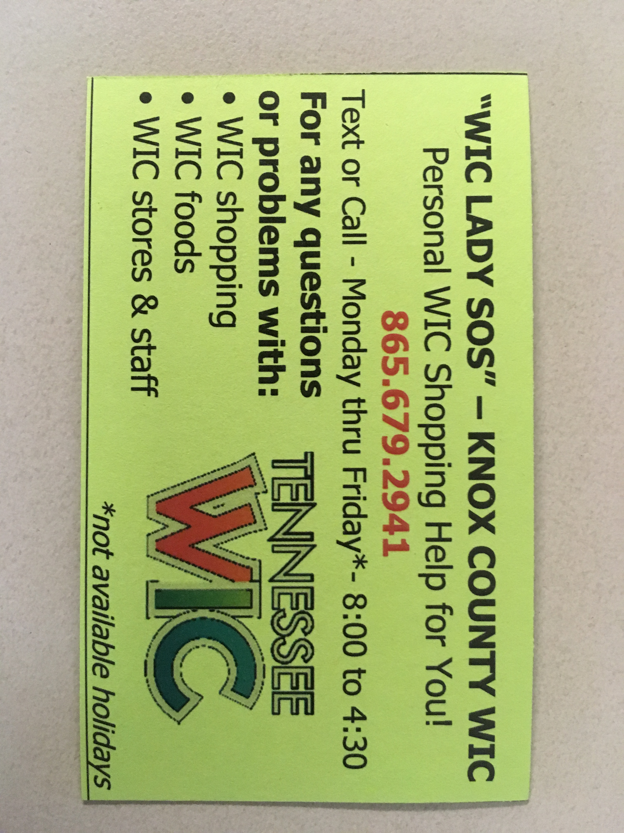
Food Package Strategy Shopper Hotline | “WIC Lady SOS”
Local agency staff provide assistance for WIC shoppers within their community
WIC staff ‘experts’ available to answer questions about WIC foods while shoppers are at the store
When necessary, staff may arrange to provide personal shopping assistance at any retail location within our region
Shoppers may call or text, or even send pictures
Notes:
Let me briefly discuss the WIC Shopping Hotline-Textline strategy that will be included in the toolkit.
This strategy is being conducted at Knox County local agency in Knoxville, Tennessee. Vendor staff and the WIC Director handle the hotline – a smart phone manned continuously during business hours. Calls and texts come in every day from folks who have questions and problems directly related to shopping. When necessary, we ask folks to take a picture of the food or the receipt in question and send it in to us, so we know exactly what we are talking about when we are determining a solution. Tennessee recently transitioned to EBT – we have had more calls than ever since! Don’t be fooled into thinking EBT solves your WIC shopping problems.
I’ll now turn it back over to Berry Kelly to wrap things up!

Slide 23
FINAL phase
Notes:
We are now in the Final Phase of the Way-to-WIC Collaborative. Strategies have been drafted and are being finalized for publishing. The next couple of slides provide a visual of a toolkit strategy and an outline of the toolkit.

Slide 24
Toolkit Format
List of acronyms
Glossary
Appendices
List of Contacts
Customizable template tools
Supporting Resources
Photo Gallery
Notes:
The format of the toolkit will include these items:
List of acronyms
Glossary
Appendices – support content section
List of Contacts – compilation of contact persons name/title for each strategy
Template tools that be personalized to fit the needs of the local agency/clinic
Supporting resources – video, document, surveys, photos, etc.

Slide 25
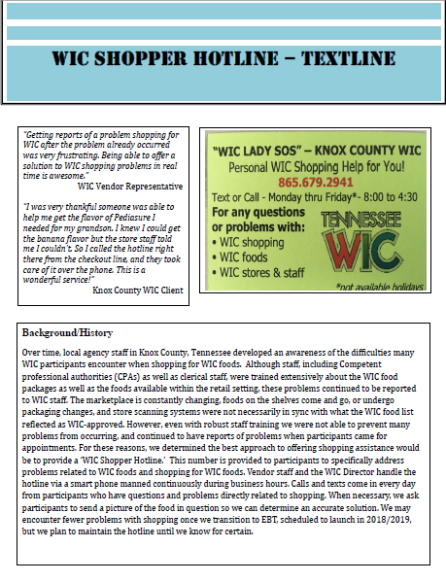
Strategy Format
Components
Introduction/Background/History
Materials/Supplies/Staffing Needs
How to Implement [Strategy]
Advantages
Challenges
Resources
Contact Information
Notes:
The graphic is an actual copy of the WIC Shopper Hotline-Textline Strategy. All strategies in the toolkit will have the same format and include some or all of the following components:
Quote: the quote is from someone who has benefited from the service. This could be the WIC participant, WIC vendor, or a WIC staff member.
Introduction/Background/History: The Background tells the story of why this strategy was initially developed. Insight is also provided on how the strategy works.
Materials/Supplies/Staffing Needs: This section, which will be shown on the next page, identifies the needs associated with implementing the strategy, i.e. staff, mobile devices, partnerships, etc.
How to Implement: Instructions on how to implement the strategy are found in this section.
Advantages: We provide advantages as a way to tell how your WIC Program will benefit from implementing the strategy.
Challenges: Of course, the road will not always be easy, so we identify challenges you may experience when trying to implement the strategy.
Resources: This section provides resources available.
Contact Information: The individual listed is the person at the local agency or clinic who developed the strategy. They are available to assist and provide further information.

Slide 26
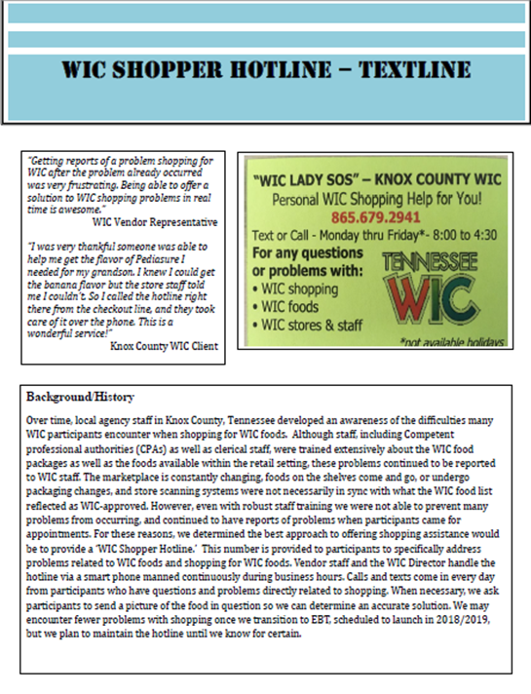
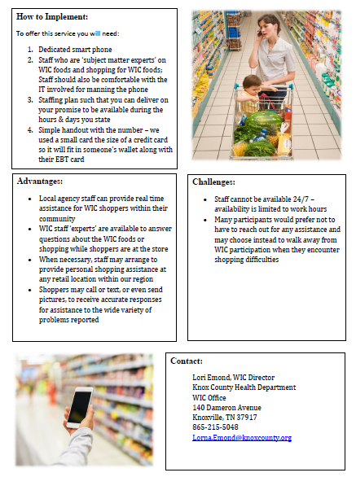
Notes:
This is a view of the entire strategy – plenty of detail if you want to explore considering this for your WIC agency.

Slide 27
WayMakers
Mandy Darlington (AL) Diane Lollar (AL)** Rhonda Herndon (FL)
Rebecca Hacker (FL) Angela Damon (GA) Brenda Forman (GA)
Rhonda Goff (KY)** Rita Hatcher (KY)** Rebecca Tyree (KY)
Beth Crumpton (MS)** Connie Tate (MS) Amanda Orifitelli (NC)
Julie Byrd (NC) Berry Kelly (SC) Jessica McDowell (SC)
Betsy Crick (SC)** Sharon Morrow (TN)** Kailey Lewis (TN)**
Emily Germer (TN)** Lori Emond (TN) Deborah Lowery (EBCI)**
Iva Denson (MBCI) Tihesha Salley (SERO) Tamika Hayes (SERO)
**indicates WayMakers who are no longer working in WIC
Notes:
This concludes our presentation of the Way-to-WIC Collaborative and the work we have done thus far. Please remember that the strategies identified are a small representation of our work. The recommendations mentioned have not been presented or shared with the USDA - FNS National Office and have not been formally shared with our Regional Office. We are diligently working to have the toolkit completed this year.

Slide 28
Notes:
What questions do you have?
Thank you for your time and attention!

