Slide 1
Innovative Approaches to Increasing Recruitment & Retention in Colorado WIC
Kelly Kading, Weld County WIC
Melanie Morrison, Tri-County Health Department WIC
Samantha Volk Jennings, Denver County WIC
Nicole Cawrse, Pueblo Department of Public Health and Environment WIC

Slide 2
Overview
WIC Innovation grant background
Local agency projects and highlights
Interagency collaboration
Questions

Slide 3




WIC Innovation Grant Background
Purpose of the grant: to support the Colorado WIC program in implementing strategies to improve participation through enrollment and/or retention in the program
State office and 13 local agencies awarded
Funded by the Colorado Health Foundation
Supported by Covering Kids and Families and the Colorado Department of Public Health and Environment
Evaluated by Kaiser Permanente
Notes:
Agencies were awarded in the Spring and Fall of 2017. Each agency wrote their own grant, so although the collective goal is to increase recruitment and retention, each agency allocated the funds a little differently. For example, some hired new positions to manage outreach work, and others opened new clinic locations. The 13 agencies represent agencies all across the state of varying sizes.

Slide 4
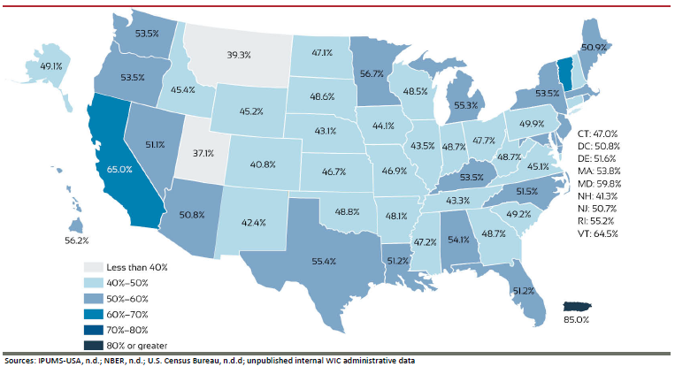
The Data that Drive the Work
40.8% overall coverage rate¹
49th lowest enrollment of all States and territories
Coverage rates lagging most in children > 1 y/o and pregnant women²
Notes:
In the most recent 2015 data, the Mountain Plains Region had the lowest coverage rate overall, with an average of 43.5%¹. What is important to note is that coverage drops precipitously after age 1, and coverage in pregnancy is much lower than after they deliver, so we’re not getting Moms nutrition education and support as soon as we’d like², and they are not getting the benefits we know exist for participating on WIC early in pregnancy, like better birth outcomes for mom and baby. Race coverage varies for each county, as do immigrant and refugee resettlement rates, which have been declining in CO⁴, affect this as well.

Slide 5

The Data that Drive the Work
Colorado Blueprint to End Hunger
  5 goals and strategies
  #4: “Maximize SNAP and WIC enrollment to propel Colorado to become a leading state for enrollment in these health and nutrition benefit programs.” ³
https://www.endhungerco.org/
Notes:
The Colorado Blueprint to End Hunger is a multi-year plan to end hunger for all Coloradans. It was developed by individuals and organizations from across the state who are working on or experiencing hunger in their own homes and communities³. Key elements of the plan include efforts to maximize the use of SNAP, WIC, and Federal Child Nutrition programs, as well as increasing access to community-based organizations³. The goal-based work groups meet periodically and report out. CO WIC State office staff sit on relevant workgroups.

Slide 6
Colorado WIC Online Referral Form
Local agencies, health care providers, and community partners requested the Colorado WIC state office develop an online referral form to streamline the referral process statewide.
Released December 3, 2018: www.ColoradoWICSignup.com
600 referrals received between 12/3/18 – 2/28/19 of which 42% Certified & 19% Scheduled certification appointments.
Data will be monitored and evaluated. Quarterly referral reports will be provided to statewide partners
https://www.endhungerco.org/
Notes:
The Colorado Blueprint to End Hunger is a multi-year plan to end hunger for all Coloradans. It was developed by individuals and organizations from across the state who are working on or experiencing hunger in their own homes and communities³. Key elements of the plan include efforts to maximize the use of SNAP, WIC, and Federal Child Nutrition programs, as well as increasing access to community-based organizations³. The goal-based work groups meet periodically and report out. CO WIC State office staff sit on relevant workgroups.
Data will be monitored and evaluated. Quarterly referral reports will be provided to statewide partners with info on the number of referrals submitted by each partner and number that were certified onto the program.

Slide 7
Weld County WIC

Slide 8
Agency Overview and Goals
Serve ~5,000 people/month with 4 clinic locations
Awarded WIC Innovation Grant June 2017 & work extended to Nov. 2019
Major grant goals and expenditures: Outreach coordinator position, outreach materials, data collection, recruitment and retention work
Goal to increase caseload by 12% by the end of the 2-year grant period
Notes:
Hired outreach coordinator in August 2017.
Outreach materials include: mobile clinic supplies (laptop, scale).
Data collection: We had great State and National data that informed us of what we might expect to find, but wanted local data to confirm

Slide 9
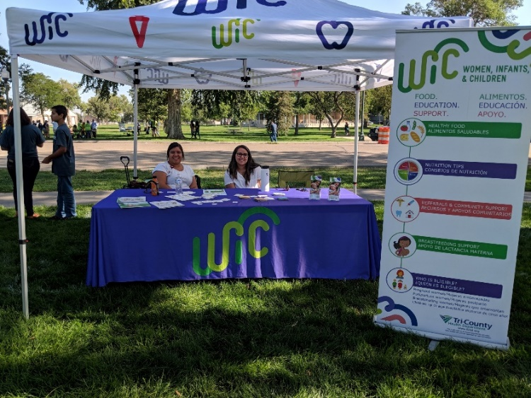
Grant Implementation
Initial data collection: focus groups and survey
Integrated referral systems
Various recruitment and retention campaigns
Community partnerships: WIC has a place at the table
Notes:
Focus groups were poorly attended. As an alternative, we created a survey and we had better response rates. Both were offered in English and Spanish, and the goal was to learn about what people found most valuable about the WIC program and what they would improve. 105 surveys were administered in-person and online.
Sunrise community health: Clinic radios, walk-ins, EHR referrals, Centering Pregnancy.
Most of the grantee have tried similar outreach campaigns using NWA branding, and as we all know, there is little to no data available on these strategies and whether they truly “work” (ie, increase caseload). Examples: 1st birthday postcards, 9 month appt bookmarks, provider baskets, refer-a-friend incentives, social media engagement incentives…
We are very proud of the progress we’ve made in improving and building upon our inter-agency partnerships throughout the County. I’ll delve into this more on the next slide.
We have carried out a lot of little projects, but these are our main areas of focus in the high level overview I’m providing.

Slide 10
Community Partnerships
We partner on some level with over 10 community agencies
How?
  Contact any and all agencies that might work with WIC families
  Revisit current/old partnerships
  Educate the community about WIC: don’t assume they are experts
  Attend any and all community meetings
  Outreach Coordinator position enables us to do this
Notes:
Call, e-mail, stop by repeat. A lot times community agencies are understaffed and overwhelmed, but they want to work with you.
Even if you have a good relationship with an agency, it is worth revisiting and refining
I have given countless WIC 101 presentations and I am always surprised at how much people don’t know about WIC. Especially our breastfeeding services. A lot of times they confuse WIC and SNAP. Giving that presentation at staff meetings or in-services has been invaluable in gaining WIC champions and increasing referrals.
Attend community meetings to achieve higher visibility and build rapport in the community. Sit on relevant coalitions, councils, workgroups. Make sure WIC priorities are addressed- they’re often in line with other agencies’ existing work. Attend community events and table with WIC info and an activity for the same reasons!
The Outreach Coordinator position is 40 hours per week and has enabled us to achieve deeper partnerships and creative collaboration that we did not have the capacity to achieve previously

Slide 11
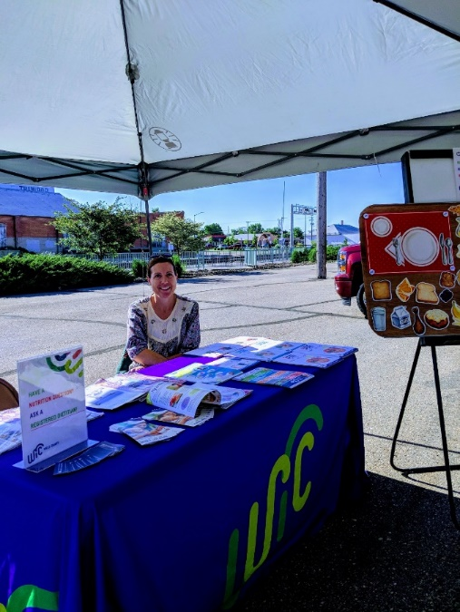
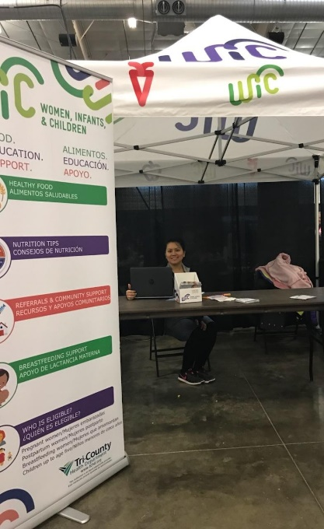
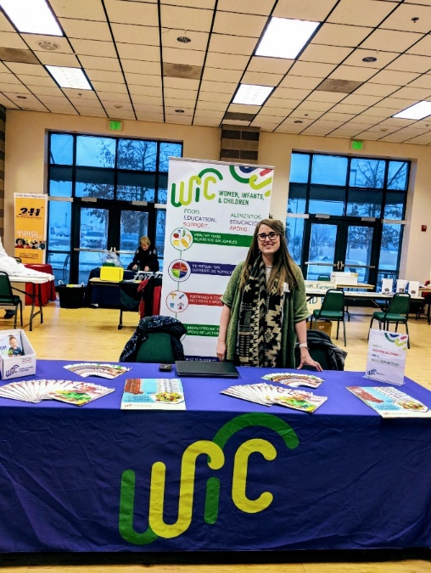
Outreach Events
Notes:
We attend over 20 events per year to educate the community about WIC and enroll new participants.
Examples of events include: farmers markets, North Colorado Children’s Festival, community wellness events

Slide 12
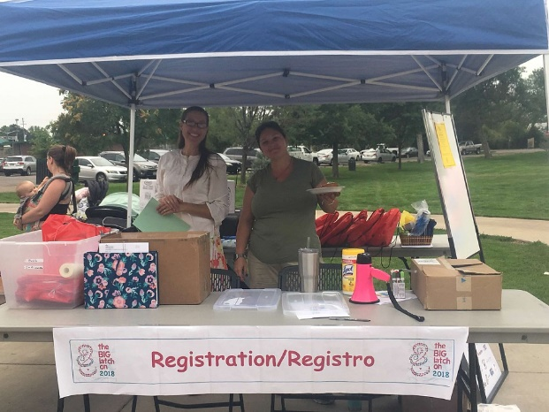
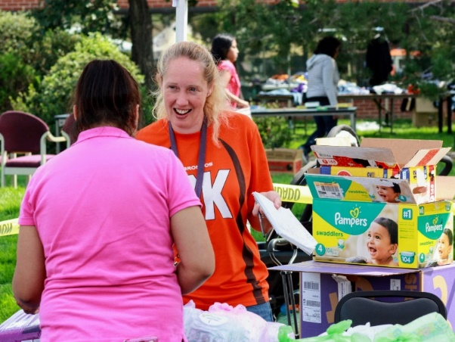
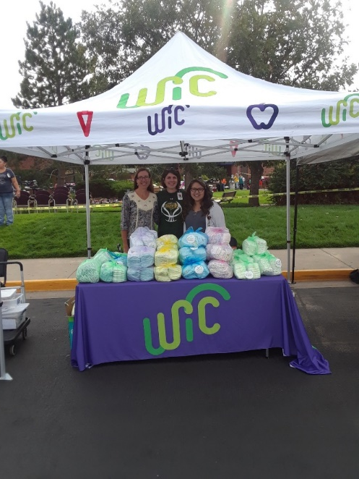
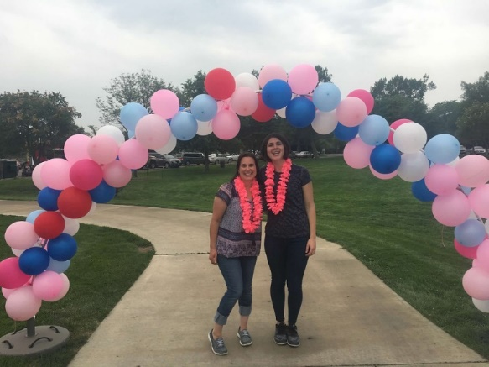
Outreach Events
Notes:
In celebration of National Community Health Center hosted a diaper drive in 2017 and 2018 and amassed over 7500 diapers each year to share with families in need.
In August of 2018, we hosted the Big Latch On Northern Colorado in celebration of world breastfeeding week. This event promotes and normalizes breastfeeding. We had 52 mothers participate, most of them WIC.

Slide 13
Impact On Caseload(?)
We know that we have markedly increased referrals and visibility in the community
Net change in caseload since grant began: -3% (original goal= +12%)
Overall, the grant has positively impacted our agency and we have adjusted our metrics for success
Notes:
However, increased referrals hasn’t led to a marked increased in caseload 8/2017= 4963; 1/2019= 4805).
We have adjusted our measures of success and we’re proud that our caseload has more or less stagnated, given the negative external forces that we cannot control (proposed rule on public charge, refugee resettlement, government shutdown).

Slide 14
Tri-County Health Department WIC

Slide 15
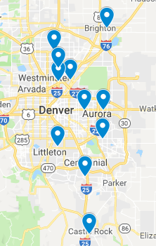
Agency Overview and Goals
Largest WIC agency in Colorado
          Over 21,000 participants
          11 offices
          Three counties surrounding Denver
            Grant focus on Douglas and Arapahoe
Objectives:
    Increase prevalence of food insecurity screening
    Internal and external marketing
    Partner and community outreach

Slide 16
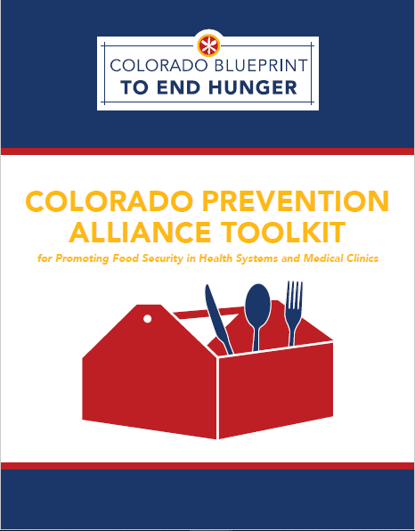
Food Insecurity Screening
Food Insecurity Screening Sub Grants for Providers
          $1,000 sub grants
          Add Hunger Vital Sign to Electronic Health Record
          Refer to Hunger Free Colorado
Hunger Vital Sign™
Are the following statements is ‘often true’ or ‘sometimes true’ or ‘never true?”
  “ Within the past 12 months we worried whether our food would run out before we got money to buy more.”
  “ Within the past 12 months the food we bought just didn’t last and we didn’t have money to get more.”

Slide 17
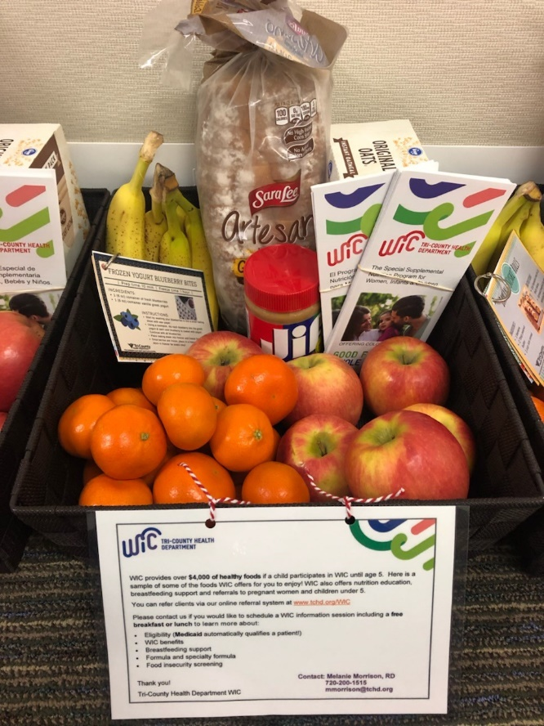
Food Insecurity Screening
Outreach to providers
          Practice Transformation Organizations
          Provider Baskets
          WIC 101s
          Professional Organizations
Results
  Two small practices received sub grants
  Sub grant was needed to cover the time/costs associated

Slide 18
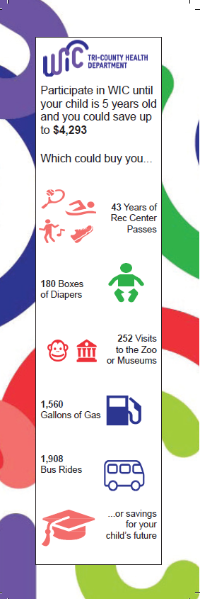


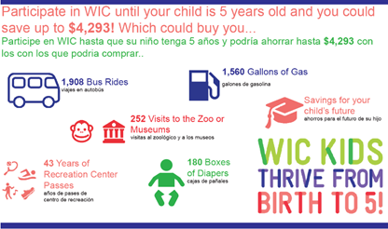
Retention Campaign
Clinic Incentives
Bulletin Board

Slide 19

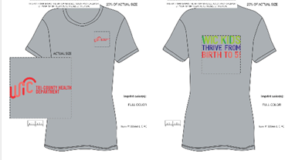
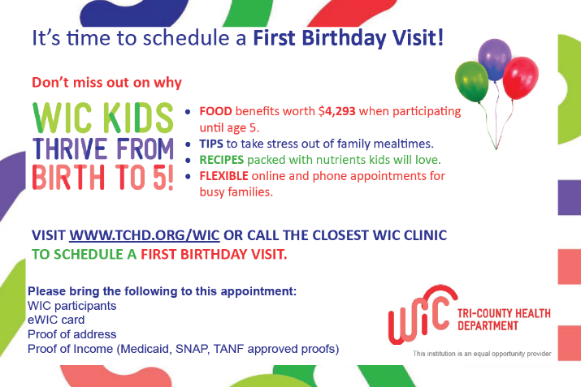
Retention Campaign
Staff T-Shirts
Social Media
Birthday Postcard

Slide 20
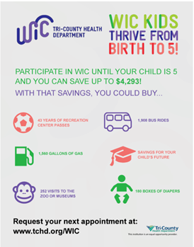
E-mail Results
Open Rate | 37% English 41% Spanish
Click Rate | 15% English 14% Spanish

Slide 21
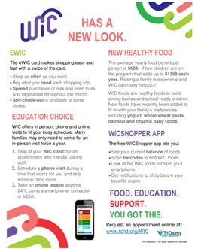
E-mail Results
Open Rate | 30% English 36% Spanish
Click Rate | 9% English 13% Spanish

Slide 22
Learning and Outcomes
Douglas County caseload increased by 15%
Overall caseload has decreased by 7%
Most successful:
WIC 101s
Co-located clinics
Online referrals
Emails
Retention Campaign
Least successful or needs more time:
Outreach events: 50% show rate
Mobile clinics
Mailers

Slide 23
Denver County WIC

Slide 24

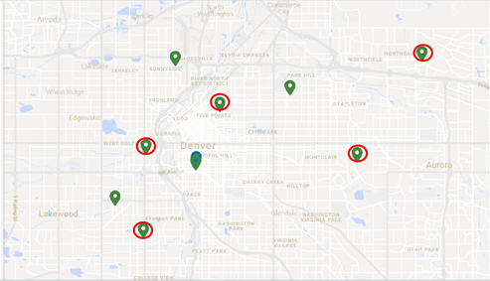
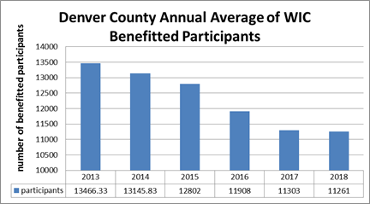
Agency Overview: Denver County
Provides services in Denver County
Over 13,400 enrolled
WIC offices located in five of Denver Health’s Community Health Clinics
Notes:
Denver Health was founded as a city hospital in 1890. Denver Health is a comprehensive integrated organization that provides care regardless of ability to pay. Denver Health is Colorado’s primary safety-net institution.
Denver County WIC has offices located in the Eastside Family Health Clinic, Westside Family Health Clinic, Montbello Family Health Clinic, Lowry Family Health Clinic and Southwest Family Health Clinic (as demonstrated with red circles)
Much like other counties in CO, Denver has seen a steady decrease in participation and benefitted PPTs on the WIC program over the past 5 years

Slide 25
Grant Goals
Create outreach and enrollment work plan and tracking database
Identify underserved areas for future co-location and enrollment efforts
Design, recruit for, and conduct interviews, focus groups, questionnaires to identify activities to improve WIC program retention
Co-locate WIC services at four Denver Health clinic sites
Increase enrollment by two percent annually
Notes:
The two year grant goals identified above.

Slide 26
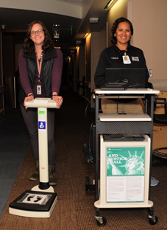
Overview of Grant Project: Co-Location Sites
Mom/Baby (Denver Health)
Over 300 families served since Feb 2018
  Does not include BF consultations/support
Staff on site 2 days a week
Satisfaction survey
118 BFPC referrals
Created database to track participants seen
Notes:
Denver WIC is in a unique position to partner with other Denver Health sites. Prior to receiving grant funds to complete appointments, staff was providing breastfeeding support to mom’s who recently delivered their babies. Currently WIC has the capacity to complete Add baby appointments on site in the hospital rooms and provide early breastfeeding support.
WIC staff participate in rounds each morning with clinical staff including nurses, MDs, NPs, PAs, and social work to discuss patient needs and identify potential WIC eligible clients.
Satisfaction survey implemented to identify PPT experience with completing appointment at hospital as compared to clinic. Outstanding positive response. When asked “How satisfied are you with completing your add baby appointment in the hospital compared to at the clinic” 62 out of 68 had the highest rating of “very satisfied”

Slide 27
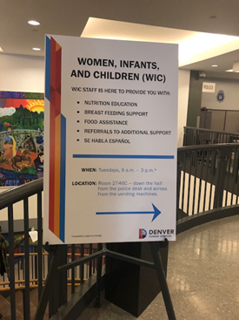
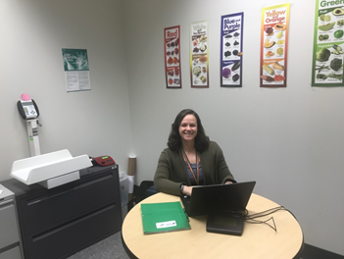
Overview of Grant Project: Co-Location Sites
Denver Human Services (DHS)
Provide WIC services to clients who are at Denver Human Services applying for other services
Once a week since June 2018
168 PPT served
  Walk-ins
  Schedule appointments
Created database to track participants seen
Notes:
Started with outreach once a week in the main lobby to determine interest and traffic. Provided a space by DHS once a week to complete WIC appointments. Office is off to the side and not visible to those sitting in the lobby. Sign was provided by DHS to direct interested applicants. WIC staff given permission to walk around lobby and approach those waiting to provide information on WIC and encourage eligible PPT to apply or complete WIC appointment. Challenges: only approach those with young children (could be missing a large amount of eligible people)

Slide 28
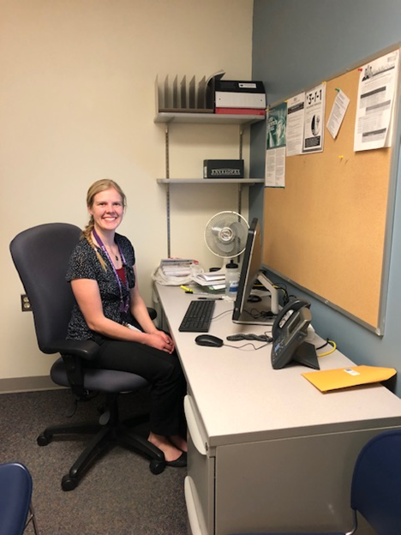
Overview of Grant Project: Co-Location Sites
Pavilion C – HR Women’s Clinic
Hospital staff see roughly 200 women daily, many who are eligible for WIC
On site once a week
58 PPTs served since September 2018
Created database to track participants seen
Notes:
WIC utilizes space at the High Risk Women’s Care clinic. Communication with MAs to obtain clinic schedule and warm handoffs given to WIC when potentially eligible participants are identified. Anthros are often already completed and available in EPIC charting system

Slide 29
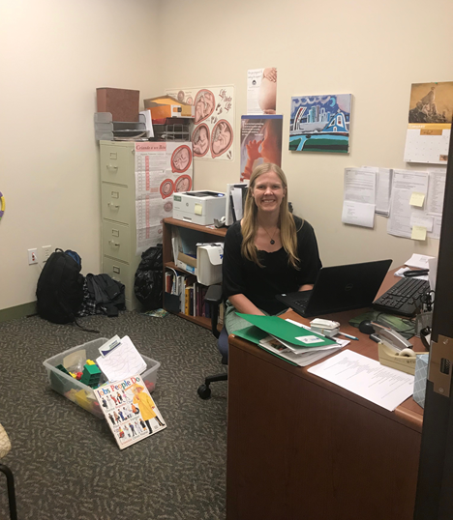
Overview of Grant Project: Co-Location Sites
Inner City Health
Serves uninsured and underinsured families in Colorado
Many of the providers and staff are volunteers
Large Spanish speaking population
Once a week
Walk-ins/warm handoffs
Newest site
  9 families served
Created database to track participants seen
Notes:
WIC given space in one of the pediatricians offices to provide WIC services. Clinic provides space and resources to complete WT/HTs and Hgb check. Working on MOU to allow WIS staff access to clinic charting system and shared schedule where Inner City staff can schedule appointments for WIC ahead of time

Slide 30
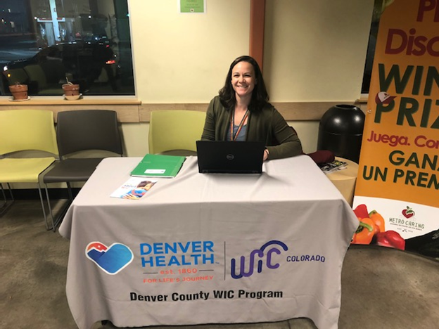
Overview of Grant Project: Additional Partnerships
Metro Caring
Jewish Family Services
Rocky Mountain Early Learning Center
Notes:
Metro Caring is a health focused organization that provides healthy groceries, and comprehensive wrap-around anti-hunger programming to break the cycle of poverty. They provide access to many resources including food pantry, cooking classes, health resources, community garden, diabetes classes, kids in the kitchen. WIC sets up a table in their waiting room once a week on Tuesday evenings to provide outreach services.
Jewish Family Services- Identified partnership in one of our target communities, southeast Denver. JFS provides innovative and professionally delivered services that empower participants to overcome difficult challenges and live fuller, more meaningful lives.WIC provides outreach during pantry hours on Fridays 10am-1pm
Rocky Mountain Early Learning Center is a federally funded program for low income families with preschool aged children. RMSER’s culturally sensitive Head Start Programs educate over 2,200 children yearly who are enrolled throughout the State of Colorado. RMSER’s Head Start program also offers qualifying participants support services such as nutrition, health, childcare, clothing, transportation and temporary shelter. WIC has collaborated with RMSER to provide services to our overlapping population. Outreach and information to staff on how to refer to WIC and vice a versa

Slide 31
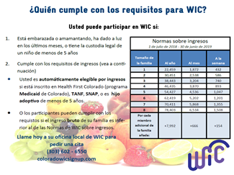

Overview of Grant Project: Outreach
Focus groups at Westside Clinic
Handouts for outreach
Facebook page
Provider Outreach
Notes:
Focus Group: One of our grant goals was to conduct focus groups to better understand the needs of our population to improve and increase participation and retention on the program. We were approached by Kaiser who wanted to conduct a focus group in Denver so instead of duplicating efforts, we teamed with Kaiser to conduct outreach and secure a space for the focus group at WS clinic. We have not received any data related to the results of the FG
Handouts: We identified early on in our outreach efforts that we did not have adequate materials to exchange with organizations and many of our resources were out of date with inaccurate information. Created income guideline tear off pads in English and Spanish to give to organizations to better understand program eligibility as well as cards with our phone # and referral website
Facebook: Worked with DH marketing to create a Facebook page to connect with the community on a social media platform. Post 3 times a week, use NWA post, shared posts from other organizations and promote Denver WIC activities. Traffic low
Provider outreach: 20 contacts with other organizations/ 7 unresponsive (Email/VM with no response). Includes: Health clinic outside of Denver Health, Head Starts, community organizations, health fairs/events

Slide 32
Results
Create outreach and enrollment work plan and tracking database
  Used excel to track outreach and enrollment
Identify underserved areas for future co-location and enrollment efforts
  Southeast Denver, Northeast Denver
Design focus groups/questionnaires
  Assisted in recruitment of Focus Group
  Satisfaction survey
Co-locate WIC services at four Denver Health clinic sites
  Mom/baby, Pav C, Inner City Health, Denver Human Services
Increase enrollment by two percent annually
  From 2017-2018 decrease benefitted participants by 1.9%
  From 2016-2017 decrease benefitted participants by 6.4%
Notes:
Southeast Denver- JFS
Northeast- limited response for outreach, tried libraries (Green Valley Ranch, Globeville) not great response
Co-Locate- 2 within DH
Increase enrollment- have not seen an increase in enrollment, but we have seen an improvement. Decrease of 1.9% compared to the year before of 6.4%

Slide 33
Challenges and Lessons Learned
Difficulty measuring success and identifying beneficial partnerships
  Knowing when to stop going to a location
  Definitions of success beside caseload
Identifying ways to be integrated into a system
Acquiring adequate space
Working on flow with current structure
Provider Outreach
  Difficult to determine effectiveness with no way to track referrals
Grocery stores
  Few referrals, less traffic
Libraries
  Less traffic and less of target population

Slide 34
Pueblo County WIC

Slide 35
Pueblo County- Main Goals
Increase fruit and vegetable intake of Pueblo County children by increasing enrollment into WIC
Increase awareness of program through marketing- social media, grocery stores
Make appointments easier by being more flexible and pseudo co-locations
Increase intercommunications and aid in a multi-disciplinary approach to care by connecting with providers in the area
Develop a more trusted relationship with community providers
Achieve message consistency

Slide 36
Pueblo County Demographics
Total population of 160,000 with about 110,000 living within the city
Mix of rural and city (mid sized)
Only delivering hospital for surrounding counties up to a 2 hour drive away
Recently took an extra of about 50 deliveries a month
Aging provider demographics and struggle to recruit more
Three major MD providers retiring this year
Food deserts
Closure of 2 major grocery stores in the last 2 years both on the east side of town

Slide 37
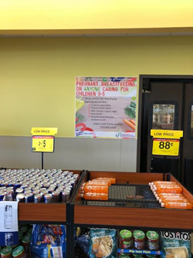
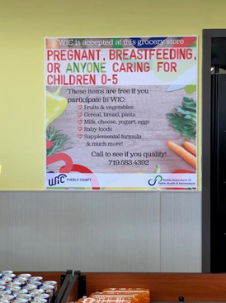
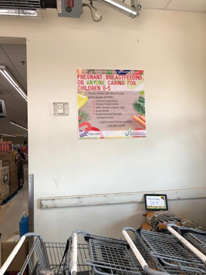
Pueblo County- Retention and Recruitment
Advertising in grocery stores
11/13 WIC approved stores agreed to advertising

Slide 38
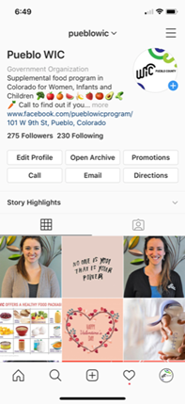
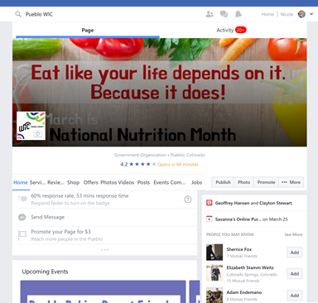
Pueblo County- Retention and Recruitment
Social media marketing-Instagram and Facebook
Successes
  Boost post
  Available appointments
Challenges
  Staying relevant
  Targeting the correct audience
Notes:
1,185 likes as of March 7th for facebook and 277 followers on Instagram
In the last 60 days we have ran 4 adds for $40.00 total and reach 3,286 people, 20 clicks, 274 post engagements- all targeted to our specific audience

Slide 39
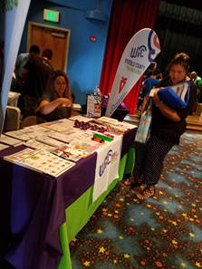
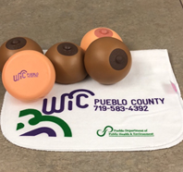
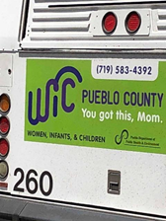
Pueblo County- Retention and Recruitment
Portable and useful pseudo co-locations
  WIFI hotspot, laptop, eWIC card reader
  Adjust food packages
  Occasional F/U
  Schedule and process new applications
In waiting rooms- SNAP, Medicaid, TANF, Community Health Center, Health Fairs
  Hired .5 FTE to complete extra outreach

Slide 40
Pueblo County- Retention and Recruitment
Successes
  Time spent vs. time scheduled
  Performance management
  Caseload increases
Lessons learned
  Some waiting rooms too challenging due to space
  Too wide or too little variety of people served
  Hard to track if they come to appointments
Notes:
Time Spent vs Time Scheduled: most successful with PCHC- average time schedule is ----/280 min there
We have seen some success with an average caseload increase an average of 182 highest being 4,325
Have seen a recent decrease- government shutTime Spent vs Time Scheduled: most successful with
We have seen some success with an average caseload increase an average of 182 highest being 4,325

Slide 41
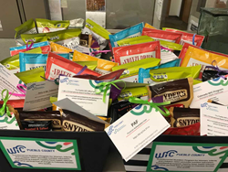
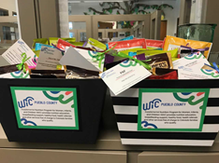
Pueblo County- Increasing Interpersonal Communication
Lunch and learns
  Total of 53 providers reached through 4 lunch and learns
  With another 80-90 providers by end of grant cycle
Lessons learned
  Don’t just focus on high level practitioners
  Bring baskets with healthy snacks and information
    Scheduled 3 out of 4 baskets dropped off
  Try to team with other community partners
  Difficult to track success
Notes:
Organized providers bios to focus on who is most passionate about what…
This not only allows for you to strengthen community bonds but the MD/ clinics get more out of the lunch and learn

Slide 42
Other Grantee Projects

Slide 43
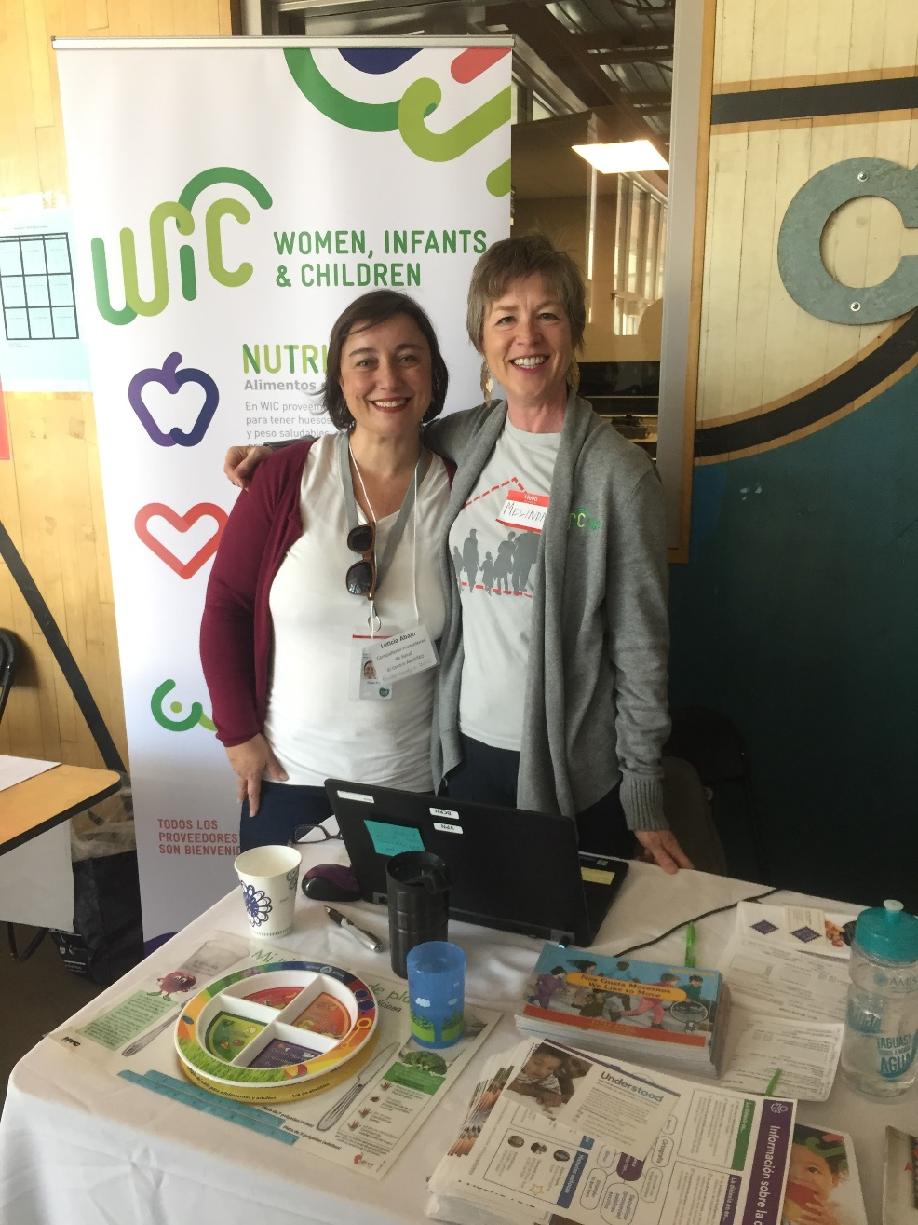
Boulder County WIC
Leveraged community relationships and explored perceived advantages and disadvantages to using WIC
Co-located with Clinica Family Health
Held focus groups
In year 2, created and are working with an advisory group to assist in planning, executing, and improving communication with the community.

Slide 44
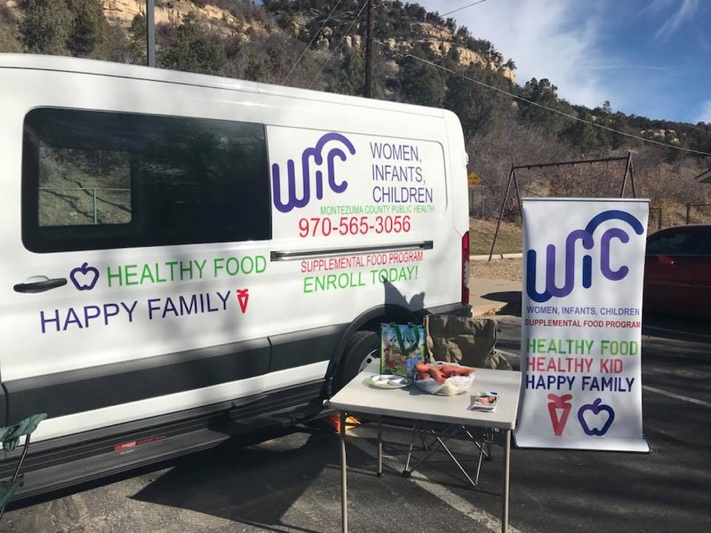
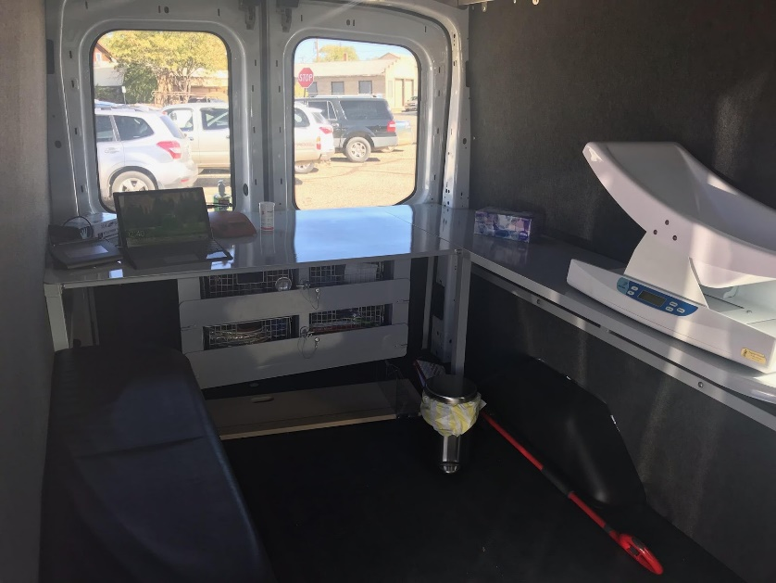
Montezuma County
Outfitted a mobile outreach van that goes all over the county and to people’s homes
Started Oct. 2018
2040 square miles
In the summer, van will distribute fresh, local fruits and veggies
Notes:
Organized providers bios to focus on who is most passionate about what…
This not only allows for you to strengthen community bonds but the MD/ clinics get more out of the lunch and learn

Slide 45

San Juan Basin Public Health
Grant goal: to increase recruitment and retention through targeted community outreach
Rural counties: established two new colocation sites
Year 2 goals: continue to strengthen partnerships and integrate WIC into communities in the counties we serve
Notes:
Organized providers bios to focus on who is most passionate about what…
This not only allows for you to strengthen community bonds but the MD/ clinics get more out of the lunch and learn

Slide 46

Grand County Public Health
Opened a new clinic which is co-located at a non- profit that offers many services, one of which is a food bank
Have promoted WIC by various methods in the community but have not seen a rise in participation, and seeing a lot of transfers out of the county
Better serve clients by being more centrally located and all clients in that zip code are now served from the new clinic
Newest work: Marketing a program promotion
Notes:
Organized providers bios to focus on who is most passionate about what…
This not only allows for you to strengthen community bonds but the MD/ clinics get more out of the lunch and learn

Slide 47
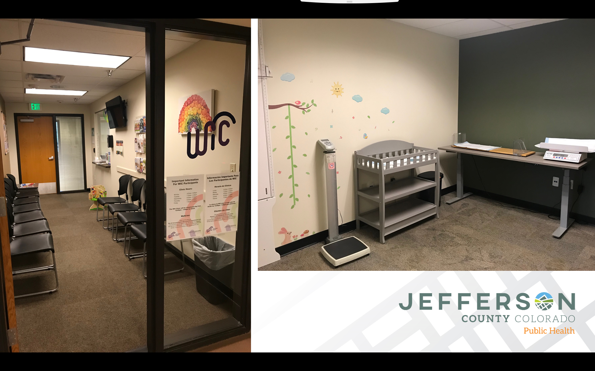
Jefferson County Public Health
Opened a new clinic, which increased access to services. Previously from that area, it was a 20 min car/60 min bus ride
Partnership with Human Services- WIC referral website is linked into their system

Slide 48

Interagency Collaboration
Basecamp: idea-sharing collaboration platform
TA calls, webinars, and annual meetings
Overall better relationships between agencies
Notes:
We use Basecamp to ask questions, make announcements, have discussions, and share documents. If one agency makes something, for example a flyer, they can upload it to Basecamp for other agencies to use and modify for their needs.
We have technical assistance calls with State office staff to check in and troubleshoot on any issues if needed. In 2018, State office staff organized quarterly learning webinars on topics of interest related to the grantees. In 2019, we have begun monthly sharing webinars where 2 agencies give an update on their work and share successes and challenges, followed by a group discussion. Once per year, we have a 2-day meeting where all grantees, State office, Covering Kids and Families, and Kasier get together to check-in, share, and learn.

Slide 49
Future Plans & Lessons Learned
Adjustment of expectations
Sustainability planning and exploration of future funding opportunities
Many agencies were granted extensions
  Most will be wrapping up WIC Innovations grant work by the end of 2019
Notes:
Many of us wrote in caseload specific measures of success, which we have had to adjust throughout the grant period. We know that although our work may not have a measurable effect on caseload numbers, the work we are doing with the WIC Innovation grant has positively impacted our agencies in myriad ways.
Since each agency carried out their grant work differently, each sustainability plan looks different.

Slide 50
Thank you!
Denver County
Samantha Volk
Samantha.Volk@dhha.org
Weld County
Kelly Kading
kkading.sunrise@nocoha.org
Tri-County Health Department
Melanie Morrison
mmorrison@tchd.org
Pueblo County
Nicole Cawrse
cawrsen@pueblocounty.us

Slide 51
References
Trippe C, Tadler C, Johnson P, Giannarelli L, Beston D. National- and State-Level Estimates of WIC Eligibles and WIC Program Reach in 2015. U.S. Department of Agriculture; 2018. https://fns-prod.azureedge.net/sites/default/files/ops/WICEligibles2015-Volume1.pdf. Accessed February 4, 2019.
Trippe C, Tadler C, Johnson P, Giannarelli L, Beston D. National- and State-Level Estimates of WIC Eligibles and WIC Program Reach in 2015. U.S. Department of Agriculture; 2018. https://fns-prod.azureedge.net/sites/default/files/ops/WICEligibles2015-Volume2.pdf. Accessed February 5, 2019.
Goals and Strategies. Colorado Blueprint to End Hunger Goals and Strategies. https://www.endhungerco.org/goals-and-strategies. Published January 2018. Accessed February 5, 2019.
COUNTRY OF ORIGIN OF COLORADO REFUGEE AND REFUGEE ELIGIBLE POPULATIONS (Including Secondary Migrants) BETWEEN FY 1980-2017.; 2017:1-2.

