Slide 1
Challenges and Opportunities for the WIC Workforce WIC Integration in Public Health
National WIC Association Annual Conference
Baltimore, MD ~ April 7, 2019

Slide 2
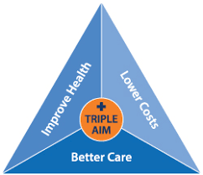
Health Care Reform

Slide 3
Value Based Care
Prevention
Social Determinant of Health
Incentivized Care
Certifications

Slide 5
WIC = Public Health Work Force
Nutrition Experts
Lactation Specialists
Language Skills
Cultural Competence
Motivational
Interviewing
Participant Centered Education

Slide 6
Workforce Needs
Impact public health
outcomes
Help individuals
Use their training
Develop & diversify
their skills

Slide 7
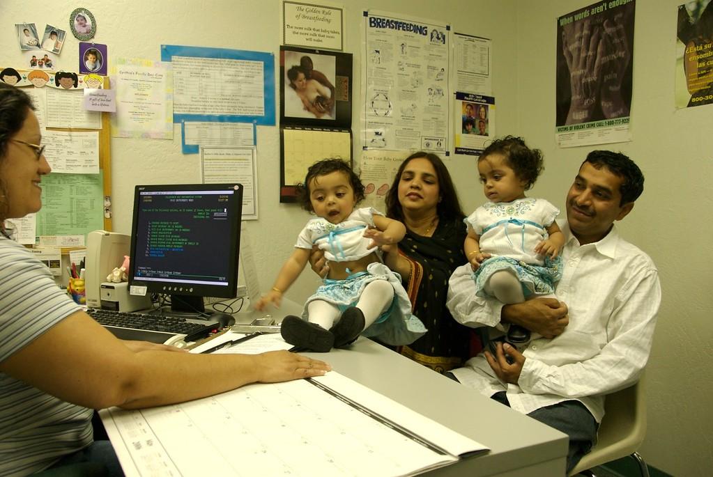
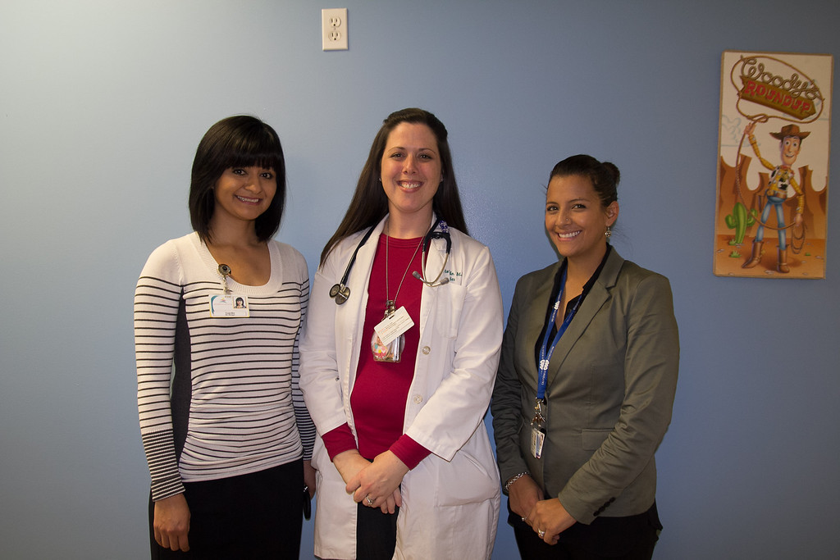
Counseling
Lactation
Perinatal Nutrition
Pediatric Obesity
Diabetes
Gestational Diabetes

Slide 8
Other Opportunities
HIV
Telehealth
Behavioral Health
(Eating Disorders)
Medical Nutrition
Therapy

Slide 9
Integration & Efficiencies
Train health care staff
Improve referrals between WIC & health center
Streamlined WIC and health center education
Use EHR
Increase capacity of health center

Slide 10
Nutrition Assistants
Improve access & retention of shared population
Provide warm hand between programs
Patient navigator for SDOH
Can document in EHR & WIC MIS
Reduce barriers that arise
Coordinate appts(WIC and Peds/ WIC and WHS)
Act as Liaison to streamline services
Provide health education utilizing extensive WIC knowledge & skills

Slide 11
Business Agreements
WIC Parent Organization
Health Center
Medical Group
Heath Insurance Provider

Slide 12
Resources
Opportunities for Nutrition and Breastfeeding Interventions Under Health Care Reform
Breastfeeding Support: Community Clinics and the Affordable Care Act Requirements
Preventive Nutrition Services: Joining Health Care Reform With a Low-Cost Approach to Improve Health
Ramping Up for Reform: Quality Breastfeeding Support in Preventive Care
Karen Farley, RD, IBCLC
California WIC Association
kfarley@calwic.org
www.calwic.org
Credit to North County Health Services, San Diego and Community Health
Centers, Stockton, WIC Programs

