Slide 1
National WIC Association
2019 Annual Education and Training Conference
Sunday, April 7, 2019, 2:15-3:15 pm
Challenges and Opportunities
for the WIC Workforce
Nancy Nesa, MA, RDN
CDPH WIC Career Development Coordinator
nnesa@sdsuwic.com, WICcareercorner.com

Slide 2
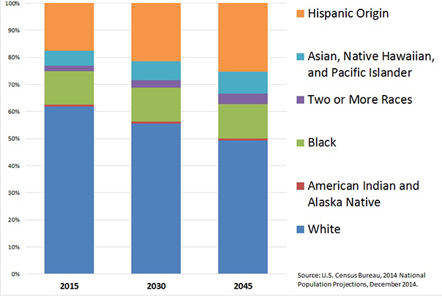
U.S. Population Will Become Increasingly Diverse

Slide 3
2017 DIVERSITY
U.S. Population
326,000,000, US Census, 2017
California’s Population
39,600,000, US Census Bureau, 2017)

Slide 4
U.S. RDs ≈205,000
(CDR 4/1/2019)
U.S. Population
4%
4%
California’s Population

Slide 5
Recruiting, Hiring and Retaining a Qualified Nutrition Workforce

Slide 6
Registered Dietitian Nutritionist (RDN) Education (ACEND 2018) Step 1: Bachelor’s Degree, Accredited Didactic Program in Dietetics (DPD) Step 2: Supervised Practice/Dietetic Internship Step 3: National Registration Exam
1-1-2024 Master’s Degree

Slide 7
Increasing Diversity of Nutrition Graduates

Slide 9
2018 Diversity of California
WIC Participants 1.1 Million
2019 Diversity of U.S.
RDNs 205,000
Notes:
WIC is focused on meeting the needs of participants in California and the needs can’t be met without RDs –Started to GROW OUR OWN
Almost 40 m people and almost 40% are Hispanic and only 3% of our membership is Hispanic--
We can’t begin to make a difference in the problem of health disparities without a more diverse workforce in California and the nation.

Slide 12
1996-2018 Diversity of WIC Dietetic Interns (370)
73% are fluent in 2 or more languages

Slide 13
Evaluate current staffing needs and ability to meet challenges

Slide 14
Opportunities and actions to protect and strengthen WIC’s nutrition workforce

Slide 15
Prepare for Challenges
Evaluate, expand qualifications and strengthen abilities
Increase recognition of WIC services, benefits and careers
Support underrepresented students
Train future nutrition professionals
Mentor employees and students to grow their careers.

Slide 16
Mentor Employees and Students

Slide 17
Your Next Step?
Nancy Nesa, MA, RDN
CDPH WIC Career Development Coordinator
nnesa@sdsuwic.com, WICcareercorner.com

