Slide 1
The Purpose of Capturing WIC Stories
and Supporting Families
on Social Media

Slide 2
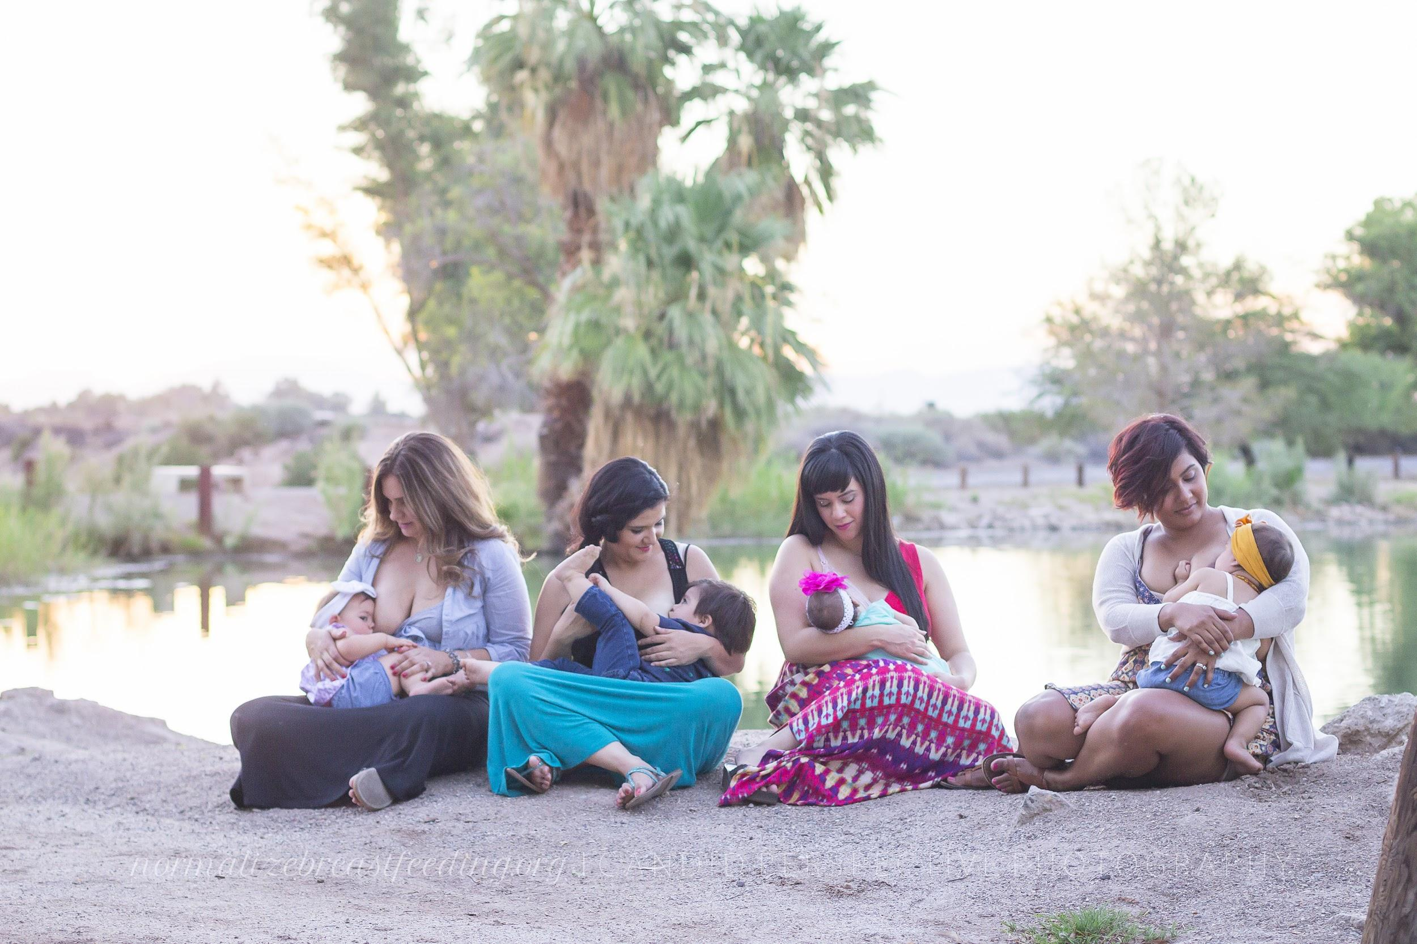
Notes:
Breastfeeding Group Portrait, Normalize Breastfeeding Tour Brawley, CA, 2015

Slide 3
Many studies from around the world
show that supporting
moms on their journey can
help them to successfully breastfeed and reach their personal
feeding goals.
Notes:
Imagine two mothers in the back of the room. One mom is breastfeeding, although she has struggled with supply and teething to get there. The other is formula feeding after attempting to breastfeed for 3 months with an undiagnosed tounge tie.
Which mom wanted/tried to breastfeed?
Which mom probably had a better support system?

Slide 4
Face-to-face support led to 20 percent less cessation of exclusive breastfeeding before six months
Telephone interventions had no effect
Layperson support may be slightly more effective than that delivered by professionals, but both were superior to no support
-Impact of Breastfeeding Support, AAFP
Notes:
Impact of Breastfeeding Support: https://www.aafp.org/afp/2013/0201/p176.html

Slide 5
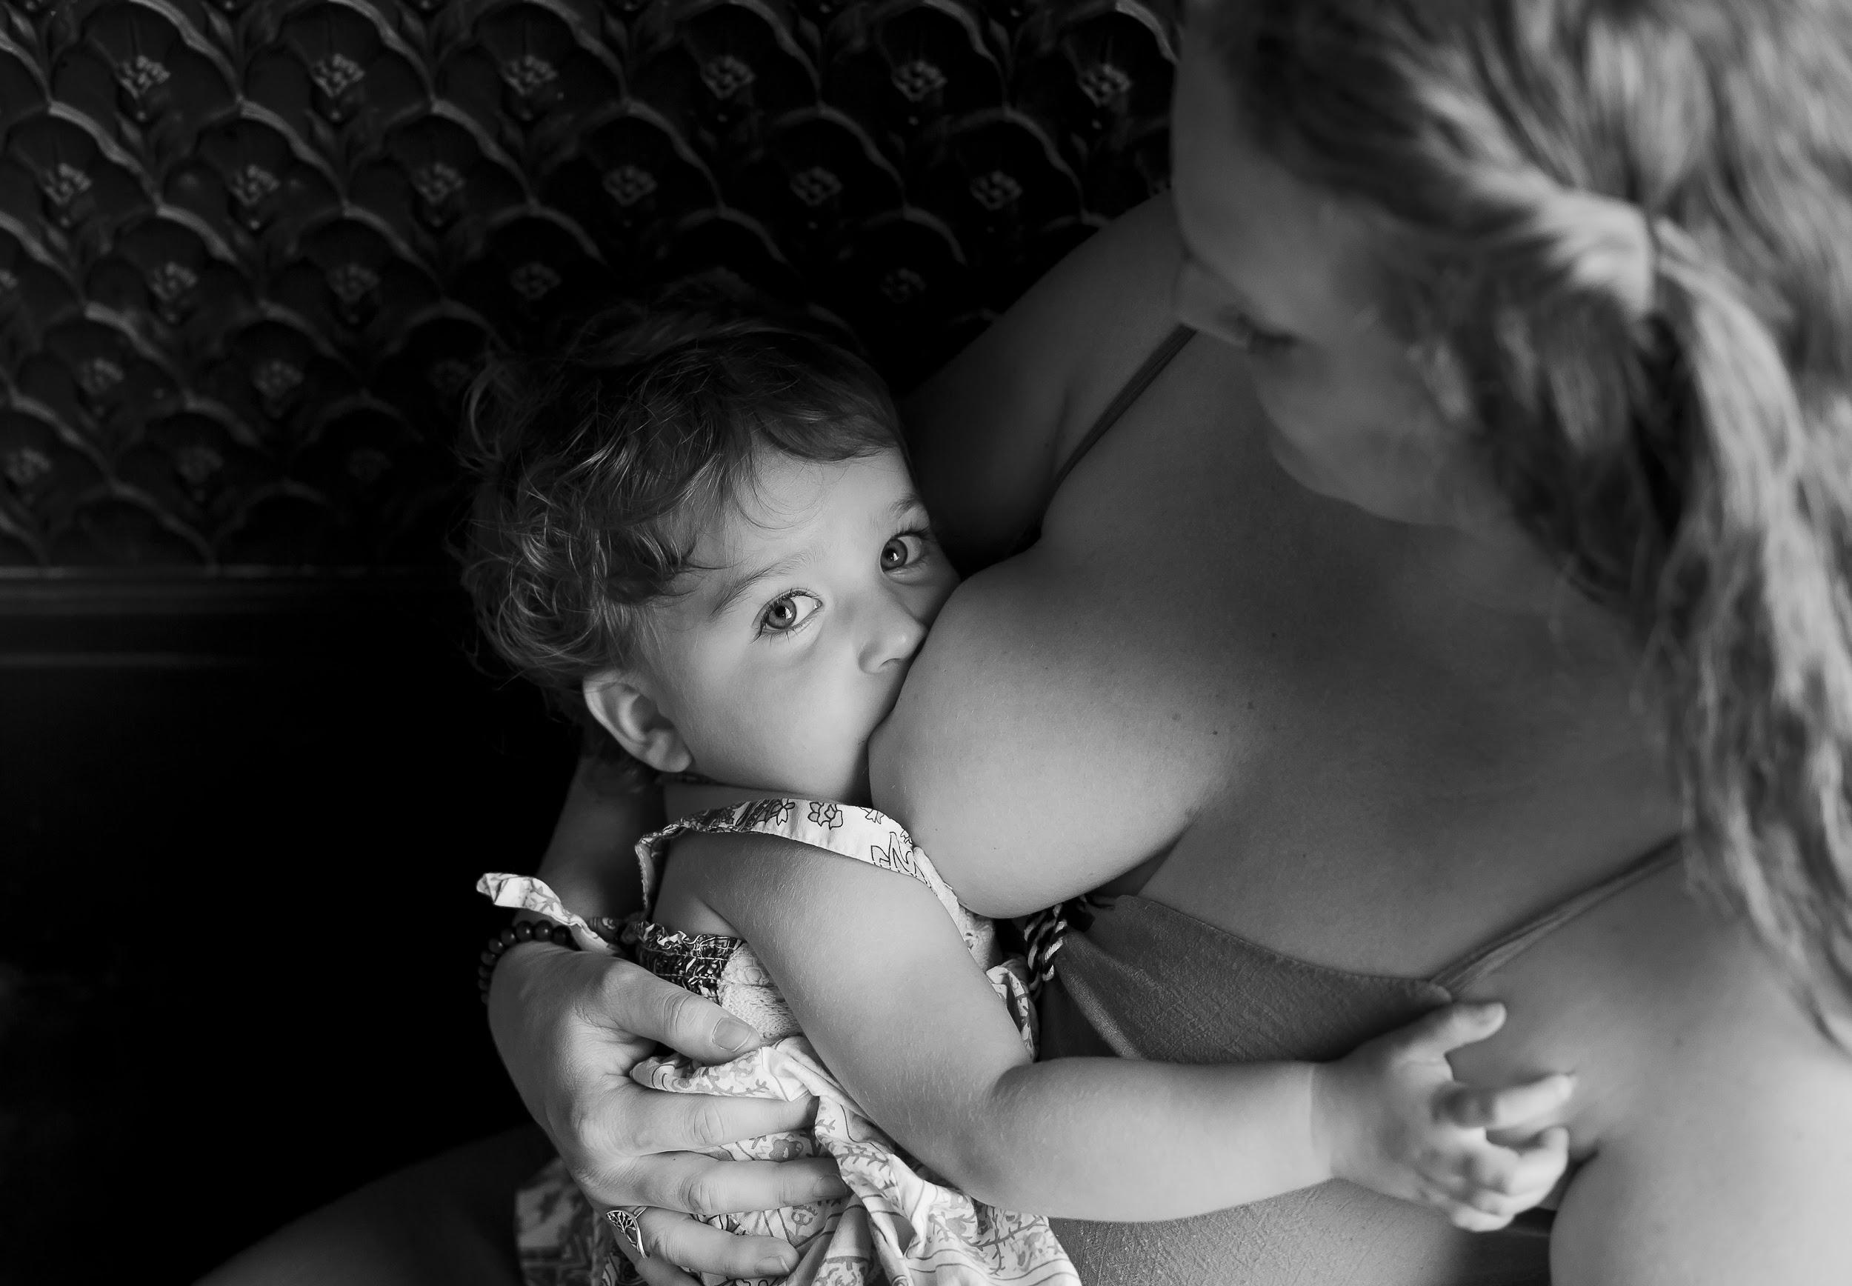
Notes:
Breastfeeding Portrait, Normalize Breastfeeding Tour Chicago, IL, 2016

Slide 6
Mothers who received:
Sufficient help with breastfeeding in hospital
Contact details for breastfeeding support groups
had a higher likelihood of breastfeeding late-preterm and term babies at 10 days and 6 weeks
-Association between breastfeeding support and
breastfeeding rates in the UK, University of Oxford
Notes:
Associated with breastfeeding term infants up to 6 weeks and late preterm infants at 10 days: https://www.ncbi.nlm.nih.gov/pmc/articles/PMC4654355/

Slide 7
Notes:
Breastfeeding Portrait, Normalize Breastfeeding Tour Oklahoma City, OK, 2016

Slide 8
The United States government
made clear opposition against the Breastfeeding Resolution proposed by Ecuador at the UN:
“We recognize not all women are able to [breastfeed] for a variety of reasons. These women should have the choice and access to alternatives for the health of their babies, and not be stigmatized for the ways in which they are able to do so.”
-New York Times, July 2018
Notes:
Article: https://www.nytimes.com/2018/07/08/health/world-health-breastfeeding-ecuador-trump.html

Slide 9
Loopholes of Support

Slide 10
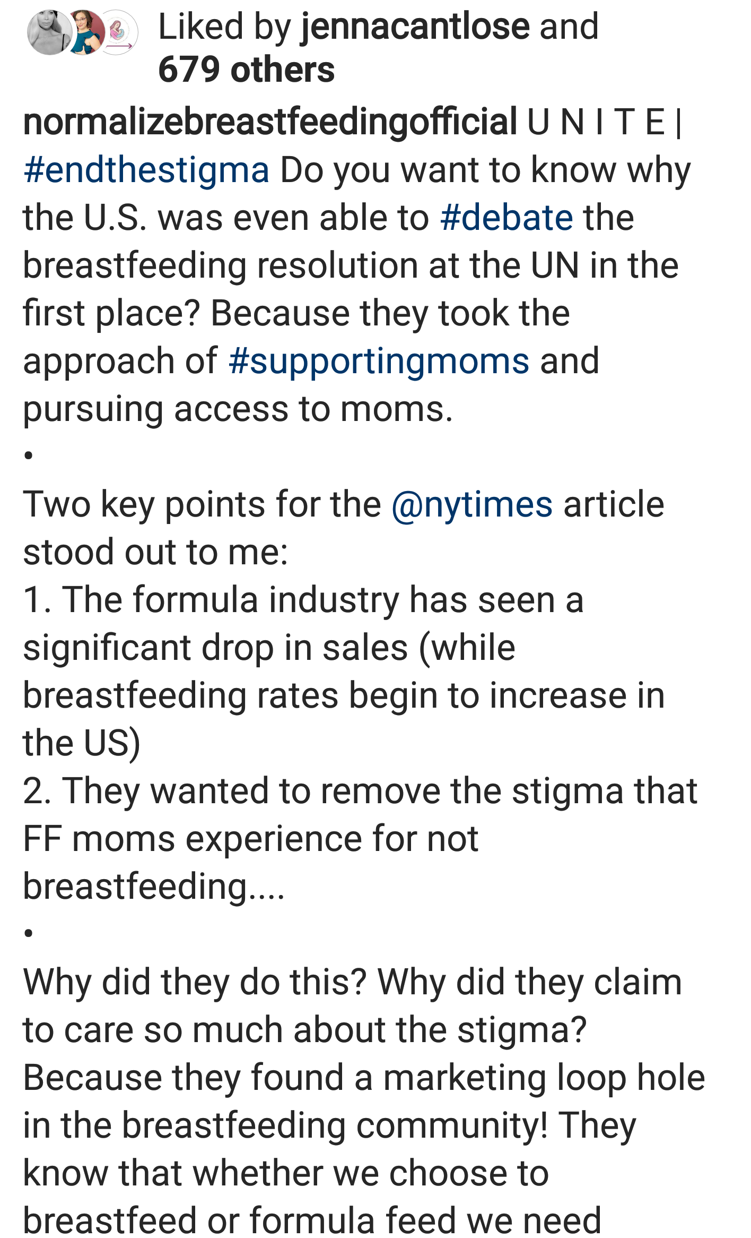
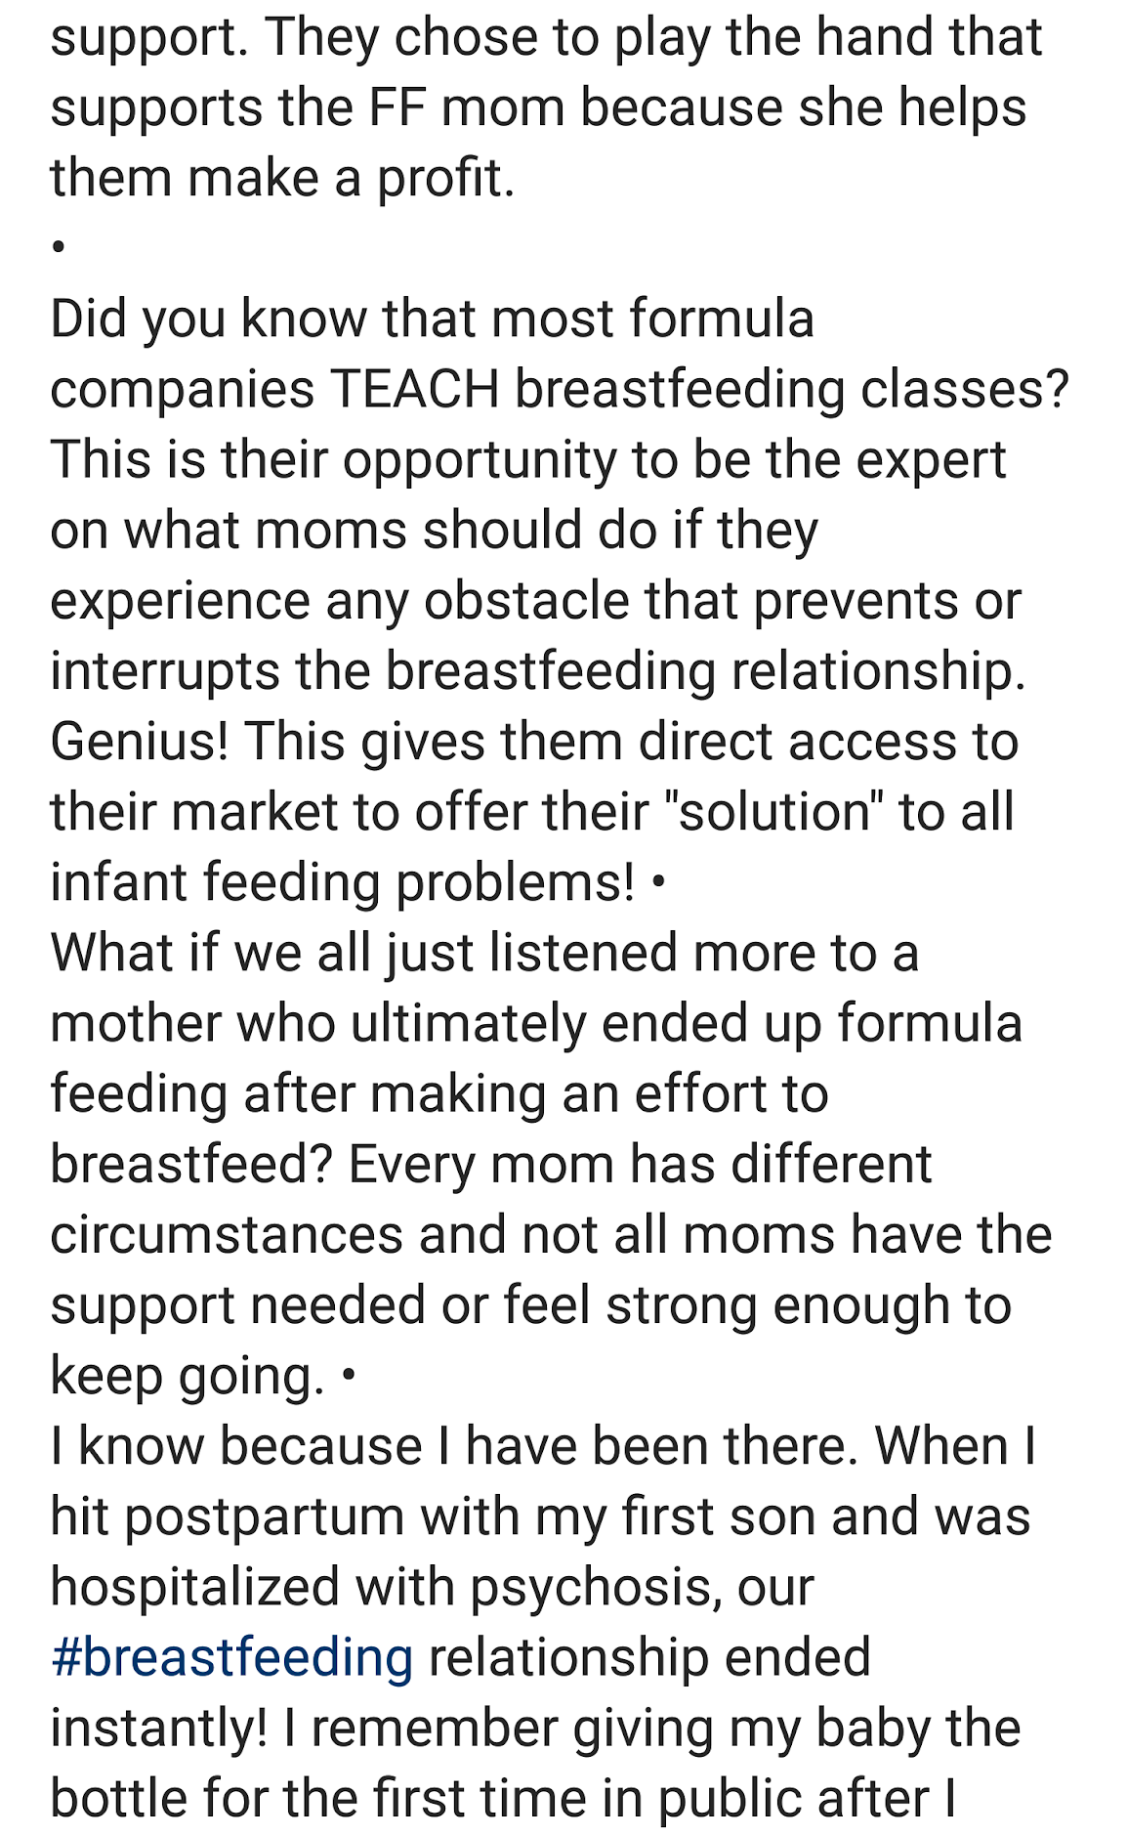
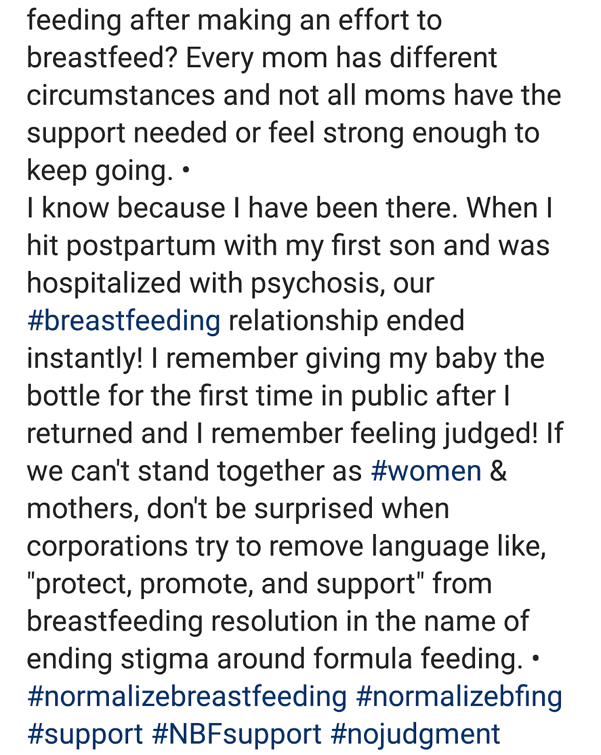
Loopholes of Support
Notes:
Article: https://www.nytimes.com/2018/07/08/health/world-health-breastfeeding-ecuador-trump.html

Slide 11
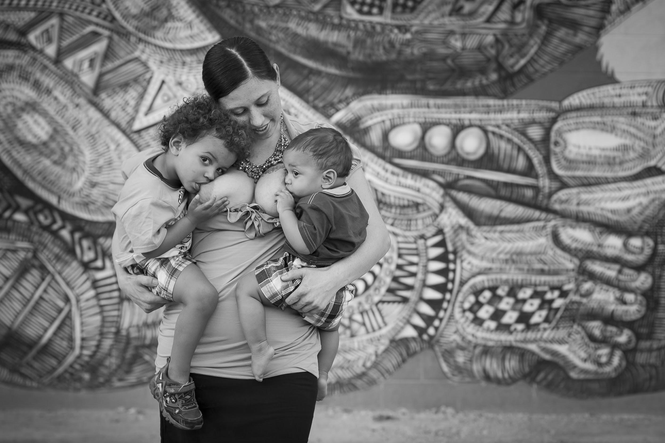
Notes:
Breastfeeding Portrait, Normalize Breastfeeding Tour Las Vegas, NV, 2016

Slide 12
BREAST IS BEST
We have worked hard to make known all of the benefits of breastfeeding babies.
Yet we may have worked SO hard that we are unable to see the damage we may have caused to those mothers who are unable or are unwilling to latch their babies.

Slide 13
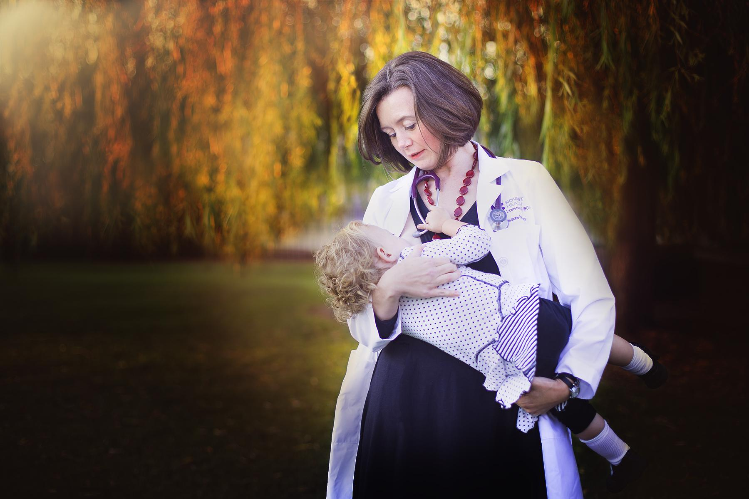
Notes:
Breastfeeding Portrait, Normalize Breastfeeding Tour Charlotte, NC, 2016

Slide 14
FED IS BEST
The problem with slogans is that they don’t tell the WHOLE STORY
Many women slipped through the cracks of breastfeeding support in hospital because of the copy-paste-care that is given in US maternity care
Although the organization is pushing for “safe breastfeeding” practices, the words they have used to define themselves are contradictory, even though they are very catchy

Slide 15
Who is missing?
Breast is best
Fed is Best
Baby’s weight gain
Risk of Jaundice
Baby’s pee/poop
M O M
Risk of Starvation
Baby’s suck patterns
Formula breast milk substitute is readily available in wealthy countries

Slide 16
Notes:
Breastfeeding Portrait, Normalize Breastfeeding Tour San Diego, CA 2017

Slide 17
A New Mantra
Encourage open dialog BEFORE & AFTER the first latch
What is the new mama’s feeding goal?
Check in with Mom about feelings of exhaustion and overwhelm
Teach new mama about the FIST rule
Teach new mamas to hand express an additional 1 tsp after each feed to ensure that she has a well-established supply
How observant is the new mama? Does she know when her baby is hungry versus when her baby is full?

Slide 18
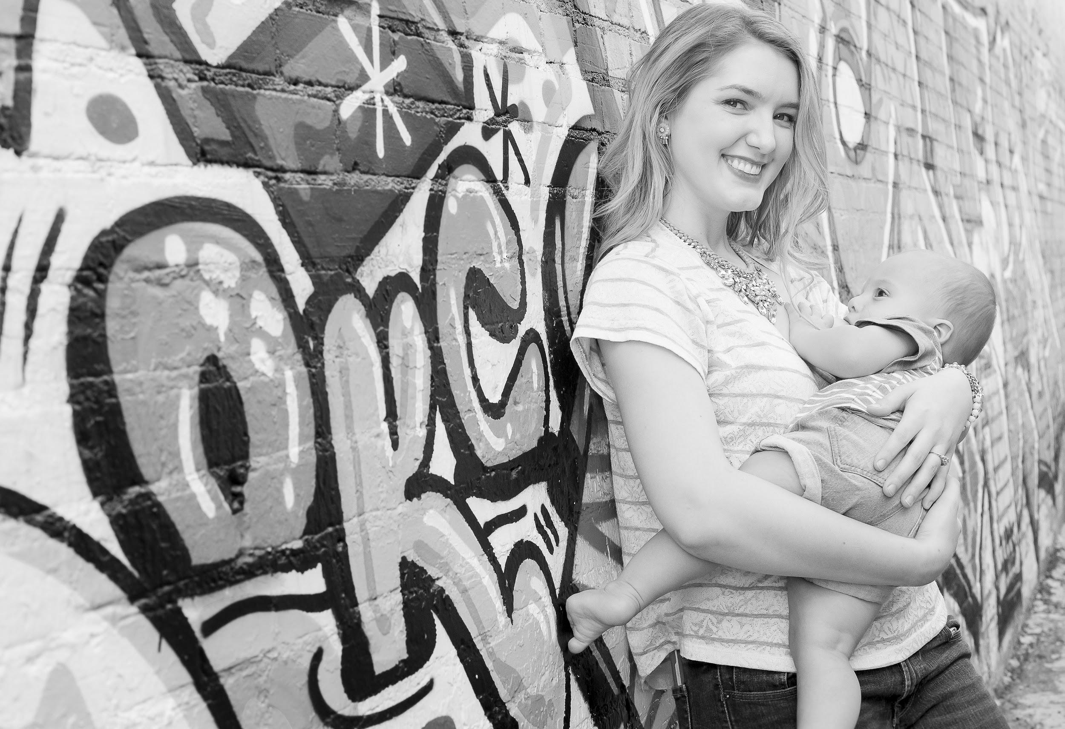
Notes:
Breastfeeding Portrait, Normalize Breastfeeding Tour Oklahoma, OK, 2016

Slide 19
Objectives
Define how to connect with potential WIC moms on social media
Describe how to use your mobile device to document WIC participants with photography, video, blogging, and podcasts to capture and share their stories.
Identify which type of media and platform best suits your posting style and availability

Slide 20
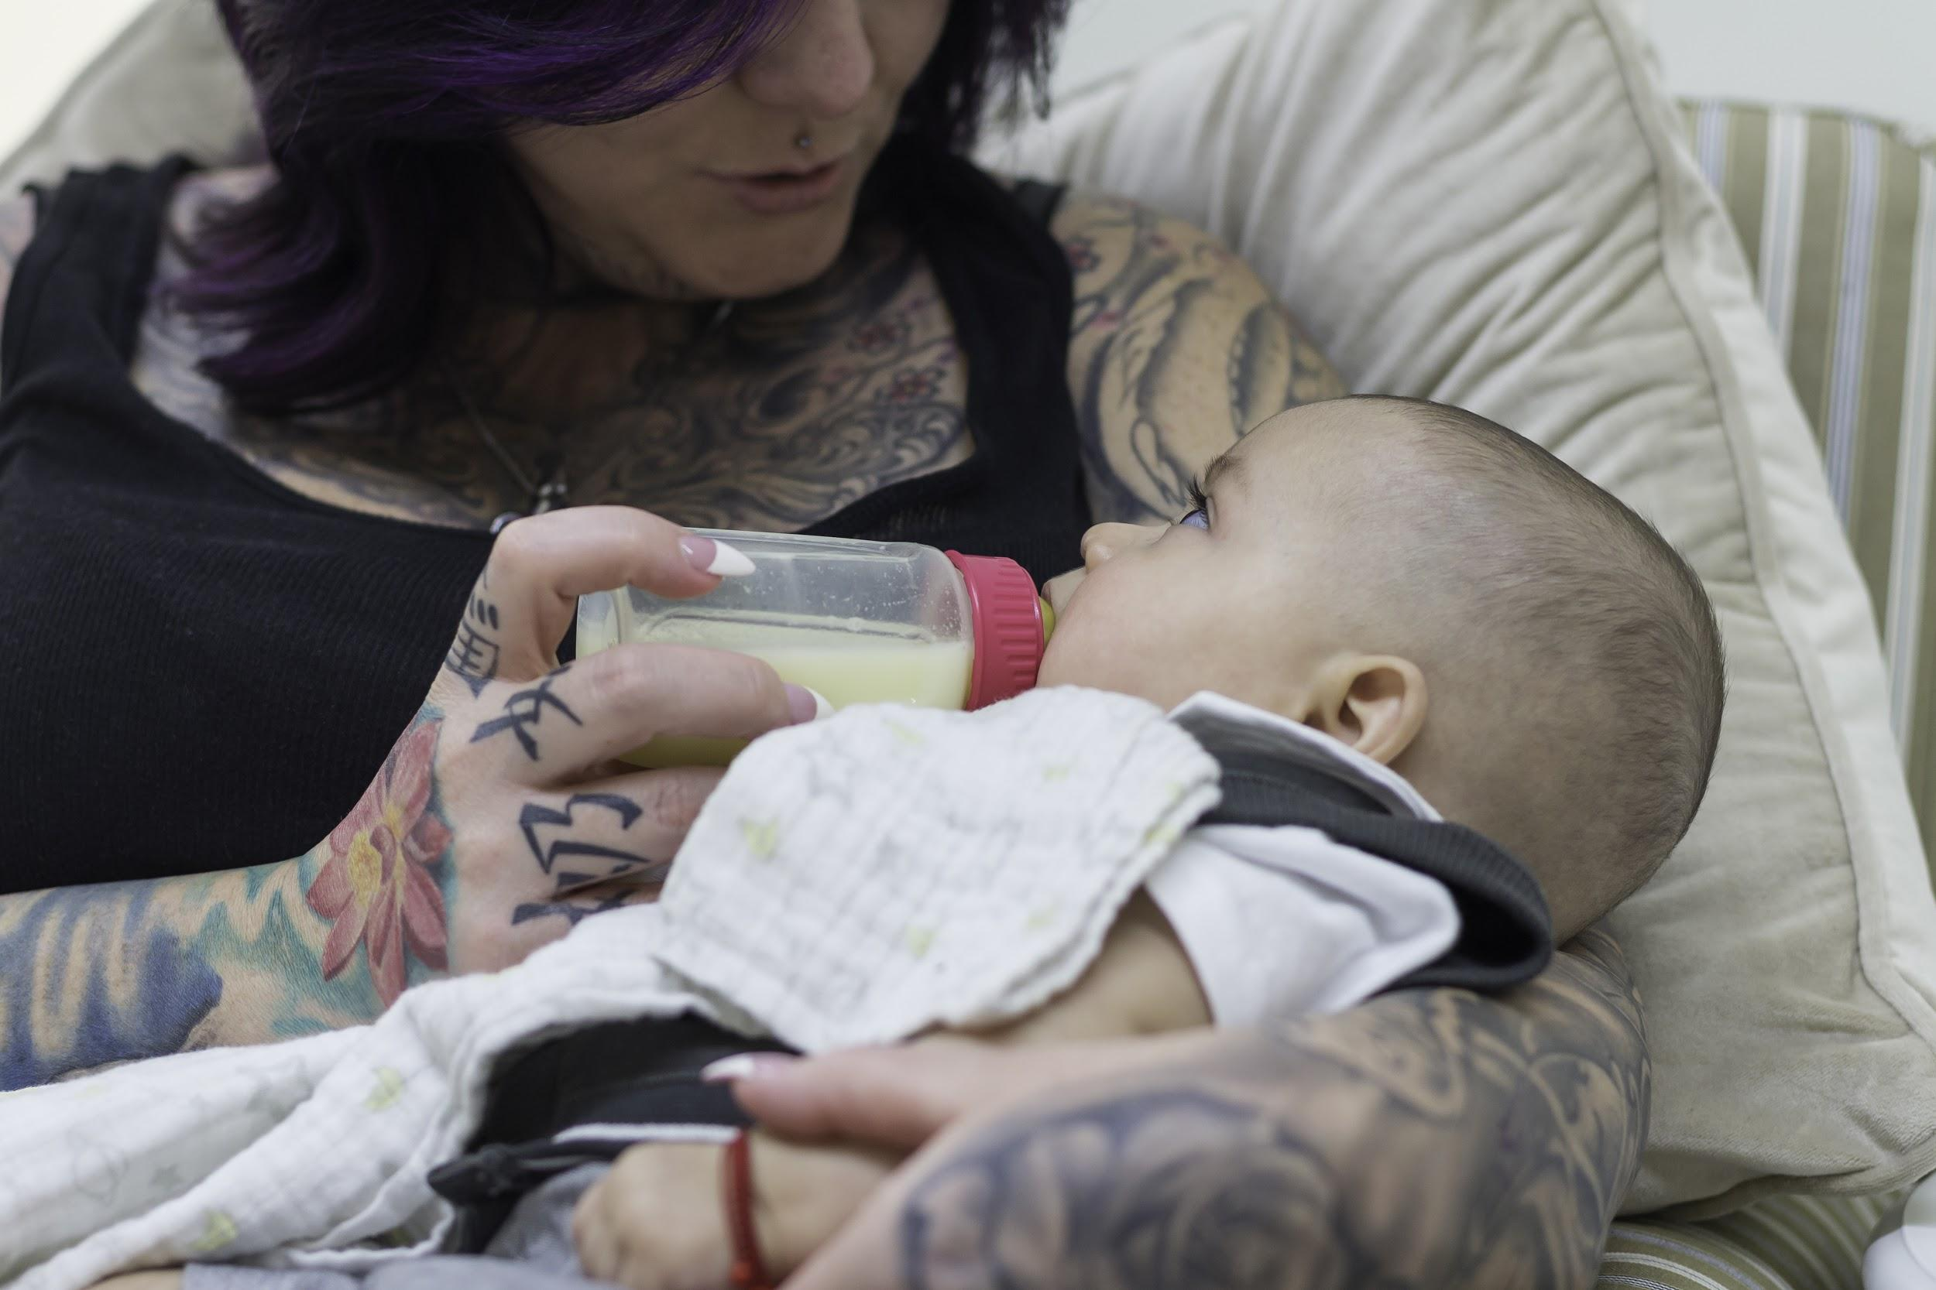
Notes:
Breastfeeding Portrait: Aunt Feeding Donor Milk After Mother Passed, Normalize Breastfeeding Tour Los Angeles, CA, 2016

Slide 21
How to Connect
With Potential WIC moms

Slide 22
Notes:
Breastfeeding Portrait, Normalize Breastfeeding Tour Washington, DC, 2016

Slide 23
Title, Look, and FEEL
Use Your name + Your WIC location as your profile name.
Ex. Maria Tarafa, CLEC, WIC Chula Vista
Connect women to your WIC Office with your WIC website in your profile
Describe WIC Services in your profile
Create a WIC business page for your office to use to promote your community events

Slide 24
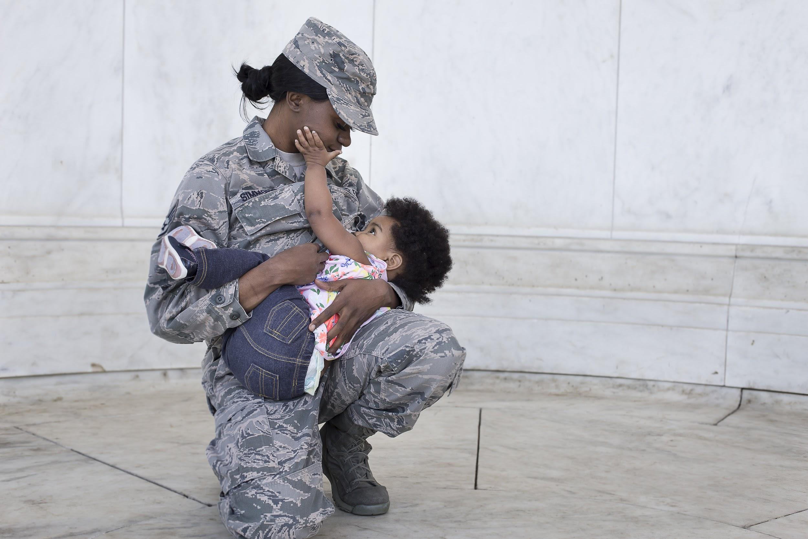
Notes:
Breastfeeding Portrait, Normalize Breastfeeding Tour Washington, DC, 2016

Slide 25
Things to remember
Biggest challenge is to just get started! People can only find your WIC office once you’re online and they can only attend your events if they are aware of them!
Take advantage of free online resources via social media. Create opportunities to support moms where they are.
Posts shouldn’t be a difficult process. Use them to find local moms through online education. If you repost images always credit the original page it came from and tag the artist/photographer
Try ALL aspects of a platform and search before moving on to the next.

Slide 26
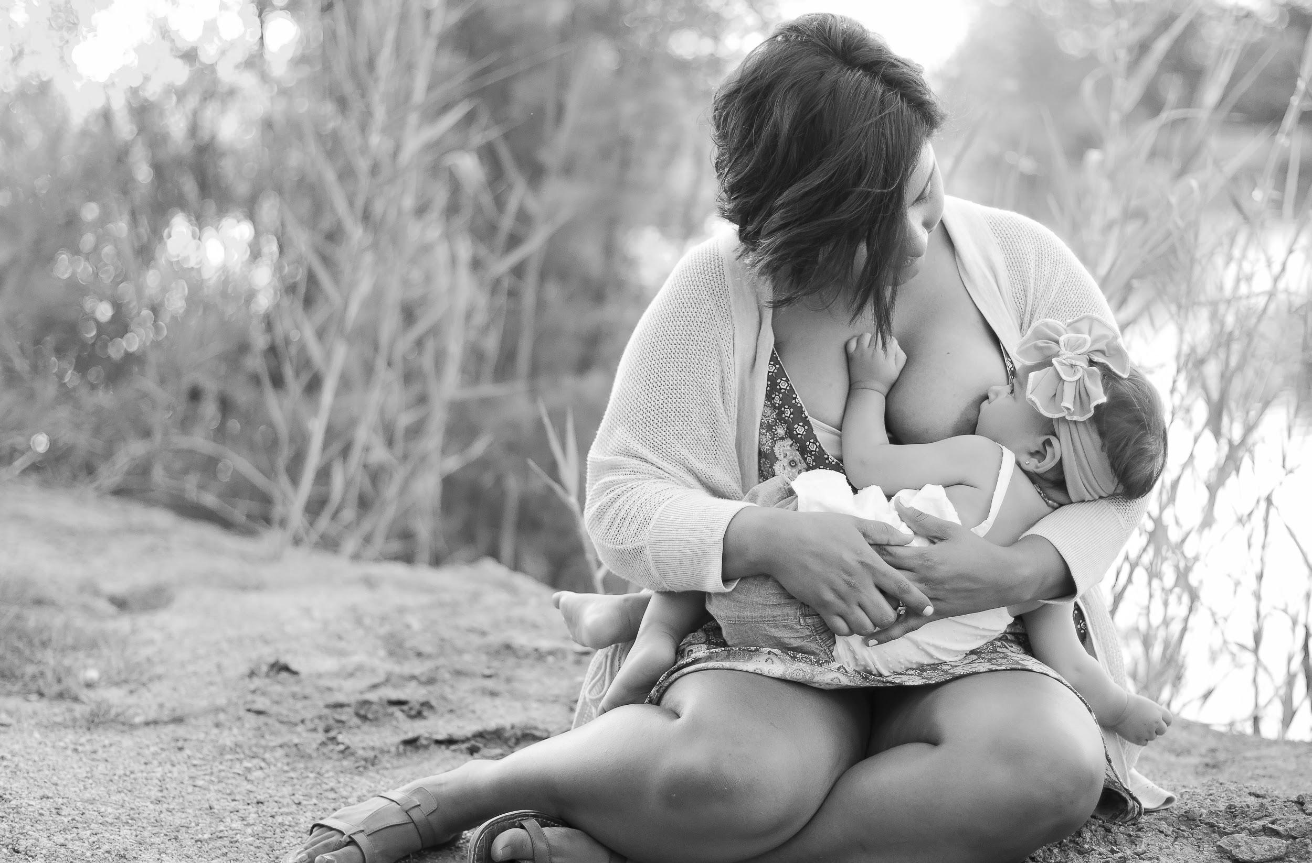
Notes:
Breastfeeding Portrait, Normalize Breastfeeding Tour Brawley, CA, 2015

Slide 27
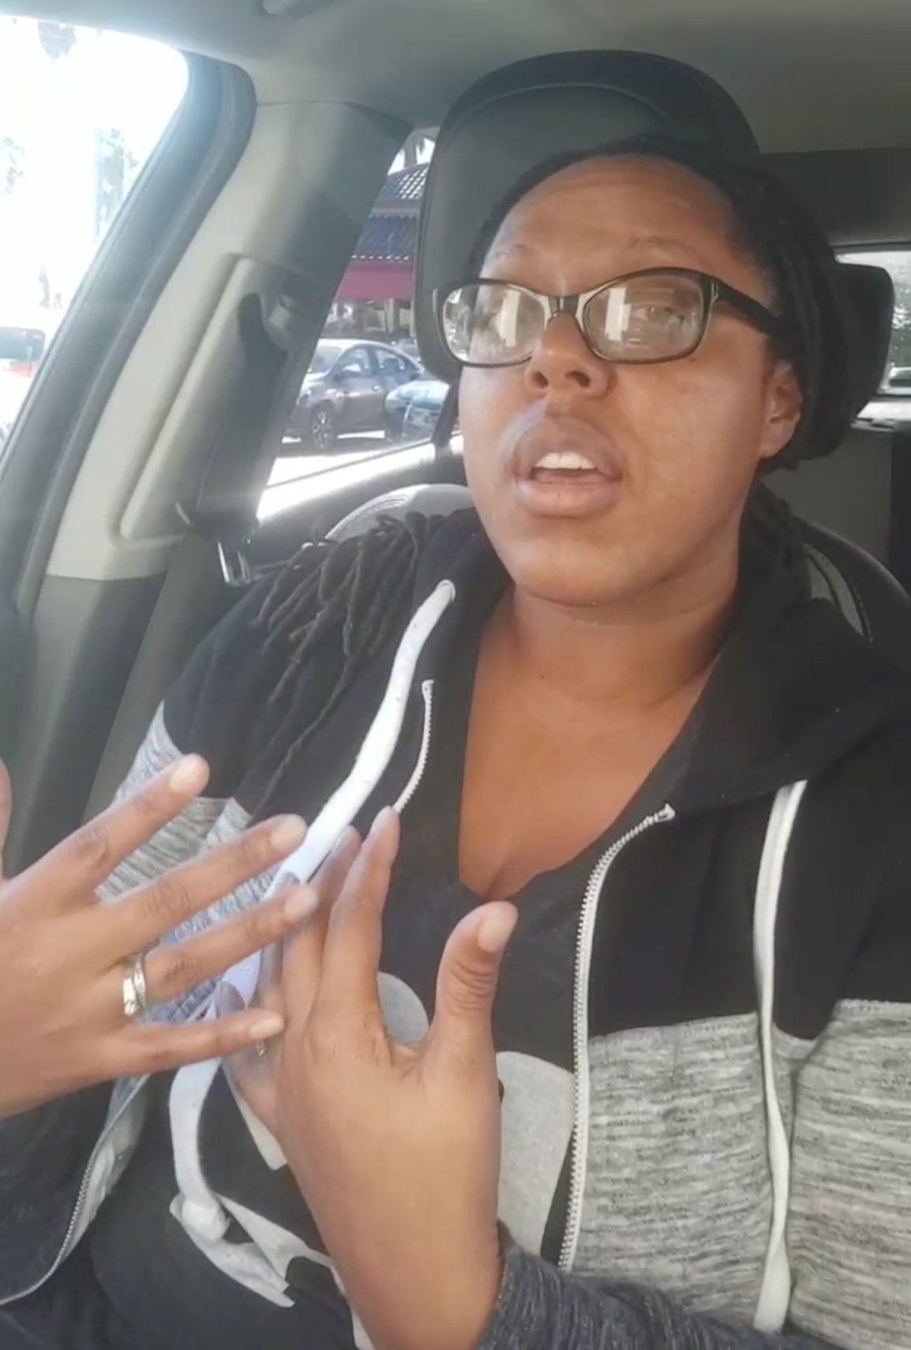
LIVE CHAT
Stay Calm people will come and go
Invite viewers to stay and comment
You can save and post your video at the end
Spontaneous vs Planned
Get out of the box
Be sure to SAVE the video for other uses
Story Save App
Great way to promote upcoming events, offer live support, and show whats happening at the office or at an event.

Slide 28
Take Advantage of the #InstaMom
Your office can provide a model release for you to capture your clients
Have you mobile device available to capture and share to your page
It is important to:
SHOW moms examples of the kinds of images you will be taking
LISTEN to how they feel about being photographed while breastfeeding
FIND good angles that flatter the mom, but also respect her comfort level

Slide 29
Notes:
Breastfeeding Group Portrait, Normalize Breastfeeding Tour Philadelphia, PA, 2016

Slide 30
Planning Events
Plan a meetup on social media and connect in-person
Events and meetups are encouraged
So that moms can SEE and observe many styles and methods of breastfeeding in person
Moms need time with other moms who understand exactly what they are going through. It takes away the pressure to be a perfect parent. However, no judgment is allowed in these spaces (online/in-person) in any way, shape, or form.
Although, they live online, it’s a great experience for breastfeeding moms to nurse NEAR each other. Those benefits include even sharing milk when necessary when mothers build trust.
Use Your WIC Office profile to post the event so women in your area can find your event and RSVP.

Slide 31
Using Your
Mobile Device to Capture and Share
WIC Stories

Slide 32
Taking Better Photos
Tip: minimize the distractions
Try something uniform, and try taking candid shots

Slide 33
3 Simple Secrets to Great Photos
LIGHT TRANSFER
COMPOSITION
FOCUS

Slide 34
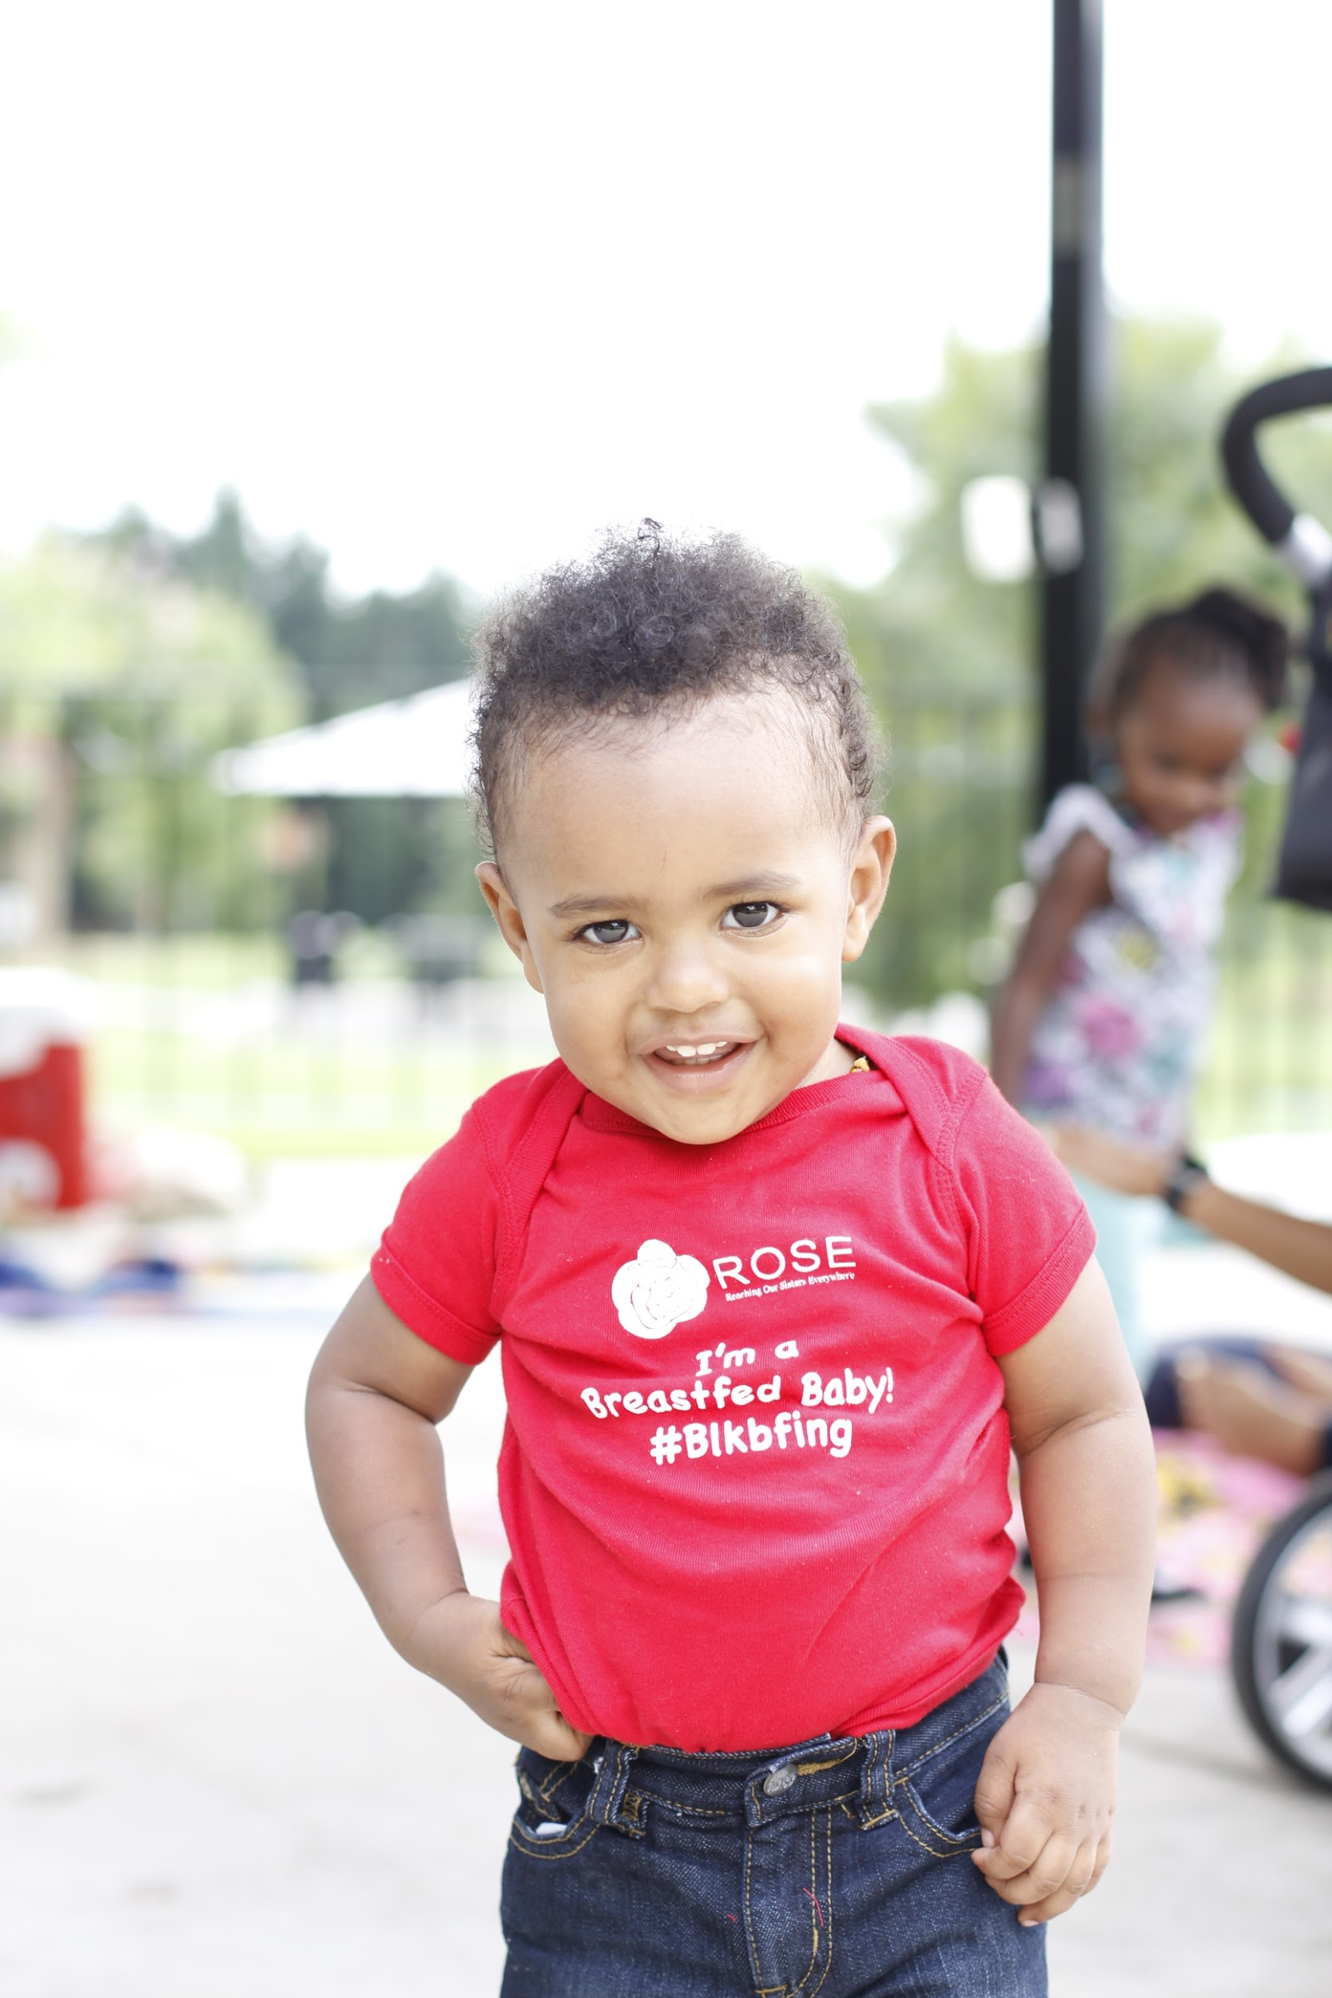
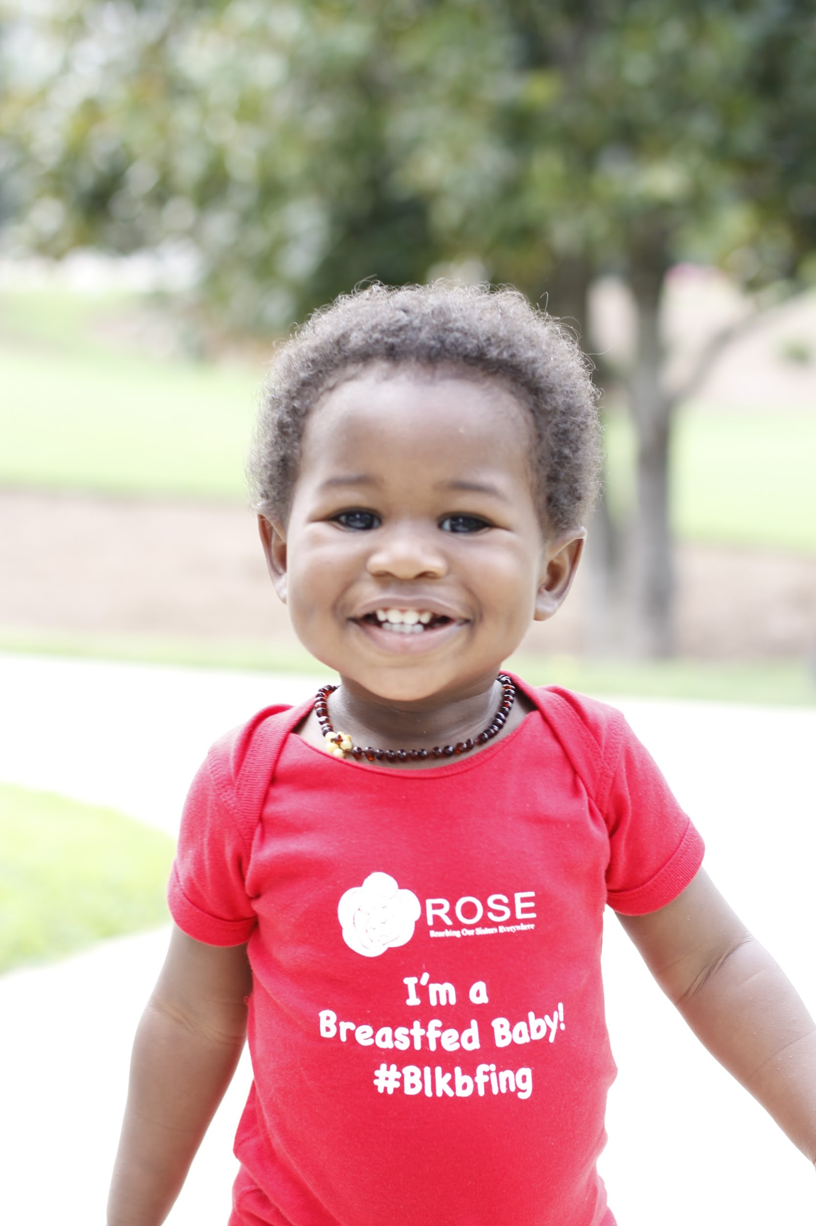

Slide 35
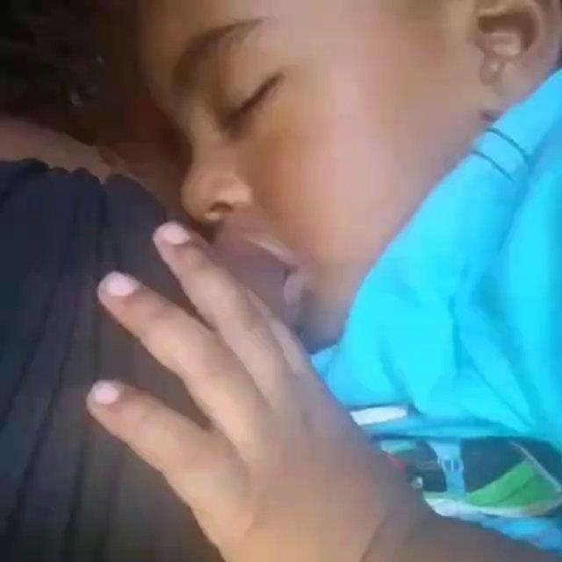
Taking Better Videos
Your video should be engaging, but funny videos tend to perform the best
Describe what is happening in the video and why you are posting about it
Clean your lens!
Find light and contrast
Captions can be simple or packed full of information.
Take lots of behind the scenes images for marketing upcoming events

Slide 36
3 Simple Secrets to Great Videos
LIGHT TRANSFER
COMPOSITION
SOUND

Slide 37
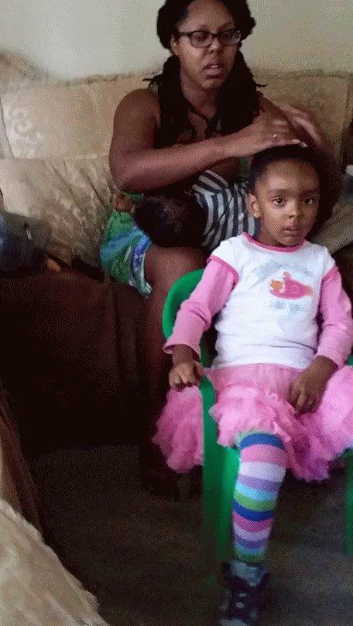

Slide 38
When all else fails, remember to...
CLEAN
YOUR
LENS

Slide 39
Recommended Apps/Editors
PicsArt
Viva Video Pro
DU Recorder

Slide 40
Adding Content to a WIC Blog
Social Media is great for connecting one on one
Blogging allow others to find you through a web search
Google Search will help potential clients find your WIC office
Couple the image with the mother’s story to make an impact on the reader
Your offices blog can be made available through your website
Keeping the blog up to date will further help the visibility of your office
Use mobile apps like PicsArt to edit your imagery
Ex: Tree of Life
Create a blog easily on WIX or Wordpress for free.

Slide 41
Giving WIC a Voice
Podcasts & Broadcasting
From your mobile device you can not only create amazing photos, videos, and blog posts, but you can also create a podcast to broadcast to your audience
This is a great way to reach potential moms via iTunes and Google Play
Listeners/Viewers will look forward to your broadcast weekly

Slide 42
Discover
Your Favorite
Social Media
Platforms
Notes:
Pull out your computer or your mobile phone and login to Facebook! Don’t have an account? Set one up specifically to create a group!

Slide 43
Notes:
Breastfeeding Portrait, Normalize Breastfeeding Tour Washington, DC, 2016

Slide 44
Things to remember (Facebook)
Millennial moms LIVE ONLINE.
They crave community and support.
They want to be part of the change that we all want to see!
KEEP IT SIMPLE
Facebook
Text + Image
Groups
Live Video
Live Chat
Instagram
Image + Text
Groups
Live Video
Live Chat
Twitter
Text + Image
Groups
Live Video
Live Chat
YouTube
Text + Image
Groups
Live Video
Live Chat
Start here
Note: Easiest to start, use, and test all features

Slide 45
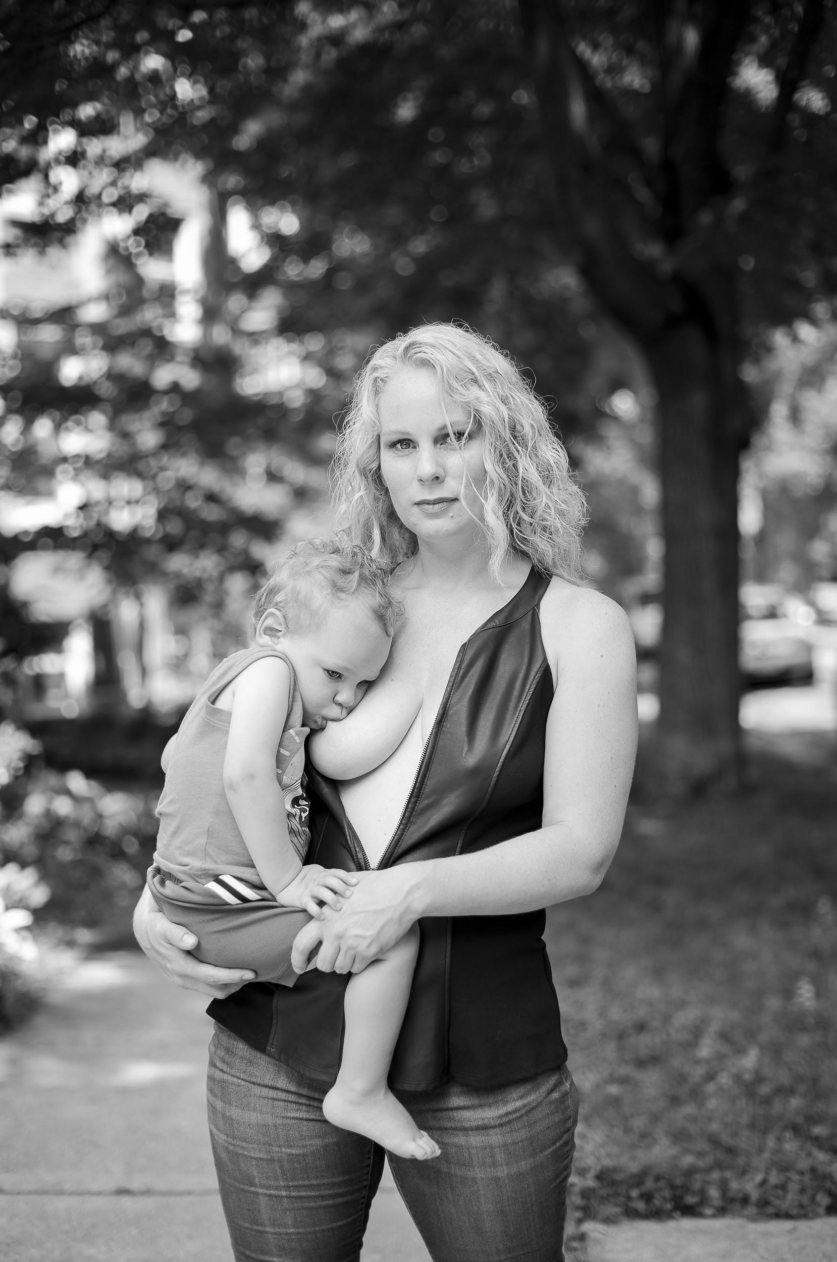
Notes:
Breastfeeding Portrait, Normalize Breastfeeding Tour Chicago, IL, 2016

Slide 46
Things to remember (Instagram)
Millennial moms LIVE ONLINE.
They crave community and support.
They want to be part of the change that we all want to see!
KEEP IT SIMPLE
Facebook
Text + Image
Groups
Live Video
Live Chat
Instagram
Image + Text
Groups
Live Video
Live Chat
Twitter
Text + Image
Groups
Live Video
Live Chat
YouTube
Text + Image
Groups
Live Video
Live Chat
Note: Notifications Disappear!

Slide 47
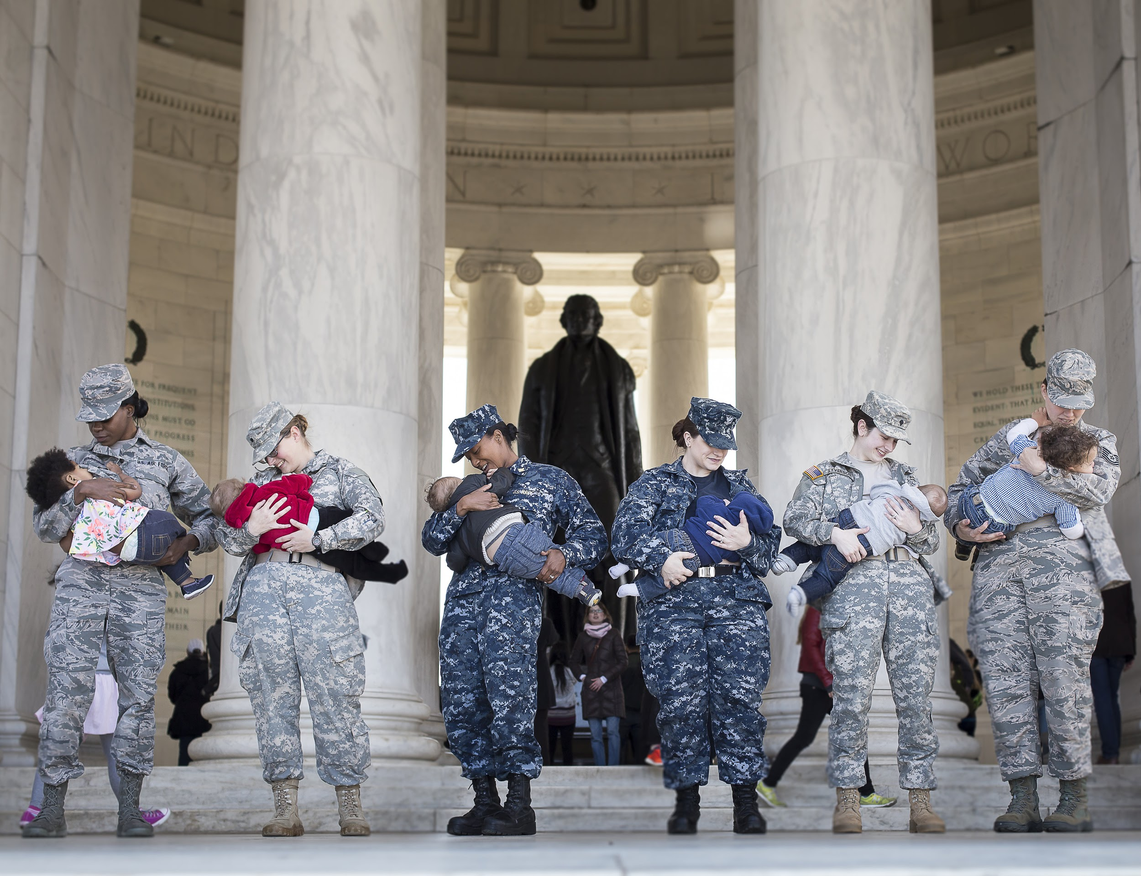
Notes:
Breastfeeding Portrait, Normalize Breastfeeding Tour Washington, DC, 2016

Slide 48
Things to remember (Twitter)
Millennial moms LIVE ONLINE.
They crave community and support.
They want to be part of the change that we all want to see!
KEEP IT SIMPLE
Facebook
Text + Image
Groups
Live Video
Live Chat
Instagram
Image + Text
Groups
Live Video
Live Chat
Twitter
Text + Image
Groups
Live Video
Live Chat
YouTube
Text + Image
Groups
Live Video
Live Chat
Note: Professional hang out,
but breastfeeding moms are
not really using Twitter

Slide 49
Notes:
Breastfeeding Portrait, Normalize Breastfeeding Tour Las Vegas, NV, 2016

Slide 50
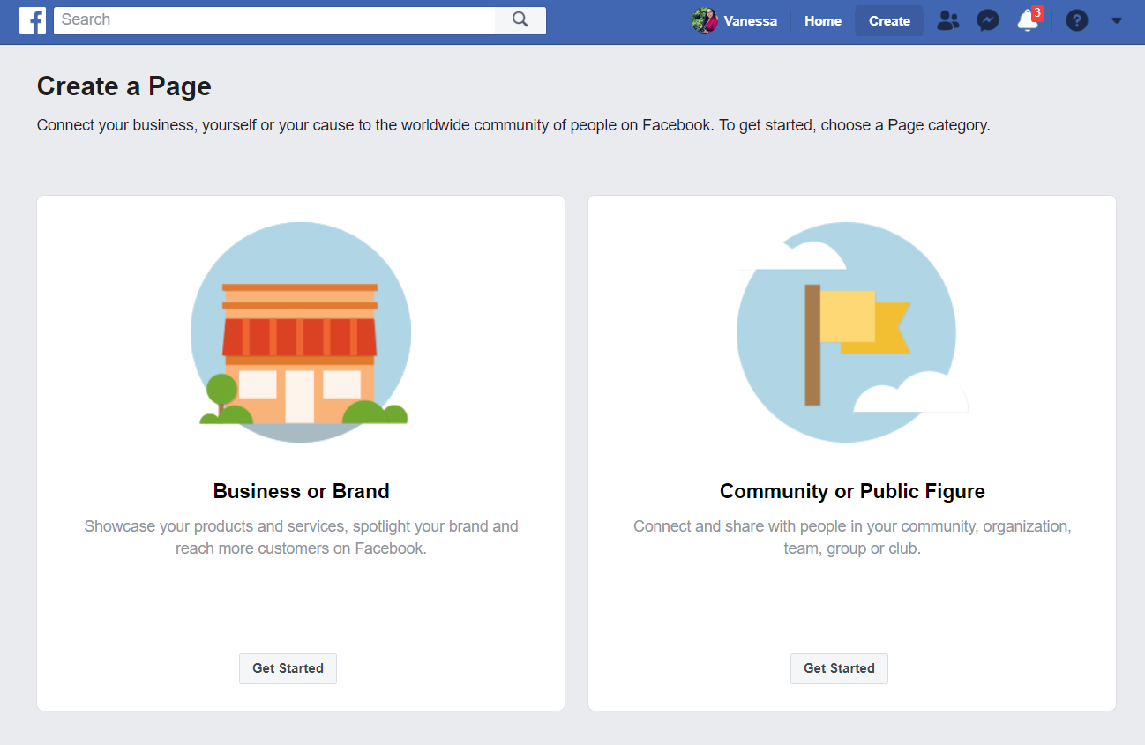
What’s the difference?
Public business pages vs Public, Closed, Secret Groups on Facebook
Accessibility
Admin/Moderator Controls
Growth and Advertising

Slide 51
Personal Events
If you don’t want to manage too much online you can simply create an event from your profile. If your profile is named correctly and the event location matches your profile name, it will be easier for those interested in your event to RSVP.

Slide 52
Name & Location

Slide 53
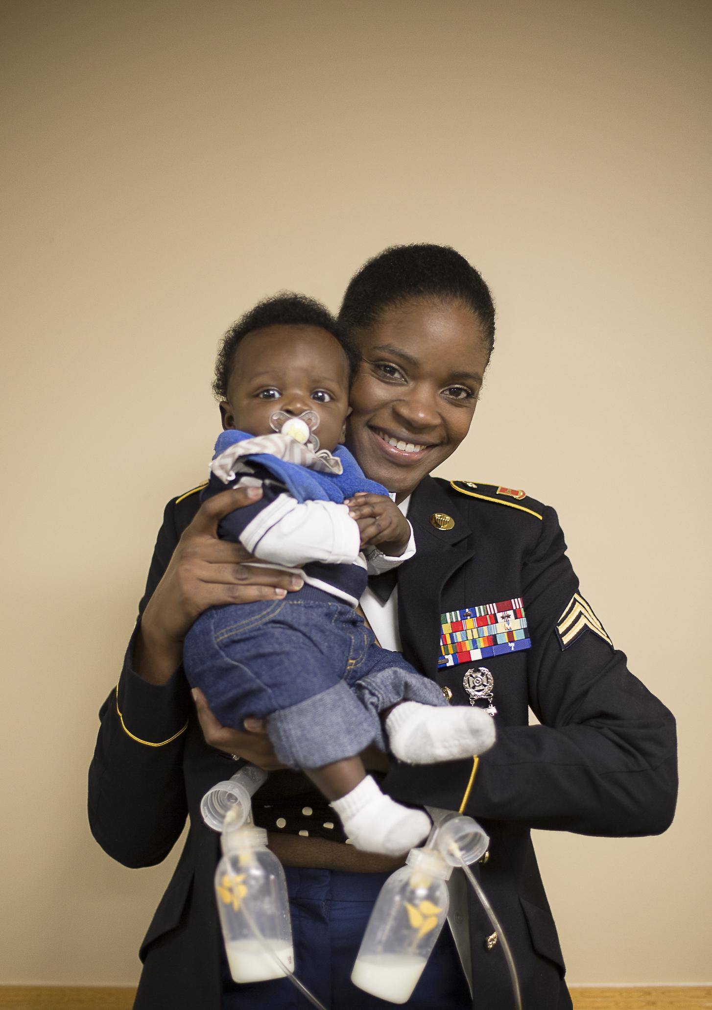
Notes:
Breastfeeding Portrait, Normalize Breastfeeding Tour Charlotte, NC, 2016

Slide 54
Get Results
We recently surveyed our largest group in Charlotte, NC. Although a very small amount of people responded to the survey, we generated some pretty interesting information about their experiences with online breastfeeding support.

Slide 57
Notes:
By Vanessa Simmons

