Slide 1


Telelactation Among Rural Breastfeeding Mothers
Results from the Tele-MILC RCT
Lori Uscher-Pines
April 5, 2019

Slide 2

OVERVIEW

Slide 3
U.S. children born in 2012
SOURCE: National Immunization Study
Notes:
Only 22% of mother exclusively breastfeed at 6 months even tough AAP and ACOG recommend it. AAP recommends continued through one Year. Only 31% do.
Breastfeeding

Slide 4
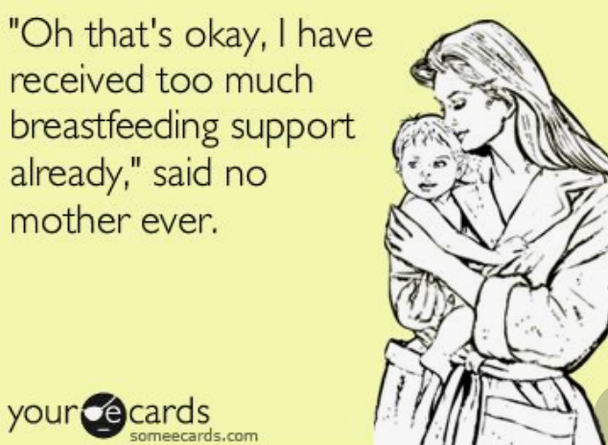
“Oh that’s okay, I have received too much breastfeeding support already,” said no mother ever.

Slide 5
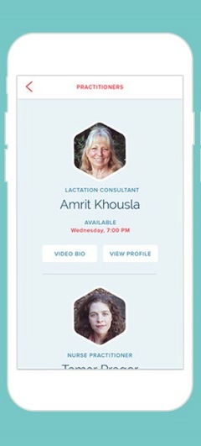
International Board-Certified Lactation Consultants
Health care professionals who specialize in the clinical management of breastfeeding
Although they are proven to help, many communities lack IBCLCs
Notes:
From 2006 to 2013, the number of IBCLCs increased from 2.1 to 3.5 per 1,000 live births, which is great. But in 11 states, there are fewer than three IBCLCs and fewer than 3 CLCs per 1,000 live births.

Slide 6
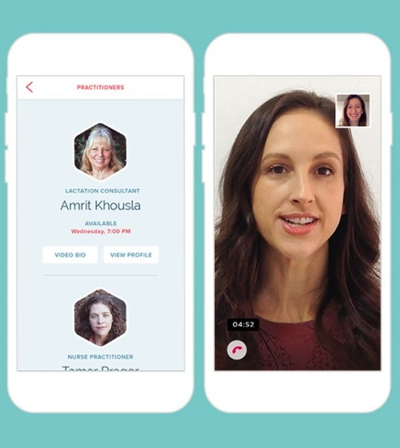
Telelactation is a potential solution, but research is limited

Slide 7



A new telelactation model has emerged…
But there has been no research on the impact of these services
and whether they are feasible and acceptable to breastfeeding mothers

Slide 8



Interactive instructional/ support video calls through patient’s personal device
Breastfeeding mother
Lactation consultant
Unscheduled, on-demand assistance
Available 24/7, including from home
Inexpensive
Advantages
Disadvantages
Requires wifi or data network access and computer literacy
Consultants cannot provide hands-on assistance

Slide 9
STUDY AIMS
Breastfeeding mother
Lactation consultant
The Tele-MILC trial evaluated the feasibility, acceptability, and impact of telelactation via personal devices on breastfeeding duration and exclusivity among rural women.

Slide 10
METHODS

Slide 11


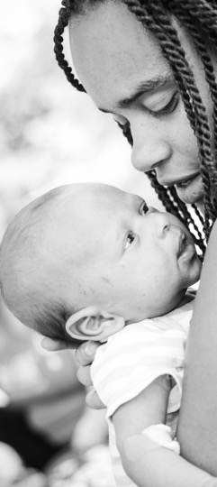
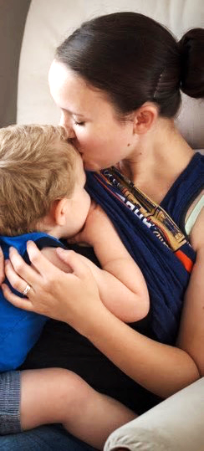

Slide 12
Randomized controlled trial
Recruitment:
October 2016–May 2018 in a critical access hospital in PA

Slide 13
Randomized controlled trial
Inclusion
criteria
Recruitment:
October 2016–May 2018 in a critical access hospital in PA
Postpartum women:
>18 years
Valid email
Spoke English
Gestational age >35 weeks
Initiated BF and planned to continue
Notes:
Postpartum women were eligible to participate if they were at least 18 years old, spoke English, had a valid email address, had a singleton baby at a gestational age of at least 35 weeks, and had initiated breastfeeding and planned to continue after hospital discharge. Exclusion criteria included planned separation from the infant (e.g., incarceration), or having a condition where breastfeeding was medically contraindicated (e.g., HIV positive).

Slide 14
Randomized controlled trial
Inclusion
criteria
Exclusion
criteria
Recruitment:
October 2016–May 2018 in a critical access hospital in PA
Postpartum women:
>18 years
Valid email
Spoke English
Gestational age >35 weeks
Initiated BF and planned to continue
Multiple infants
Separation from infant
Condition where BF contraindicated
Notes:
Postpartum women were eligible to participate if they were at least 18 years old, spoke English, had a valid email address, had a singleton baby at a gestational age of at least 35 weeks, and had initiated breastfeeding and planned to continue after hospital discharge. Exclusion criteria included planned separation from the infant (e.g., incarceration), or having a condition where breastfeeding was medically contraindicated (e.g., HIV positive).
Parallel design, 2 arm trial. Individual level randomization.
Block randomization stratified by first time mom and gestational age.
Eligible moms: have initiated breastfeeding and intend to continue. Over 18+.
Moms get incentives: phone or gift cards. Intervention moms also get services. Cole nurses get funding for educational purposes.
Outcome- use of tool, duration, exclusivity, satisfaction. ADD
Mother breastfed her infant or expressed milk at least once (Yes/No )
Gestational age (Indicate weeks completed. So 34 0/7 to 34 6/7 is 34 weeks)
<33 weeks
34 weeks
35 weeks
36 weeks
37 weeks
38 weeks
39 weeks
40 weeks
41 weeks
> 42 weeks
Singleton birth? (Yes/No)
Infant expected to stay at Cole Memorial (i.e. infant will NOT be transferred out to another hospital for inpatient medical care) (Yes/No)
Infant expected to go home with the mother (i.e., the baby will NOT be put up for adoption or CYF custody)
Mother can read, speak, and understand English (Yes/No)
Mother is NOT a prisoner (Yes/No)
Mother is HIV/HTLV NEGATIVE (Yes/No)
Mother does NOT need chemotherapy or radiation after delivery (Yes/No)
Mother is eligible to breastfeed per Cole protocols (toxicology screen) (Yes/No)
Programming note: All 11 questions must be completed for nurse to proceed.

Slide 15
Randomized controlled trial
Inclusion
criteria
Exclusion
criteria
Mothers tracked for 12 weeks
Recruitment:
October 2016–May 2018 in a critical access hospital in PA
Postpartum women:
>18 years
Valid email
Spoke English
Gestational age >35 weeks
Initiated BF and planned to continue
Multiple infants
Separation from infant
Condition where BF contraindicated
Surveyed at baseline, 4, and 12 weeks
$25 in incentives for each assessment

Slide 16




















Tele-MILC process at recruitment hospital
Intervention
Intervention follow-up
Online survey 2, 4, and 12 weeks
post-discharge
Use of and satisfaction with video calls
Random assignment
Online survey at enrollment
Assessed for eligibility
Control
Control
follow-up
Excluded (not eligible)
Notes:
We will recruit 200 moms total (100 in each group) . Eligible moms: have initiated breastfeeding and intend to continue. Over 18+.
Moms get incentives: phone or gift cards. Intervention moms also get services. Cole nurses get funding for educational purposes.
Outcome- use of tool, duration, exclusivity, satisfaction. ADD
Mother breastfed her infant or expressed milk at least once (Yes/No )
Gestational age (Indicate weeks completed. So 34 0/7 to 34 6/7 is 34 weeks)
<33 weeks
34 weeks
35 weeks
36 weeks
37 weeks
38 weeks
39 weeks
40 weeks
41 weeks
> 42 weeks
Singleton birth? (Yes/No)
Infant expected to stay at Cole Memorial (i.e. infant will NOT be transferred out to another hospital for inpatient medical care) (Yes/No)
Infant expected to go home with the mother (i.e., the baby will NOT be put up for adoption or CYF custody)
Mother can read, speak, and understand English (Yes/No)
Mother is NOT a prisoner (Yes/No)
Mother is HIV/HTLV NEGATIVE (Yes/No)
Mother does NOT need chemotherapy or radiation after delivery (Yes/No)
Mother is eligible to breastfeed per Cole protocols (toxicology screen) (Yes/No)
Programming note: All 11 questions must be completed for nurse to proceed.

Slide 17
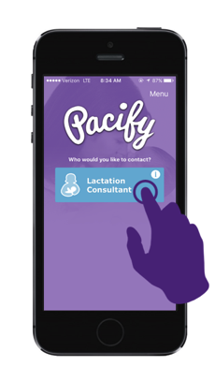
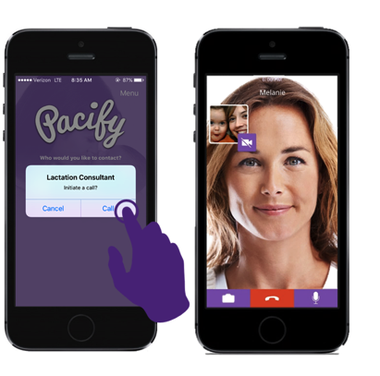
The intervention
Download the PACIFY app and enter coupon code
Unlimited, on-demand access to video calls with IBCLCs

Slide 18


Self-reported primary outcomes
Any breastfeeding at 12 weeks (yes/no)
Exclusive breastfeeding (infant fed only breastmilk) at 12 weeks (yes/no)
Feasibility measures
(telelactation participants)
Use of telelactation (any use, number of visits)
Satisfaction with advice received via telelactation video calls
Self-reported secondary outcome
Breastfeeding satisfaction during the period of breastfeeding (satisfied vs. not satisfied)
Notes:
Our primary and secondary outcomes of interest were binary indicators for 1) any breastfeeding, 2) exclusive breastfeeding, and 3) satisfaction with the breastfeeding experience at 12 weeks. The primary study outcomes of any breastfeeding and exclusive breastfeeding (i.e., infant fed only breastmilk) were self-reported by participants at 12 weeks. We measured both of these outcomes using infant feeding questions from the National Immunization Survey³¹ that asked participants to report if they were currently breastfeeding or feeding pumped milk to their new baby and if no, the age of the infant in weeks when he/she completely stopped breastfeeding or receiving breastmilk. Similarly, participants were asked to report the age of the infant when he/she was first fed formula.
The secondary outcome was breastfeeding satisfaction during the period of breastfeeding. Participants still breastfeeding at the time of the 12-week assessment were asked to rate how satisfied they felt about the experience of breastfeeding their baby over the past three months (very unsatisfied, somewhat unsatisfied, neither satisfied or satisfied, somewhat satisfied, and very satisfied). Participants reporting that they had stopped breastfeeding were asked to think back on the time they were breastfeeding and indicate how satisfied they were with the experience. In both cases, we defined a participant as “satisfied with breastfeeding” (yes/no) if she indicated that she was “satisfied” or “very satisfied.” Feasibility measures included use of telelactation (any use and number of telelactation video calls) and satisfaction with telelactation video calls overall among participants in the telelactation arm as reported at 12 weeks.

Slide 19

Assessment of whether randomization achieved balance across arms
(t-test and chi-squared tests)
Linear regression
Intent-to-treat approach that estimates the effect of treatment on those randomized to receive it
Instrumental variable approach that estimates the effect of treatment on the treated
All models adjust for exclusive breastfeeding in the hospital
Underpowered study
ANALYSIS
Notes:
We first assessed whether randomization achieved balance on measurable characteristics across intervention and control participants via two-sided t-tests and chi-squared for continuous and binary variables, respectively. We then used an intent-to-treat (ITT) approach³² adjusting for individual-level maternal characteristics that varied at baseline. The ITT analysis gives the average effect of the treatment on participants randomized to receive it, but these results suffer from “treatment contamination” because not everyone assigned to the treatment arm used the telelactation services.
To adjust for this contamination to usual care, we also used an instrumental variables (IV) model that produces an estimate of the treatment effect on the treated (i.e., intervention group participants who used the intervention). More specifically, we estimated a 2-staged least squares (2SLS) IV model where we instrument for the probability of compliance (in this case, use of telelactation) using the randomization variable (i.e. “in treatment group”) as the instrument.^{33,34} We estimated probit regressions and produced marginal effects for ease of interpretation. We estimated the IV model linearly. We included one covariate (exclusive breastfeeding in the hospital prior to enrollment) that was not balanced across the two groups.

Slide 20
Regression models
with and without adjustment for exclusive breastfeeding in the hospital
Alternative regression models
Tested within the IV approach using probit model
Survival analyses
Time to breastfeeding cessation
SENSITIVITY ANALYSIS
Comparable results for all tests
Notes:
We conducted several sensitivity analyses to test the robustness of our findings to statistical assumptions and choices. First, we ran regression models with and without adjustment for exclusive breastfeeding in the hospital. Second, we tested alternative regression models within the IV approach by using a probit model instead of a linear regression model. Third, we investigated results obtained through survival analysis using a cox proportional hazard model at three timepoints: 2 weeks, 4 weeks, and 12 weeks. All statistical analyses were conducted using Stata version 15 (StataCorp). Statistical significance was defined using a 2-sided test and a significance level of 0.05.

Slide 21
RESULTS

Slide 22
Consort diagram
Enrollment
Allocation
Follow-up
Analysis
Allocated to intervention (n=102)
Lost to follow-up (n=8)
Analyzed (n=94)
No participants excluded from analysis
Assessed for eligibility (n=313)
Randomized (n=203)
Allocated to control
(n=101)
Lost to follow-up (n=8)
Analyzed (n=93)
No participants excluded from analysis
Excluded (n=110)
Did not meet inclusion criteria (n=89)
Declined to participate (n=19)
Other reasons, not screened (n=2)
Notes:
We screened 313 women for eligibility and 224 were eligible for the trial
We enrolled a total of 203 participants (102 in the telelactation arm and 101 in the care as usual arm) for a participation rate of 91%.
Sixteen participants (8 in each study arm) did not complete the final, 12-week assessment for an attrition rate of 8%.

Slide 23
Participant characteristics at enrollment
Education
High school diploma or less
Race/ethnicity
Non-Hispanic, white
Married
47%
43%
53%
57%
96%
97%
Planned to work during baby’s first year
Owned a smartphone
Telelactation
Control
52%
59%
97%
95%

Slide 24
Participant characteristics at enrollment
Annual household income
Insurance during pregnancy

Slide 25
Participant characteristics (pre-pregnancy)
Maternal health
Smoked during last 3 months of pregnancy

Slide 26
Participant characteristics at enrollment
Childbirth and labor
Gestational age
> 37 weeks
Infant birthweight
< 2,500g

Slide 27
Participant characteristics at enrollment
Planned to breastfeed
at least 3 months
Planned to breastfeed
at least 6 months
Breastfeeding intentions and initial patterns
100%
96%
93%
90%
Breastfed in first hour
after birth
Breastfed exclusively
in hospital
Telelactation
Control
79%
87%
86%
71%

Slide 28
Experiences with the intervention
50%
of telelactation arm participants reported participating in one or more video calls with an IBCLC during the study period*
Breastfeeding mother
Lactation consultant
Vendor EMR data showed that 33% of participants engaged in substantive discussion about a breastfeeding challenge
* Includes demonstration calls in which they briefly spoke to an IBCLC to learn how to use the application

Slide 29
Among users who received substantive support…
83 total calls completed
3+ calls
29%
1 call
45%
2 calls
26%

Slide 30
Characteristics of Telelactation Users and Non-users
Childbirth and breastfeeding
Users
Non-users

Slide 31
Characteristics of telelactation users and non-users
Other maternal characteristics
Users
Non-users
Working by
12 weeks

Slide 32
Reasons for Not Using Telelactation
(among non-users)
Notes:
Convenient access to in-person support that the mother preferred
Limited need for professional breastfeeding support (e.g., previous breastfeeding experience, lack of challenges)
Competing demands that deprioritized breastfeeding concerns

Slide 33
Call Characteristics (n = 83)
1–4
weeks
5–8
weeks
9–12
weeks
13+
weeks
<7 days
Age of infant
8 AM–12 PM
12 PM–4 PM
4 PM–8 PM
8 PM–8 AM
Time
of call
Weekdays, 8 AM–6 PM
Calls during business hours

Slide 34
Topics Discussed during Call (n=83)
Issues discussed similar to hotline calls, with exception of nipple shield use

Slide 35
User Experiences Were Overwhelmingly Positive
87%
91%
78%
reported that the app was helpful
were satisfied with the help they received
did not report any technical difficulties
Recommendations for improvement:
Add text or audio-only visits
Allow user to request a particular IBCLC
Connect users with peers
Automatically schedule monthly visits

Slide 36
% breastfeeding at 12 weeks
(by model)
Difference = 3%
Difference = 5%
Exclusive breastfeeding
Difference = 11%
Difference = 5%

Slide 37
Breastfeeding satisfaction
Telelactation participants were less likely to report satisfaction with their breastfeeding experience, but differences were not statistically significant
73% (lactation arm participants)
67%
78% (control participants)
78%
ITT
IV
(5% difference, p=0.41)
(11% difference, p=0.41)
Notes:
Recognizing that the difference was not statistically significant, we found it surprising that women in the intervention group reported less breastfeeding satisfaction. Perhaps continuing to face breastfeeding challenges and barriers (e.g., return to work) even with access to professional support leads to greater frustration with the breastfeeding experience. In addition, since fewer telelactation participants were breastfeeding exclusively in the hospital as compared to controls, it is likely that they experienced more breastfeeding challenges; thus, their satisfaction ratings may be reflecting these difficulties.

Slide 38
DISCUSSION

Slide 39
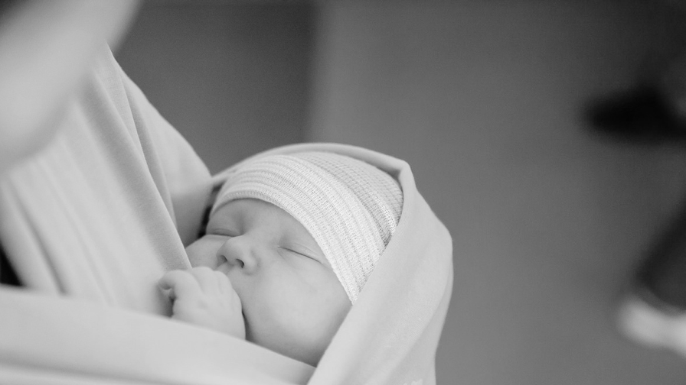
Study had high participation rates, little attrition, and 50% of intervention women had a video call
Suggests the feasibility and acceptability of telelactation
However, we did not see statistically significant improvements in primary outcomes
Notes:
The study had high participation rates, little attrition, and half of women in the intervention arm had at least one telelactation video call. Together, these results suggest the feasibility of telelactation and that women are interested in using it. However, we did not see any statistically significant improvements in our primary outcomes.

Slide 40

Observations
Telelactation has higher uptake than other telehealth interventions
  A population of mothers committed to breastfeeding
  App introduced by trusted providers, and test calls were encouraged
Notes:
While we could not identify any research that describes the content of direct-to-consumer telelactation visits, numerous studies both within and outside of the U.S. have assessed telephone breastfeeding support visits.³²⁻³⁷ The top three issues discussed in video calls in this study included: breast pain, soreness, or infection; use of nipple shields; and latch/positioning. No prior analyses of telephone visits identified nipple shield use as a common topic; however, leading reasons for visits seemed to vary depending on the patient population. For example, common issues discussed by 908 callers on a helpline in the UK included difficulties with positioning and concerns about inadequate milk supply.³² In contrast, common issues identified in an analysis of 1969 calls to an inner-city hospital breastfeeding support line in the U.S. included questions about obtaining and/or using a breast pump and breast issues.³³ Numerous questions about nipple shields in this study may reflect the local practices of healthcare professionals at the recruitment hospital during the postpartum hospitalization.
This work builds upon our prior qualitative work that showed that direct-to-consumer telelactation is acceptable and feasible for rural mothers. While select participants in both analyses recommended the addition of audio only and text message visit options, one participant in the current analysis also indicated a desire for regularly scheduled video calls that the breastfeeding mother did not have to initiate. At this point, direct-to-consumer models require the mother to identify and seek help for a breastfeeding issue. Prior research has differentiated between proactive (pre-scheduled at regular intervals) and reactive (as demanded by the mother) breastfeeding support, and suggested that proactive support can lead to greater engagement and impact.³⁸ Future telelactation models can consider how best to deliver services that are responsive to urgent needs but also require less activation from mothers who could benefit from professional advice.
The primary limitation of this study is that we recruited participants at one study site that serves a population of rural, predominantly White mothers in Pennsylvania. As such, it is unclear how patterns of telelactation use may differ in other communities with different breastfeeding support services. Nonetheless, the study was conducted in the context of a randomized controlled trial, and is the first of its kind to use quantitative methods to explore use of and experiences with direct-to-consumer telelactation.
Direct-to-consumer telelactation is an innovation in the delivery of professional breastfeeding support. Although our study focused on a rural population, these services may increase convenience and reduce costs associated with seeking in-person breastfeeding support in urban settings as well. Although additional research should document the impacts of these services on breastfeeding outcomes and healthcare costs within more diverse populations, this research documents robust usage of and positive experiences with telelactation in an underserved population.

Slide 41
Future models should consider how to deliver support services that require less activation by mothers.
Notes:
At this point, DTC models require the mother to identify and seek help for a breastfeeding issue. Prior research has differentiated between proactive (pre-scheduled at regular intervals) and reactive (as demanded by the mother) breastfeeding support, and suggested that proactive support can lead to greater engagement and impact.³⁸

Slide 42
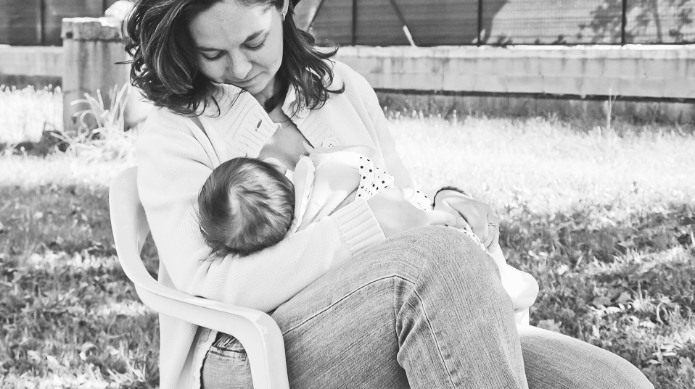
The study was underpowered and included one site with predominantly white mothers in Pennsylvania.

Slide 43



1st
Breastfeeding mother
Lactation consultant
First experimental evaluation of
two-way video for breastfeeding support
First evaluation of direct-to-consumer
telelactation services
Notes:
The results of this study will inform ongoing policy debates about reimbursement and regulation of DTC telehealth services and the strengths and limitations of this model of healthcare delivery as applied to breastfeeding. It will also provide valuable information on whether telelactation is an acceptable and feasible way to increase access to IBCLCs in communities that lack them and whether changes need to be made to these services in order for them to meet the needs of rural, underserved populations.
If we find that telelactation services are feasible and acceptable and there is demand for these services in rural communities, this could have significant implications for the delivery of breastfeeding support. Because telelactation services are less costly than in-person services, interventions that use this model of delivery can reach mothers that would otherwise have no access. In addition, by substituting in-person visits for virtual visits where appropriate, we can provide the same support at lower cost. If we learn that DTC telelactation can effectively increase access to IBCLC services in rural communities, making these services widely available will help to reduce rural-urban disparities in breastfeeding rates.
In contrast, if we find that DTC telelactation services are not feasible or do not improve breastfeeding rates overall, our quantitative data may be able to identify whether there are subgroup effects while our qualitative data may identify ways to improve telelactation delivery. If we find that there is limited demand for telelactation services in rural communities or a set of critical barriers to uptake, we can offer recommendations regarding how to structure these programs for maximum impact. Telehealth is often regarded as a potential solution to access problems. Little is known, however, about how demand and utilization of these services will vary across urban and rural settings due to unique characteristics of the healthcare delivery system, patient demographics, and culture/norms around healthcare seeking. For example, although telehealth services may be introduced with the explicit aim to increase access to rural populations, rural communities may be least likely to benefit due to the digital divide (less use of and comfort with technology) and inadequate broadband. Although we expect to address these issues in part in our study by providing participants with a smartphone and data plan, we note that challenges remain for the implementation of telehealth services in rural areas more broadly.
We plan to disseminate the results of this study to the payer community to inform decisions regarding coverage and reimbursement of these services. The Affordable Care Act (ACA) required that private, non-grandfathered health insurance plans include coverage for comprehensive lactation support and counseling from (in-network) trained providers without patient cost-sharing. However, this provision does not apply to all health plans (e.g., Medicaid, grandfathered private plans) and is silent on the role of telelactation services.⁵⁷ If telelactation is effective, payers that are not subject to this requirement may elect to provide coverage given that increasing breastfeeding rates can decrease healthcare costs in the short and long term; also, some plans struggling to comply with the ACA’s requirements may elect to offer these services as a cost-effective alternative to in-person lactation support.

Slide 44
Conclusions
We documented robust usage and positive experiences with telelactation in an underserved population
Services feasible and likely to improve access and convenience

Slide 45

Telelactation may improve breastfeeding rates, but a larger study is needed
(e.g., with higher-risk populations, longer tracking, first-time mothers)
Notes:
These results suggest the potential value of a larger RCT which 1) focuses on a population with lower baseline breastfeeding rates; 2) includes only primiparous women who have less breastfeeding self-efficacy; and 3) tracks women for 6-12 months.

Slide 46
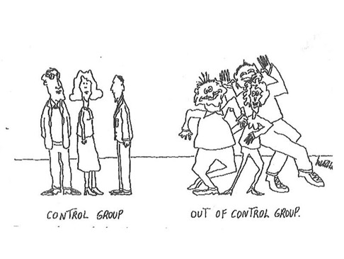
Acknowledgments
Thanks to
Kandice Kapinos,
Ateev Mehrotra,
Bonnie Ghosh-Dastidar,
Virginia Kotzias,
Debra Bogen,
Kristin Ray,
Jill Demirci,
Mary Ann Rigas, Laura Stokes

Slide 47
Additional Slides

Slide 48
Standard Intent-to-Treat (ITT) Analysis for RCT
Intervention
Intervention follow-up
ITT: Compare women across two groups at follow-up
Random assignment
Control
Control
follow-up

Slide 49
Some Will Not “Take-up” or Use the “Treatment”
Intervention follow-up
Intervention
Use app
Use instrumental variables technique to “adjust” for this in our comparison across groups
Random assignment
Do not use app
Without this adjustment, treatment “effect” may look smaller than it actually is
Control
Control
follow-up
Notes:
Parallel design, 2 arm trial. Individual level randomization.
Block randomization stratified by first time mom and gestational age.
Eligible moms: have initiated breastfeeding and intend to continue. Over 18+.
Moms get incentives: phone or gift cards. Intervention moms also get services. Cole nurses get funding for educational purposes.
Outcome- use of tool, duration, exclusivity, satisfaction. ADD
Mother breastfed her infant or expressed milk at least once (Yes/No )
Gestational age (Indicate weeks completed. So 34 0/7 to 34 6/7 is 34 weeks)
<33 weeks
34 weeks
35 weeks
36 weeks
37 weeks
38 weeks
39 weeks
40 weeks
41 weeks
> 42 weeks
Singleton birth? (Yes/No)
Infant expected to stay at Cole Memorial (i.e. infant will NOT be transferred out to another hospital for inpatient medical care) (Yes/No)
Infant expected to go home with the mother (i.e., the baby will NOT be put up for adoption or CYF custody)
Mother can read, speak, and understand English (Yes/No)
Mother is NOT a prisoner (Yes/No)
Mother is HIV/HTLV NEGATIVE (Yes/No)
Mother does NOT need chemotherapy or radiation after delivery (Yes/No)
Mother is eligible to breastfeed per Cole protocols (toxicology screen) (Yes/No)
Programming note: All 11 questions must be completed for nurse to proceed.

Slide 50
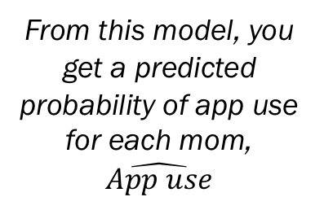

How the Instrumental Variables Model Works
From this model, you get a predicted probability of app use for each mom, $\hat{App use}$
Randomization (instrument)
Stage 1
App Use
Breastfeeding outcomes: duration, satisfaction
Stage 2
$$\hat{App use}$$

Slide 51

Qualitative Interviews in First 6 Months of Study
Telephone interviews with high-volume IBCLCs identified by app vendor (n=7)
Telephone interviews with mothers who were offered telelactation services at 5 weeks postpartum (n=17)

Slide 52
































Characteristics of Mothers We Interviewed
39 mothers
enrolled in telelactation portion at time of interviews
Participant characteristics
Median age: 25 (SD = 5.3 years)
Majority white, married, high school–educated, multiparous, with prior breastfeeding experience
Receiving Medicare or Medicaid
17 mothers
interviewed
All initiated breastfeeding in hospital and planned to continue

Slide 53

Characteristics of IBCLCs We Interviewed
Professional backgrounds included dietetics, nursing, case management, childbirth education, public health program coordination, WIC counseling
All had prior experience providing telephone-based lactation counseling
All had provided telelactation services for 1+ years at interview
Years since IBCLC certification range: 4–20 (median: 7 years)
IBCLCs

Slide 54

Characteristics of Telelactation Visits
I used [the app] mostly at night, because it was quiet while my son was sleeping.
Women reported visits most often in the first
two weeks postpartum
Wide range of issues (cluster feeds, latch, pain, pump operation)
All times of the day, when a mother had a quiet time and space
Would use again for any breastfeeding issue (teeth, transitions to bottle)
Just really questions
that I think any mom who can Google stuff should already know.
IBCLCs made distinctions between rural and metropolitan calls
Rural mothers: crisis, basic info, comprehensive assistance
Urban mothers: seeking reassurance, affirmation
I’m going back to work. I have a private office.

Slide 55

Positive Attributes of Telelactation
IBCLC quality and experience
Empathetic, patient, professional, consistent, clear
Ease of use
On-demand access to support on mother’s personal device
[My IBCLC] was a good listener. She was caring. She cared what I had to say, too. . . .
It was an actual two-sided conversation.
It’s right there. It’s so easy to click on it and just do it.

Slide 56
Positive attributes of telelactation
Video enhances experience
Convenient, efficient, facilitated trust, visuals
Fills a void
Bridge between in-person visits, timely support in areas with limited providers, providers get education too
Especially with the post-partum mom who’s tired [it’s difficult].
I mean, it’s so amazing to be able to say, . . . “See that suck? That’s a suck where [baby] is getting milk.” Or, “See that suck? That’s where she’s telling you she’s done with that.”
I like sitting in on [app breastfeeding consults] because I, as a nurse, feel like I’m getting feedback too.
IBCLC
RN

Slide 57
Impact of Telelactation:
Encouragement to Keep Going
Obviously, there was nothing like this app [when I had my first child]. If they had this a couple years ago, I probably would have breastfed him longer—if I had someone I could call right at home.
I probably would have ended up waiting. I would have kept my questions and waited until the pediatrician’s visit, even though they’re not lactation consultants.
But I was able to get my questions answered before that, and then I didn’t have to spend time during [the doctor] visit to talk about that stuff. I was able to focus on other things.

Slide 58
Barriers and Reasons for App Non-use
Barriers to telelactation
Getting up the nerve to call (Potential solution: Offer text and audio/phone visits in addition to video visits)
Continuity of care (Potential solution: Allow IBCLCs to see previous provider’s notes; allow mothers to request same IBCLC)
Getting the app to work (affected a small subgroup): dropped calls, poor connection/signal/coverage
I know some people feel uncomfortable with video chatting. . . . I wasn’t too positive on video chatting somebody I didn’t quite exactly know.
Reasons for not using the app
Convenient access to in-person support that the mother preferred
Limited need for professional breastfeeding support (e.g., previous breastfeeding experience, lack of challenges)
Competing demands that deprioritized breastfeeding concerns

Slide 59
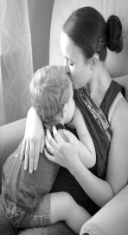
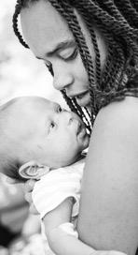
Conclusions
Feasibility and utility of telelactation services
Telelactation for rural mothers is feasible and acceptable
  Easy to use
  Fills a void
Rural mothers: crisis, basic info, comprehensive assistance
Potentially more useful for first-time mothers
“Digital divide” not a major issue
Notes:
Rural mothers: crisis, basic info, comprehensive assistance
Urban mothers: seeking reassurance, affirmation

