Slide 1
Community Partnerships for Healthy Mothers and Children
Quinney Harris | National WIC Association | 2019 NWA Annual Conference

Slide 2
Overview --------------------------------------------------------------------
Background on NWA’s CDC project
Barriers to building partnerships that local WIC agencies encountered
Nationwide message testing project

Slide 3
Background --------------------------------------------------------------------
This project was part of a large CDC grant, called National Implementation and Dissemination for Chronic Disease Prevention
This 3-year cooperative agreement supported national organizations and their members in building/strengthening community infrastructure to implement population-based strategies to improve communities’ health.
The National Organization Awardees included:
National WIC Association (NWA)
American Planning Association (APA)
American Heart Association (AHA)
Society for Public Health Education (SOPHE)
Directors of Health Promotion and Education (DHPE)
Community Capacity Building and Implementation
Dissemination and Training

Slide 4
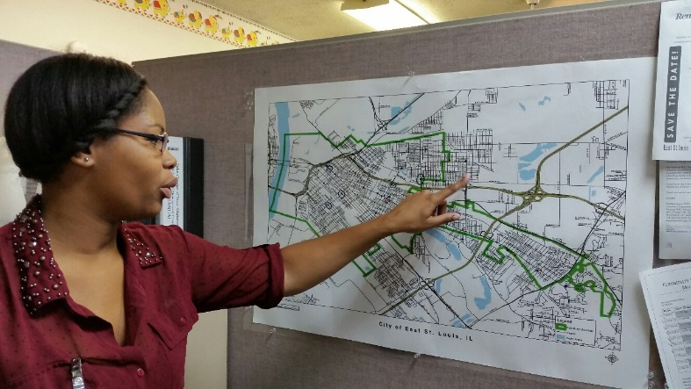
Beyond the Clinic: Supporting WIC Clients and the Community --------------------------------------------------------------------
Community Partnerships for Healthy Mothers and Children
Primary Objectives:
Improve access to healthy food and beverage options
Improve access to chronic disease prevention and management services
Target population: Low income women and children
National Partners: American College of Obstetricians and Gynecologists (ACOG) and Altarum Institute
Local Partners: 30 local WIC agencies
Leadership Team: Project Coordinator, OB/GYN or women’s healthcare provider, and WIC Client

Slide 5
CPHMC Project Context --------------------------------------------------------------------
Leveraging WIC strengths in a larger public health context
Consider the external and home environment
Programming based on the identified needs of the target population
Community partnerships
Consistent messaging with other stakeholders
Community-driven plans to reduce chronic disease through policy, systems, and environmental (PSE) strategies
Evaluation

Slide 6
CPHMC Projects ----------------------------------------------------------

Slide 7
Snapshot of Frequent CPHMC Partners ----------------------------------------------------------
Category/Sector | Sub Categories
Community Members | Moms, WIC Clients, Local Residents
Medical and Public Health Organizations | Pharmacies, Health Departments, Hospitals, WIC, Women’s Services, Health Systems, Health Insurance Companies, Mental & Behavioral Health, Community Clinics, FQHCs
Media | Local Newspapers
Local Businesses and Community Orgs | YMCA, Community Centers, Community Development Orgs, United Way, Community Action Orgs, Chamber of Commerce, Foundations, Rural Health Services, Local Coalitions, Food Policy Councils, Environmental Orgs, Family & Aging Services
Education | Public School Districts, Master Gardeners, Head Start, Cooperative Extension, Smart Beginnings, SNAP-Ed, Universities, School Board, Vocational and Technical Colleges
Food Systems | Grocery Stores/Supermarkets, Food Pantries, Local Farmers/Farm Stands, Farmers’ Markets, Food Distributors
Local and State Government | Department of Social Services, State Senators, Department of Human Resources/Services, Housing Authority, City Mayors, Police Department/County Sheriff’s Office, Parks and Rec, Public Relations Officers, Commissioner’s Offices, City Government, Public Libraries
Religious Orgs | Churches (Multiple Denominations)
Military | Military support services
Notes:
Enhanced partnerships with existing partners and established new partnerships resulting in increased communication and resource sharing. Additional, in several communities such as Baltimore and East St. Louis , local WIC agencies were able to connect with planners and local affiliates of the American Heart Association to explore opportunities to partner and build healthier communities.

Slide 8
CPHMC Achievements
Video snapshots from Kenosha (WI), Plattsburgh (NY), and Sandpoint (ID)
Notes:
CPHMC achievements – video snapshots from Kenosha (WI), Plattsburgh (NY), and Sandpoint (ID)

Slide 9
Barriers to Building Partnerships ---------------------------------------------------
Modesty amongst church congregations (reluctant to become breastfeeding friendly)
Turf issues
Meeting and training availability (medical providers)
Reluctance to change business practices (grocery stores and other food retailers)
Values: profit vs public health
Lack of interest
Unreliable commitments
Loss of interest due the time/effort required to make policy, systems, and environmental change
False perceptions of WIC

Slide 10
Research and Development of Communications Strategy for Partnership Building in WIC
NWA Annual Conference
April 8, 2019
Mary Christ-Erwin
Sarah Meirama

Slide 11
Objectives
Develop a framework to build awareness of and support for WIC, navigating challenging communications issues.
PURPOSE:
Explore perceptions and test messages about the WIC program in general, and garner insights that will help connect eligible recipients with support.
Test specific messaging from NWA and explore the value-based foundation and attitudes that disparate stakeholders bring to this issue.
Craft compelling and resonant audience-specific messaging by identifying communications challenges and opportunities unique to each audience.

Slide 12
Methodology
All aspects of the research were completed from July to August 2017
Five conversations with “Top Learners” from local Community Partnerships for Healthy Mothers and Children programs
Twelve in-depth telephone interviews lasting between 30 minutes to an hour
Fourteen in-person focus groups to explore issues and test messaging frames
Conversations spanned several stakeholder groups
Focus groups included a mix of urban (28), suburban (35), and rural (21) respondents and spanned the ideological spectrum
Local business leaders
Community religious leaders
WIC-eligible women (including African-American and Latina groups)
Middle- and upper-income Americans
K12 teachers and academia
Healthcare professionals
Military families
Retail professionals

Slide 13
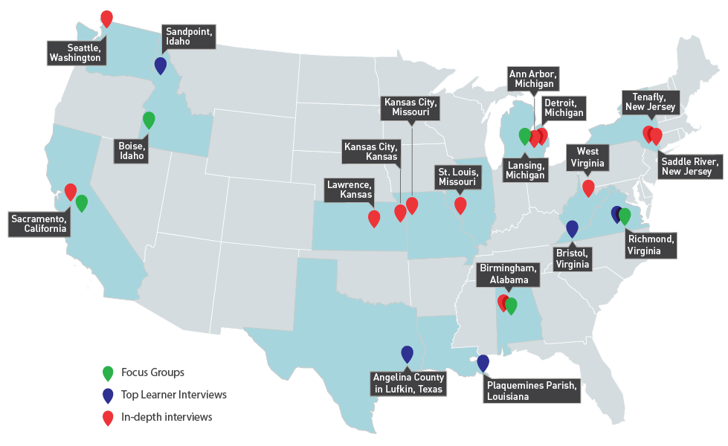
Where we went

Slide 14
Key Findings

Slide 15
Where we are
WIC has good name recognition and largely positive top-of-mind associations, particularly in comparison to other government assistance programs.
But, there is limited awareness of the ultimate purpose, goals, or successes of the WIC program.
Greater visibility and education is needed among the general public and key stakeholders, including among those that the program serves regarding program objectives, access, logistics, and success.
Lack of information/knowledge allows opportunity for negative stories or misperceptions to fill the void.
Awareness mostly stems from media reports (typically unfavorable) or experience with the program (either personally or from a friend/family member).

Slide 16
Where we go: Three overarching takeaways
1
WIC is about the baby.
2
The NWA imperative: define program purpose and success and then show WIC being successful.
3
Don’t underestimate the frustration felt across audiences.

Slide 17
WIC Perceptions

Slide 18
Audiences are aware, have a positive view of WIC.
Topline positive attitudes generally involved providing for the baby.
WIC Eligibles
A lifeline, helping moms be “good moms”
Mid-to-Upper
Income Americans
A program that has helped someone they know and helps babies and children
Health Providers
A resource to provide formula to mothers
Religious Leaders
A positive way for babies and women in need to get
nutrition assistance
Local Business Leaders
A program they hope alleviates larger societal burden down the line
K-12 Educational
A critical program addressing problems they see students suffering from

Slide 19
The best of WIC: empowerment, support, and hope. (Softer feelings)
Accountability for baby
Sets children up for development
Academic Success
Awareness of best practices for parenting
Income (supplementing)
Education
Free/safe options
Teaching life skills
Great Resource
Smart choices
Training
Assistance for those in need
Support
Up to date with immunizations
Prepping kids for school
Farmers
Nutrition
Milk for baby
Farmers Market
More structured than food stamps
Stability
Emotional support
Portion Control
Infant support/food
Breastfeeding education
Parenting techniques
Weight control
Structure
Long term health benefits
Public Health
Provides basic care/keeps kids fed
Productive members of society
Monitoring child
Healthy foods
Referral services
Nutrition education
Early Intervention
Provides formula
Necessary
Prevention
Safe options
Hygiene/diapers
Family Planning
Relief
Expectant mothers
Federally run
Formula
Reducing hunger
Guidance
Drug testing
Networking
Get kids off to healthy start
Grocery Store

Slide 20
All audiences have concerns about WIC.
Topline negative attitudes resulted from a range of concerns from systemic abuse to perpetuated stigma
WIC Eligibles
Great benefits if you can get them, stigma
Mid-to-Upper
Income Americans
Sowing dependency, fraud, cycle of poverty
Health Providers
Cycle of poverty, limited impact beyond
formula
Retail
Administrative and bureaucratic expense
Religious Leaders
Concerns about dependency, discouraging family structure
Local Business Leaders
Dependency, fraud, poorly run government programs
K-12 Educational
Unsure about impact, cycle of poverty

Slide 21
The worst of WIC: dependency, fraud, and ineffective government. (Tangible and hard-hitting)
People who get it don’t need it
Immigration
Government administration
Male limitations
Not short-term
Judgement
Cycle of dependency
Low awareness
Lack of education resources
Income requirements are too low
Robbing someone’s dignity
Poor administration
Welfare/entitlement
Wasted taxpayer dollars
No replacement of vaccines
Abusing the system
Feelings that others need it more
Cashier wait time
Low success rate
Too few options/stores accept WIC
People who need don’t get it
Not enough regulation
Income requirements are too high
No organic options
Stigmas
Lack of local control
Poor management
Parents wont take classes
Frustration
Lack of breastfeeding support
Hard to access
Retailers price gouging

Slide 22
We underestimate overarching frustration and anger to WIC’s peril.
What are people mad about?
Another entitlement program, continuing the cycle of poverty, hard to get off
Massive, but poorly run government programs show how ineffective our government (U.S.) has become
Perpetuating stereotypes of poverty
These frustrations are shown across stakeholder groups
Religious Perspective
Impeding traditional family dynamic and responsibilities, including the role of fathers
WIC Eligibles
Recognize (and have personal examples) of peers who have taken advantage of the system
Difficulty/judgement getting help
Red Flag: Cannot take stakeholders for granted as frustration is felt across stakeholders and can latch itself onto an issue or cause.

Slide 23
WIC, SNAP & “Entitlement Programs”
Majority of audiences, but for those who have been recently served by WIC, conflate SNAP and WIC. Top-of-mind associations of WIC with SNAP/food stamps is a challenge for lower-information audiences.
SNAP provokes negative reactions related to lack of accountability in the program, misuse of the program (buying junk food and alcohol rather than nutritious staples, as well as reselling of food purchased with SNAP dollars).
At a surface level, WIC is seen more positively because of its limited length of benefits, focus on infants.
In conversation, WIC can quickly become grouped with “entitlement programs” writ large, falling into the category of never-ending and expensive assistance.
How should WIC balance the positives and negatives of connecting itself with other programs in its narrative? Embrace the connections or strike out alone?
The Question: How does WIC want to tell its story moving forward?

Slide 24
Where we go

Slide 25
Approach stakeholders with value-based messaging.
Approach audiences with relatable values, and then as needed win them with relatable facts.
True across stakeholder groups
Common values shared by majority of audiences.
Babies are innocent
Babies need nutrition if they are going to have any chance for a healthy childhood
America should not withhold nutrition from innocent babies
Opposition arguments are emotion-based and flip feelings of guilt, which is why anti-assistance messaging is so powerful.
You want to help, but people are taking advantage of your hard work and generosity.
You worked hard to persevere and provide, they didn’t and aren’t.
We’ve created a system of dependency.

Slide 26
An approach led with facts will backfire.
Facts showing WIC’s importance or impact are off-putting as a conversation opener; more apt to confirm viewpoint (whatever that may be) as opposed to changing someone’s mind.
Facts, “experts,” or stats backed by research are easily construed as elitist, biased, or trying to trick.
Skeptical audiences will question data accuracy instead of focusing on what it says.
They will ask for additional context for the statistics, or third-party validation. They are stalling or looking for a reason to oppose with your own proof points.
Audiences skeptical of WIC will not be placated by providing more or different facts; they first have to be convinced by appealing to their strongly held beliefs.
Data can provide a secondary (or even tertiary) support point as needed for specific stakeholders.
Business leaders may need facts about WIC’s low administrative costs to understand its effectiveness.
Policymakers may need information about health outcomes.
We should still begin the conversation with each by talking about our responsibility to the baby.

Slide 27
WIC is about the baby.
Audiences fundamentally believe that WIC’s primary role is to serve the baby.
Volunteered response and remained true after learning more about the program
Provides opening with audiences who are:
Health, business or religious leaders
Most apt to express frustration with public assistance programs, including illegal immigration
Eligible for WIC
This framework is the key emotional approach to the benefit of WIC. Audiences understand and sympathize with this goal.
“I wish people knew it was about infants and not about their parents. You add the ‘W’ and we all go to the abuse [of the program].”
– Religious leader, Birmingham
“Why are we still feeding the moms after birth? After she gives birth, nope. Cut it off.”
– Local business owner, Boise
“Helping babies and children is one of the purest things you can do.”
– Upper-income male, Richmond

Slide 28
When WIC is about “Women, Infants, and Children” what do some audiences hear?
A not insignificant minority express concern when they see WIC focused exclusively on women.
Government programs can foster the breakdown of families by encouraging couples not to marry in an effort to maintain eligibility. (Common theme among religious leaders.)
Program title does not recognize non-traditional/modern families, like father-led households, foster/adoptive parents, LGBTQ parents.
Lead with WIC’s focus on the baby, follow with how that helps support the family.
“When you talk about the women, it sends the signal to me that this is trying to break up the family.”
– Religious leader, Birmingham
“What about the father?”
– Upper-income male, Birmingham

Slide 29
WIC Landscape
Audiences have a very basic understanding of WIC.
WIC helps Women, Infants, Children
It’s a positive view, but it is not clearly defined nor often felt/seen by the majority of audiences. “What is WIC success” is the narrative gap, which leads to two red flags:
It is easy for others to define the narrative in detrimental ways
When left alone, audiences will fill void with their own measurements of success
What do audiences want to see from WIC?
An off-ramp from poverty. Both immediate (not a forever program) and long term (generational impact).
A well-run program that works for the baby.
The personal/emotional impact. Babies served by WIC have a better opportunity to become productive members of society….
On points like graduating from college, being in a happy marriage, finding joy in a job.
Not on points like reduced obesity rates, long-term health outcomes.
Health providers are one caveat to this; they know nutrition leads to better health outcomes, they need to see WIC connecting babies to the services that provide those outcomes.

Slide 30
WIC Landscape
Define Success and then Show Success.
Our messages should fit into this framework of success, clearly stating and then showing WIC’s impact (in a way that rings true to WIC’s work).

Slide 31
WIC’s role in breaking the cycle of poverty.
Success is a story.
Aspirational: Successful adults looking back on their experiences with WIC as a child
Empathetic: The desire of parents to do right by their child, with the emotional pull created when “good” parents need help
Relatable: Emotion-driven indicators of success include getting married, getting a job, going to school, not using WIC as an adult
Show the people.
Putting into action = bringing successful “WIC reps” to member meetings, rotary clubs, high schools
Spotlighting long-term success in mass communications and outreach
Data-driven indicators of success should play the supportive role.
Nutritional benefits for baby
Classes to teach new parents skills, such as how to breastfeed or provide right nutrition to baby
Health and nutrition outcomes

Slide 32
What this is vs. what it’s not
It IS:
Driving the story with values. Basing the conversation on empowerment. Making WIC story audience-appropriate. Forward looking: Help babies today because it works; here’s the relatable way that you can see it working.
It IS NOT:
Data, data, and more data. Telling the WIC story with only facts about why WIC works. Showing current WIC recipients or moms. Basing the story in today.

Slide 33
Messaging Takeaways

Slide 34
What works
Message | Why it works
“Providing tools and support for new and expecting mothers and their babies” | The idea of tools and support imply an ultimate goal of self-sustainability and weaning off the system.
“WIC is about the babies and children that our program serves” | Audiences care most about the babies/children. Babies are innocent, unlike parents who could be gaming the system or abusing benefits.
“Supporting nutrition while providing education” | Other programs address hunger (ex. SNAP), WIC’s commitment to nutrition makes it stand out, more palatable to audiences against assistance programs.
“Promotes healthy habits early on” | Ties back to long-term effects. Don’t want to see a handout, but a program that can change the cycle of poverty.

Slide 35
What doesn’t work
Message | Why it doesn’t work
“The recession hits families hard” | Recession messaging feels dated, seen as a part of the past. Seems like an excuse. Doesn’t resonate in a WIC-specific context.
“WIC benefits get back into the community immediately” | Statement rings false, audiences struggle to connect how WIC would help their broader community not just the Women, Infants, and Children.
“WIC works for low-income babies” | Referring to the babies as “low-income” stigmatizes them.
“Moms who use WIC are bound and determined to do what is right for her baby” | Don’t separate moms who use WIC and those who don’t, creating an in-group and out-group conflict. The focus should stay on the baby, not the mother.

Slide 36
Data and Stats
What you say | What they hear
WIC supports 53% of all infants born in the US. | That’s depressing. WIC’s been around forever and obviously isn’t working.
In 2016, 24% of participants were women, 24% were infants, and 52% were children under the age of 5. | That’s three children per one mother, she shouldn’t be having babies she can’t afford.
Benefits top out at around $47 a month, and those dollars can only go towards healthy foods like milk, cheese, and eggs. | That sounds low. Also, is that $47 per household or per child? If per child, what’s stopping them from having more kids to get more benefits?
There are 47,000 WIC retailers across the country, and the program receives just over $6 billion a year. Less than 8% of WIC’s budget is spent on administrative costs, so the rest of that is for food and training programs. | This is a good message for business leaders, who see 8% administrative costs as low. Less informed audiences get caught on $6 billion, which feels far too high.
The average household income of WIC families is $17,372. | Wow, these households are really struggling. This is a great level-set statistic to immediately show who WIC helps.

Slide 37
Moving Forward

Slide 38
Building friends through…
1
Impactful partnerships
2
National thought leadership
3
Local exposure and outreach

Slide 39
Impactful partnerships
Lowest hanging targets for partnerships:
Religious organizations. It’s in their mission, they have systems in place to help families, but they have very limited awareness of WIC.
K-12 educators and academics. They see the need, often interact with the families, but have limited awareness of the program.
Retailers and Grocers. Frontlines. They know the administrative side of the program, need to hear more on the positive impact.

Slide 40
Impactful partnerships
Attainable but more difficult:
Medical professionals. They see the importance of the program but are pressed for time and expensive to reach.
Business leaders. They do not automatically see their role in assistance programs, even when their staff utilize the programs.
Official military representatives. Requires more formal partnerships/a lot of red tape (active duty hesitant to engage without official sign-off). Also risks some backlash (Why isn’t military providing for our troops? Why is this needed?).

Slide 41
National thought leadership
Few national assistance-based organizations have conducted this extensive of a messaging review in recent months.
Your work is an opportunity to provide other like-minded organizations with helpful information as we navigate forward.
Turn the research into action with editorials, speaking engagements to show others what you have and how it can help them.
National Consumer Federation of American: National Food Policy Conference

Slide 42
Local exposure and outreach
Opportunities are abundant for communications efforts at local levels to educate the public on WIC and its impact. Including:
Grocery store materials & programs.
“I’m a WIC kid!” success stories.
Community toolkits & resources

Slide 43
Grocery store pilot program
What we heard: WIC recipients feel stigmatized and embarrassed in grocery stores.
To better educate the public on WIC, provide resources to stores and cashiers with explanation of program to share with people who are inquiring and/or curious.
Cashier cards: postcard-/flyer-size to hand out at checkout line
Tear sheets for store shelfs: place with WIC products for placement besides marked products with quick overview of what program entails.
Pilot in select markets and test perception/awareness pre- and post-program

Slide 44
“I’m a WIC Kid!”
Give WIC a “face.”
Show success stories of people who benefited from the program when they were younger. Where are they and what have they accomplished? Bring to life via “I’m a WIC kid!”
Potential for larger public education campaign to illustrate reach and impact of WIC long term; how use of the program is temporary during early childhood.

Slide 45
Local community toolkit
Help partners use new insights in their communities.
Create a straight-forward, easy to use deck to encourage WIC conversations in their community.
What’s in the deck?
Suggested venues for conversations (e.g.: churches, rotary clubs, chambers of commerce)
Talking points or “stump speech” to help guide their conversations
Ideas on what to do/what not to do when talking to local groups.
DO: bring along a WIC success representative to put a face to the program
DON’T: start the conversation with just faceless data or stats
Helpful hints when speaking in public

