Slide 1
Forging a Path to Great Participant Experience
Georgia WIC Heartfelt Project
National WIC Association/Brandon Whitney, MPH, CPH/April 8, 2019
Notes:
Forging because working hard to get there, though not there yet.

Slide 2
Objectives
Summarize two components of the Heartfelt Project that were used to address participant concerns in Georgia WIC
Describe the survey process that Georgia WIC used to evaluate participant satisfaction and the results it produced
Outline the training curriculum that was developed to improve supervisors' coaching skills

Slide 3
WIC Background

Slide 4
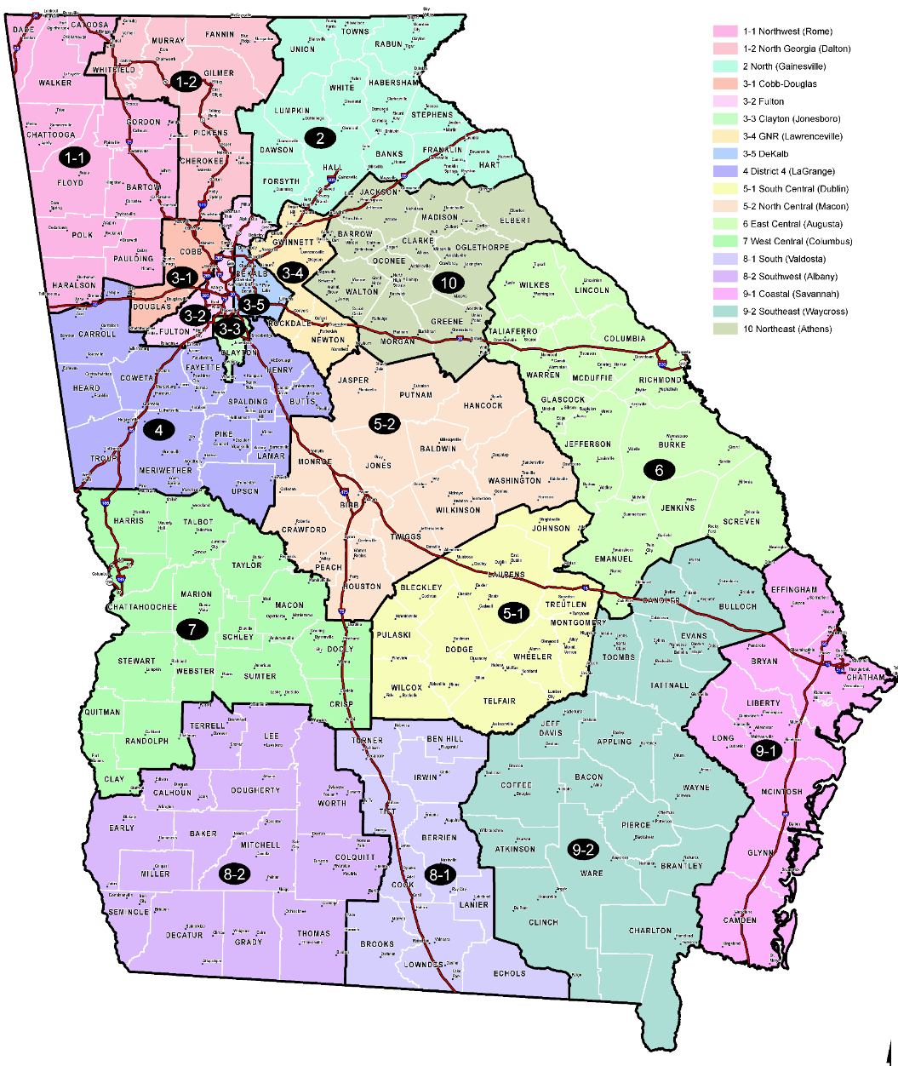
Georgia WIC Overview
19 WIC Local Agencies:
18 Public Health Districts + 1 contract agency
Health districts are independent.
Shared public health governance
± 200,000 WIC participants
198 WIC clinics (159 counties)
± 1300 WIC-authorized vendors
Planning/implementing eWIC (EBT)
Notes:
Local agencies have supervisory authority under health district (ie don’t report to State WIC Office)
WIC falls under hd.
We’re big and diverse . Urban and rural, small clinics and large

Slide 5
Georgia WIC Priorities
eWIC implementation
Breastfeeding
Nutrition counseling
Language Nutrition
Caseload decline
Funding
Integrated Eligibility System
Staff turnover
Notes:
Lot going on like most agencies. These are all essential, but hard to maintain a direct focus on our participants when all these things are pulling us elsewhere.
eWIC includes getting a new MIS to coordinate, because currently we have multiple systems.

Slide 6
Why Focus on Participant Satisfaction?
Staff Satisfaction
Participant Care
Complaints
Caseload
Quality Improvement
Public Health Accreditation
Notes:
These are just some reasons I came up with. They’re related
QI=Practical Evaluation. QI ain’t simply a new system…but a mindset and culture that starts with focusing on your customers

Slide 7
Best Practices for Service Excellence
Leadership
Hiring Techniques
Training Practices
Cultural Climate
Organizational Courtesy
Employee Empowerment
Seamless Service
Management of Discourteous Service
Performance Measures
Customer Loyalty
From World Class Courtesy Best Practice Report - http://govinfo.library.unt.edu/npr/library/papers/benchmrk/courtesy/chapter1.html
Notes:
First thing we did was a best practice review, and best summary doc identified these principles. Using these as a framework.
We gained support for this project nationwide by discussing these principles, and by soberly deciding we needed to focus on them. It takes many approaches.

Slide 8
Heartfelt Project: Progress to Date
USDA Operational Adjustment Grant
Customer service training
ServiceSkills.com
Increased frequency and quality
Promotional branding/tagline
Data collection/evaluation
Supervisory skills training
Notes:
Used ServiceSkills and did in-person and video trainings. Enhanced civil rights training to emphasize service. Training is important, and has occupied a lot of our effort, but didn’t stop there.

Slide 9
Exploratory Evaluation
Notes:
Did 2 separate surveys, but evaluated together. Exploratory because the goal was to identify participant priorities in enough detail to design more-targeted customer service evaluations and initiatives.

Slide 10
Methods: Active Participant Survey
Conducted in-person at 39 purposively selected clinics (July-November 2017)
Included a mix of large and small clinics
Interviewers asked two questions:
On a scale of 1 to 5 (with 5 being “completely satisfied”), how satisfied are you with the services you received at today’s WIC visit?
What could we have done to improve your experience?
Notes:
Staff doc’d whatever they said…cts often didn’t directly answer the question.

Slide 11
Methods: Inactive Participant Survey
Conducted over phone with participants who failed to pickup vouchers for two months, or failed to recertify (but were still categorically eligible)
Interviewers followed a brief series of steps to record a response:
Ask: “What is your reason for not returning for WIC vouchers?”
Record responses directly into predefined categories
Ask clarifying follow-up questions based on the participant’s initial response
After responding, respondents were offered opportunity to return to WIC
Notes:
Asked open-ended, but doc’d as closed with some added notes. This process gave both quantitative and qualitative responses, all in a <2 minute call

Slide 12
Methodological Notes
Qualitative methods were included because they are useful for understanding “Why?” and “How?”
Methodical data collection and analysis, but not based solely on numbers
“Unit of measure” is information, not necessarily an individual.
Samples may not be statistically representative.
Allows more inclusion of uncommon cases (e.g. small clinics, participants with barriers)
Notes:
Inactive survey uses more quan, and active uses more qual.
Qual is misunderstood and underutilized. Not simply reading, but methodical critical thinking. It is also very labor intensive, but allows us to capture more “complicated” concepts.
Uncommon cases is important in service review, because tho may be few in #, dissatisfied customers are more passionate (some say may tell 9-15 people about it).
Nvivo helped organize qual. Still have to read everything, but let syou organize it, count themes (if needed), discover relationships between themes, create new (deeper) themes if needed. Using it
for complaint analysis this year

Slide 13
Methodological Notes (cont.)
Analysis included coding responses based on themes (using NVivo for Windows). This process was performed by two people for validity.
Incorporated both surveys along with external data and knowledge to “tell the story” of the data and draw theories/conclusions
Notes:
Inactive survey uses more quan, and active uses more qual.
Qual is misunderstood and underutilized. Not simply reading, but methodical critical thinking. It is also very labor intensive, but allows us to capture more “complicated” concepts.
Uncommon cases is important in service review, because tho may be few in #, dissatisfied customers are more passionate (some say may tell 9-15 people about it).
Nvivo helped organize qual. Still have to read everything, but let syou organize it, count themes (if needed), discover relationships between themes, create new (deeper) themes if needed. Using it
for complaint analysis this year

Slide 14
Summary of Results: Active Participants
Total surveys: 1,322
Average score: 4.5
Most common score: 5 (67% of responses)
Commonality of “5” may be more reflective of our methods
9 local agencies had at least one participant that rated their experience “1”
Notes:
Take with a grain of salt…. There is a lot of variety

Slide 15
Summary of Results: Inactive Participants
Issue | Number of Responses | Percent of Responses
All Responses | 2304 | 100%
Unintentional Missed Appointment | 1034 | 44.9%
Work/School Conflict | 379 | 16.4%
No Longer Needed | 211 | 9.2%
Moved | 187 | 8.1%
Transportation | 179 | 7.8%
Foods/Formula | 76 | 3.3%
Believed Ineligible | 66 | 2.9%
Clinic Wait Time | 32 | 1.9%
Shopping Issues | 13 | 0.6%
Employee Courtesy | 7 | 0.3%
Other | 411 | 17.8%
Notes:
These are the categories I mentioned. 2304 responses total, and they may have selected more than 1 (so responses don’t sum to 2304).
Unpack some of these categories shortly, but for now notice there’s no majority. Our participants are complex
(On click) now we’ll unpack these missed appts

Slide 16
Discussion: Missed Appointments
Issue | Number (Percent) of Responses | Note
Work/School Conflict | 379 (16%) | ~Half reported being too busy for WIC
Forgot | 258 (11%) | Appointment itself or to reschedule the appointment
Illness/Death in Family | 176 (8%) | Temporary illnesses only, chronic conditions/disabilities were different.
Travel | 119 (5%) | Sometimes the child alone was sent to visit family
Appointment Trouble | 86 (4%) | Includes didn’t realize appointment was missed, or was denied service at clinic
Clinic Phone Issues | 54 (2%) | Calls/voicemails to clinic go unanswered
Lost Folder/Vouchers | 50 (2%) | Some believed this permanently disqualified them.
Miscarriage or Death | 38 (2%) | Most miscarriages assumed they were no longer eligible, without speaking to clinic staff.
Notes:
If they said they left WIC just because they missed an appt, we followed up by asking why they missed. Many didn’t give a clear reason why missed (and we didn’t press them). Some just wanted to r/s their appt.
This is where it gets interesting. Note: also no majority. %s are of ttl responses (not of Missed Appt category).
Immediate customer service implications: We need to address their needs (w/o burdening clinic)…we can serve these if we schedule according to their needs (eg around work schedule).
District and clinic level analysis is needed to understand and improve, especially when making policy/organizational changes (ie changing hours, staffing levels). (was done with this data in distr reports, but more needed)

Slide 17
Discussion: Wait Times
Most commonly cited area among active participants (referred to 640 times)
Many participants expressed a positive (or “not-as-negative”) response.
Among inactive participants, uncommon reason for not participating
32 responses (2% of total)
Wait time may be a root cause for non-participation: Not the first reason participants provide but an underlying factor (that they may consider unchangeable)
Revealed in deeper interview of inactive participants
Notes:
Why the dif between active and inactive? My theory is wait times is more of a root cause…ie why miss appts?, Why no longer need it? Why is transportation an issue?
I mentioned that in analyzing qual and mixed data, need to use all your resources. This validates your inferences. Last year (independent of this work..I hadn’t finished this yet), acfb did focus groups in Atlanta… in this deeper context, this came up as a key, repeated theme (whereas difficulty missing appts did not).
Important to understand this dynamic because help us prioritize next steps. As most root causes, it’s harder to address/manage, but likely more worth it.

Slide 18
Discussion: Courtesy and Communication
Courtesy is a key theme of importance to active participants, although it was not a common reason for non-participation (only seven mentions).
Most references among active participants were positive.
In both surveys, courtesy was usually cited along with other issues/themes .
This is another underlying reason for non-participation, clarified in a deeper interview.
Courtesy was sometimes inextricably linked to communication.
Misinformation = rudeness
Notes:
This is another root cause like wait, but with this one, it was usually cited along with other issues…commonly also issues of communication
Misinfo speaks to fact that clients often connect being nice to explaining things well.

Slide 19
Discussion: Courtesy and Communication (cont.)
116 instances (from both surveys) of correctible clinic issues
Mostly include policy misunderstandings in clinic, or simply poor service
100 instances (from inactive survey) where education or assistance to the participant could have mitigated their personal barriers.
Improved service helps participants navigate the program.
Notes:
These are all issues that conversation could have helped or fixed (not major structural changes to the program or clinic). This is the value of looking at the “atypical” cases I mentioned.
Ex of 1st: Her husband is not working and cannot provide pay stubs which the WIC staff has asked for.
Participant said she knew she was terminated. She went to the office, but no one could let her know why she was terminated.
Ex of 2nd: Vouchers are unclear - do not specify what type of green beans
Mom works until 5pm every day (clinic has extended hours)

Slide 20
Discussion: No Longer Needed
Mentioned by 211 inactive participants (9%)
Most commonly due to raises in income or custody changes
Participants often indicated they only planned to receive WIC temporarily (during infancy or maternity leave).
Questions to consider:
How can WIC convince these families to stay (if they are eligible)?
How can WIC better help families, regardless of when the enter or exit the program?
The key to both may be maximizing our program benefit: strong nutrition education and program information.
Notes:
Q1= caseload
Q2= helping/health…even if they only stay on for 1 year

Slide 21
Discussion: No Longer Needed (cont.)
Rational Choice Theory suggests participants consider costs and benefits to WIC participation. After a time, costs become too high for the benefits.
Improved service can tip the scale by helping participants take full advantage of the program. This may help participants stay on WIC longer, and enrich their experience while they are participating.
Notes:
Consider this along with all the other categories we discussed: wait time and courtesy as root/underlying areas, missed appts for a complex variety of reasons built on that, need to improve communication and service so cts can take advantage.
ACFB validated this as well. Clients and former clients actually stated they see the nut ed as a benefit, and suggested leveraging it more.

Slide 22
Actions Taken
Presented summary findings to local agency directors, along with the following recommendations:
Prioritize addressing barriers and maximizing the benefit for each participant:
Provide quality nutrition education and program explanations. Short-changing the participant creates barriers, minimizes the participant benefit, and hurts our program goals.
Begin outreach and callbacks by asking participants “Why?” You may be surprised how helpful you can be ☺
Provided each local agency a summary of survey findings from their agency, including recommendations for further study and action

Slide 23
Actions Taken
Began quality improvement project to address clinic wait times
Providing clinics structured, sustainable, consultative support
Includes aim to decrease time spent performing tasks not adding to participant benefit
Receiving training and support from Public Health Foundation and Georgia Department of Public Health- Office of Quality, Performance, and Accreditation
Notes:
In past we’ve helped w/ wait times, but it’s not sustainably helpful because just go in and make recommendations based on our experience. By using a structured qi process, doing it based on data so don’t need to be an “expert” to evaluate, and also showing local staff how to continue the work themselves.
Important for us to not only dec total time, but inc time we can spend on nut ed, explaining FP, explaining WIC
Doing work in equity and doing analysis on access that will include rural analysis. Done lit review already, but considering how to leverage. Ideas welcome. Open to partnerships.

Slide 24
Actions Taken
Began project to improve service related to appointment scheduling
Altered a local agency’s phone center process to ask “Why were you unable to make your WIC appointment?”
Responses are documented and tracked for quality improvement.
Examples of results:
High frequency of “missing documentation” in 2 clinics
High frequency of MD appointment conflicts in 1 clinic
Agency-wide work conflicts due to varying work schedules
Pending completion of evaluation, will suggest model to other local agencies
Notes:
Focused on service, because don’t want to miss opportunities to meet needs or innovate (plus most districts are already using auto reminders). Already yielding interesting data.
None of this is mind-blowingly new, but it allows us to target our efforts. Thinking outside the box to problem-solve is easier if you’re starting within a single context (ie 1 clinic’s issues)
I enjoy gathering and using simple, practical data; this work may be published on the NWA Hub.

Slide 25
Actions Taken
Planned project to identify and address barriers to voucher redemption
Pilot will be in the lowest redeeming local agency in the state
Utilizing public health intern to create materials and collect data
Includes clerical and CPA components:
Clerks- identifying participants that have not redeemed vouchers and discussing their barriers
CPAs- nutrition education curriculum focused on under-redeemed foods
Pending completion of evaluation, will be recommended to other local agencies with low redemption.
Notes:
We know EBT will help us, but the data I’ve seen from this project and looking at redemption shows that there may be more to the story than what EBT will help us resolve. EBT won’t fix all our service shortcomings, and QI is a culture, not a system.
Lowest redeeming agency is in metro-Atlanta (not where have most severe vendor access issues), and also happens to have a very high missed appt rate (despite having tech)

Slide 26
Heartfelt Supervision: Coaching for Success
Notes:
Shifting gears. Series of trainings and resources meant to improve Supervisor-employee relationship. As we saw, external service stems from internal, and that relationship is key.
We have managers that are there due to SME, but not great at coaching staff for this stressful work.

Slide 27
Program Overview
Optional monthly videoconference trainings for WIC supervisors and leaders
Developed with assistance from DPH Human Resources
Created to be convenient in busy environment
30 minute trainings, repeated three times per day
Focus is on simple soft skills, not policy or disciplinary procedure.
Developed SharePoint resource page for trainings and materials
Notes:
Not focused on HR policy because remember they have separate organizations (w/ distinct policies).
Each training doesn’t cover a lot of ground, but digs deep and provides practical examples in a single simple skill.
We’ll next share some content examples. Sharing several to hopefully inspire you as it has inspired us.
Considering eval results now. Considering looping topics.

Slide 28
Content Example: Why Engage?
This training focused on defining the levels of engagement and encouraging supervisors to be engaged.
Remember: A manager’s level of engagement directly influences the employee’s engagement!
“If you look after your staff, they’ll look after your customers. It’s that simple.”
-Richard Branson, founder Virgin Group
Notes:
This concept was the entire training. Asked staff to identify what each looks like, and shared how engagement trickles down from supervisor to employee to customer.
We use quotes because our staff respond well to inspirational quotes.

Slide 29
Content Example: Engagement Methods
This training provided more tips for supervisors to engage their staff.
Incorporate “get to know you” team activities into meetings.
Practice Management by Walking About (MBWA).
Set clear expectations for minimum and advanced performance.
“An employee is far more likely to be engaged when they have clear performance expectations, the tools to do their job well and a manager who cares about them as a person (rather than just an ‘economic unit of production’) and communicates effectively with them.” - Ross Clennett, Recruitment Coach
Notes:
This we provided

Slide 30
Content Example: Communication
This training provided tips on how to communicate with staff.
Determine your employees’ preferred communication style.
Be trustworthy and honest.
Pause before responding; don’t just hear- listen.
“Communication is a skill that you can learn. It’s like riding a bicycle or typing. If you’re willing to work at it, you can rapidly improve the quality of every part of your life.” – Bryan Tracy, Motivational Speaker

Slide 31
Content Example: Employee Development
This training provided examples of how supervisors can develop and reward their staff.
Work with your team to identify professional development goals and opportunities.
Make a habit of expressing appreciation.
Reward behaviors you want to see more of.
“When you become a leader, success is all about growing others.”
- Jack Welch, former CEO of GE
Notes:
This is a pin we purchased with grant, encouraged to use as a reward. Other ideas provided: certificates, inexpensive tokens.

Slide 32
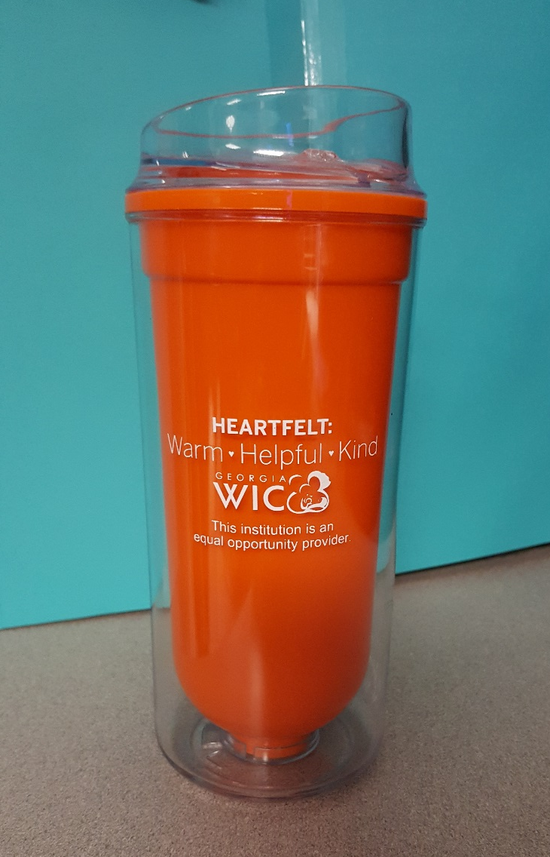
Heartfelt Service Lesson Plan
~30 minute interactive overview of Heartfelt service and tagline
Framed as a team discussion facilitated by supervisors
Learning objectives:
Describe the ways to provide Heartfelt service
Identify the connections between Georgia WIC performance standards to Heartfelt service
Upon completion, staff are provided promotional cups.
Notes:
Supervisors facilitate a discussion where staff identify what it means to provide excellent customer service, and provide specific examples of how they have/can do so. Then they connect those ideas to our performance standards and the tagline of being warm, helpful, and kind.
Full lesson plan will be made available on NWA Hub. Obviously it is specific to our objectives and our promotion, but the concept would work well for adaptation.
Improving supervisor skills while improving cs by allowing them to lead and engage with their staff.

Slide 33
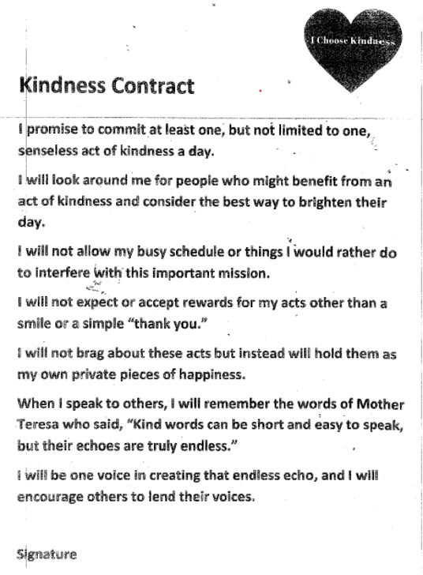
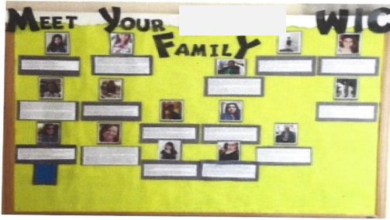
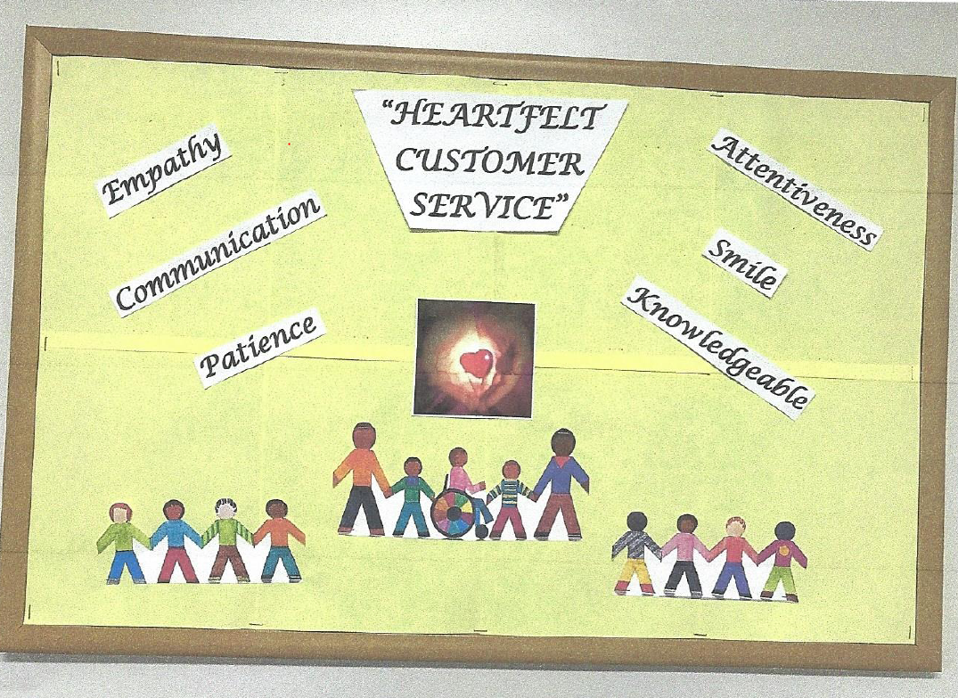
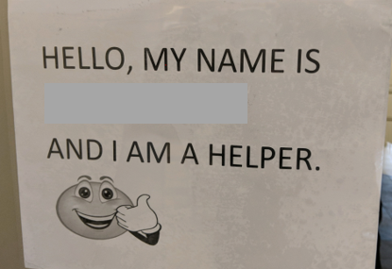
Heartfelt Service Lesson Plan (cont.)
Rather than completing a post-test, employees completing the training were asked to creatively show how they will commit to providing Heartfelt service.

Slide 34
Conclusion

Slide 35
Heartfelt Service is Warm, Helpful, and Kind
Despite many competing program priorities, Georgia WIC remains dedicated to devoting immediate attention to participant satisfaction. This will be achieved by:
Continuing to explore new ways to utilize participant-facing data for small and large-scale program improvements
Creatively designing and implementing resources to engage supervisors and staff
Encouraging and modeling high quality, Heartfelt service with internal and external customers

Slide 36
What Questions Do You Have?

Slide 37
Contact Information
Brandon Whitney, MPH, CPH
Manager of Planning & Strategic Partnerships
Georgia WIC Program
Phone: 404.657.9002
Email: Brandon.Whitney@dph.ga.gov
Coauthors
Sharon Joseph, MPA, CLC
Regional Advisor
Georgia WIC Program
Barbara Stahnke, MEd, RD, LD
Advisory Team Manager
Georgia WIC Program

Slide 38
THANK YOU!

