Slide 1
SNAP into WIC
NWA Conference - April 9, 2019

Slide 2
Overview
Context
Key Questions
Data Sharing & Match
Agency Selection & Training
Messaging
Key Findings
Agency Experience & Feedback
Lessons Learned and Opportunities
2
Notes:
Thank you to CBPP

Slide 3
Key Questions
How many pregnant women and children under 5 are enrolled in SNAP or Medicaid but not WIC?
What are effective methods of conducting targeted outreach to their families and enrolling them in WIC?
Specifically, how effective is a text message strategy and can it lead to a more streamlined enrollment process?
3
Notes:
While we are still evaluating results, once we took at enrollments in the control versus the intervention – we do not see a significant difference in enrollment outcomes.
We are awaiting further analysis on additional enrollment outcomes as well as data that will show us whether outreach impacted overall number of requests for appointments

Slide 4
Project Recap
Messages approved
May - June
July
October - December
January - March
Executed CDHS data share amendments
CDPHE-WIC unveiled new referral site!
Six agencies chosen
August - September
Executed WIC data share
Completed data match
Rolled out cloud-based tracking tool
Received SNAP file
Received WIC file
Sent first messages Sept. 10th
New data match to reduce number of Already Enrolled
Monthly dashboards reports begin
Begin evaluation
Replaced Prowers with Northeast
Complete non-responder outreach to initial pilot agencies on Dec. 10th
Completed Evaluation
National WIC Conference presentation, April 2019
BDT concluded follow up to WIC referral site
BDT provided CDPHE households needing follow up
BDT received final enrollment file
Agency training completed
GuardRails texting continued for new responders
Notes:
July
- Developed five outreach messages with additional guardrails texting for outreach responders
August
One-time SNAP enrollment file from CDHS received
BDT data match of SNAP to WIC data identifying eligible WIC households
Sept
- CDPHE conducted trainings with the selected agencies to ensure staff project knowledge, engagement tool use, and follow up process
Messages sent weekly over a course of 11-weeks for a total of 9-weeks of outreach
This outreach included follow up non-responder messages and guardrails to appointment scheduling to those that responded

Slide 5
Data matching is an effective tool to identify significant numbers of likely eligible but unenrolled WIC families
Cross matching WIC and SNAP identified at least:
20,191 families were eligible but not enrolled in WIC statewide
12,079 families were eligible but not enrolled in WIC in participating pilot agencies
5
Notes:
Data sharing logistics between agencies
Crossmatching outcomes, challenges, and results

Slide 6
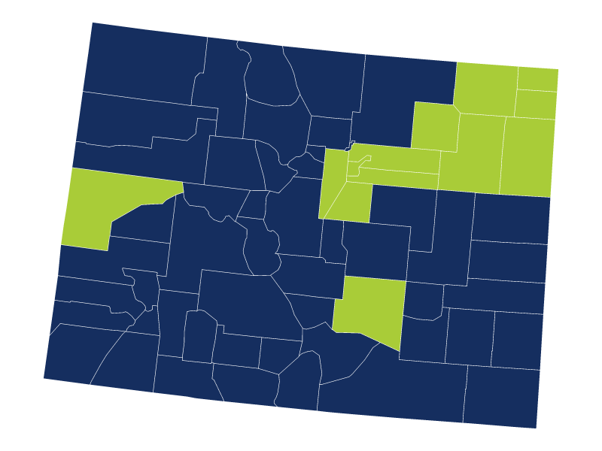
Local Agency Selection & Training
Six participating agencies:
2 Small Counties (1-2 Clinics)
2 Medium (3-5 Clinics)
2 Large (5+ Clinics)
Notes:
Erin to review agency selection, onboarding, and training process

Slide 7
Messaging

Slide 8
Texting is a viable mode of engaging people
8 in 10 WIC-eligible households have a mobile phone
1 in 5 households requested assistance or more information
4-day average response to text outreach compared to 6-weeks with traditional mail
Texting is cheaper than mail outreach
8

Slide 9
Crafted messages for SMS outreach
BDT and CDPHE used a range of approaches to inform clients of the advantages of WIC
Based on existing outreach experience and WIC marketing research
Emphasized behavioral economics principles of inclusive and positive support
Created four different messages on the advantages of WIC
9
Notes:
WIC marketing research demonstrates the WIC populations respond best to positive outcome framing without drawing attention to low-income status or other stressors

Slide 10
Message #1 Family Health
“Your family’s health is important!
WIC pays for health food and helps you find low-cost dentists, family doctors, and more.”
WIC is more than just food, participants can also receive additional healthcare support.
Additional Info message: “WIC provides breastfeeding help, healthy food and formula, and expert advice tailored for your family”
10
Notes:
Reply 1/YES- Request a WIC Call Reply 2 - More info Reply 3 - WIC is not for me Reply WIC - Already Enrolled STOP - Messages Stop/Unsubscribed

Slide 11
Message #2 Nutrition Support
“Dealing with a picky eater? WIC can help you find healthy choices that everyone loves!
Get free, personalized advice from WIC.”
Inclusive supports more than just formula, food needs, also supports all types of families
Additional info message: “WIC is for all families who care for infants and kids under 5 – married, single, grandparents, foster parents, migrant, refugee, working or not – including you”
11
Notes:
Reply 1/Yes - Request WIC Call Reply 2 - “I don’t think I qualify”/More info STOP - Messages Stop/Unsubscribed

Slide 12
Message #3 Monetary Value
“What could you do with an extra $50 for food this month? Let WIC free up your household’s budget!”
BDT utilized the behavioral economics concept of “Gain Framing” by including a dollar value for WIC
This message performed best among non-responders than any other messaging
12
Notes:
Average 2.6% for non-responders , $$ message 3.7%
Reply 1 - Request WIC Call Reply 2 - More Info Reply 3 - “I don’t think I qualify” STOP - Messages Stop/Unsubscribed

Slide 13
Message #4 Connection to SNAP
“Got SNAP? Get WIC too! WIC helps pay for food for families with a pregnant women or kids under 5. You could receive an extra $630/year for food!”
Making a connection to existing participation in benefits bridges the gap
Additional Info message: “If your family receives SNAP, you qualify for WIC”
13
Notes:
Reply 1 - Request a WIC call Reply 2 - More Info STOP - Messages Stop/Unsubscribed

Slide 14
Responses continue with iterative messages
Message | Households receiving a text | Engagement Count | Engagement Rate | Appointment Request | Appointment Conversion
1A (food + health) | 6,112 | 433 | 7.1% | 182 | 42.0%
1B (nutrition counseling) | 5,423 | 140 | 2.6% | 69 | 49.3%
1C (gain framing) | 5,089 | 188 | 3.7% | 99 | 52.7%
1D (SNAP connection) | 4,806 | 123 | 2.6% | 60 | 48.8%
The first outreach message achieved the highest engagement rate: 7.1%
Average 2.6% for non-responders , gain-framing message increased to 3.7%
14
Notes:
While engagement rates decreased with subsequent messages, clients continued to engage throughout all four weeks of texting

Slide 15
“Gain Framing” messaging increases
client response
“Gain Framing” = showing a dollar value for WIC
Messages frame targeted behavior; gain frame is associated with a benefit
15
Notes:
This message performed better with non-responders than other messaging
Allows the recipient to envision what they would do with an extra $50 instead of telling them what $50 could be used for

Slide 16
Key Findings

Slide 17
Individuals who engaged with text outreach enrolled at higher rates than those who did not
Non-responders enrolled at 5.2%
Households who responded, but did not request an appointment enrolled at 11%
While higher, only 23% of households who requested an interview enrolled
17

Slide 18
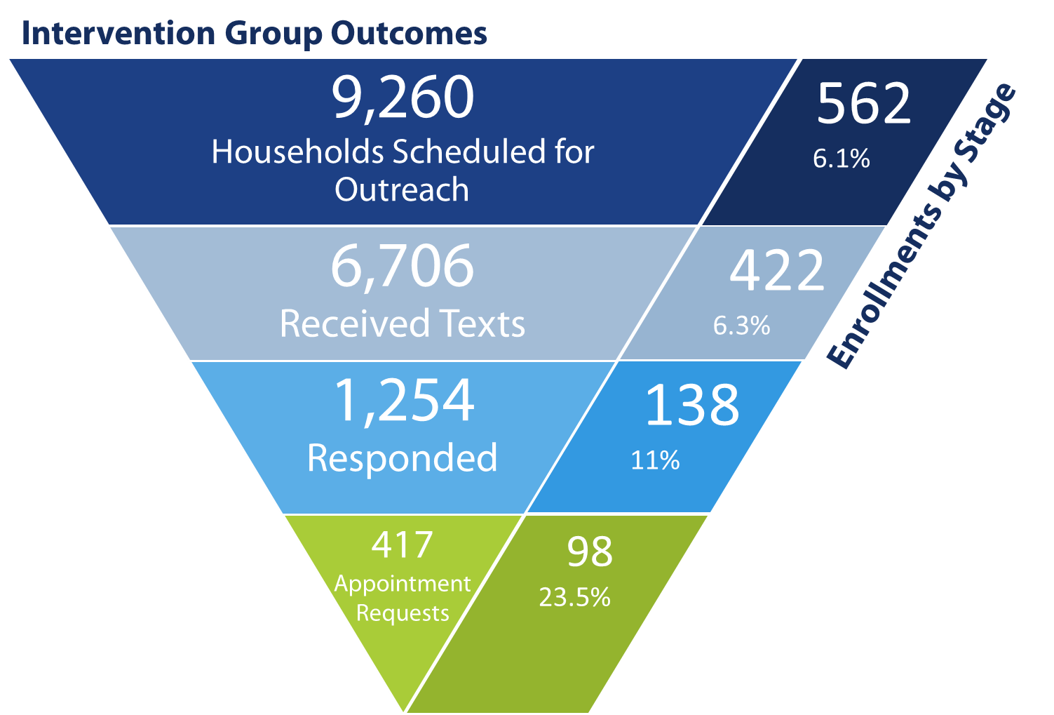
No significant difference in enrollment between control (6.3%) and intervention (6.1%)
18
Notes:
We were surprised that at this point in time, once we took at enrollments in the control versus the intervention – we do not see a significant difference in enrollment outcomes.
We are awaiting further analysis on additional enrollment outcomes as well as data that will show us whether outreach impacted overall number of requests for appointments

Slide 19
Drop-off between requesting an appointment and enrolling in WIC
About 1 in 4 households requesting an appointment enrolled in WIC
Local agency “Best Practices” may differ across agencies
Ability to reach the client after appointment requests declines over time
The drop off from appointment request to completing an appointment is significant in multiple settings
19
Notes:
It is possible that as more time passes, more households will successfully enroll in WIC from the intervention
ERIN to discuss policy to f/u with 10 calendar days but sooner is best practice? Turnaround time wasn't evaluated but would've been beneficial to do so to see if drop off rate increased if LA contact > a certain # of days.

Slide 20
Enrollment results varied across agencies
The overall conversion rate from appointment request to enrollment is 23.5%
But this masks the varied rates across agencies from 6.7% to 28.6% (with an outlier at 66.7%)
20
Notes:
Additional analysis, detailed data, and larger samples sizes would be required to identify the driving factors for the variation

Slide 21
Activity by Local WIC Agency
 | Large |  | Medium |  | Small
 | Denver | Tri- County | Mesa | Pueblo | Jefferson | Northeast
Receiving texts | 1,768 | 3,438 | 434 | 726 | 268 | 72
Responding to texts | 312 | 656 | 81 | 138 | 53 | 14
Requesting appointments | 104 | 243 | 15 | 35 | 17 | 3
% responding to texts | 17.6% | 19.1% | 18.7% | 19.0% | 19.8% | 19.4%
% responders requesting appointments | 33.3% | 37.0% | 18.5% | 25.4% | 32.1% | 21.4%
% appointment requesters enrolled | 19.2% | 25.1% | 6.7% | 28.6% | 23.5% | 66.7%
Enrollments (of appointment requesters) | 20 | 61 | 1 | 10 | 4 | 2
21

Slide 22
Agency Experience & Feedback
Surveyed 10 local agency staff and 1 Director
WIC Director:
Pilot was relatively simple
Had low impact on daily workload
Agency Staff:
Mostly agreed pilot was easy to integrate into operations
Some reported that the pilot somewhat impacted their workload
Survey Question / Statement | Clinic Staff | WIC Director
The SNAP Referrals Inbox designed for the WIC texting pilot was easy to use. | 2 Agreed 2 Mostly Agreed 5 Responded Neutral 1 Disagreed | Agreed
I received adequate training on how to use the SNAP Referrals Inbox. | 6 Agreed 2 Mostly Agreed 1 Responded Neutral 0 Disagreed | Agreed
My daily workload was impacted by this pilot | 4 Responded 'Somewhat' 6 Responded 'Very little.' 0 Responded 'A lot.' | 'Very little.'
It was easy to integrate this pilot into daily operations. | 5 Agreed 4 Responded Neutral 1 Slightly Disagreed | Mostly Agreed
I believe using texting for outreach improved access to WIC for households that participated in the pilot. | 5 Agreed 1 Mostly Agreed 4 Responded Neutral 0 Disagreed | Agreed
22
Notes:
Erin to provide details on overall agency experience

Slide 23
Lessons Learned & Opportunities
Need more data to understand why certification is not complete
Explore alternative calls to action
Link directly to the referral website
Schedule appointments online
Provide more support for families ("Guardrails" texting)
Focus on opportunities to streamline the process
Scripting for adjunctively eligible clients
23
Notes:
1) Collect more comprehensive data, including:
Date of enrollment – Did texting help people enroll in WIC faster? How many individuals who enrolled through the pilot were previously enrolled?
Why wasn’t certification completed? –Were people ineligible or didn’t show up or struggling to complete steps?
Appointment scheduled and completed dates – How did the ability to complete steps vary for people who scheduled appointments vs. walk-ins vs. online referrals?
2) Explore alternative calls to action such as providing a link to schedule an appointment on line, providing a link to a web site that results in receive a call to schedule an appointment, or offering the option to walk in (and provide the address of the closest site)
Track progress by local WIC agency during the pilot and provide more support, if needed.
Provide more support for families during the enrollment process (“guardrails” texting with tailored messages)
Focus on opportunities to streamline the process to reduce barriers (e.g., making sure local agencies are aware these families are adjunctively eligible and scripting)

Slide 24
Contact Information
Erin Kendrick
Nutrition Consultant, Colorado WIC Program
Erin.Kendrick@state.co.us
Heather Benninghoven
Colorado Program Coordinator, BDT
hbenninghoven@bdtrust.org

