Slide 1




SNAP into WIC;
Using Program Coordination, Data, and Technology for Targeted Recruitment and Retention
National WIC Association
2019 Annual Education and Training Conference
Tuesday, April 9, 2019

Slide 2
SNAP into WIC
Using Program Coordination, Data, and Technology for Targeted Recruitment and Retention
A successful partnership: NH Easy & NH WIC Program
Notes:
Intro/welcome to project

Slide 3
Why now?
NH has seen a steady decline
2012 New Hampshire was serving 16,299 participants.
2016 caseload was down to 14,121 and was continuing to decline.
Notes:
Where we were when we attempted this data sharing agreement. Set up the story and actions that needed to happen.
Data Sharing agreement work in silo.
NH EASY dashboard workgroup.

Slide 4
How did we get here?
Stakeholder Meeting
Share Results
Data Sharing Agreement
Creative Design Meeting
User Acceptance Testing
Deployment
Collect Data
Continuous QI
Policy
Monitoring tools
Identify the Goal
Internal work group Formed
Training & Manual
Weekly Challenges
Notes:
Walk through the process. PDSA cycles within some of these steps.

Slide 5
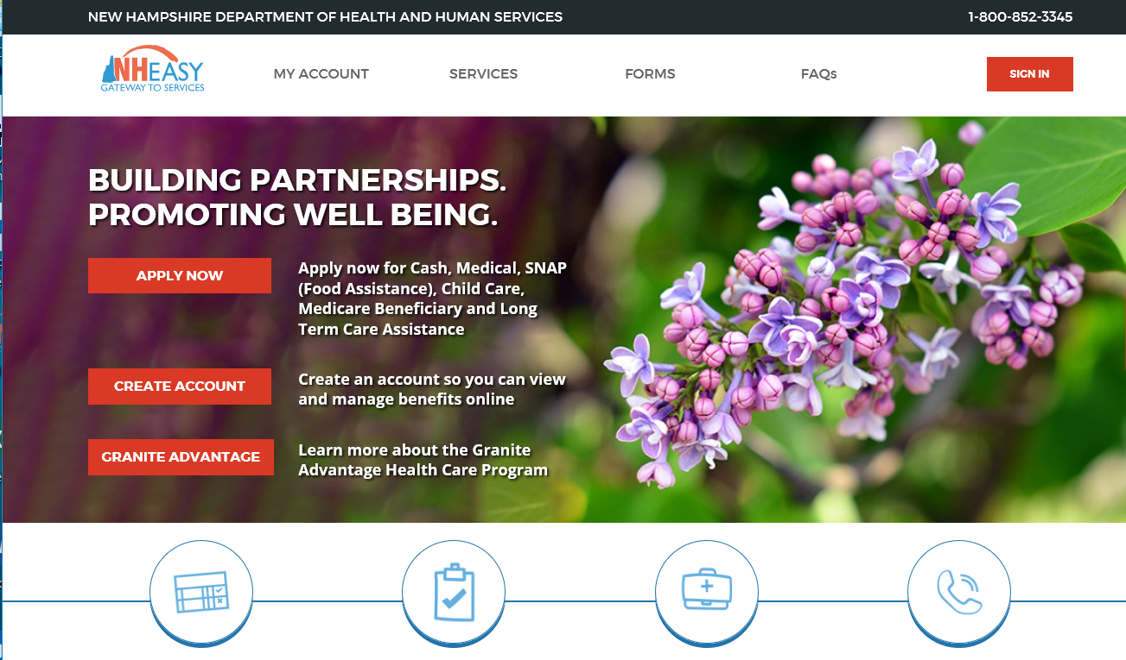
A shared tool: DPHS & DFA
Notes:
The tool. NH WIC did not have to pay.

Slide 6
WIC Dashboard
Notes:
Peak into the dashboard

Slide 7
Peak into the Dashboard

Slide 8
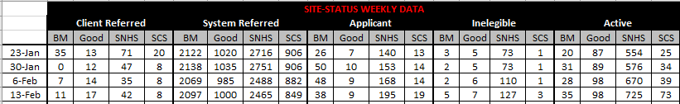
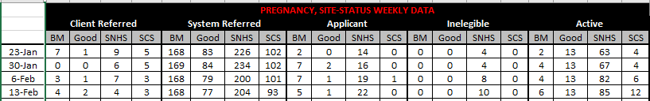
More than 10,000 Households
Notes:
Initial data dump was huge.

Slide 9
Ongoing Improvement Cycles
Roll out
Revised Status labels-1
Revised Status Labels-2
Manual & Training Revision
Changed timeline for data collection
Notes:
Lissa- last slide
Got QI on board. Knew we needed a plan to tackle this work and show improvement with data.
Did not have a clear plan to measure the success.
Knew there was potential in the data.

Slide 10
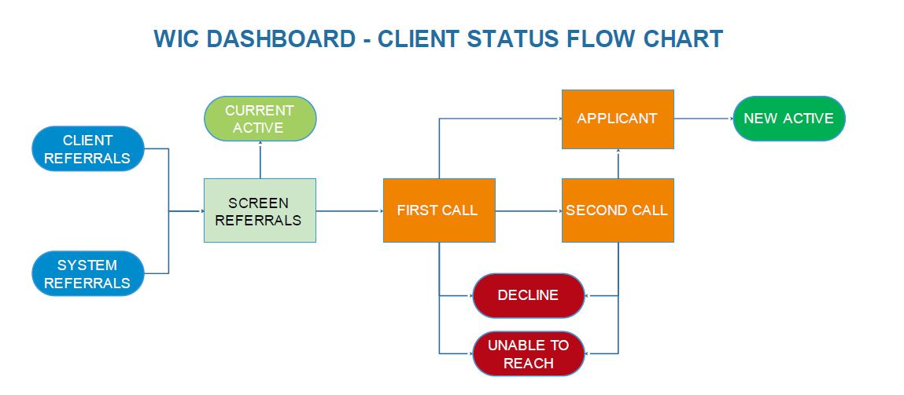
Client Status Flow Chart
3
8
9
1
4
7
2
5
6
Notes:
Tara- the flow used in the dashboard
Staff are always directed to work with “Client Referrals” first. They requested.
1st screen if family is on WIC already. No = First Call Yes = Current Active
2nd Make 1st call – move to decline, unable to reach, 2nd call, or applicant
3rd follow-up on 2nd calls. Move to applicant or unable to reach.
4th Review applicant status and move to new active or follow-up on missed appointment.

Slide 11
Weekly Challenges
SCS – Great job, you essentially met your target in decreasing the number of pregnant system referrals from 65 to 2!
This effort looks like it netted you 7 additional WIC applicants!
Your weekly challenge: by November 6, decrease the number of System Referrals from 355 to 200 (remembering that about half will be “current actives”).
Focus on processing the newest referrals. This will load up your 1st call bucket and prime you for engaging viable referrals next week!
Notes:
Example of a weekly challenge email.
You make SMART objectives/goals for them so they can see the improvement each week with data.
Clear!! Be their cheerleader.
We have recently moved to saying if they are currently in “Maintenance mode” which means they are staying current with all required work.

Slide 12
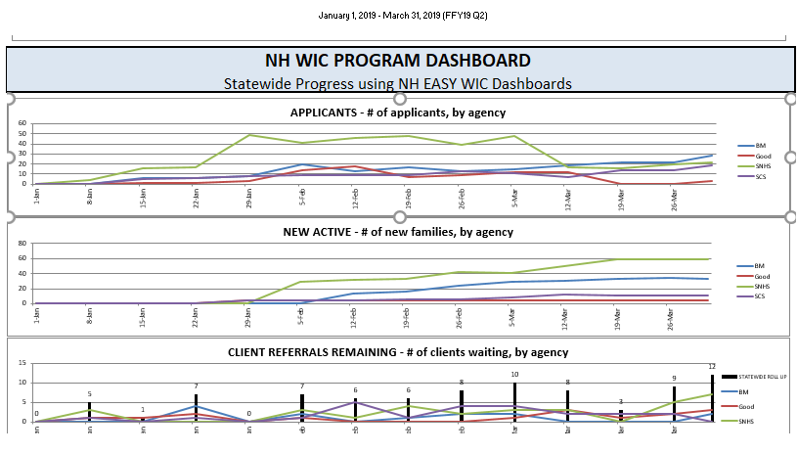
Weekly Updates
Notes:
Talk through the charts.
Applicants – By Agency – We like to see the line stay level. A jump means staff are not going back to update status.
New Active – We want to see the line continue to increase. It should be a slow steady increase to show weekly work.
Client Referrals Remaining – This should always be as close to zero as possible – The bold black bars show the State Total.
These graphs are also provided on a local agency level.
As staff have to open the attachment in the weekly updates sent, I like to pick one chart (sometime Statewide sometime local agency) that I highlight in the text of the email.

Slide 13
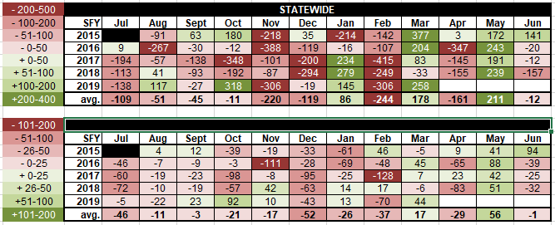
Heat Map
Notes:
Heat map!
This map quickly shows us trends in monthly caseload changes and looks back at previous years.
Top chart is Statewide and bottom one is a local agency.
Want to see less bold red and more green.
Shows Feb is always a typical lost month for us.
Our goal is to have no medium or bold red in the future.

Slide 14
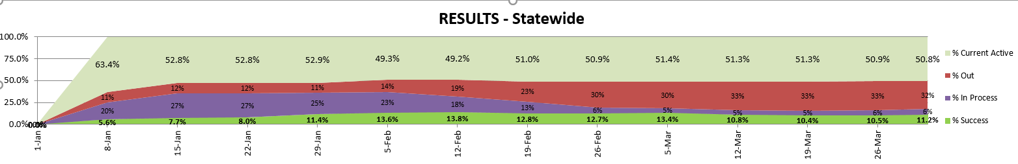
Eligible Pool of Applicants
Data through March 31, 2019
Notes:
Quickly shows us:
% of families already on WIC – Top section – around 50%
% of families declined or unable to reach – rust coler – 11-30% at any given time
% of families in process (still in 1st or 2nd call status) – purple status – 5-27% - We don’t like to see this too high – 5% is good
% of families success (applicants and new active) – bright green
We focus on the purple and green areas to ensure clients are being followed up on in a time manner and track our success rate.

Slide 15
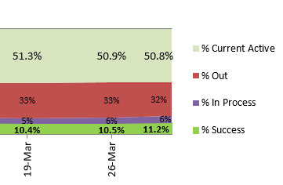
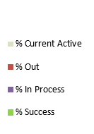
Gaining Caseload
We are currently seeing a success rate of 11.2% of our referrals.
Notes:
Output.
Always looking at the neon green level.
With 2019 we moved to quarterly reporting.
During the end of the last quarter you can see we were doing a great job maintaining statewide.

Slide 16
Why focus on families with pregnant woman first?
Notes:
Greater success in the pregnant population compared to total households.
Rates at local agency levels had a 1-18% difference in success rates.

Slide 17
It’s Working!
Notes:
Year to Year participation trend…we have lessen the decline

Slide 18
NH compared to National Data
Notes:
The win is in 2018. That is the year we were actively using the dashboard with weekly challenges and monitoring activities.

Slide 19
NH compared to National Data
Notes:
Tara- last slide
Cumulative decrease over the years. NH is pulling away from the national trend.
Over the last 4 years we typically saw the same trend the Nation did.
In 2018 we finally broke away from that National trend.

Slide 20
Lessons Learned
Communicate, communicate, communicate
Gain buy-in early
Workgroups
Continuous Improvement
Process for sustainability
Leverage IT
Share small wins
Explore other opportunities where same framework can be repeated
Be patient
Notes:
Lissa- share that we are happy to send any documents, templates to other states.

Slide 21
Questions and Contact Information
NH Dept of Health and Human Services, Nutrition Services Section
Lissa Sirois, RD, IBCLC
Administrator
603-271-0571
Lissa.Sirois@dhhs.nh.gov
Tara Orchard
MIS Program Specialist
603-271-4239
Tara.Orchard@dhhs.nh.gov

