Slide 1
Integrating Opioid And Other Substance Misuse Interventions in Non-Traditional Settings
National WIC Association Annual Conference
April 2019

Slide 2
Acknowledgements
This project was made possible by St. David’s Foundation’s Focus on the Fourth initiative to improve postpartum access and outcomes for low-income and underserved women in Central Texas.
The project is a collaborative effort between Cardea and Altarum.

Slide 3
Myth or Reality
People addicted to drugs can stop using if their willpower is strong enough.
Myth!
The National Institute on Drug Abuse (NIDA) defines addiction as an enduring condition that triggers the user to compulsively search out and use substances. This compulsive search will often continue no matter the consequences.
The physical power of addiction also means that the person’s body now requires the substance to function normally. If the person does not use the substance, they will experience physical and mental distress.

Slide 4
Myth or Reality
A person can become addicted to a prescription medication.
Reality!
While many people assume that if your doctor prescribes you a medication, it is completely safe and non-addictive, this is not true.
People can misuse and become addicted to medications such as opioids, benzodiazepines, sleep aids, and stimulants.

Slide 5
Myth or Reality
If a person can go to work or school and take care of their family, then they do not have a substance use disorder.
Myth!
SUD does not look the same in every one and can progress at different rates among different people.
Many people dealing with a SUD are able to hold down jobs and continue to function normally, at least for a period of time.

Slide 6
Myth or Reality
All forms of substance use tend to decrease among women during pregnancy and during the first year of a baby’s life.
Myth and Reality!
While it’s true that women are motivated and are successful at decreasing substance use during pregnancy, a significant number of women relapse and return to substance use during the first year of the baby’s life, defined as the postpartum period.
The first year after delivery is stressful; with stress being a known relapse risk factor, women are at increased risk of relapse and overdose at that time.

Slide 7
Opioids and the Epidemic

Slide 8
What are Opioids?
Opioids are a class of natural, synthetic, and semi-synthetic drugs that interact with opioid receptors on nerve cells in the body and brain to relieve pain.
Opioids Include:
Heroin
Synthetic opioids such as fentanyl
Pain relievers available by prescription such as:
Oxycodone (OxyContin, Percocet)
Hydrocodone (Vicodin)
Codeine
Morphine

Slide 9
In 2016, 116 people died every day from opioid-related drug overdoses and 11.5 million people misused opioids.
2.1 million people misused opioids for the first time, with more than 17,000 dying from commonly prescribed opioids.

Slide 10
Opioids and Women

Slide 11
Women and the Opioid Epidemic
Women are more likely than men to experience chronic pain and use prescription opioid pain medications for longer periods and in higher doses.
Women are experiencing increases of use and overdose from opioids at a faster rate than men.
Women who enter treatment for substance use disorder routinely arrive with medical, behavioral, psychological and social problems that can be as complex and debilitating as the addiction itself.

Slide 12
Women and the Opioid Epidemic
Risk Factors
Consequences of Addiction
Relationships
Trauma/Adverse experiences
Concurrent disorders
Geography
Socioeconomic status
Recent incarceration
Stressful interpersonal events
Unique concerns related to pregnancy
Societal stigma
Caregiver role
Biological Affects
Menstrual irregularities
Subfertility/infertility
Premature menopause
Sources: Powis 1996; SAMHSA TIP 51; Finnegan 2013; Greenfield 2009; OWH 2017

Slide 13
Opioids & Women: Reproductive Health

Slide 14
Reproductive Health Outcomes
Lower rates of:
Contraceptive use, especially more effective methods
Cervical cancer screening
Higher rates of:
Unintended pregnancy
Lifetime prevalence of abortion
STIs, especially HIV and HCV
Adverse perinatal outcomes
Gender-based violence
Sex work

Slide 15
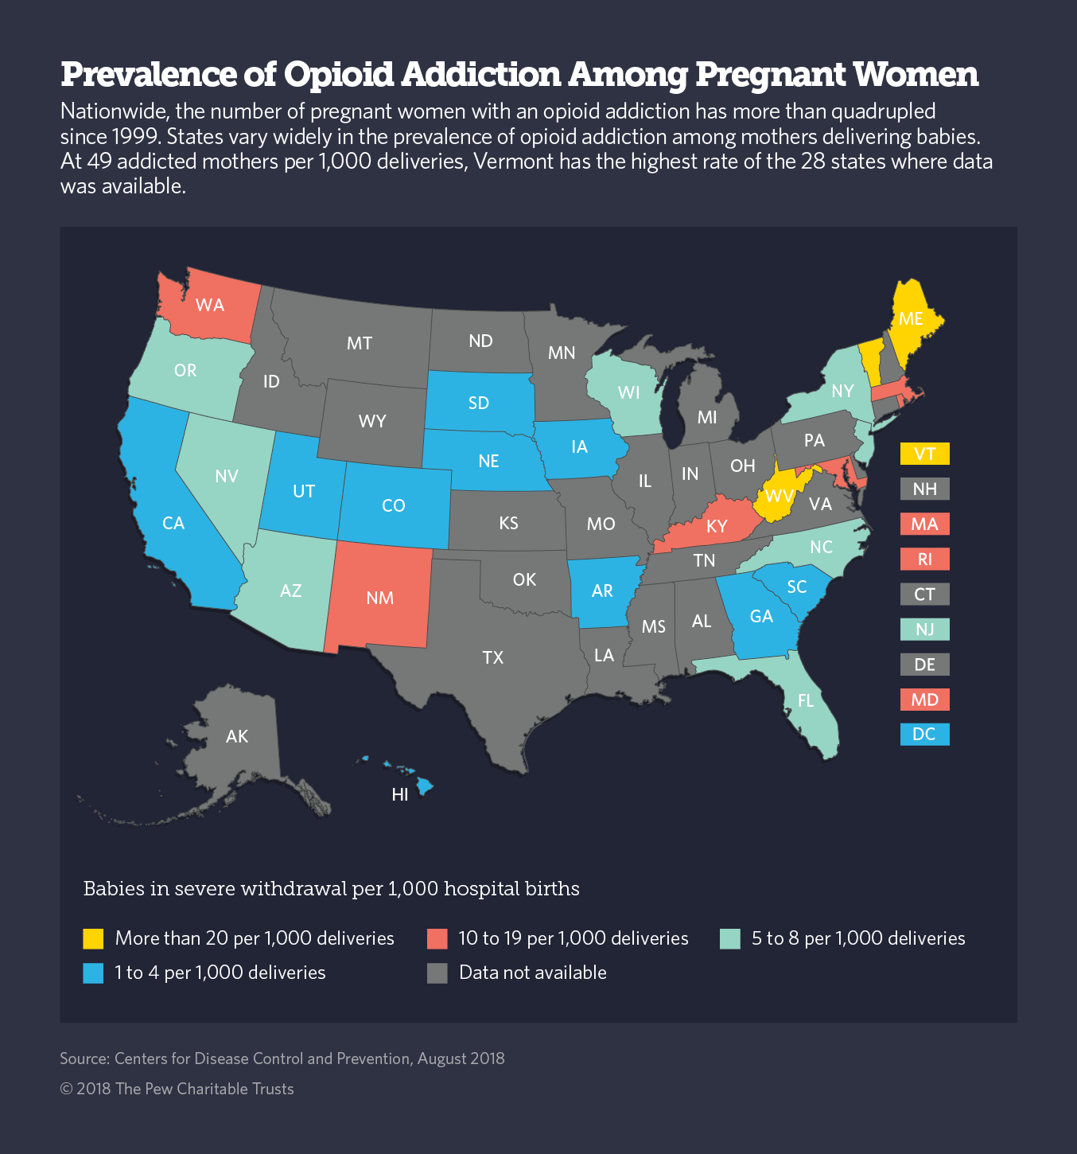
Snapshot of Opioid Addiction Among Pregnant Women
The number of women with Opioid Use Disorder at labor and delivery quadrupled from 1999-2014.
Highest rates of babies born in severe withdrawal are seen in Maine, Vermont, and West Virginia, but 22 states have no data.

Slide 16
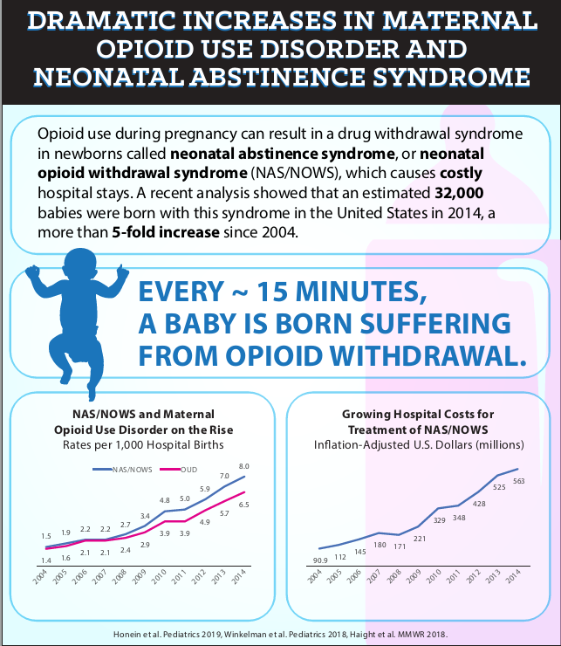
Neonatal Abstinence Syndrome (NAS)
Neonatal Opioid Withdrawal Syndrome (NOWS)

Slide 17
MAT is Recommended and Effective during Pregnancy and Breastfeeding!
Medication Assisted Treatment or MAT is the use of medications such as Methadone, Buprenorphine or Naltrexone, in combination with counseling and behavioral therapies, to provide a “whole-patient” approach to the treatment of substance use disorders.
MAT during pregnancy can prevent maternal (and fetal) withdrawal and improve pregnancy outcomes.
For breastfeeding moms, MAT can benefit both the mother and the baby, including with Neonatal Abstinence Syndrome.

Slide 18
Our Project: Addressing Post-Partum Opioid Misuse through an Integrated Approach
The purpose of our project was to enhance the capacity of WIC and community health clinics to screen and refer women in the post-partum period to needed recovery support services.

Slide 19
Why WIC?
Trusted location for pregnant women and women who are breastfeeding
Non-judgmental, compassionate, and supportive
An ideal environment for screening, education and referral

Slide 20
Our WIC Training Objectives
Understand the basics about opioids, addiction, and impacts on women and babies
Build upon WIC’s current assessment to identify additional opportunities for identifying potential opioid/substance use or misuse
Identify strategies for initiating conversations regarding substance use or misuse
Enhance motivational interviewing techniques through the use of role plays
Understand how and when to make a referral for further assessment

Slide 21
The Role of WIC in Substance Use Disorders
Screening
Referral
Diagnosing
Counseling

Slide 22
Understanding Bias
Bias is the negative evaluation of one group and its members relative to another. It can be implicit or explicit.
The first step to understanding your own biases is to notice your observations and recognize ways in which you might be stereotyping.
As care providers, it is also critical to acknowledge that stigma exists for our clients, especially those dealing with substance use disorders.

Slide 23
Signs and symptoms of SUD can mirror other health conditions With additional conversation, opportunities exist to recognize where a substance use challenge may be present The current WIC assessment can serve as a starting point for conversation
Job Aid: Using The Current WIC Assessment to Create Opportunities for Conversation

Slide 24
Five Basic Motivational Interviewing Skills
Ask Open Ended Questions
Practice Reflective Listening
Encourage Self-Motivational Statements
Affirm
Summarize Statements
Tell me a bit about…
What do you know about….
What happens when…
It sounds like…
It seems as if….
What I hear you saying…
Its clear that you are trying to…
It sounds like you have made real progress in…
By sharing, it appears that you are ready to…
You showed a lot of strength by….
You demonstrated a lot of courage by…
Your coming back today reflects….
It sounds like you are concerned about….because it is..
You mentioned a number of things about your current lifestyle…
You spoke of….

Slide 25
Implementing a Referral Pathway
“You mentioned during our time together today that you’ve been taking _________. How does this (medication, substance) make you feel?”
Build additional rapport to discuss the issue
“Based on responses to some of the screening questions, I am concerned about you and your health. For example, you shared _______”
“Has anyone else among your family or friends expressed a similar concern?”
Show authentic concern

Slide 26
Implementing a Referral Pathway
“If you are concerned about your (medication, substance use) I am here to help connect you to supportive resources.”
“If you do not have any concerns about your (medication or substance use), perhaps we can connect you to a resource to discuss ways to lesson the possible future impact of use on your health.”
Reassure Support
Provide Resources or connect directly (e.g., warm hand-off)
“We do no need to get into any additional specifics today. May I provide you with a list of resources that will help you determine the best next steps for you?”

Slide 27
Role Plays

Slide 28
Please rate your ability to discuss the relevance and unique nature of opioid use and misuse among post-partum women before and after the training
After the training, 88% of participants rated their ability to discuss post-partum drug use as good, very good or excellent compared to only 39% before the training.

Slide 29
Please rate your ability to list common barriers women face on their journey to recovery before and after the training.
After the training, 100% of participants rated their ability to discuss barriers for women and recovery as good, very good or excellent compared to only 61% before the training.

Slide 30
Feedback from our WIC Training
The majority (89%) of participants at WIC trainings indicated that they intend to change practices as a result of this training.
- "I will remember that anyone can be subject to opioid abuse and to treat all patients equally."
- "Approach the question of drug use no longer always expecting a "no"."
- "I'll approach the question about drug use with a preface regarding no judgment."
- "Be more sensitive and empathize with the clients more so than before."
- "Ask open ended questions."
- "Ask questions in a different manner to help clients feel more comfortable with opening up regarding resources needed.“
- "We will now have the ability to refer to various agencies to better serve our clients."

Slide 31
Contact Information
Jennifer Rogers, MPH
Project Director
Center for Healthy Women and Children
Altarum
jennifer.rogers@altarum.org
Denise Raybon, MPH
Senior Specialist
Center for Healthy Women and Children
Altarum
denise.raybon@Altarum.org
Melanie Ogleton, MHSA, MPH
Chief Strategy Officer
Cardea
mogleton@cardeaservices.org

