Slide 1
Relationship Building to Increase Referrals & Caseload
Community Partnerships
Amber France MS MPH IBCLC Julie Lothamer MS RD IBCLC

Slide 2
Importance of Relationship Building

Slide 3
State Relationships & Communication
Notes:
State, Hospital, WIC, Home Visiting

Slide 4
Develop & Strengthen Local Community Relationships
Notes:
State, Hospital, WIC, Home Visiting

Slide 7
Building Connections

Slide 8
Collaboration, Communication, & Connections

Slide 10
Project Goals
Prepare
Preparing pregnant women to make an informed decision on feeding choice and to experience the evidence-based practices in the hospital, using consistent messaging

Slide 11
Project Goals
Care
Implement evidence-based maternity care practices in the hospital

Slide 12
Project Goals
Support
Increase awareness & utilization of community breastfeeding support services early in pregnancy and after discharge

Slide 13
Local Coordination

Slide 14
Coordinate. Coordinate. Coordinate.

Slide 15
Relationship Building at the Local Level

Slide 16
Relationship building can be difficult!

Slide 19
8 Key Local Stakeholders
WIC Hospital Hospital Community Benefits Home Visiting Prenatal Clinics Local Health Department Local Coalition Community Groups

Slide 20
Hospital Webinar + Survey

Slide 21
Data Collection
Motivation Perception Existing Communication Pathways Status Quo Capacity Interest

Slide 22
Survey Approach: Driving to Action
Status Quo
Interest
Action
Notes:
State, Hospital, WIC, Home Visiting

Slide 23
Survey Approach: Driving to Action
Status Quo
Interest
Action
Understand existing practices, knowledge & relationships
Notes:
State, Hospital, WIC, Home Visiting

Slide 24
Survey Approach: Driving to Action
Status Quo
Interest
Action
Understand interest in improving practices, knowledge & relationships
Notes:
State, Hospital, WIC, Home Visiting

Slide 25
Survey Approach: Driving to Action
Status Quo
Interest
Action
Provide concrete next steps & associated tools to turn interest into action
Notes:
State, Hospital, WIC, Home Visiting

Slide 27
Chapter Report Presentations!

Slide 28
Checklist of Actionable Steps

Slide 29
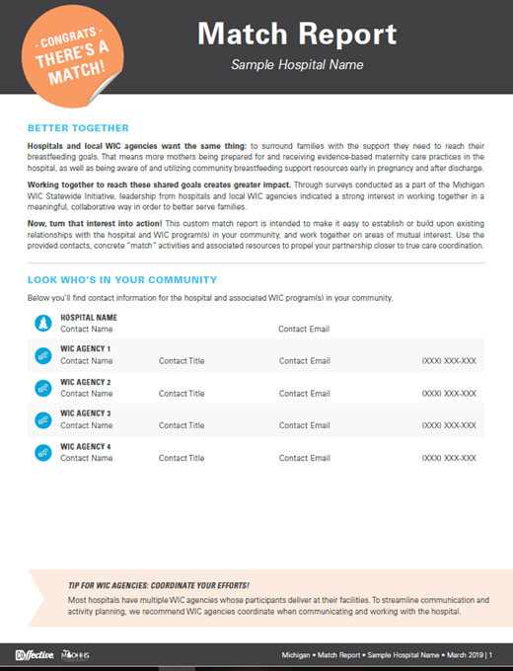
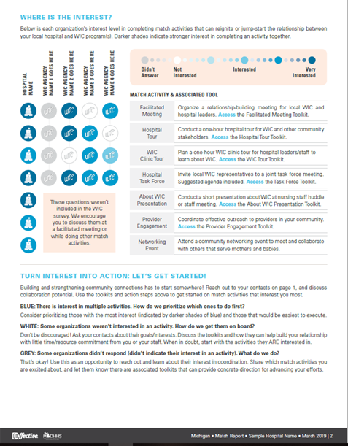
Community Match Report

Slide 30
Tools to Execute

Slide 31
Michigan Success & Lessons Learned

Slide 32
Opportunity Today!

