Slide 1
Registered Dietitians in Georgia WIC: Workforce Development through a Nationally Accredited Competency Based Supervised Practice Program
DPH WIC Dietetic Internship
National WIC Association/Rhonda Tankersley/April 10, 2019
Notes:
DPH WIC Dietetic Internship Program: Workforce Development through a Nationally Accredited Competency Based Supervised Practice Program for Qualified Georgia WIC Employees to Obtain the Registered Dietitian Credential

Slide 2
Objectives
Identify Department of Public Health (DPH) WIC Dietetic Internship Program role in recruitment of Nutritionists in the Georgia WIC Program
Identify DPH WIC Dietetic Internship Program role in development of the Georgia WIC Registered Dietitian workforce
Identify process and outcomes in DPH WIC Dietetic Internship Program quality improvement

Slide 3
History and Mission

Slide 4
Background
Established in 1992
Pathway to the Registered Dietitian credential
- Community Nutrition Concentration
Accredited by the Accreditation Council on Education in Nutrition and Dietetics (ACEND)
Ten (10) Standards of Accreditation
Self-Study
Site Visit
Notes:
The 2017 accreditation report cites “strong emphasis and dedication to the community nutrition concentration.”
Interns gain competence in community nutrition through activities and experience beyond their usual work in WIC.

Slide 5
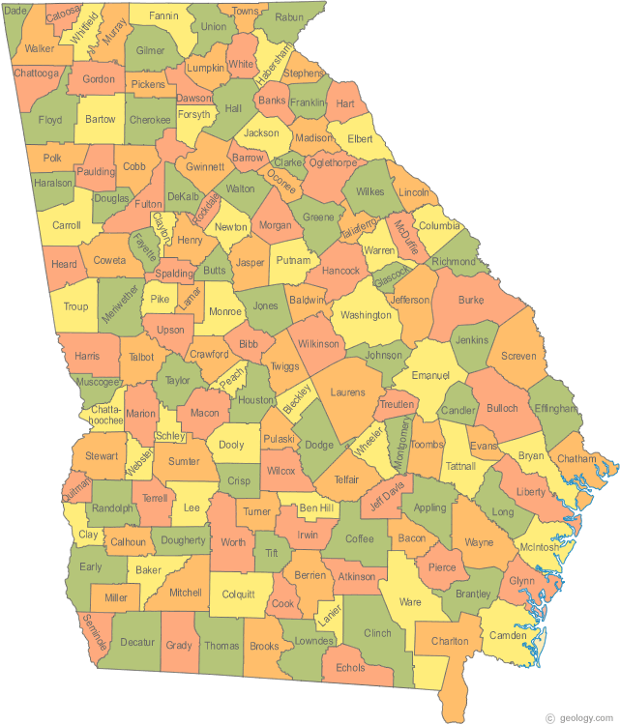
Importance
Lack of Dietitians in Georgia
Currently 2,569 active licenses
< 4% of these employed in Georgia WIC
Difficulty recruiting Dietitians in rural Georgia WIC programs
Notes:
4 % Based on survey of districts ending June 2017.
A survey of GA WIC NSD’s in 2016 revealed the top reasons nutrition positions are not filled in GA WIC – lack of qualified applicants in the area, position not in a desirable location. The internship provides these districts with a means to attract qualified entry level nutritionists applicants and then grow their own base of RD’s via internship participation.

Slide 6
Mission
“To improve the health outcomes of Georgians through promotion of quality nutrition care practice by assisting qualified employees of the Georgia Department of Public Health’s Women, Infants, and Children’s Special Supplemental Nutrition Program (WIC) to become Registered Dietitians competent to practice at entry level.”

Slide 7
Program Philosophy
Staff of the Georgia Department of Public Health WIC Program and participating Health Districts are committed to assisting those interns/employees who wish to overcome financial, geographical, or personal barriers to verify their professional competence through the Academy of Nutrition and Dietetics (AND) credentialing process.
Notes:
Barriers
Access – 50% of applicants get matched (citation needed)
Geographic
Financial
Cost of internship tuition
Unpaid internship
Program Strengths
Strengths:
The program is fortunate to have the availability of substantial resources to forward the mission. Interns are not charged tuition and receive their full-time pay and benefits while completing the program during which they are granted 24 hours per week for internship practice and work their respective jobs in local WIC clinics for 16 hours per week. Additionally, districts of participating interns are allocated $25,000 per intern to secure temporary part-time staff in the absence of the intern or to cover other internship related expenses as the district deems appropriate.
In addition to financial resources, the program has active and engaged stakeholders including district WIC Nutrition Services Directors, state WIC staff, Advisory Board members, and preceptors. The Advisory Board meets two times per year at which time program goal and objective outcomes are reviewed, discussed, and decisions made for on-going improvement. Feedback is sought from and given by preceptors on an annual basis. Additionally, preceptors have volunteered to help with preparation for the Registered Dietitian (RD) exam, and introductory sessions to food service and clinical practice areas.

Slide 8
Program Goals and Objectives

Slide 9
Program Goal 1 and Objectives
The DPH WIC Dietetic Internship Program will prepare graduates to be competent at an entry level through high quality educational offerings.
Over a five (5) year period:
80% of graduates will pass the CDR registration examination within one (1) year of the first attempt
100% of graduates will take the CDR credentialing exam for Dietitian/Nutritionist within 12 months of program completion
80% of employers will rate graduates as competent at entry level

Slide 10
Program Goal 2 and Objectives
The DPH WIC Dietetic Internship Program will attract and retain well qualified candidates.
Over a five (5) year period:
90% of the interns will complete the program in 18 months or 150% time planned for completion
90% of graduates will be employed in Nutrition and Dietetics or related fields within 12 months of graduation

Slide 11
Program Goal 3 and Objectives
The DPH WIC Dietetic Internship Program will prepare graduates who will continue to practice in Community Nutrition Care Services in Georgia after program completion.
Over a five (5) year period:
80% of program graduates will indicate working / volunteering in DPH nutrition two (2) years after program completion

Slide 12
Program Assessment and Improvement

Slide 13
Challenges
2012 Probationary accreditation status issued
Administration turnover
Admission policies and procedures
Registered Dietitian Exam preparation and pass rate
Lack of practice sites and preceptors
Program on-going evaluation and improvement
Notes:
2011-12 cohort accepted (16 and 1 alternate); PD retired and program was “put on hold” – lead to not meeting accreditation standard (150% time from acceptance to completion required).
Other deficiencies cited were pass rate and ongoing evaluation and program improvement
Issues identified – 5 PDs in 5 years (high turnover), lack of stringent admission policies (i.e. everyone applying meeting minimum requirements = accepted), continually low RD pass rate, lack of practice sites (lost due to poor intern/program performance), lack of data collection, assessment, and utilization.

Slide 14
Solutions
Start with standards in mind
Resources
Policy and Procedure
Curriculum
Evaluation
Partnership
Marketing

Slide 15
Resources
Administration
Funding for Full-time Program Director
Allocation to districts
Advisory Board
Expert training to interns
Notes:
Administration
The program has access to legal consultation via full-time attorneys employed by the Georgia WIC program. Annual review and revision of the program handbook as well as the intern contract provide continued improvement and structure to the program. This has also allowed for affiliate expansion through timely review and approval of memorandums of agreement
PD Funding – 1 FT staff dedicated to internship (had Program Coordinator)
District Allocations -$25,000 per intern to districts in addition to intern full salary and benefits paid for internship duration.
Advisory Board – engaged and active (represented program graduate, food service, clinical, and community RDs)
Training and resources to interns
CHOA 3 day, NCM, NFPA, RD Review Course x 2

Slide 16
Policy and Procedure
Application and Admission
Points system
Performance evaluation
Personal statement
Project
Interview
Contract
Notes:
Current full-time status as a DPH employee in the WIC Program with at least one Full-Time Equivalent (FTE) year of working experience. (The one-year period is from hire date to internship application date).
o Although the requirement for a one-year FTE work experience in the WIC program lengthens the period of time from undergraduate to supervised practice, it is considered to be a more positive influence on pass rate. There are some who come to WIC and the DI due to financial constraints that prevent them from going to other internships and there are some who do not match to other programs. As such, the DI provides an option for supervised practice to many with varying degrees of academic achievement.
o WIC provides Didactic Program Dietetics (DPD) graduates the opportunity to apply knowledge in practice through job duties, such as nutrition screening, basic nutrition assessment, nutrition counseling using motivational interviewing techniques and provision of nutrition education. Additionally, DPD graduates have the opportunity for further maturity, development of communication skills, interdisciplinary care (nurses, physicians, dietitians and others), and self-reflection and assessment to guide them in career decisions, such as entering into supervised practice via internship. It is of note that several preceptors have commented specifically on the ability of Interns from this program to interact with clients, patients and interdisciplinary team members.
• Letter of support from the Health Director and the Nutrition Services Director in the public health district in which the applicant is employed
o Allowing an employee educational leave to complete the DI is quite a commitment for Georgia Public Health Districts. Written letters of support from both the Health Director, who is also the Chairperson for the local boards of health in his/her district, and the Nutrition Services Director is an assurance that the employee is well supported and vetted for success in a position with the DI.
• Supervisor’s confirmation of applicant's job performance as satisfactory or better. (Submit a copy of the most recent Performance Management Form).
o The most recent performance appraisal, as part of the application, provides information from the applicant’s direct supervisor on recent performance in areas of customer service, teamwork, accountability, decision-making and professionalism; all of which are keys to RD competency attainment and demonstration.
• Signed agreement from a community preceptor in the public health district in which the applicant is employed.
o The community preceptor serves as a front-line role model, instructor and evaluator for interns.
o The DI is a community/public health emphasis internship. Having a specified community preceptor working side-by-side with the intern through the 504 hours of community rotation provides for support and evaluation that contribute to competency attainment and skill acquisition.
• Complete academic requirements as defined by ACEND for an undergraduate didactic program verification statement.
o The completion of ACEND requirements with BS degree provides the intern with the knowledge preparation required in dietetics supervised practice.
• A reliable laptop computer, e-mail address and internet service:
o Utilization of technology is imperative in dietetics today. Interns must have ready access to evidenced based nutrition information. Interns must be comfortable using technology as the implementation of tele-health and Electronic Medical Record (EMR) is ever increasing. Additionally, the RD test is computerized and Interns must be familiar with this mode of testing. Interns use computer, email and internet for research, collaboration, and RD exam preparation.
• A Overall GPA of 2.80 or above
o Although the requirement of a minimum 2.8 overall GPA is less than the minimum requirement for many other programs, it is not seen as having a negative impact on the pass rate. Those who do not have the minimum are required to provide evidence of academic preparedness and motivation by taking nine (9) hours in upper level dietetics courses and passing all classes with an A or B.
o Completion of recency of education requirement if applicant has been out of college more than five (5) years
Georgia Department Of Public Health WIC Dietetic Internship Program Page 13
o For those who have been out of a dietetics program for more than 5 -9 years, there is a requirement to update the education through completion of an upper level dietetics course (a three (3)credit hour class) with a grade of an A or B; those out ten (10) years or more must take six (6 )semester credit hours. This provision allows for submission and verification of evidence of academic preparedness and motivation as well.
• Personal Statement
o Guidelines for the personal statement are posted on the website and included in any packet requested by a potential applicant. The statement is scored using a rubric that accounts for the applicants ability to follow directions, display writing skill and clearly articulate their experience, knowledge and skill in a multitude of parameters including working independently, managing multiple responsibilities, communication, team work, acceptance and integration of constructive feedback, motivating others, as well as professional and educational goals and how this internship will impact those goals.
• Project
o Guidelines for the project are posted on the website and included in any packet requested by a potential applicant. The project was added to the application process for the 2016 selection year. Applicants are required to access secondary data using a WIC database called Georgia WIC Information System (GWIS), or results from a program review in their district/county; identify trends and issues of concern, and conduct a literature review with research that addresses the issue and potential solutions. The project is scored using a rubric that evaluates skill in written presentation of data collection, use of research literature, discussion of the issue, and recommendations for follow-up. Having applicants complete the project serves as a means to get a baseline on skills required throughout all rotations to assess, diagnose, intervene, monitor and evaluate. Those who score very low on the project may not be appropriate for internship. They may benefit from remediation to prepare them to enter supervised practice at a later time. Additionally, having applicants complete the project gives an indication of level of commitment and willingness to put forth the work that is required throughout the program.
• Interview
o Applicants are required to interview in-person. Interns may be required to do extensive travel for orientations, trainings and rotations during the program. An applicant who is unwilling to drive a distance for a one-time interview may not be able to accommodate travel requirements during the program. Additionally, meeting the applicant face-to-face gives an opportunity through presentation and question/answer to and with the panel for them to display professional dress and communication through body and spoken language, which is required in all rotations.

Slide 17
Curriculum
Area expert input
Pre-rotation preparation
Rotation specific orientation
Competency based activities
Supervised practice
Simulation
Case studies
Standardized rubrics and performance definitions
Notes:
Curricular Changes:
The curriculum is reviewed at the end of each rotation annually. Revisions are made based on preceptor and intern formal and informal evaluation and feedback. Working closely with preceptors on curriculum changes provides preceptors the opportunity to determine intern work that will be a relevant learning experience for the intern as well as a benefit to the preceptor.
Pre Rotation Preparation
Interns now complete pre-modules on assessment and care in bariatric, wound, cardiac, pulmonary, hepatic, enteral, parenteral, diabetes, gastrointestinal and oncology conditions. A module is due every other week from January to March. All submissions are reviewed and returned to Interns for revision. The modules are assigned to prepare the Intern for the clinical skills simulations and real life clinical practice.
Primary Methods to Teach Curriculum
The Department of Public Health (DPH) WIC Dietetic Internship Program curriculum is delivered through a variety of methods including field trips (CHOA PRACTICUM), role-play, simulation (ACFB FOOD GAME), classroom instruction (COMMUNITY NEEDS ASSESSMENT, question and discussion, and problem based learning (COMMUNITY NEEDS ASSESSMENT)
Technology tools are important to the intern learning experience. Interns participate in discussion board via Coursesites.com and collaborate on group projects using video-conferencing, teleconferencing, and document sharing technologies.

Slide 18
Evaluation
Formative
Pre/post rotation goals
Individual activities and assignments
RD practice exams
Mid-point evaluation
Summative
Preceptor/intern interview post rotation
Final rotation evaluation
RD exam
Employer survey
Notes:
• Preceptors: Preceptors provide formal and informal evaluation and feedback of intern performance. Preceptors are interviewed via phone or in-person using a standardized set of questions to obtain feedback on intern preparation, appropriateness of curriculum, recommended changes in curriculum, preparation and resources as well as training for preceptors.
• Interns: Intern performance in competency achievement is measured against set benchmarks. Interns complete a preceptor/rotation evaluation for each preceptor and rotation. Interns are also contacted and interviewed via phone for their perspective on the curriculum.
• Graduates: Graduates are invited to participate in an online survey one year post-graduation to provide their perspective on how their academic preparation and supervised practice prepared them professionally.
• Employers: Employers are invited to participate in an online survey of their program graduate six (6) months post program completion. Employers rate their program graduates in parameters of evidence based practice, professionalism, customer service, resource utilization and overall improvement.
• Advisory Board: Data is collected on learning outcomes, program goals and objectives after each rotation. Findings are presented to the advisory board twice a year. The members discuss the finding and by consensus determine if and what changes are needed based on outcome data.

Slide 19
Partnership
Affiliates and Preceptors
Community
School Nutrition
Clinical
Notes:
Preceptors
Interns complete their food service supervised practice exclusively in the school setting. This has allowed the program to access more RD food service preceptors as well as expose interns to the next step in the community nutrition continuum of care for well children.
Community organizations were added including the Division of Aging (senior centers), Atlanta Community Food Bank (ACFB), the Middle Georgia Food Bank, the Chattanooga Community Food Bank, Head Start, the Atlanta Regional Commission, and Project Open Hand. School food service affiliates in all areas of the state have been added annually which allow for interns to complete meaningful experiences and important community connections in the areas where they live and work. Prior to the 2014-15 cohort, Interns did not have long term care rotations. The program has retained long term care affiliates and every intern is now provided with a rotation in long term care.
Preceptors are recruited and retained for practice areas including community nutrition, school nutrition/food service, acute care, long term care, bariatric nutrition, outpatient diabetes nutrition, pediatric nutrition, and renal dialysis nutrition. The majority of DPH WIC Dietetic Internship Program Preceptors are Registered Dietitians. While others may not be RD’s they hold degrees, experience and certifications in their respective practice areas, such as School Nutrition Director or School Nutrition Specialist Certifications. All preceptors must meet qualifications and experience requirements for their respective practice areas.
Preceptor Preparation
New Preceptors receive communication from the Program Director to introduce the rotation materials and to ensure preceptor readiness prior to arrival of the intern. Preceptors receive a rotation description, summary, and as well as preceptor handbook. Any preceptor who does not receive an in-person visit with presentation of materials receives an orientation via phone.

Slide 20
Marketing
Internal
Program promotion to Department of Public Health Board of Health and District Nutrition Services Directors
Annual virtual “Open House” session with local county Nutritionists
External
Program promotion and outreach to undergraduate didactic programs in dietetics (DPD) in:
- Georgia, North Florida, East Alabama, South Tennessee and Western North and South Carolina

Slide 21
Outcomes

Slide 22
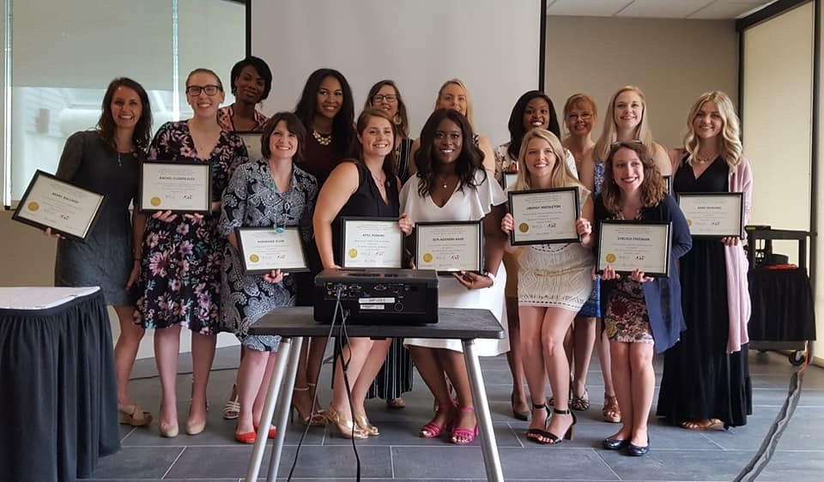
Outcomes
Goals and Objectives
Recruitment
Program Completion
Pass Rate
Employment
Competency Achievement
Retention

Slide 23
Recruitment

Slide 24
Program Completion

Slide 25
Pass Rate

Slide 26
Program Objective Outcomes: Dietetics Employment

Slide 27
Competency Achievement
Notes:
Interns are evaluated on criteria in the following categories:
Evidence based practice
Professionalism
Customer Service
Resource Utilization
Areas note to be opportunities for improvement have been time management and decision making.
Changes to curriculum with current PD
Time management strategies beginning of program (must set due dates with preceptor)
Increased didactic requirements
Increased complexity of activities to address competencies – promotes time management and critical thinking skills
Focus on NCP use and documentation
2016 exit session revised
Professional Development Portfolio
Resume
Interviewing

Slide 28
Retention
30+ registered dietitian graduates currently working in Georgia WIC
The program maintains an average long term (more than 5 years) retention of 50%
9 of 18 Local Agency District Nutrition Services Directors are DPH WIC Dietetic Internship graduates
4 of 9 RD employees in the State WIC Office are DPH WIC Dietetic Internship graduates
Notes:
The retention objective has been met three (3) out of the past five (5) years
What changes might have impacted 2 (two) year retention outcome?
Lost Program Director mid-year for 2011 graduates
Small cohort of 2016 graduates
What changes, if any, need to be made?
The majority of graduates from 2011 – 2016 are not currently working in WIC (especially RDs)
Con – not meeting mission on the broader scale in the long term
Pro – increased number of affiliates and preceptors

Slide 29
Benefit Beyond Retention
Program graduates work in a variety of positions
School nutrition
Clinical nutrition
Private practice
Community organizations
Network of RD’s to promote and advocate for WIC
Potential partnership contacts
Internship program preceptors

Slide 30
Future Threat and Opportunity

Slide 31
Future Threat and Opportunity

Slide 32
2024 Mandate
Beginning January 1, 2024, all applicants sitting for the RD exam will be required to have a completed master’s degree
Program Options
Accept the last class in 2022 and close in 2023
Continue accredited program as is, but graduates cannot test until they meet the requirement
Policy change to take only interns who have a completed master’s degree
Partner with university/college to provide distant education degree option
Notes:
The program is considering all options that continue to fulfill the programs purpose – RD’s in GA and GA WIC.

Slide 33
The Story of Lisa Murray

Slide 34
The Story of Lisa Murray

Slide 35
Meet Lisa Murray
Notes:
Get Lisa to give me her story or attend with me and tell her story.

Slide 36
Summary and Questions

Slide 37
Summary and Questions

Slide 38
Summary
The DPH WIC Dietetic Internship Program is a vital tool in recruitment of Nutritionists in the Georgia WIC Program
The program removes barriers allowing qualified Georgia WIC employees to obtain the Registered Dietitian credential
Resources directed at program improvement began and have continued annually since 2012
The program meets accreditation standards and outcome goals including pass rate, program completion, dietetics employment, competency achievement, and workforce development

Slide 39
What questions do you have?

Slide 40
Contact
Rhonda Tankersley, MPH, RD, LD
Dietetic Internship Administrator
Office: 404-463-0742
Email: Rhonda.Tankersley@dph.ga.gov

