Slide 1
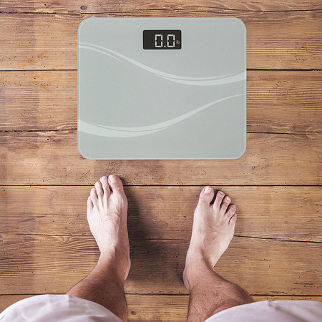
Weight…Wait, Don’t Tell Me
Erin Camacho, RDN, Director, CNMI WIC Program
Jaclyn Chamberlain, MPH, RDN, CSP, Pinnacle Prevention

Slide 2
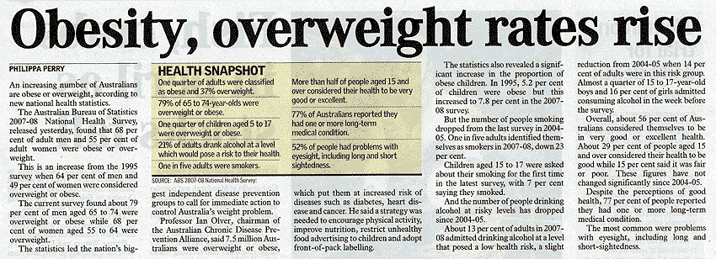
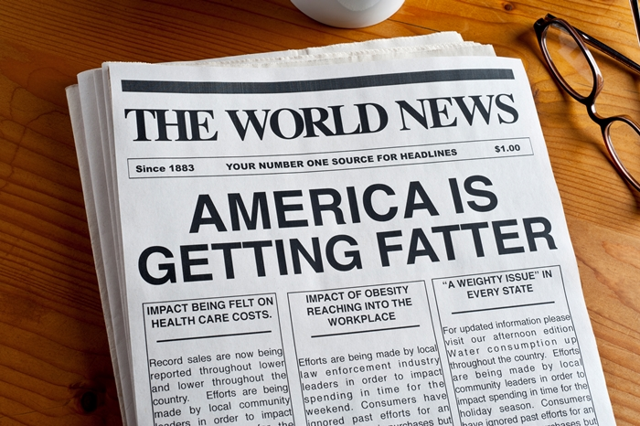
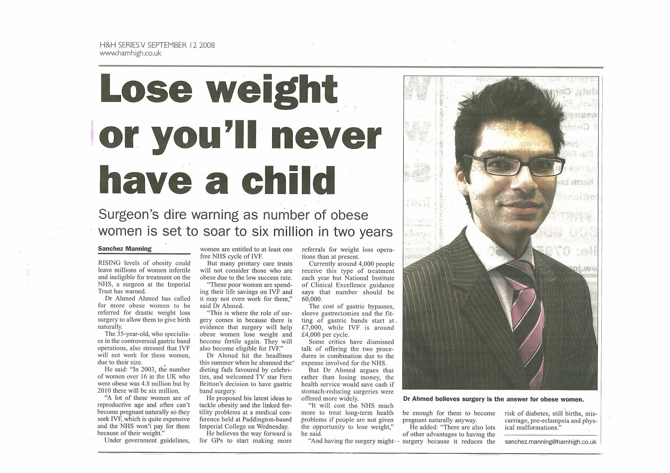

Slide 4
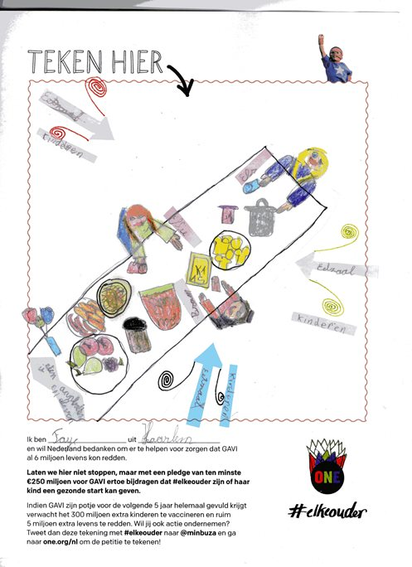

Slide 5
A No Harm Approach to Anthropometric Assessment in CNMI
CNMI
Island info and background
Identified Need for Project
Staff input and observations
Weight…Wait, Don’t Tell Me
Why HAES?
6 “Session” Training
In – Person Training and Feedback
Impact
Next Steps

Slide 6
CNMI

Slide 7
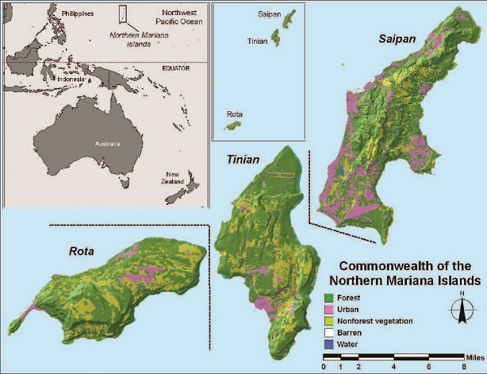
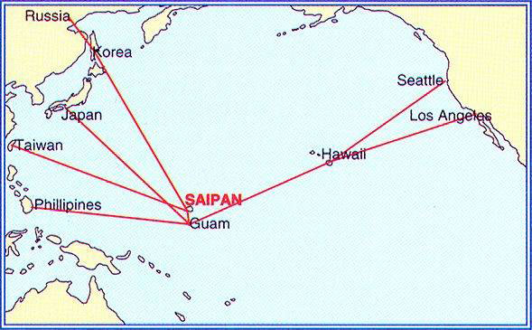

Slide 8
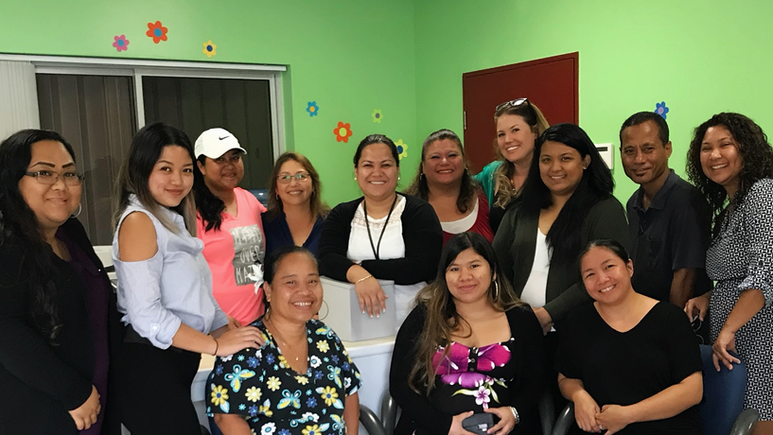

Slide 9
The Need to Address Weight From A Different Point of View

Slide 10
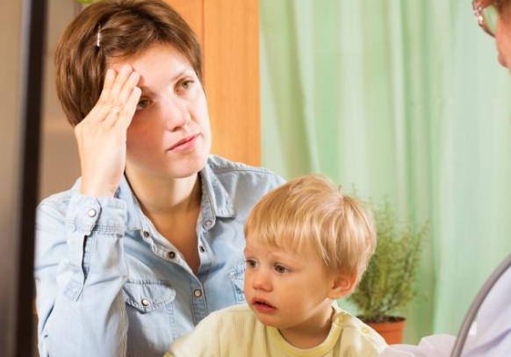
Imagine This Scenario

Slide 12
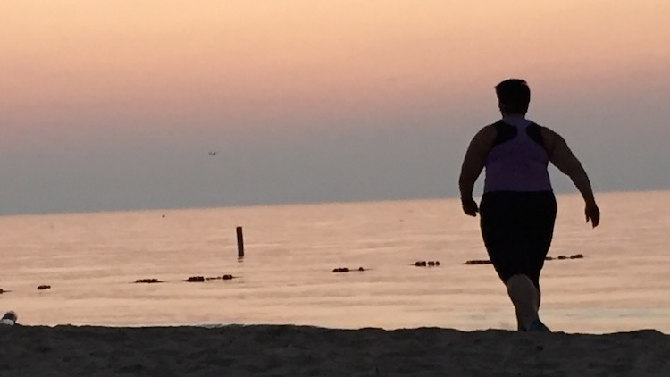
Health At Every Size
Keeping Our Eyes on The Prize

Slide 13
What is Health At Every Size
Mindshift
Weight ➔ Behaviors
Mental, Physical Well Being
Focus on including healthy foods, activity, sleep and other healthy behaviors

Slide 14
All Roads Lead to Life Style

Slide 15
Health At Every Size Challenges
that adiposity poses significant morbidity and mortality risk,
that weight loss will prolong life,
that anyone who is determined can lose weight and keep it off through appropriate diet and exercise,
that the pursuit of weight loss is a practical and positive goal,
that the only way for people living with obesity to improve health is to lose weight, and
that obesity-related costs place a large burden on the economic and health system, and this can be corrected by focused attention to obesity treatment and prevention.14
Penney T, et al. The Health at Every Size Paradigm and Obesity: Missing Empirical Evidence May Help Push the Reframing Obesity Debate Forward. Am J Public Health. 2015 May; 105(5): e38–e42.

Slide 16
Not all Fat is Equal

Slide 17
Is Weight Itself The “Savior”
BMI Does Not Equal Automatic Health
In recent study:
1/3 of “normal” BMI patients had markers of CV disease
1/2 of “overweight” BMI patients had no indication of CV disease
Tomiyama AJ, et al. Misclassification of cardiometabolic health when using body mass index categories in NHANES 2005–2012. International Journal of Obesity volume40, pages883–886 (2016)

Slide 19
We Are More Than A Number On A Scale

Slide 20
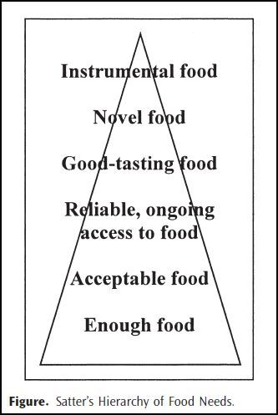
Hierarchy of Food Needs

Slide 21
Food and Culture

Slide 22
An Interesting Perspective
Poor parents honored their kids’ junk food requests to nourish them emotionally, not to harm their health.

Slide 23
Going From Weight to Health
Goal is healthy food relationships/active living
In ways that are pleasurable, relatable to life, culture, family
Change comes from self-acceptance not self-loathing
Managing our own thoughts/biases is crucial

Slide 24
What HAES is NOT

Slide 25
What Does This Mean in Practice
Weight is not the driving force of the conversation
“Ideal” weight is different for each body
Approach each session with “DO NO HARM” as goal. Assess family’s individual needs and strengths.

Slide 26
“Let the Client Lead the Dance”

Slide 27
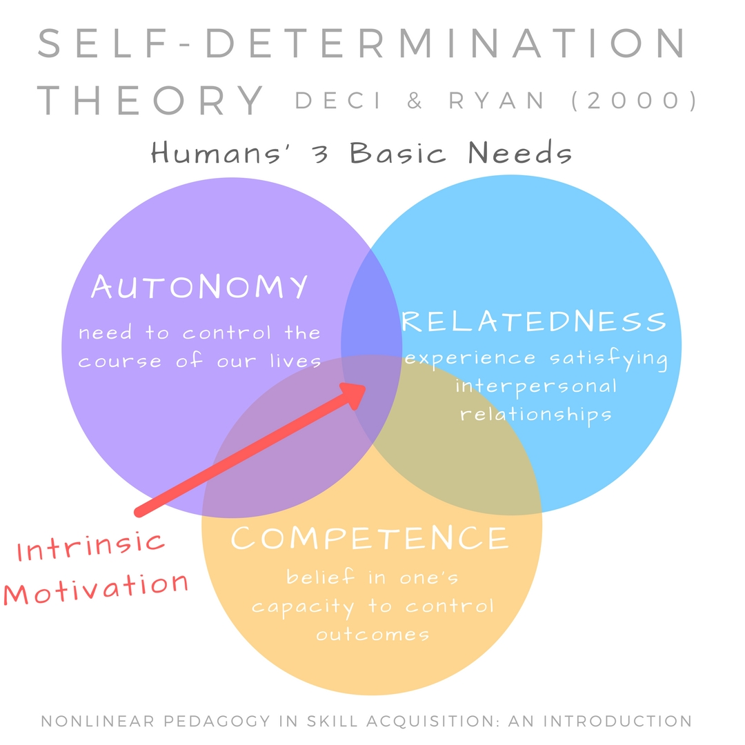
Focus on Autonomy

Slide 28
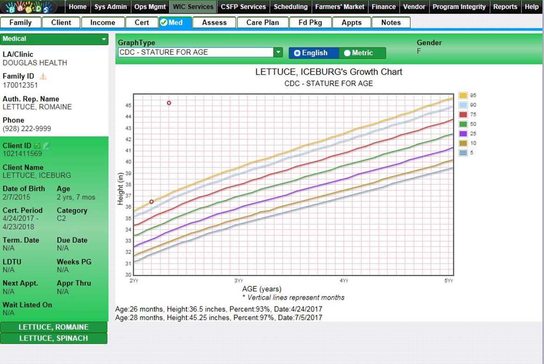
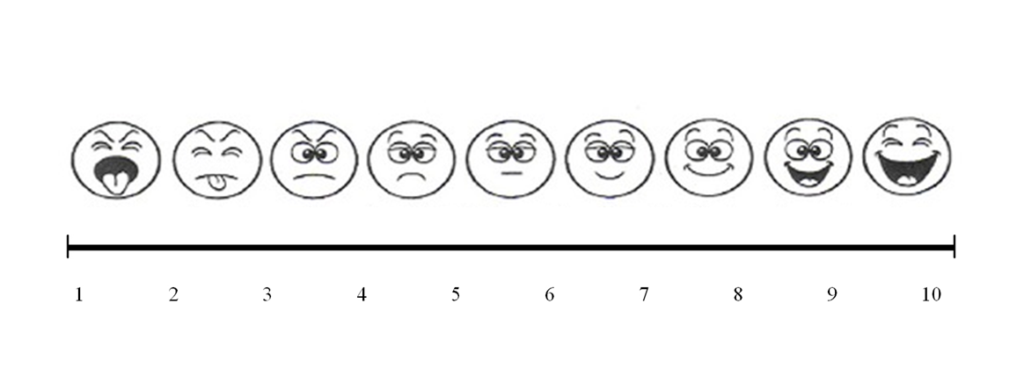
During Anthropometric Assessment

Slide 29
Offer Choice

Slide 30
Our Approach
6 Session Training + In-Person Training and Feedback
5 Webinars + Reading and Discussion Board
What actually is healthy weight?
Lifestyle
Other factors/Do No Harm
Healthy At Every Size
What gets in the way?
Weight Bias
Harvard Implicit Bias Test
In-Person Training and Practice
New Approach to Anthropometric Assessment
Observation Feedback and Simulated Clients
Standardized Clients

Slide 31
Impact
Its hard to unlearn biases
“At first I didn't agree with my result but now I see how I may be biased bc for myself I want to get to a healthy wt. It may impact my counseling bc I have a preference towards a certain size for myself that I may want it for others.”
Works, but still is tricky
“I haven't come across any challenges using the scale so far. I have been able to get to how the clients feel about their weight gain/child’s growth and most of the time, that is their main concern.”
“Not so challenging. Some participants don't really mind answering the question or don't know what it say esp. the one's that don’t understand English much or doesn't feel like to need to make any changes.”

Slide 32
Reality

Slide 34
