Slide 1
S.C. WIC SoW: Services on Wheels
Berry Kelly, MBA, MA
State WIC Director
Division of WIC Services – SC DHEC

Slide 2
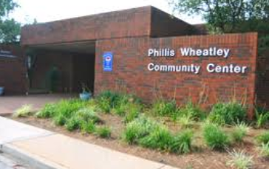
Why Mobile Clinics?
The mobile clinic project is based on a successful off-site clinic pilot initiative in the Upstate
Transportation is an identified barrier for our participants
We want to serve folks within their very own communities

Slide 3
The Grant Process
South Carolina applied for FNS mini-grant funding in 2016 for the purchase of a mobile WIC van in the state’s Lowcountry Region
Grant Goal: Increase Child Retention
Strategy:
Take van to Head Start locations
Easy accessibility to events held outside of regular clinic hours, when parents of WIC-eligible children would be available (i.e., Parent Night at Head Start)

Slide 4
Why Head Start?
FNS encourages WIC to work with Head Start
It just makes good sense!
Go to where the folks already are... make it easy on the parents AND the children

Slide 5
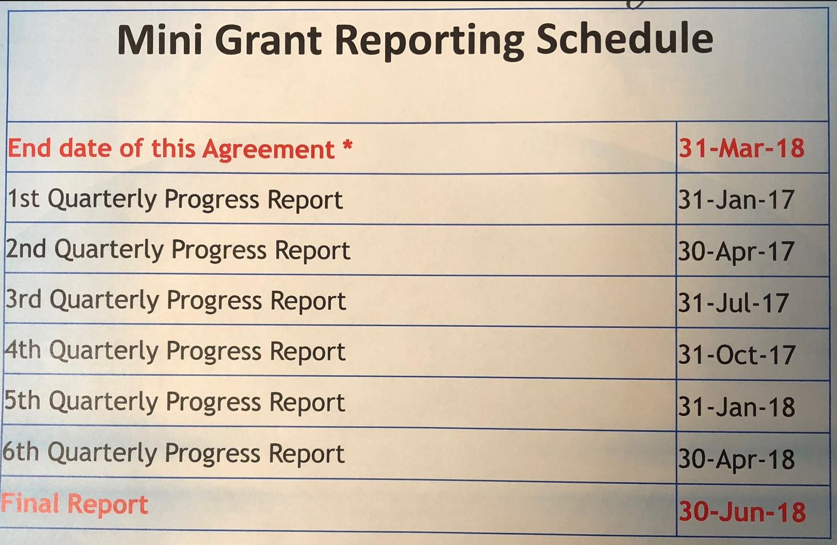
Grant Oversight
Quarterly grant reports for FNS
Quarterly calls with FNS to discuss successes/challenges
Final presentation will provide the opportunity for other states to learn from our experiences

Slide 6
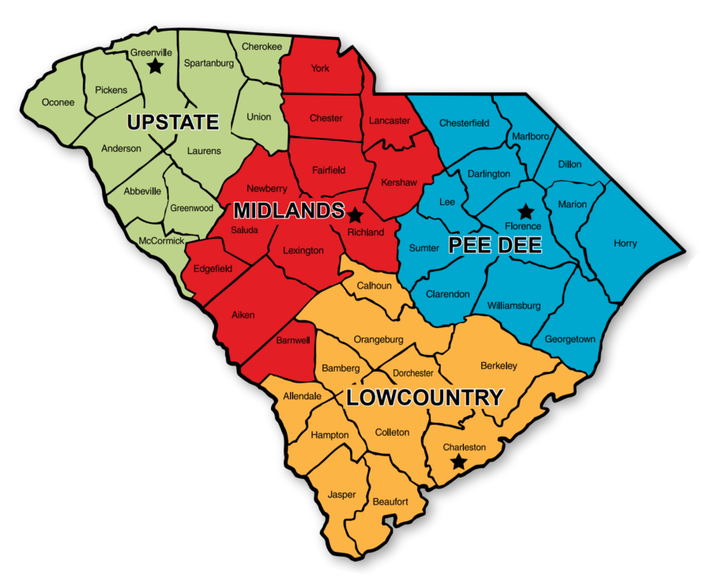
Public Health Regions
S.C. WIC was able to purchase 3 additional vans, to provide statewide coverage

Slide 7
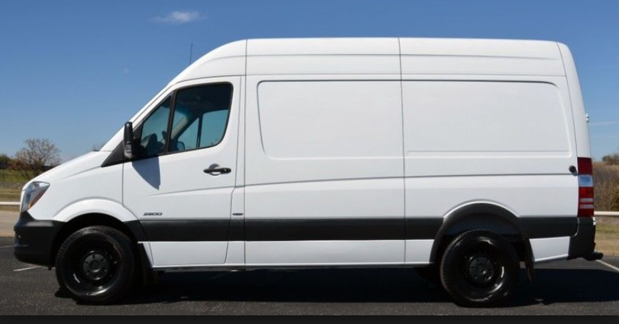
Van Procurement
S.C. WIC was able to purchase the vans from state contract, therefore eliminating the need to bid out the project…a very lengthy process!

Slide 8
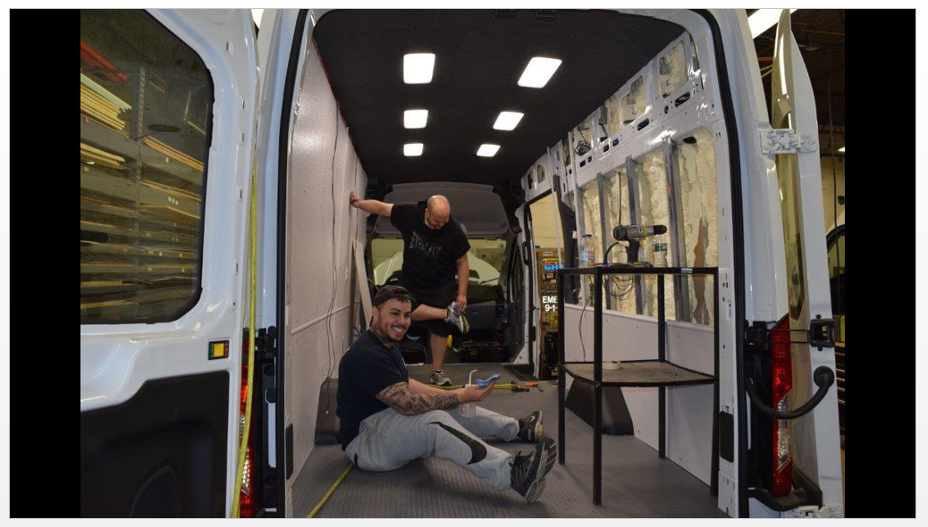
Upfitting the Vans
Upfitting the vans had to go out on bid
DHEC contracted with a company out of New Jersey
Turned the van into a clinic on wheels!

Slide 9
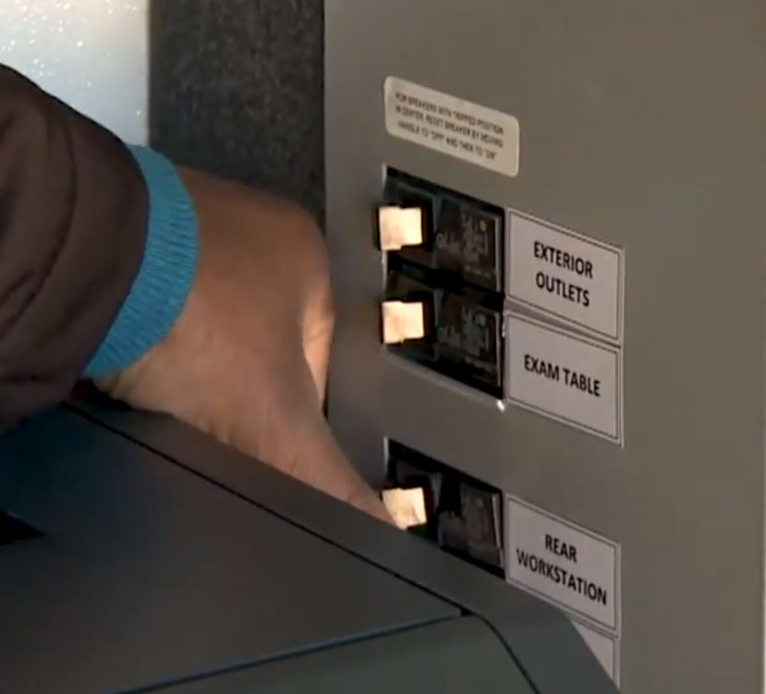
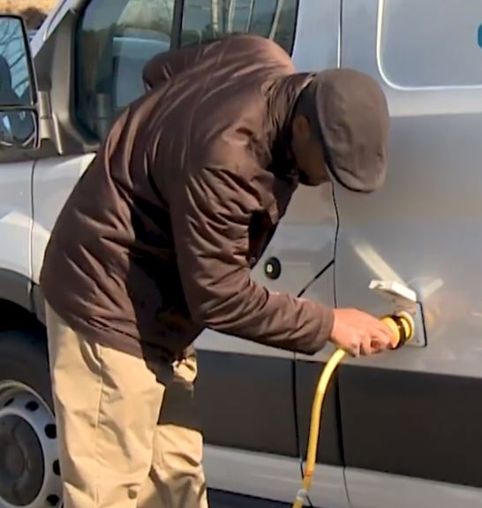
Training for WIC Staff
5-minute training video was created – with step-by-step instructions for van operation – all Regions have access to it

Slide 10
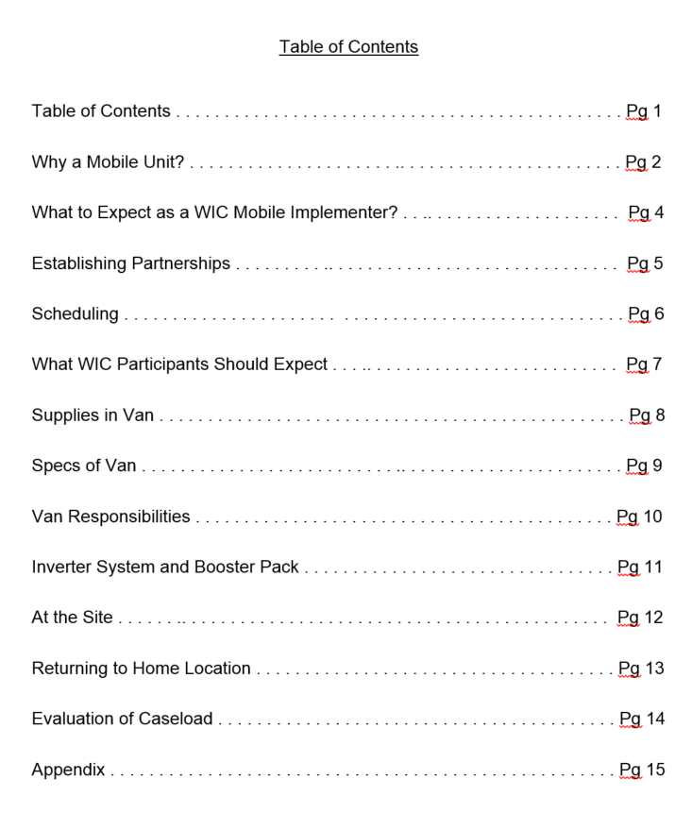
WIC SoW Toolkit
To be kept in the van at all times
Answers frequently asked questions that may arise
This is a best practice!
Had a Master's student develop this toolkit as a practicum project

Slide 11
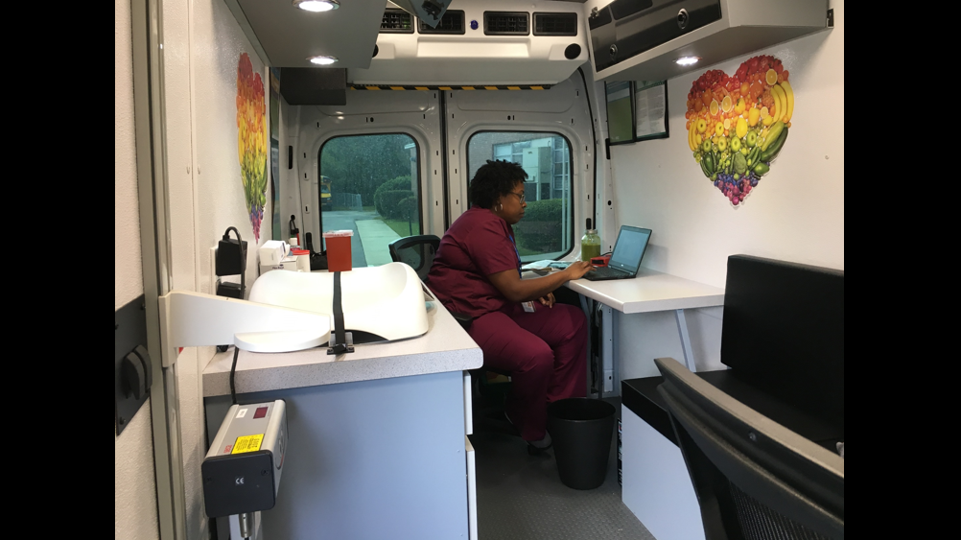
Services Provided
Height checks, weight checks, hemoglobin sticks
Nutrition education & breastfeeding support
Can print WIC vouchers on van!

Slide 12
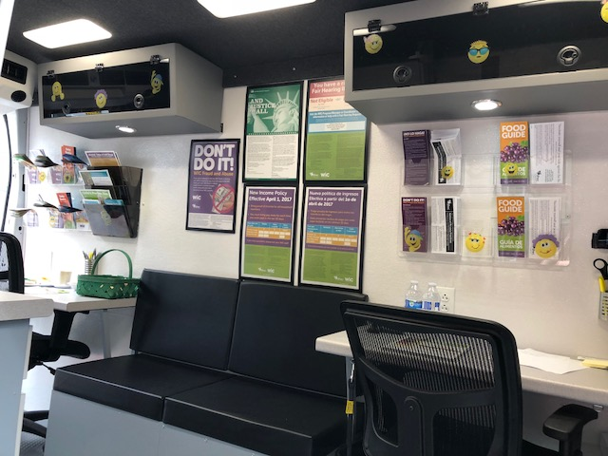
Who Can Use the Vans?
New participants and current participants
Scheduled appointments and walk-ups

Slide 13
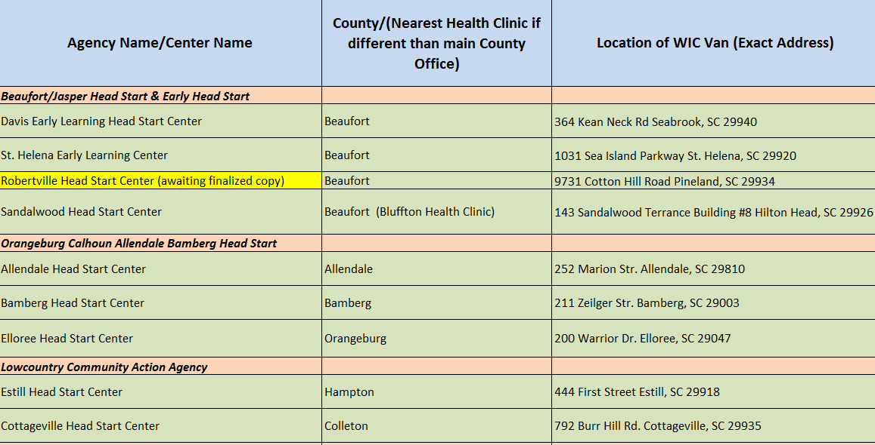
Lowcountry WIC SoW Schedule
Local level staff set up MOAs – it’s important to have a good relationship with the partners!
One van is able to cover an entire Region of the state with coordination between different staff
Lowcountry keeps their schedule on shared drive for easy access

Slide 14
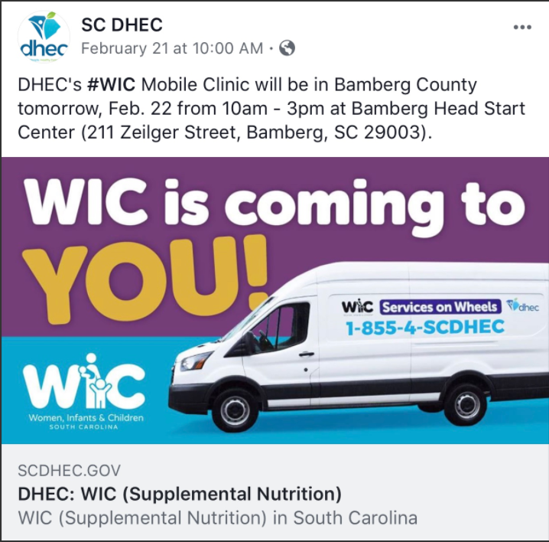
Promotion
Social media
Fliers (English & Spanish)
Radio commercials

Slide 15
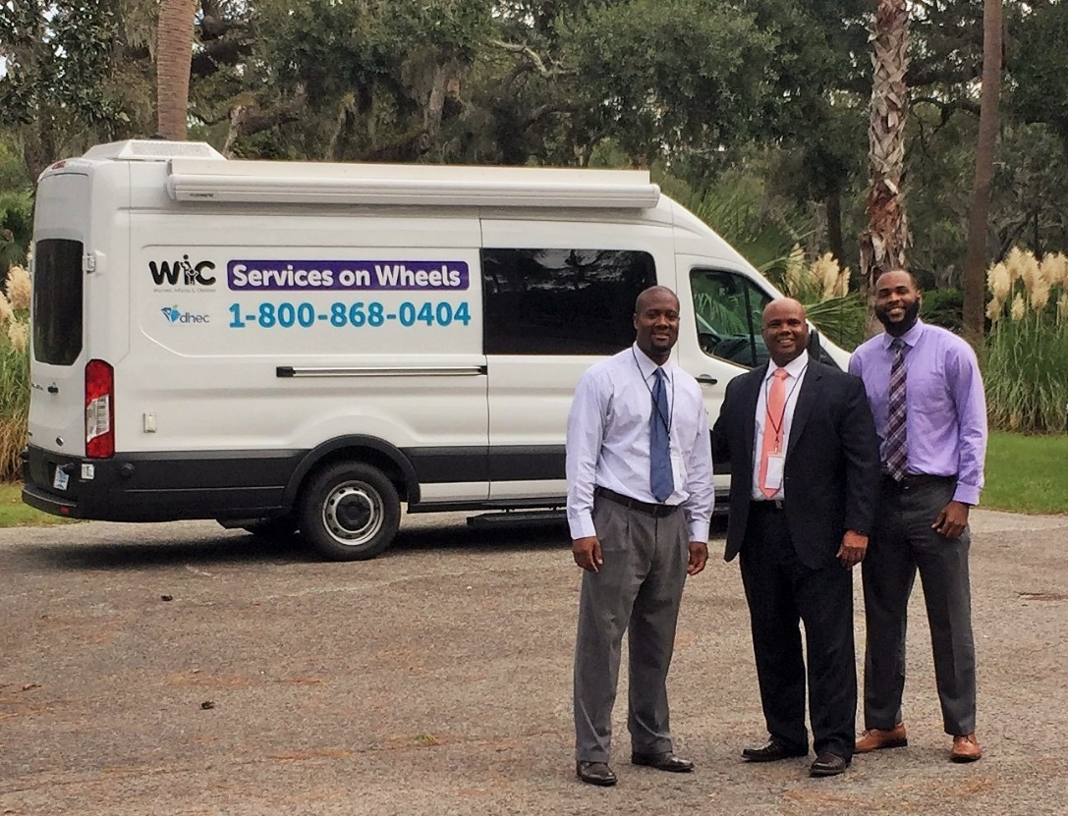
The Dream Becomes a Reality…
WIC SoW launched services in Oct. 2017 in the Lowcountry
No additional staff were hired to work the van
Van had mechanical issues Nov. & Dec., back on the road in Jan.

Slide 16
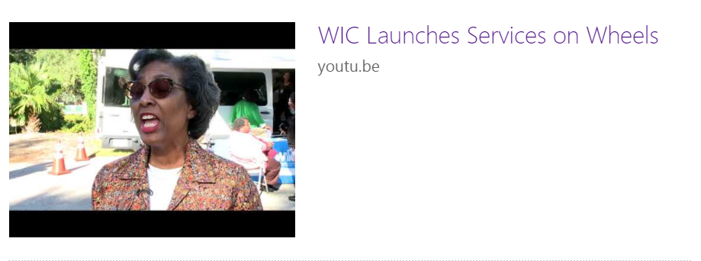
WIC SoW Launch
https://youtu.be/Fv78LlvlSGY

Slide 17
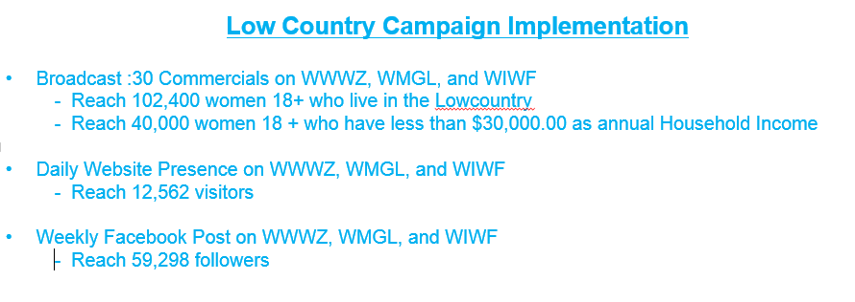
Lowcountry Radio Campaign
Grant funds allowed us to develop a radio campaign for the DHEC Lowcountry Region
Commercials run March 19 – April 29:

Slide 18
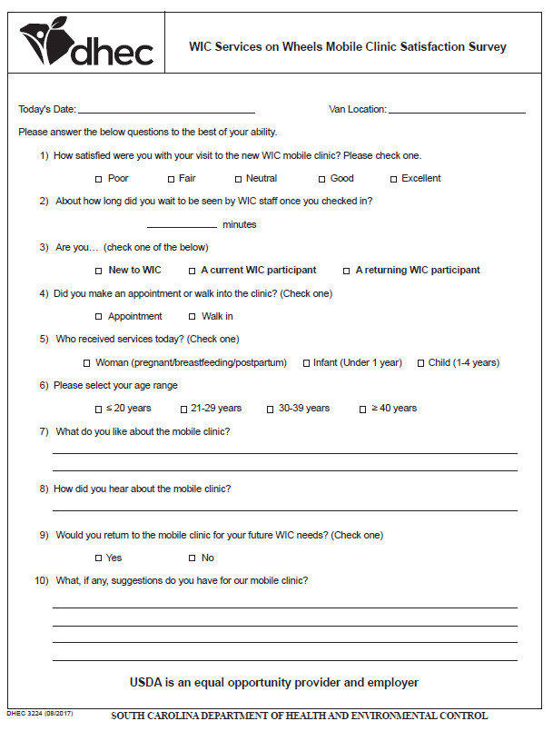
Evaluation
This survey is given out to each person who is seen on van
Are we meeting participants’ needs through van services?

Slide 19
Survey Results
EVERY SINGLE survey respondent said they would return!
This is so important, since the grant focus is child retention.

Slide 20
What Are Folks Saying?

Slide 21
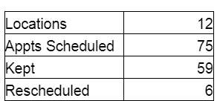
How Many Participants Have Been Seen?
Not all WIC services are provided on the van... it’s our goal to bring more people to WIC and have an easy stepping stone to get them into our program

Slide 22
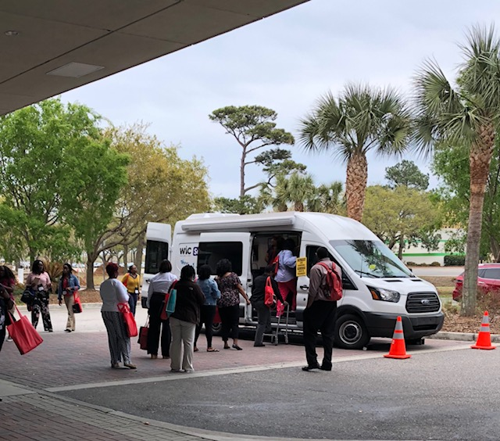
Next Steps
Four vans operational throughout the state
Schedules in places for stops at locations throughout each Public Health Region
Vans on the road five days a week

Slide 23
Berry Kelly, MBA, MA
State WIC Director
kellybb@dhec.sc.gov
803.898.0744

