Slide 1
A Red State Solution:
WIC and the Emergency Food System

Slide 2
Georgia WIC Working Group
Public-private partnership
Formed by the Atlanta Community Food Bank and GA WIC Department as an initiative of Georgia Shape
Discussions initiated in 2016
Planning, data analysis, and focus group research in 2017
Strategic action to drive enrollment, participation and voucher redemption: 2018 and beyond!

Slide 3
Focus Group Design Committee:
Kayla Anderson, Project Open Hand
Angela Damon, GA WIC
Rebekah Hudgins, GA Family Connection Partnership
Wendy Palmer & Katherine Shary, Children’s Healthcare of Atlanta
Janani Thapa, UGA
Emily Anne Vall, GA Shape
Lauren Waits, Atlanta Community Food Bank

Slide 4
Focus Group Participants
English language | Spanish language
“Dropouts” (2 groups) Prior WIC experience Not currently participating | “Dropouts” (2 groups) Prior WIC experience Not currently participating
“Non-participants” (1 group) Aware of WIC Never enrolled | “Non-participants” (1 group) Aware of WIC Never enrolled
“Unawares” (1 group) Know little/nothing about WIC Never enrolled | “Unawares” (1 group) Know little/nothing about WIC Never enrolled
All Participants are WIC-eligible

Slide 5
Discussion Topics
GENERAL AWARENESS AND PERCEPTIONS OF WIC What is WIC? | GENERAL KNOWLEDGE OF ENROLLMENT AND PARTICIPATION How did you become aware and how did you enroll? | GENERAL KNOWLEDGE OF FOOD BENEFITS What foods does WIC provide? | GENERAL KNOWLEDGE ABOUT NUTRITION EDUCATION What is awareness and usage of nutrition education programs?
FOOD INSECURITY Does WIC help guard against food insecurity? | CULTURAL COMPETENCY AND IMMIGRATION STATUS Experiences of participants from varied cultures? | TECHNICAL ISSUES What is the response to voucher vs. EBT card? Other digital platforms? | INCREASING “PARTICIPATION” (ENROLLMENT + REDEMPTION) What could WIC do better?

Slide 6
Findings
Notes:
Extensive research shows that WIC participation is connected to
Better birth outcomes
Improved diets among children
Higher rates of primary care and dental care
Increased immunization rates
Better educational outcomes

Slide 7
General Awareness of WIC
General Market – English
Spanish Language
A temporary safety net
Help with breastfeeding, formula and milk
Nutrition education
Support for pregnancy and babies
Not really sure, see signs in grocery stores
Something to use only when absolutely necessary
A government program
Help with the basics
Dropouts and Non-Participants agree WIC is a much-needed program to help with formula or breastfeeding, nutrition education, and general support.
Non-Participants are less familiar with WIC and view it as a government program in which they are reluctant to participate.
Notes:
Keep in mind

Slide 8
Awareness & Enrollment
Most common sources across ALL groups:
Spanish-speakers also said:
Their most-trusted sources would include community service organizations and even an attorney
They have concerns about how WIC participation could affect their immigration status.
Doctors’ offices: OB/GYNs and Pediatricians
Hospital at time of delivery
Friends & family

Slide 9
Food Insecurity is Common
“My kids eat at school, so at least I know they’re getting nutrition.”
“They keep cutting back, though. My mom’s on disability and only gets $10/mo. From SNAP.”
“I’ve never gotten to that point, thank God. But I have knocked on my mother’s door a few times and she made us all sandwiches.”
SNAP and school meals for older children are a big help to many families and some express worries that there have been or will be cuts in these programs.
For those who have family or close friends nearby, they may reach out for help stretching until the next payday.
WIC may be seen as both the baseline to prevent food insecurity and the last defender against it, especially for families with pre-school aged children.
Regular income is often stretched to its limits when trying to cover basic bills like housing, utilities and transportation.
Many WIC-eligible families also rely on local food banks or programs through churches, etc., at least occasionally.
“I have gotten to that point a few times. I’ve got extra fat, so I’ll be okay if I don’t eat for a day or two until the next check comes in. But the babies always ate. I knew with WIC they’ll always have their milk.”
“It doesn’t cover the entire cost [of formula]—but it provides that base so I don’t worry.”
“Even a small, not-so-nice one bedroom runs $1100/mo. After you pay rent, phone, and I don’t even have a car, there’s not much left over.”
‘When we first arrived (in this country) we got food, clothes and other help from our church.’
“No one should be embarrassed to get help. You should be embarrassed NOT to get help for your child.”
Notes:
WIC IS very often the safety net moms need to ensure they know where their child’s next meal is coming from. Parents set up a line of defense against hunger that involves many resources to guard against getting to that point.

Slide 10
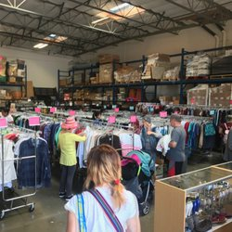
Other Supports
Local Food Banks and Charitable Organizations
Medicaid
Several group members say they also rely on local food banks and charitable programs
Most participants were aware of Medicaid and had received it, either during pregnancy or for longer periods of time.
“Sometimes you have to fill in, between food stamps, WIC and occasionally the food bank”
It’s helpful ‘cause doctors are expensive! “
“They almost try to force you to the point of not working just to get Medicaid.”
Other Programs Mentioned
SNAP/Food Stamps
Energy Assistance
Section 8
TANF (“Welfare”)
Most participants either currently receive SNAP or have in the past
School Meals
“They give you a card that looks like a debit card so no one knows.”
“SNAP has strict income limits.”
Those with older children often utilize school lunch and breakfast programs
“I have 3 kids in school and it’s pretty easy, helpful , it does save us cash. My kids get on the bus at 6:30am so they get breakfast too. They’ve never given me a problem, easy to apply.”
Notes:
Most former WIC participants are also aware of and have used at least one other service like Medicaid, SNAP, school breakfast/lunch programs and local food banks.

Slide 11
Barriers to Applying for WIC:
SPANISH SPEAKERS
GENERAL MARKET
FEAR OF GOVERNMENT
I DON’T /DIDN’T REALLY NEED IT
“I don’t know if this will affect my application for citizenship down the road. Maybe they go back and look if you’ve taken advantage of these benefits and think you’re not contributing.”
“I may have been eligible, but we were able to cover our expenses so it didn’t seem worth it.”
I TAKE PRIDE IN PROVIDING FOR MY FAMILY,
DON’T REALLY NEED IT
TOO MUCH OF A HASSLE FOR WHAT YOU GET
“As long as I’m healthy and have a job, I can make ends meet. I wouldn’t take help unless I really needed it.”
“People say we [Latinos] just want to mooch off the government. You see it every day on TV; we have to fight to overcome these stereotypes.”
”I’ve heard you have to go down every month or few months, wait in line and what you get in the end really isn’t very much.”
WHAT WIC OFFERS , I DON’T NEED
I WON’T TAKE AWAY FROM THOSE WHO DO REALLY NEED IT
“If I took it there might be someone else who really needs it.”
“I knew I was going to breastfeed so it seemed like a lot of hoops to jump through for formula.”
TACTICAL CONSIDERATIONS
“When I first arrived here, I didn’t drive. My husband works all day and I had no transportation to go down to the office to sign up, go down there to keep participating, go to the grocery store for certain ”
Notes:
Not feeling they really need WIC is a barrier to sign up; Hispanics also have a fear of being on the government’s radar.

Slide 12
The Food Package
GENERAL MARKET “DROPOUTS”
Do you think WIC foods are healthy? Healthier than other food?
What Foods did you receive through WIC?
What would you like to receive through WIC?
Foods mentioned most often include the following:
Baby formula, including “special” varieties for allergies, etc.
Milk
Formula
Cereal
Dry beans
Cheese
Baby food
Juicy Juice
Some fruits and vegetables
Participants would like WIC to include more:
Fresh foods like fruits and vegetables
“Healthier” options like nut and soy milk
Meat, fish and canned tuna
Healthy foods/snacks that kids can take on-the-go
The ability to customize to their own tastes and dietary needs (low/full fat milk, organic, vegetarian options, culturally-specific items)
In general, participants feel that WIC food is healthy and nutritious. Health discussions largely centered on milk/dairy products:
Some feel the 1% milk does not provide enough nutrition, that the children just don’t like the taste or that it assumes all kids are overweight (and some are underweight)
Several raise an eyebrow at the sugar content in Juicy Juice as well
Notes:
While MILK AND FORMULA top the list of what WIC provides, participants also mention a variety of other foods they receive. They would like to see more meat, fresh foods and a greater variety of options.

Slide 13
The Food Package
SPANISH-SPEAKING NON-PARTICIPANTS
What Foods do you think WIC provides?
What foods would you like WIC to provide?
Do you think WIC foods are healthy?
Perception of which foods WIC provides are largely based on signs seen in grocery stores or on word-of-mouth from friends and family who have used the program.
Fruits and vegetables
Cereal
Milk and formula
Cheese
Juice
Bread
Eggs
In addition to the foods currently provided, which non-participants view as “the basics,” other items on the wish list would include the following:
Chicken, meat
A variety of fruits and vegetables
Non-participants perceive WIC food to be healthy and supportive of a nutritious diet.
They note that the foods provided are healthy staples like fruits, vegetables, bread, milk eggs and cheese.
Notes:
HISPANICS see WIC as providing healthy, “basic foods” and are less focused on formula and milk than their general market counterparts.

Slide 14
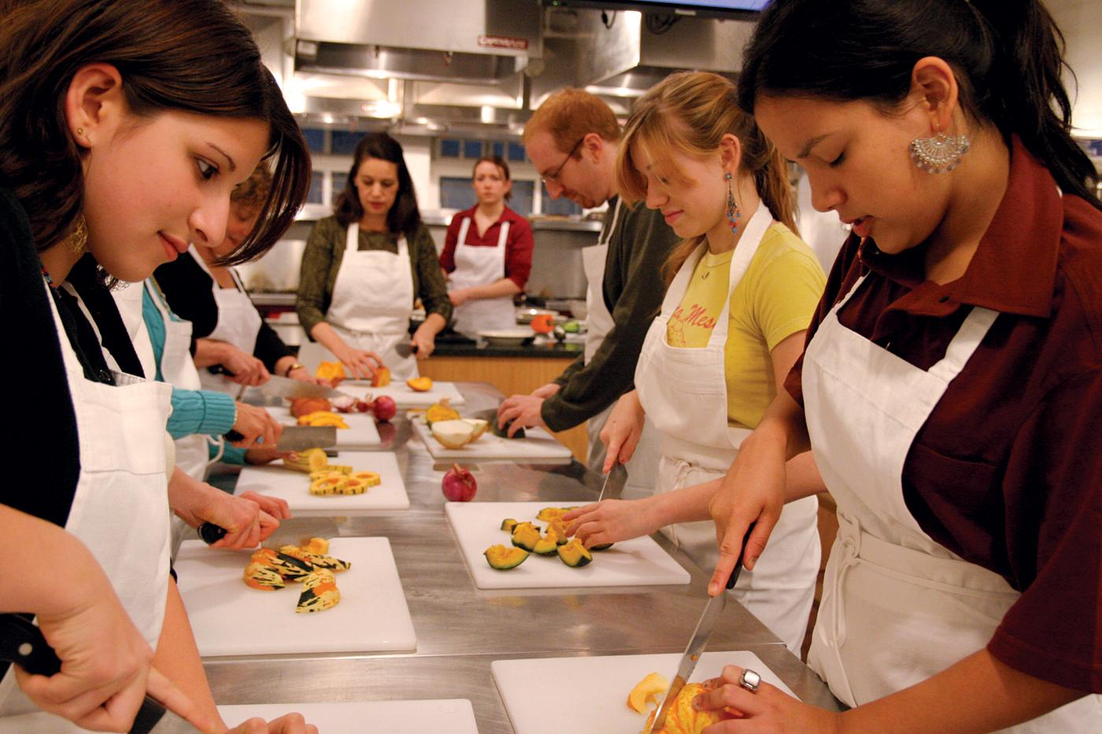
Nutrition Education
NUTRITION EDUCATION
COLLATERAL MATERIAL
WHAT THEY’D LIKE
Insert your photo here
They gave me a chart with the food pyramid that I stick on my fridge. That helps remind me how much of each thing we should be eating.”
Insert your photo here
“Sometimes they’ll have classes where they show you how to cook with the WIC food you get. I learned a lot!”
“In our generation, we don’t really know how to cook anymore. What we do is ‘fix stuff,’ rather than cook a meal.”
Participants have a positive reaction to receiving:
Individual nutritional counseling
Classes on food preparation and nutrition
Check-ups for themselves and their children
Several mention receiving collateral materials such as food pyramid charts and informational brochures.
For many, this information is completely new to them and they appreciate having something to take home and stick on the fridge.
They’d like to see more:
Classes/videos on food preparation
Healthy recipe ideas that kids like
Nutritional plans for pre-school aged children
Help with picky eaters, allergies, special dietary needs
Many of these parents were not very confident in their cooking/ food preparation skills.
Notes:
In addition to food vouchers, WIC’s nutritional programs are a valued part of what participants receive through the program. Classes, collateral material and individual plans are all perceived as a great benefit. Several AfAm participants mentioned that they grew up eating not-so-healthy foods so they weren’t sure how to prepare healthier meals.

Slide 15
Nutrition Education
ELIGIBLE NON-PARTICIPANTS
WHAT WIC INCLUDES
WHAT THEY’D LIKE
Insert your photo here
Insert your photo here
“I’ve heard from friends that it can provide baby formula. Not everyone can afford a can a week; it’s very expensive. So this is a great benefit.” –H Non-Participant
“Maybe if they offered a greater variety of foods, like some type of meat or chicken.” –GM Non-Participant
Non-participants have a general idea that WIC is a nutritional program:
Coupon/Voucher system for helping needy families buy food
Help for pregnant women and small children with nutritional needs
Low awareness of nutritional classes and counseling services
They’d like to see more:
Fresh fruits and vegetables
Meat
Chicken
When described, nutrition education was considered a plus.
Notes:
ELIGIBLE NON-PARTICIPANTS are not as likely to be aware of the nutritional and other programs offered.
One participant was aware of the car seat program (actually a DPH program)

Slide 16
Cultural Competency
SPANISH SPEAKERS
Was it easy to receive WIC services in your preferred language?
Yes—the application process was often done in-hospital or in an office where information was presented in-language
“There was a social worker who came around and explained everything to me in Spanish and filled out all the paperwork for me.”
Services are available in Spanish, though many feel the wait times are longer and they don’t receive the same level of service.
“Sometimes I’d help translate when I can see people have been sitting there for 3 hours, waiting for a Spanish speaking worker.”
How are ongoing services in Spanish?
Is there fear or concern about immigration status?
Yes—there is an inherent distrust of government agencies; many say the current political environment leaves them fearful and exposed.
“”They may say it’s for the children, they’re citizens, but ICE may even come to a school and deport the parents who are picking up their kids.”
“You have to be very careful. They can take your kids away and deport you.”
There is a great deal of fear among the Hispanic community when it comes to “being seen” by a government entity.

Slide 17
Technology Enhancements
Many past participants had complaints about the current voucher system:
“Use it or lose it” system often leads to waste
Time-consuming and often frustrating at the grocery store to find the exact item, or go back to replace it if rejected by cashier.
Vouchers are very visible at the store; can be embarrassing
“I feel like people in line behind me are judging when they see the vouchers.”
The idea of switching to debit-style cards was met with great enthusiasm:
Most participants were familiar with SNAP cards and liked that they are discreet, you can check your balance online and they are automatically loaded
When EBT is implemented for WIC, they hope this allows them to go to the WIC office less often and saves time in the store and checkout
A card-based system would encourage parents to stay in the program longer
“(EBT) takes away a LOT of obstacles!”
“Much more convenient. They can probably set it up where you don’t have to get vouchers, do it all online.”
Online Access and Communications
All parents in these groups own a smartphone. Many also have laptops, desktop computers or tablets at home.
Periodic e-mails/newsletters from WIC would be well-received
They would not be opposed to occasional texts from WIC
E-mails or texts would be a good way to communicate account information as well as providing nutritional education, ideas for recipes and cooking tips.
Periodic e-mails/newsletters from WIC would be well-received
They would not be opposed to occasional texts from WIC

Slide 18
Recommendations for increasing WIC participation in Georgia:
OFFER GREATER FLEXIBILITY
UPDATE TECHNOLOGIES
Many of the negatives surrounding the program had to do with the paper voucher system. While these parents were unsure as to how it would work, they say that if cards mean you don’t have to go to an office every three months and they are more discreet, they would be seen as a great improvement over vouchers.
Specific requirements for products, package sizes and brands often lead to prolonged time in the grocery store, frustration and benefits that go unused. Offering a bit more flexibility in time limits, specific items that qualify or substitutions within grocery stores if they don’t have the specific item in stock, would go a long way in reducing frustration and keeping people on the program longer.
LEVERAGE/PROMOTE NUTRITION EDUCATION
The nutritional education aspect is one which many participants perceive as a great benefit, though it may not be the first thing that comes to mind when WIC is mentioned.
There is opportunity to expand awareness and the scope of nutritional programs offered. Individual dietary counseling, help with older children’s needs, recipes and instruction on how to prepare
healthy meals would all be welcomed.
INCREASE EFFORTS WITHIN THE LATIN COMMUNITY
Awareness of the program among Hispanics living in Georgia appears to be lower than awareness among other groups. For those aware, many do not have a clear idea of what the program entails. There is a great deal of fear and mistrust of the government and government programs, even for legally-documented people.
Community outreach through trusted leaders (churches, community organizations, etc.) may serve to educate and alleviate many of these concerns.

Slide 19
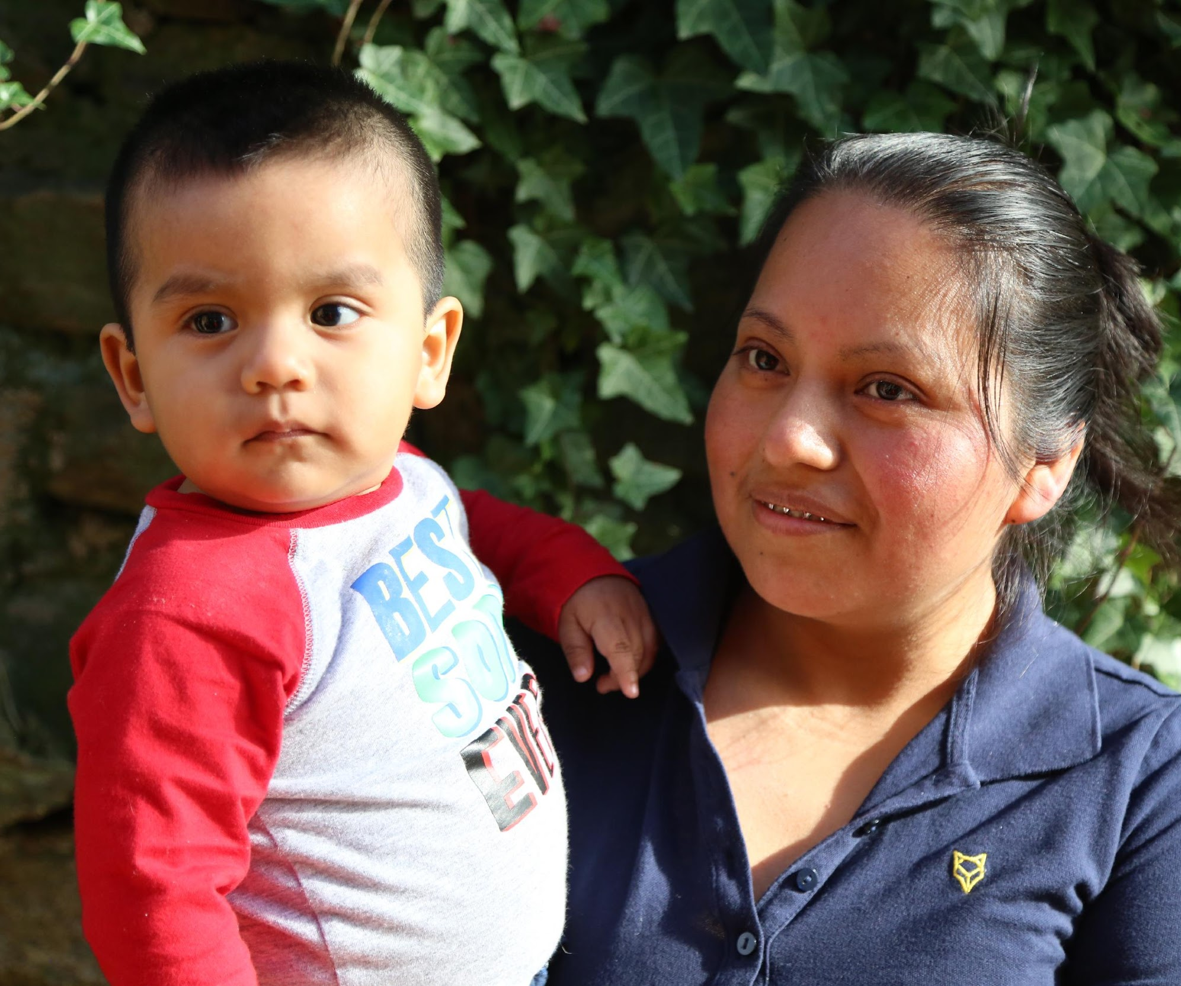
Discussion

Slide 20
Thank you!
Lauren Waits
Director of Government Affairs
Atlanta Community Food Bank
For more information:
lauren.waits@acfb.org
404-892-3333 x 1363

