Slide 1
Quality Improvement and Performance Management in the WIC Clinic:
Improving Customer Service and Staff Performance
Todd Kirkpatrick, MS, RD, LD
Director of Health Promotion
Licking County Health Department

Slide 2
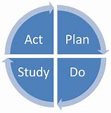
Quality Improvement (QI)
To address quality and efficiency
Very common practice in private business and becoming more common in government and non-profit agencies
Focus is on the PROCESS
Quality Improvement and Performance Management in the WIC Clinic:
Improving Customer Service and Staff Performance

Slide 3
Performance Management
To address quality and efficiency
Similar to QI but more of the “big picture”
Focus is on PERFORMANCE
Quality Improvement and Performance Management in the WIC Clinic:
Improving Customer Service and Staff Performance

Slide 4
Accreditation
Public Health Accreditation Board (PHAB)
Introduced national accreditation in 2011 with the first agencies receiving recognition for completion in 2013
Currently 31 state, 1 tribal and 189 local health departments are accredited
Includes 100 standards, of which QI and PM are included
Quality Improvement and Performance Management in the WIC Clinic:
Improving Customer Service and Staff Performance

Slide 5
Our Journey
Quality Improvement
1. Brainstorming
2. Process Mapping
3. Collecting Data
Quality Improvement and Performance Management in the WIC Clinic:
Improving Customer Service and Staff Performance

Slide 6
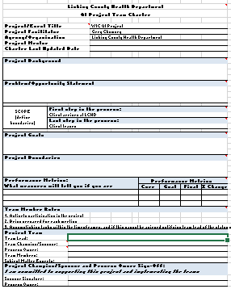
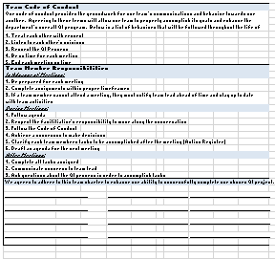
Quality Improvement
Charter
Quality Improvement and Performance Management in the WIC Clinic:
Improving Customer Service and Staff Performance

Slide 7
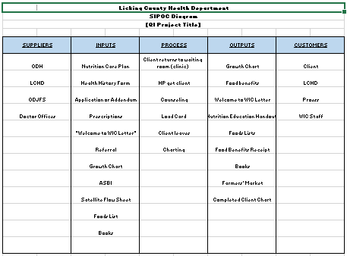
Quality Improvement
SIPOC
Quality Improvement and Performance Management in the WIC Clinic:
Improving Customer Service and Staff Performance

Slide 8
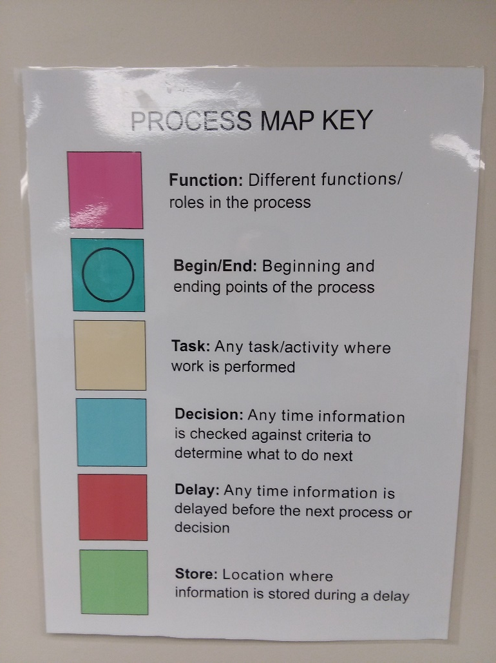
Process Mapping
Quality Improvement and Performance Management in the WIC Clinic:
Improving Customer Service and Staff Performance

Slide 9
Clinic Flow
Current Process
1. Check-in: initial sign in, assess & document eligibility and begin all forms
2. Clinic: height/length, weight and hemoglobin
3. Counseling: review forms, data entry, counseling, assign risk codes, tailor food package, load benefits, set next appointment
Quality Improvement and Performance Management in the WIC Clinic:
Improving Customer Service and Staff Performance

Slide 10
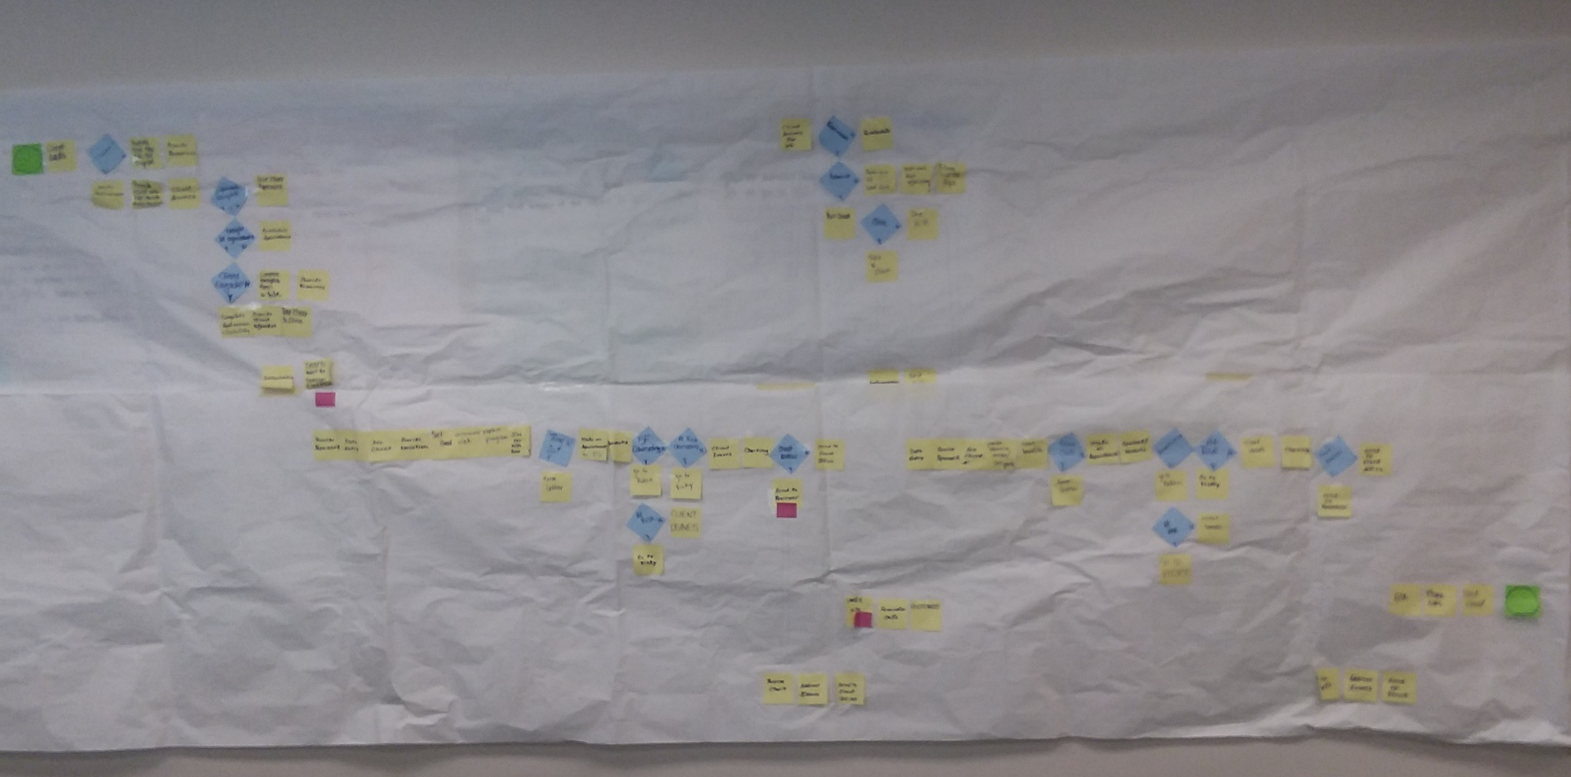
Process Mapping
Add: our map
Quality Improvement and Performance Management in the WIC Clinic:
Improving Customer Service and Staff Performance

Slide 11
Clinic Layout
Health Professionals
Clinic
Check-in Office
(4 staff)
Waiting Room
Sign In WIndow
Entrance/Exit
Quality Improvement and Performance Management in the WIC Clinic:
Improving Customer Service and Staff Performance

Slide 12
Initial Data Collection
Design of the Collection Tool
Waiting for Check-in
Check-in
Waiting for Clinic
Clinic
Waiting for Counseling
Counseling
Quality Improvement and Performance Management in the WIC Clinic:
Improving Customer Service and Staff Performance

Slide 13
Initial Data Collection
Quality Improvement and Performance Management in the WIC Clinic:
Improving Customer Service and Staff Performance

Slide 14
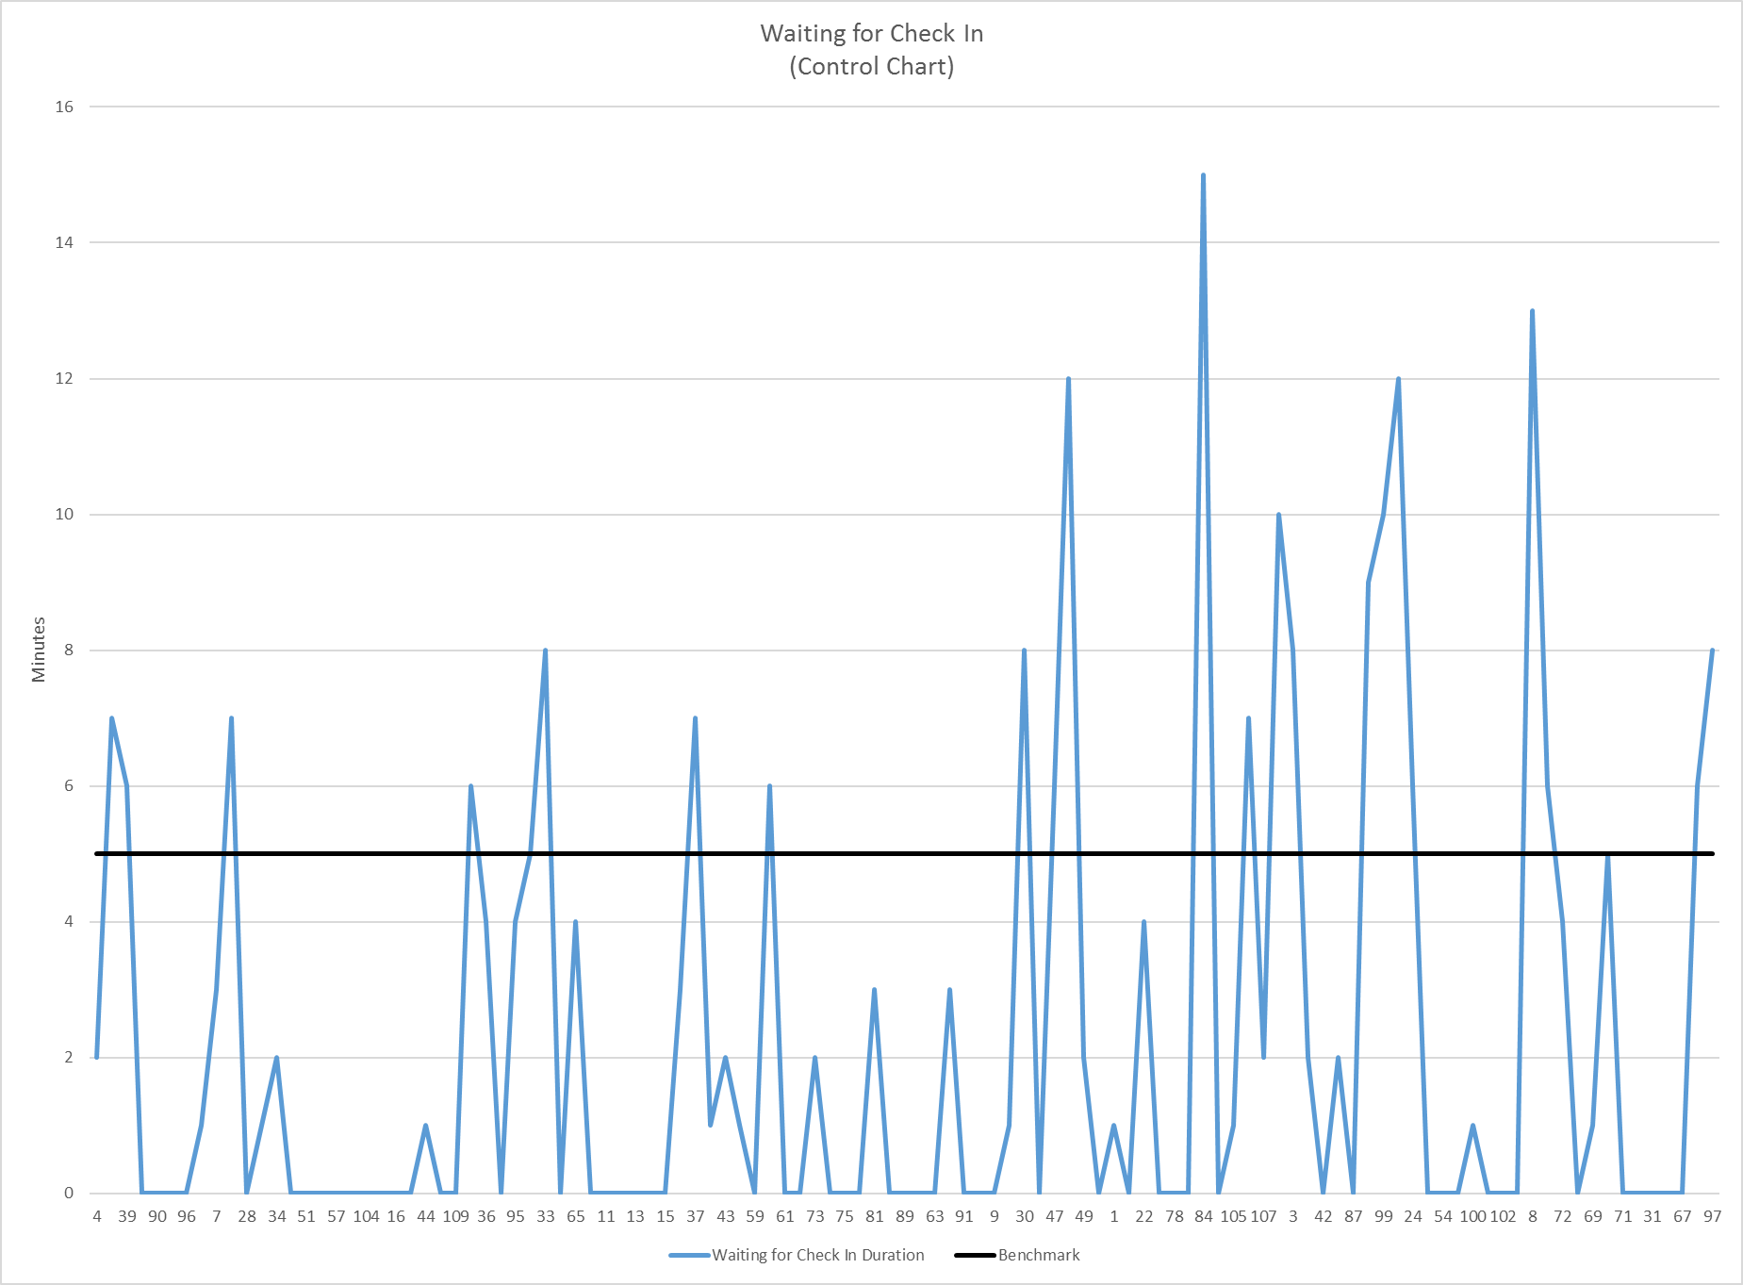
Initial Data Collection
Waiting for Check-in (benchmark: 5 minutes)
Quality Improvement and Performance Management in the WIC Clinic:
Improving Customer Service and Staff Performance

Slide 15
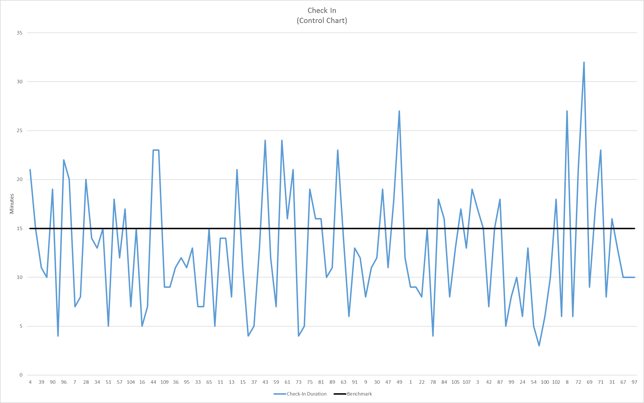
Initial Data Collection
Check-in (benchmark: 15 minutes)
Quality Improvement and Performance Management in the WIC Clinic:
Improving Customer Service and Staff Performance

Slide 16
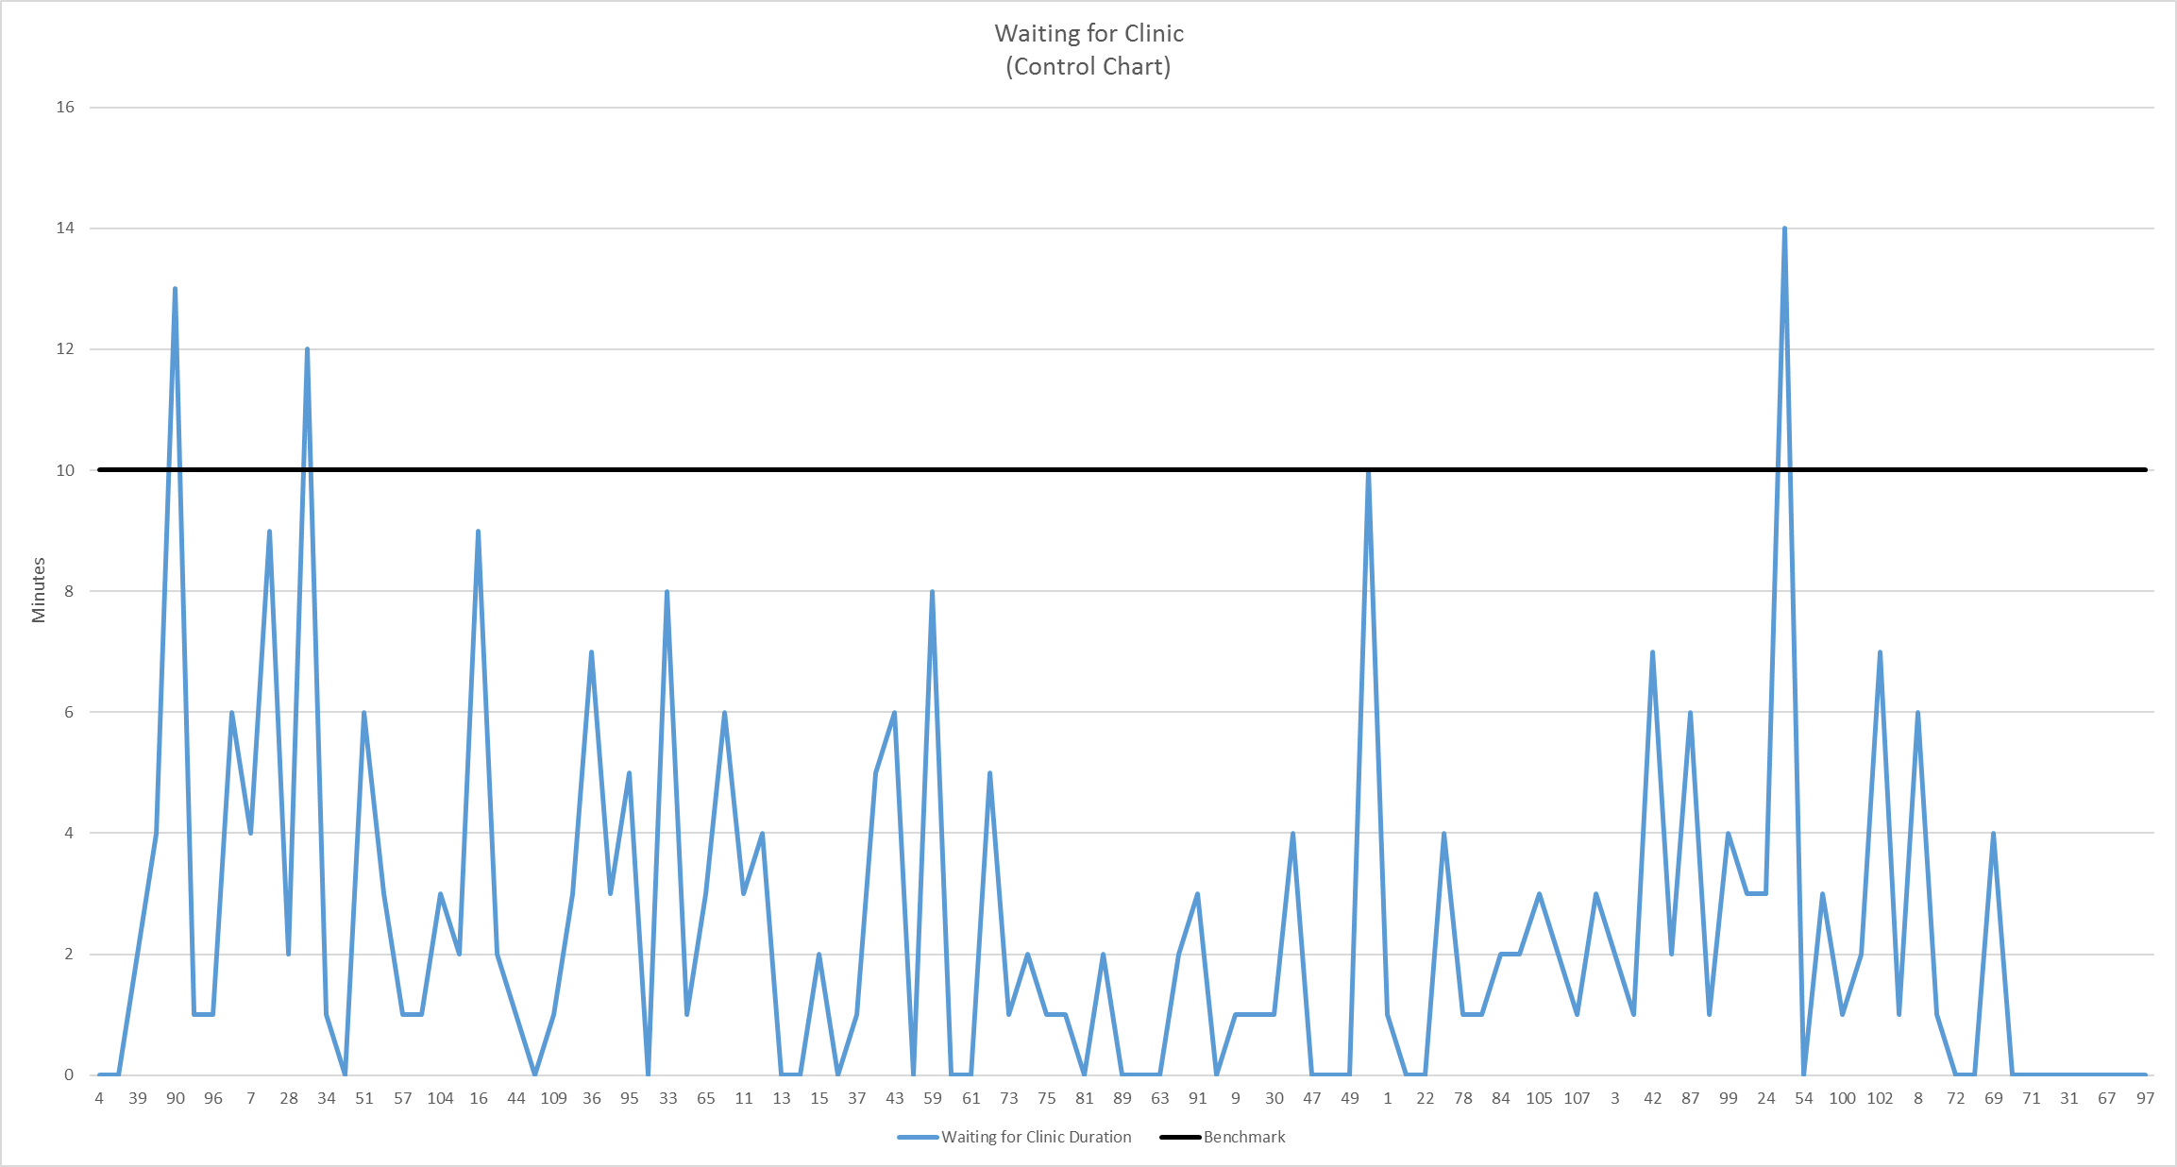
Initial Data Collection
Waiting for Clinic (benchmark: 15 minutes)
Quality Improvement and Performance Management in the WIC Clinic:
Improving Customer Service and Staff Performance

Slide 17
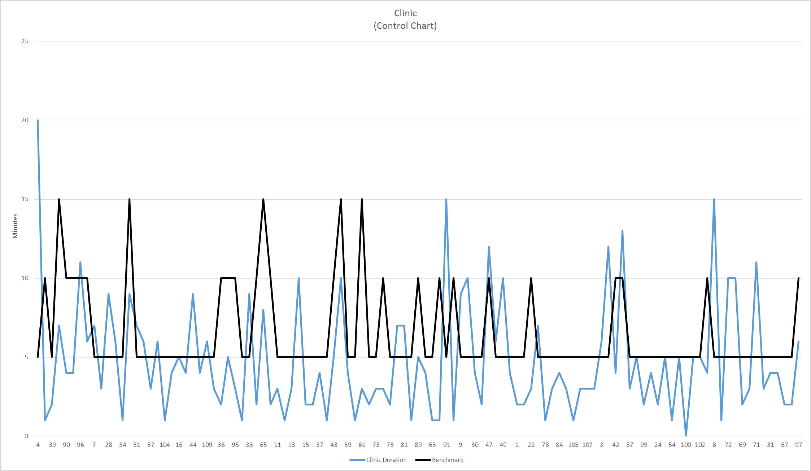
Initial Data Collection
Clinic (benchmark: 5 minutes per participant)
Quality Improvement and Performance Management in the WIC Clinic:
Improving Customer Service and Staff Performance

Slide 18
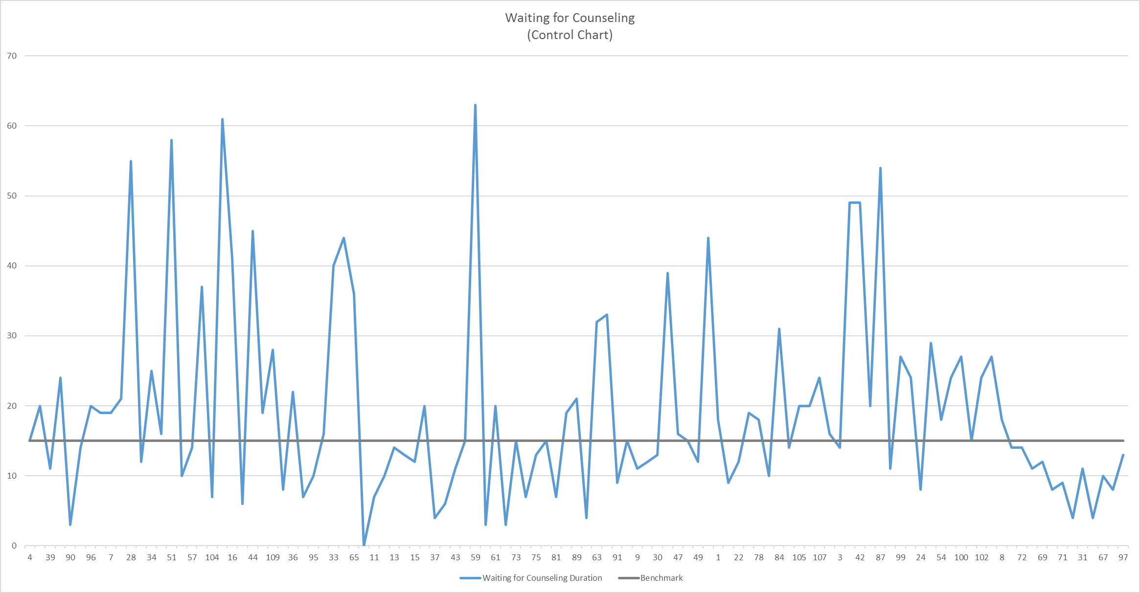
Initial Data Collection
Waiting for Counseling (benchmark: 15 minutes)
Quality Improvement and Performance Management in the WIC Clinic:
Improving Customer Service and Staff Performance

Slide 19
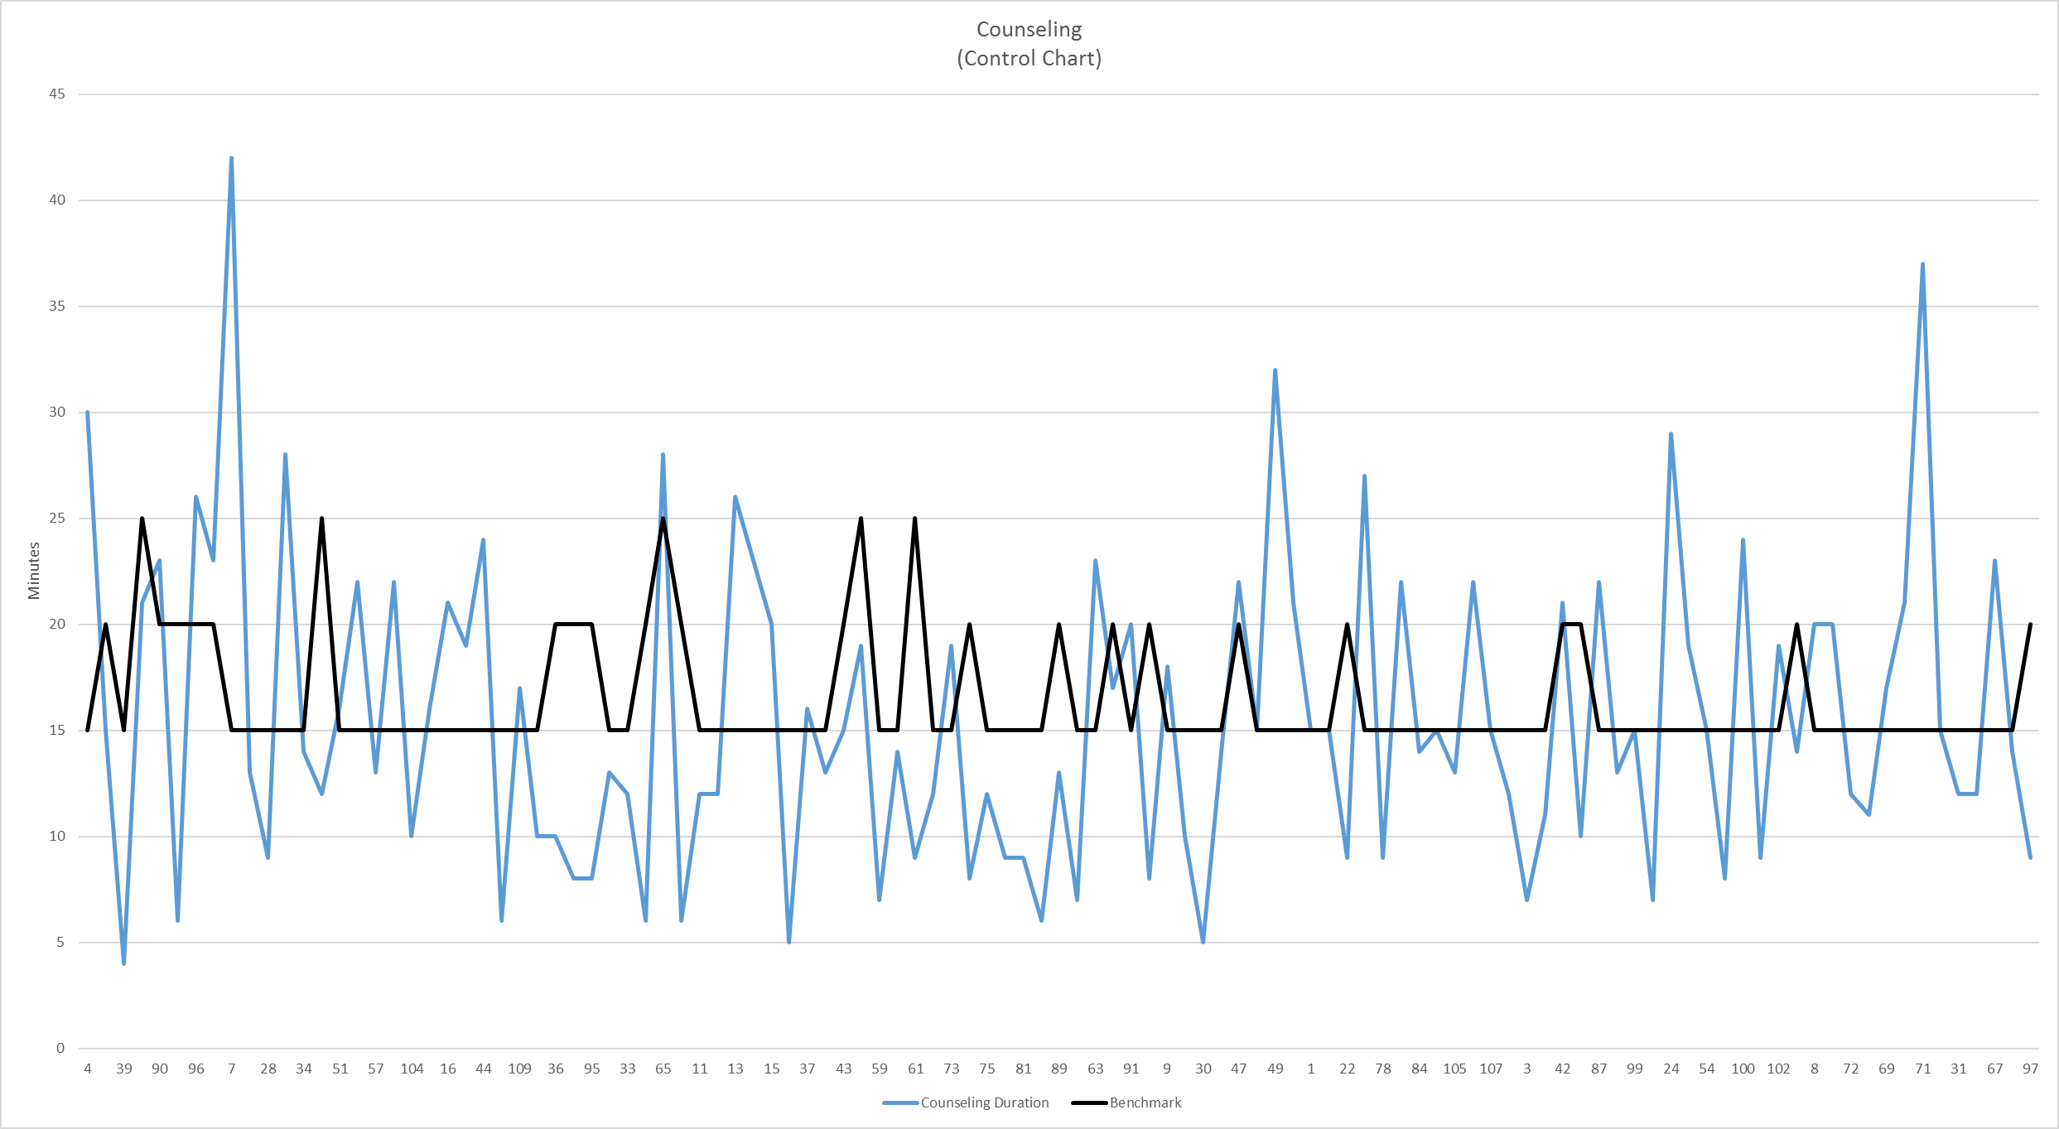
Initial Data Collection
Counseling (benchmark: 15 minutes)
Quality Improvement and Performance Management in the WIC Clinic:
Improving Customer Service and Staff Performance

Slide 20
Initial Data Collection
Results (n = 109)
Waiting for Check-in: exceeded benchmark 20% of the time
Check-in: exceeded benchmark 31% of the time
Waiting for Clinic: exceeded benchmark 2% of the time
Clinic: exceeded benchmark 25% of the time
Waiting for Counseling: exceeded benchmark 48% of the time
Counseling: exceeded benchmark 36% of the time
Quality Improvement and Performance Management in the WIC Clinic:
Improving Customer Service and Staff Performance

Slide 21
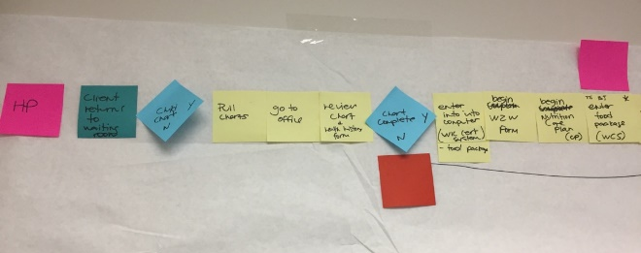
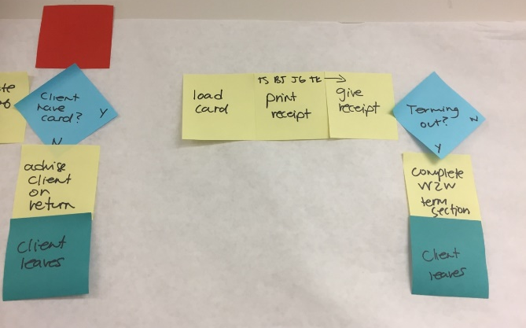
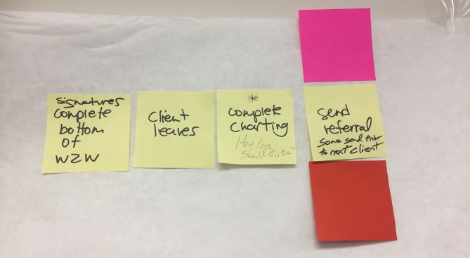
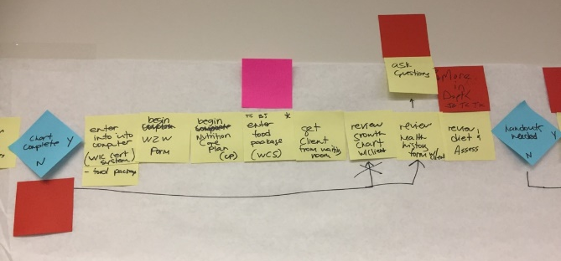
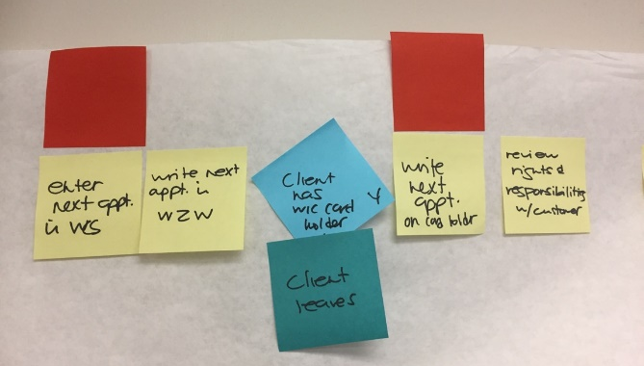
Process Mapping – Round 2
Focus on Counseling Process
Quality Improvement and Performance Management in the WIC Clinic:
Improving Customer Service and Staff Performance

Slide 22
Change from QI to PM
Change Focus: from Process to Overall Performance
Quality Improvement = process
Performance Management = performance
Quality Improvement and Performance Management in the WIC Clinic:
Improving Customer Service and Staff Performance

Slide 23
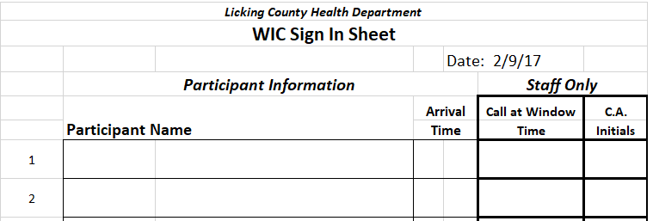
New Data Collection
Original Design Current Design
Quality Improvement and Performance Management in the WIC Clinic:
Improving Customer Service and Staff Performance

Slide 24
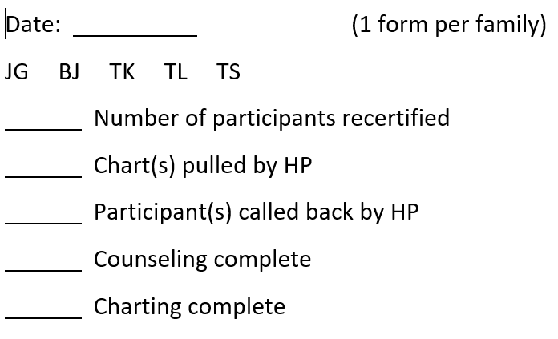
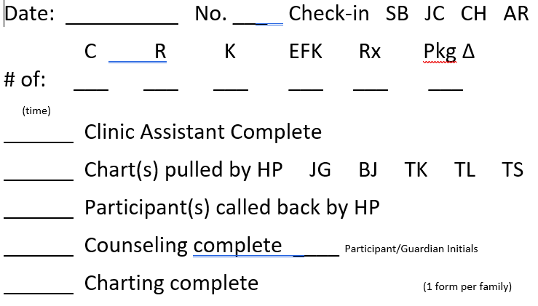
New Data Collection
Original Design Current Design
Quality Improvement and Performance Management in the WIC Clinic:
Improving Customer Service and Staff Performance

Slide 25
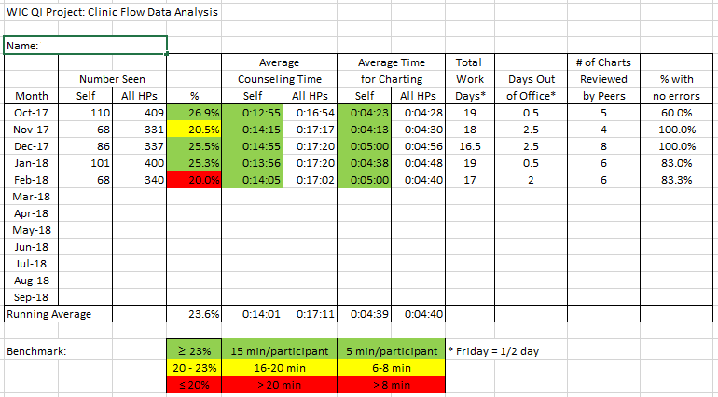
Performance Management
Data Shared with Health Professionals each Month
Quality Improvement and Performance Management in the WIC Clinic:
Improving Customer Service and Staff Performance

Slide 26
Performance Management
Counseling by group size
Quality Improvement and Performance Management in the WIC Clinic:
Improving Customer Service and Staff Performance

Slide 27
Performance Management
Counseling by appointment type
Quality Improvement and Performance Management in the WIC Clinic:
Improving Customer Service and Staff Performance

Slide 28
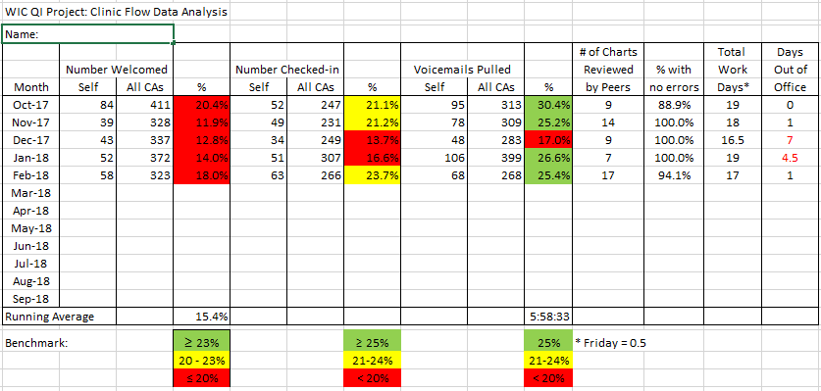
Performance Management
Data Shared with Clinic Assistants each Month
Quality Improvement and Performance Management in the WIC Clinic:
Improving Customer Service and Staff Performance

Slide 29
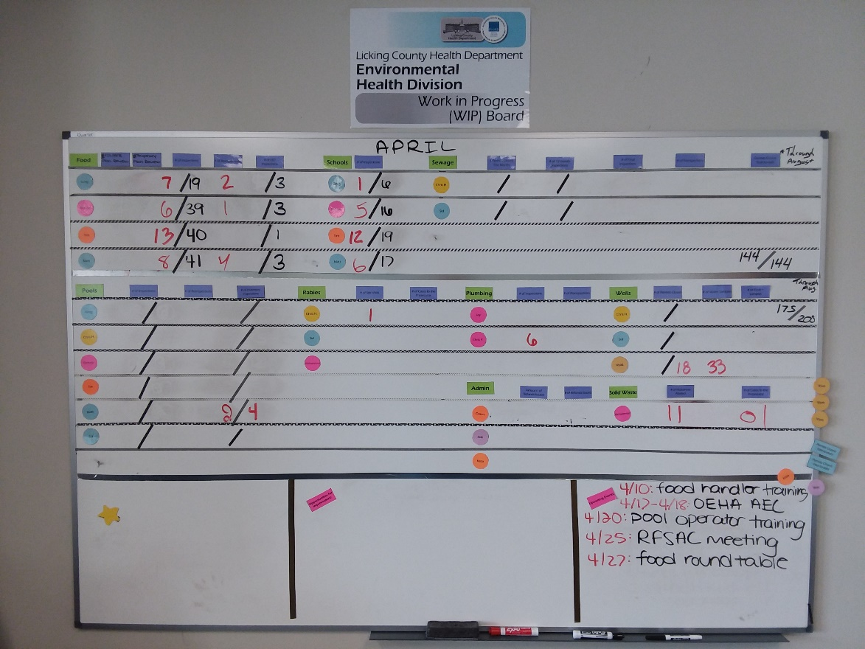
Performance Management
Environmental Health: Work in Progress Board
Quality Improvement and Performance Management in the WIC Clinic:
Improving Customer Service and Staff Performance

Slide 30
Impact on Original Objective
Reduce Overall Time at the WIC Clinic
Quality Improvement and Performance Management in the WIC Clinic:
Improving Customer Service and Staff Performance

Slide 31
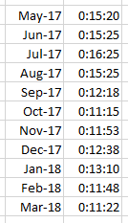
Impact on Original Objective
Reduce Participant Waiting Time Between Clinic and Counseling
Quality Improvement and Performance Management in the WIC Clinic:
Improving Customer Service and Staff Performance

Slide 32
How much time does this take?
Time Commitment
Collecting data: part of the normal clinic process
Organizing data sheets: 5 to 7 minutes, each day
Entering data: 25 to 30 minutes, each day
Validating data: 50 to 60 minutes, once a month
Creating reports: 30 to 40 minutes, once a month
Sharing reports: 1 to 3 minutes per staff, once a month
Quality Improvement and Performance Management in the WIC Clinic:
Improving Customer Service and Staff Performance

Slide 33
Todd Kirkpatrick, MS, RD, LD
Director of Health Promotion
Licking County Health Department
tkirkpatrick@lickingcohealth.org
(740) 349-6485

