Slide 1
Making it Easier to shop for wic foods: a panel discussion
Antonia Violante
March 4, 2019
Notes:
My name is Antonia Vioante and I’m an Associate at ideas42
Going to give you a quick intro to ideas42 and behavioral science and then introduce a few insights we learned about the shopping experience.
First, what is ideas42?

Slide 2
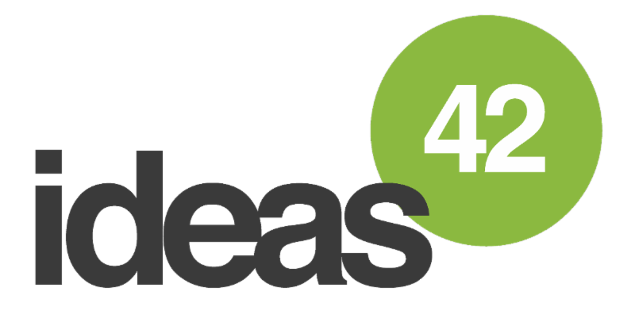
We use insights from behavioral science and psychology to design solutions to some of the world’s most persistent social problems.
Notes:
Ideas42 is a non-profit that….
I’ve been lucky to have been working on a project in WIC for almost 3 years now
Most recently working on a project focusing on retention
But before that did research to learn more about how behavioral science could be used to improve the WIC experience, from enrollment to drop out
We focused on San Jose, CA as a case study and talked with current and past participants as well as WIC staff – which culminated with a white paper
During that time we learned a lot about partcipants’ perceptions of the shopping experience
Will go into those in a second, but first want to introduce one key theme from behavioral science with an example

Slide 3
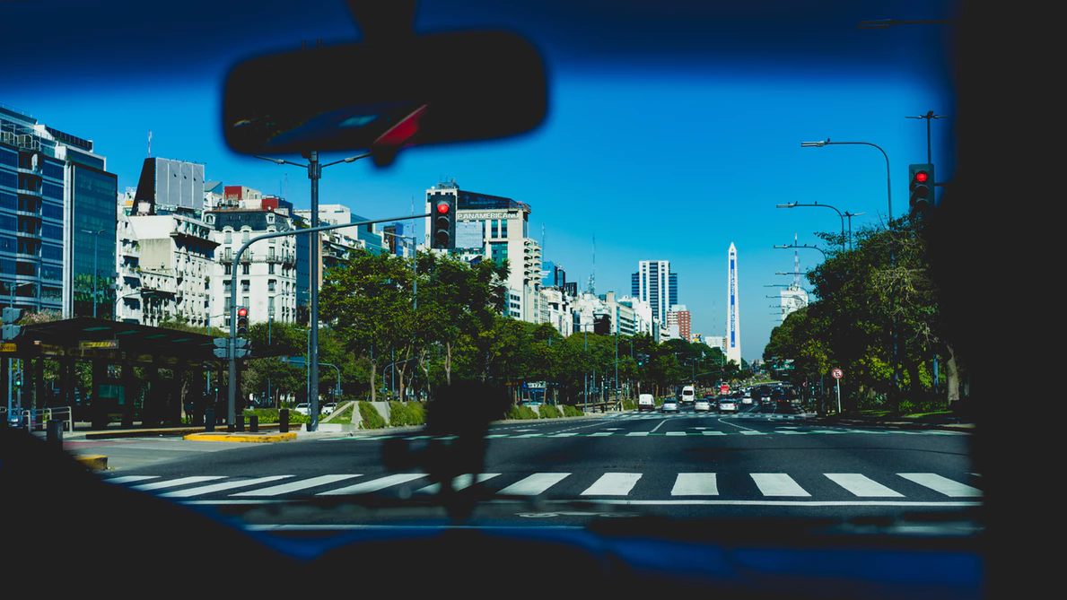
What is behavioral science?
Notes:
This example requires audience participation.
Imagine you’re driving your car down Mass. Ave. and the stop light turns red and you pump your breaks and stop before the cross walk.
But a car next to you whips right through the light.
What might you think about the driver behind the wheel?
Common answers: Inpatient, rude, reckless….
When you ask people this, they pretty consistently come up personal traits like this.
What they typically don’t come up with is situational factors….like that the driver might have someone with a medical emergency in the back seat.
This tendency to assume that any given decision or action people make is because of their personality, rather than the situation they are in, has been well documented by behavioral scientists
It’s called fundamental attribution error. The key insight here is that we systematically under-estimate the power of the situation, even tho it can be the key driver in a lot of decisions and actions people make
At ideas42, we use this insight and others from bsci lens to identify instances when people have intentions to do something, like redeem all of the foods on their WIC voucher or participate in WIC until they are no longer eligible, but don’t follow through in part bc features of the situation getting in the way
This is the lens we took to our research of the shopping experience several years ago.
Just like this example here, when we ask the question “why do people not redeem all the WIC foods they are eligible for”, it’s intuitive to assume it may be because of their own personal traits or preferences – they must not like the foods, they must not find the foods very beneficial
It’s reasonable that some of these people may exist, but we hypothesize that there are other people who do want to purchase all the WIC foods their eligible for, but features of the situation create barriers for them along the way
This is along the lines of what we found

Slide 4
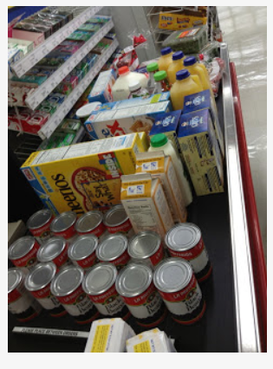
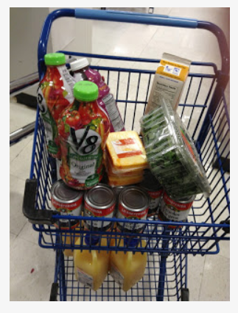
People intend to redeem vouchers (with minimal hassle), but don’t.
Geek Like Me, Too. “The WIC Experience”. Friday, April 12, 2013.
Notes:
I came across a blog that’s done by a dad who writes about his life and he had an entry about the WIC shopping experience, that’s where these photos are from
His story highlighted some of the same barriers we heard from WIC participants in our interviews
To set it up, this was his first shopping trip using WIC vouchers and he went to the store with his wife. He said they read the shopping guide beforehand and sketched out a preplan of what they would get from the store.
When he got there, he was surprised that deciphering which products were WIC eligible was not always clear. A couple features that make this difficult are that sometimes the requirements are complex, involving the brand name, weight and nutritional contents of the food, and the stores don’t always consistently label the WIC products. He and his wife stuck it out and put something in their basket for every category. But other people we talked to described having limited time and attention to devote to shopping. Maybe they are borrowing a car and can only use it for a half hour. They also might have a child with them. For these people, the small hassle in identifying the WIC product may deter them from buying the food altogether.
Second, once he made his way to the register, the cashier told him that not all of the products were WIC eligible. He described another cashier and a manager all having to come to their aisle to verify the products. And people in line behind him getting frustrated. You can imagine this not being a super pleasant experience and how it may affect your shopping trips in the future. Humans are risk averse, and when they go to shop next time and are only 50% sure that something is WIC eligible, they may not think it’s worth risking holding up another line and pass up on the item all together.
We talked to some participants who said that the hassles in the shopping experience impacted whether they thought the program was worth it to them in general.
The good news is we have behavioral scientists like Glencora and Caroline working to identify how we can make small tweaks in the context of the shopping experience that could make a big difference
One context we can consider updating is existing communications materials, like WIC shopping guides or WIC shopper apps, with behavioral levers like offering simple rules of thumb for eligibility
We could also think about how to update the physical context within the store
Could create an aisle with WIC eligible products so people have a default selection, but are still free to shop for other foods
Or, if we wanted to go super blue sky, we could imagine some stores pre-packaging a bag of WIC foods for participant to pick up
Ideas42 hasn’t yet had the opportunity to try any of these out, but looking forward to the possibility of doing so in the future.

