Slide 1
Making the Digital Connection: Using Integrated Marketing to Connect Families to WIC
2017 National WIC Association Conference

Slide 2
Making the Digital Connection: Using Integrated Marketing to Connect Families to WIC
Jean Holmgren, Maternal & Family Health Services 2017 National WIC Association Conference

Slide 3
Some Background:
About Maternal & Family Health Services

Slide 5
110,000
Women, children and families served by Maternal & Family Health Services each year.

Slide 8
Identifying the Issues:
Why online marketing?

Slide 9
74%
Of households making less than $30,000 per year report regular internet usage.
*Perrin, Andrew & Duggan, Maeve, Americans’ Internet Access, Pew Research Center, 2015

Slide 10
19%
Of all Americans indicate that their smartphone is their only means of accessing the internet regularly.
*Smith, Aaron, U.S. Smartphone Use in 2015, Pew Research Center, 2015

Slide 11
56%
Of households making less than $30,000 per year use social media.
*Perrin, Andrew, U.S. Social Media Usage: 2005 - 2015, Pew Research Center, 2015

Slide 12
Identifying the Issues:
The MFHS strategy

Slide 13
The MFHS Strategy
Point all traffic to a central information hub.
Regularly test and adjust messaging.
Integrate online and traditional marketing.
Maintain a consistent schedule of fresh content.
Review data and adjust strategy.

Slide 14
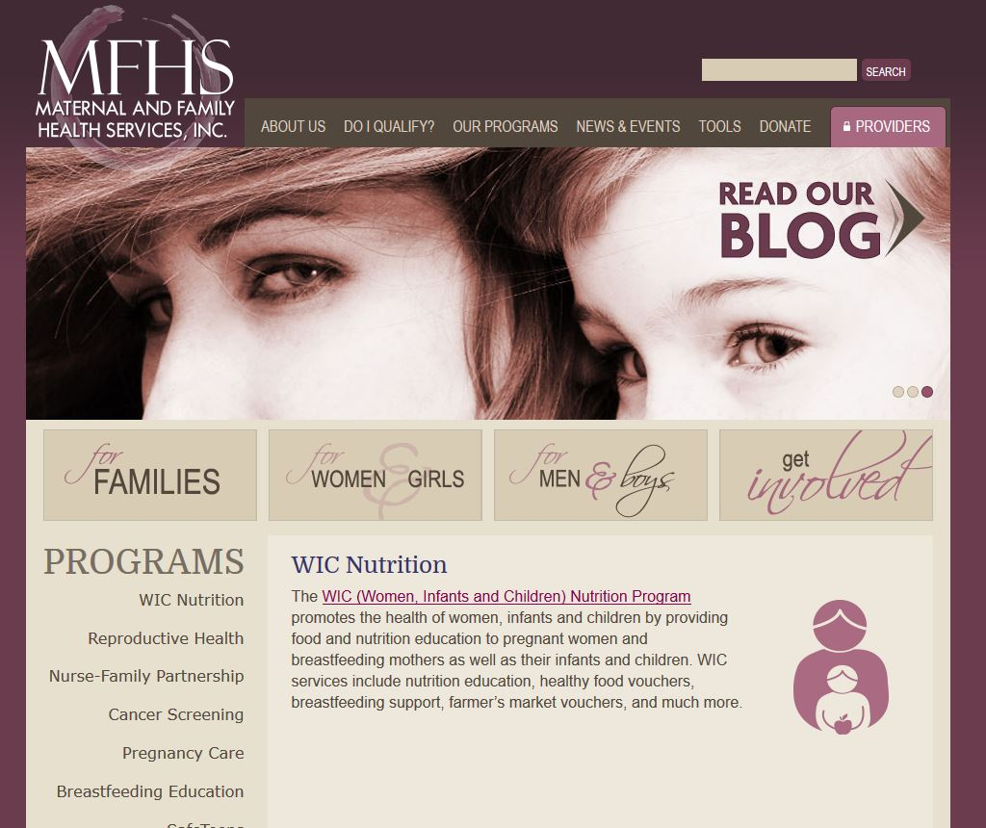

Slide 15
Online Marketing Tools
A brief overview

Slide 16
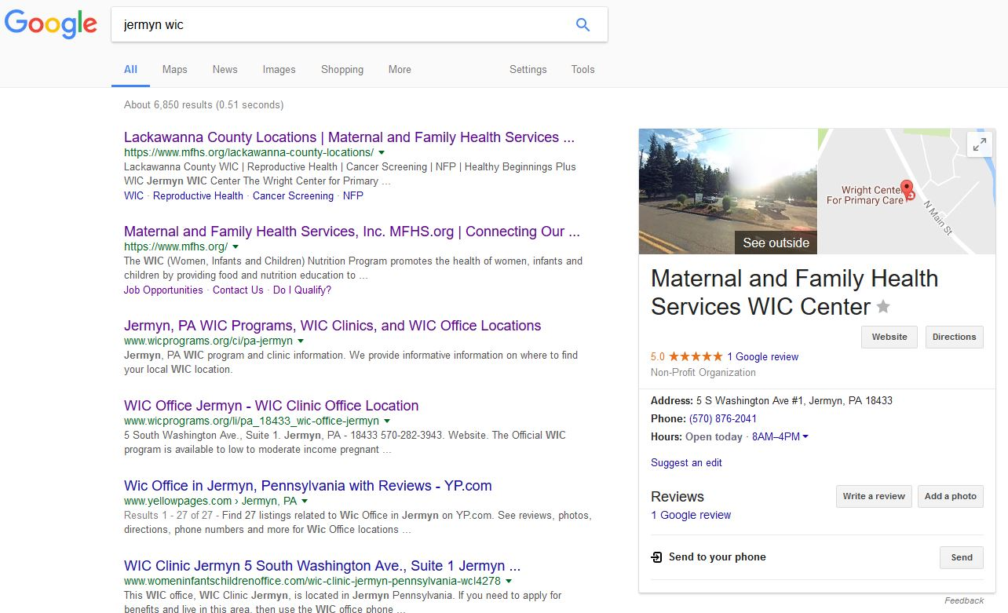

Slide 17
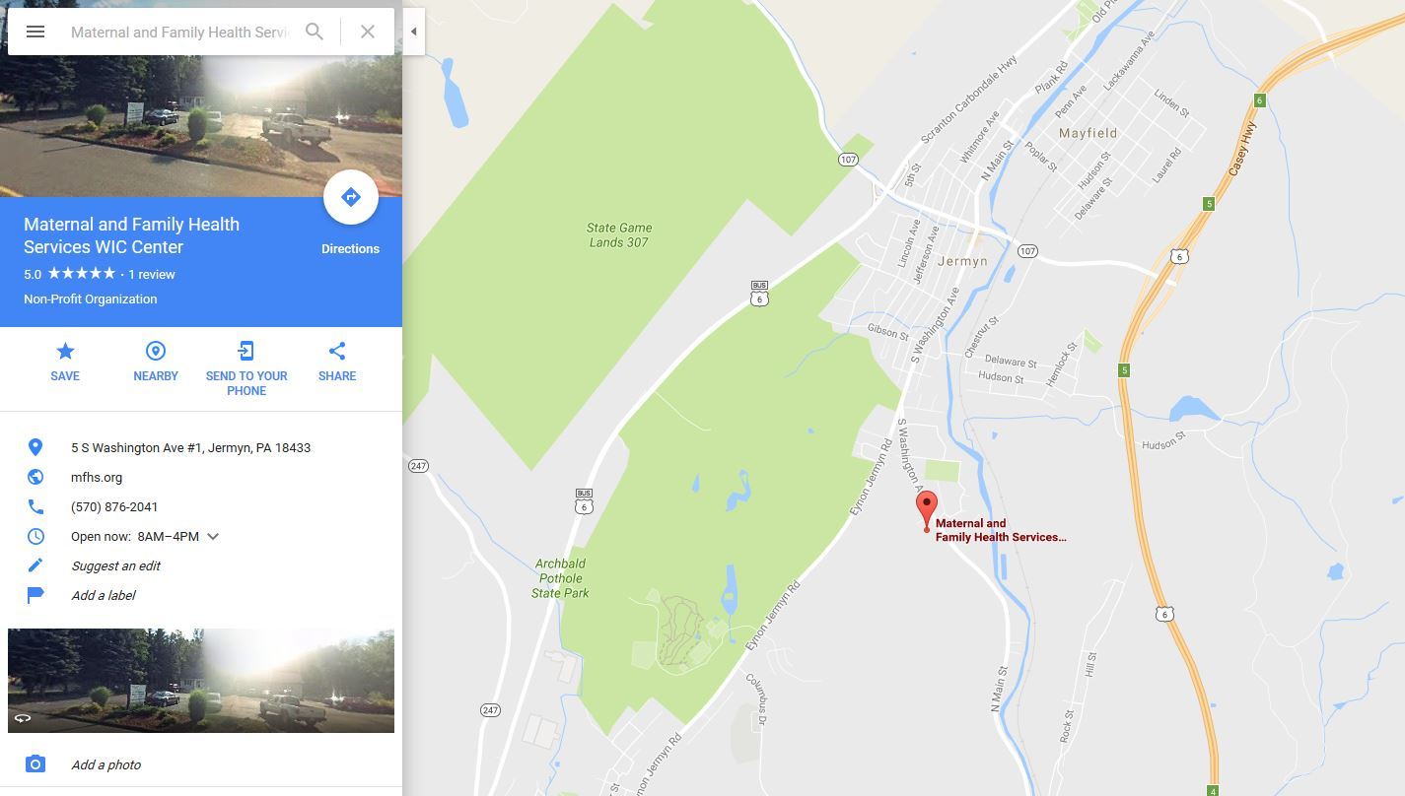

Slide 19
Keywords, “WIC Income Guidelines” ad group, MFHS WIC Google AdWords Campaign

Slide 20
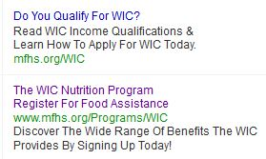
Sample Ads, MFHS WIC Google AdWords Campaign

Slide 21
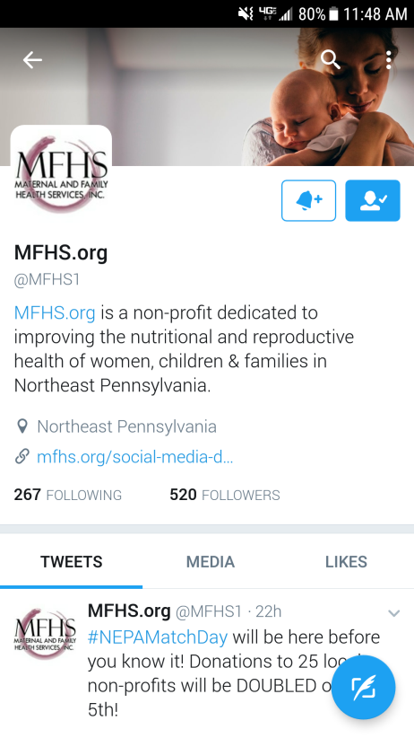
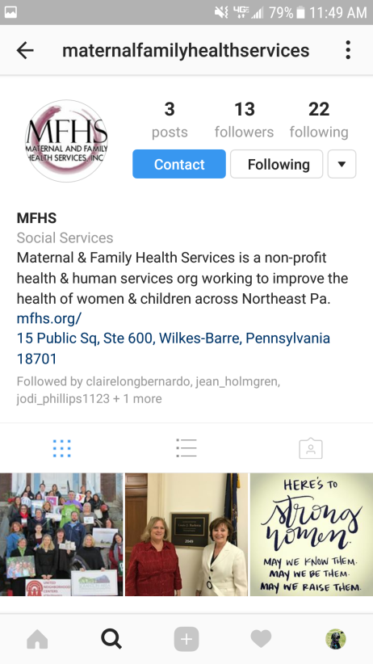

Slide 22
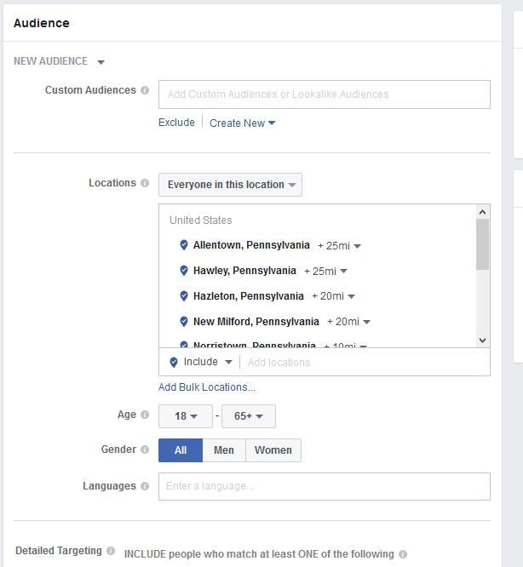
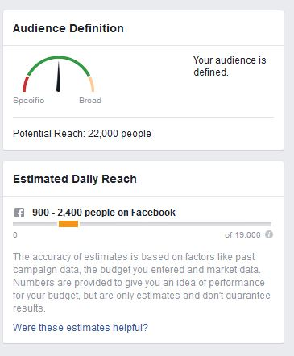
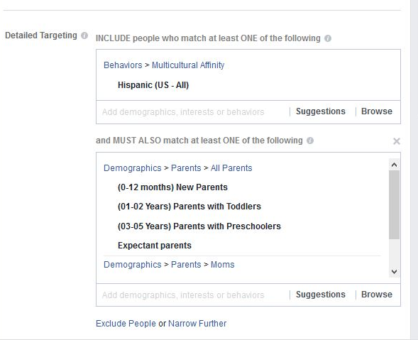

Slide 23
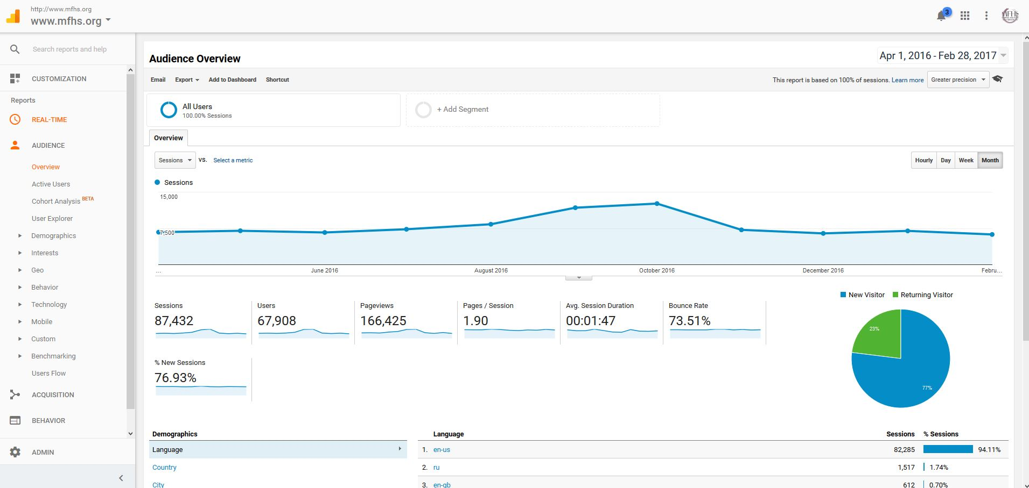
Google Analytics

Slide 24
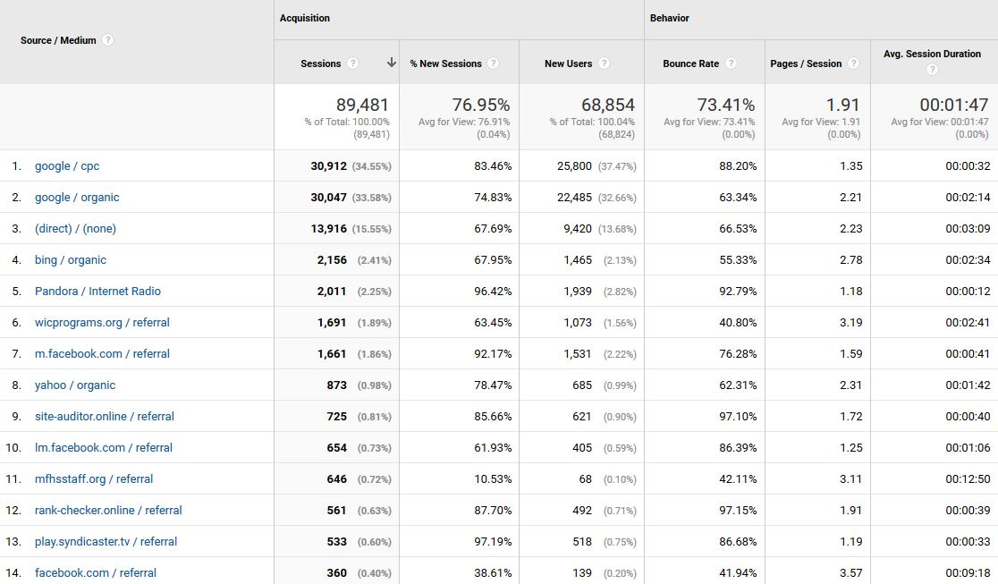

Slide 25
Key Takeaways

Slide 26
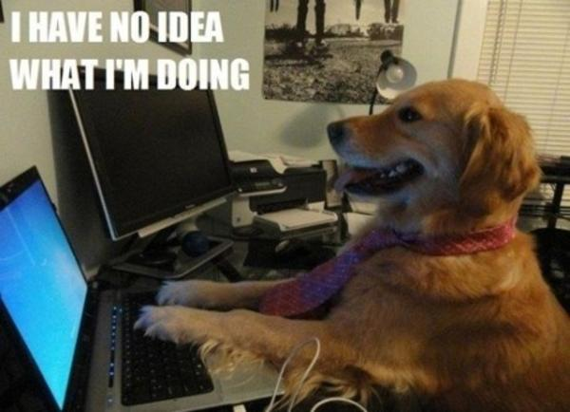

Slide 27
Key Takeaways
WIC participants are already online. It’s up to us to join the conversation.
Search engines are great – but they don’t always get it right.
Online advertising is budget friendly, highly targeted and customizable for local and state agencies.

Slide 28
Key Takeaways
Make a plan – what do you know, what can you learn?
Know your limits – implement one or two new tools at a time.
It’s ok to fail!
Don’t be afraid to engage. Social media is key to great customer service.

Slide 29
jeanh@mfhs.org

