Slide 1
NJ Healthy Corner Store Initiative: Partnering to Improve Community Health
Presenters:
Karin Mille, RDN
Nutrition Consultant
NJDOH Community Health & Wellness (CHW) Program
Johanna Garcia, BSW, MPA
Vendor Manager
NJDOH Women, Infants, & Children (WIC) Program
Miriam Manon, MPA
Senior Associate
The Food Trust
NWA Conference
April 4, 2017

Slide 2
Overview
Partnering to Improve Access to Healthy Foods in Underserved Areas of NJ
The Food Trust
NJDOH: Community Health and Wellness
NJDOH:
WIC Services
Notes:
An innovative partnership to increase access to healthier retail options for families located in under-served areas
-NJDOH Community Health and Wellness Unit
-NJDOH Women, Infants and Children Supplemental Food Program (WIC)
-The Food Trust

Slide 3
Community Health and Wellness (CHW)
The mission of the Community Health and Wellness Unit (CHW) is to:
prevent premature death and disability from chronic diseases including: diabetes, heart disease, stroke, cancer and asthma
enable people to manage risk factors for chronic disease, and
promote healthy behaviors including tobacco-free, healthy eating and active living

Slide 4
CHW: “State Public Health Actions to Prevent and Control Diabetes, Heart Disease, Obesity and Associated Risk Factors and Promote School Health” (DP13-1305)
1305 is a federal grant used to help states prevent and control chronic diseases, such as obesity, diabetes, heart disease, and stroke
One major focus of 1305 is establishing healthy environments in workplaces, schools, early childhood education facilities, and in the community
Notes:
nutrition and physical activity
Diabetes
heart disease and stroke prevention, and
promote school health

Slide 5
Fortuitous Timing
Simultaneous to the awarding of the CDC grant to the NJDOH CHW Unit, a federal WIC policy change was also instituted
The collaboration was an opportunity to address policy and environmental changes
The goal of the policy and environmental change is to “reinforce healthful behaviors and expand access to healthy choices”

Slide 6
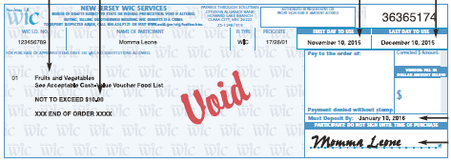
WIC: Cash Value Vouchers (CVVs)
One objective of the grant is to improve access to healthy foods in underserved areas
This objective is being measured through CVV redemption
Notes:
Participants receive Cash Value Vouchers (CVVs) (commonly referred to as fruit and vegetable checks by participants).
WIC checks and CVVs are redeemed at NJ WIC-authorized food establishments.

Slide 7
WIC: Policy Change
In June 2014, NJ WIC instituted a policy change requiring all WIC- authorized stores to stock more fresh fruits and vegetables (2 fresh fruits, 2 fresh vegetables)

Slide 8
Training Sessions
In an effort to capitalize on existing, mandated WIC vendor training, NJWIC, CHW, and the Food Trust held 20 bilingual training session for all WIC-authorized vendors statewide
Attendees took part in a post-training survey to assess their reactions to the training and concerns regarding selling fresh fruits and vegetables in their stores

Slide 9
The Food Trust
A nationally recognized nonprofit dedicated to ensuring that everyone has access to affordable, nutritious food
Notes:
They work with neighborhoods, grocers, and policymakers using a comprehensive approach to improved food access that combines nutrition education with improving food environments
The Food Trust’s Healthy Corner Store Initiative offers technical assistance to store owners interested in making healthy and profitable changes to their stores

Slide 10
Training & Technical Assistance Topics
Choosing healthy products for your store
Buying and handling fresh produce
Produce display
Incorporating produce throughout the store
Fresh produce and temperature guide
Value added product ideas
Fresh produce pricing and markup
Pricing and promotions
Advertising your business
Maximizing your space
Notes:
Year long training and technical assistance

Slide 11
Post-Training Survey Results: Small Stores
60% stocked fewer than 10 varieties of fresh produce
Owners expressed concerns about waste/ spoilage of fresh produce, marketing/space to display, and profitability
Owners requested additional training sessions that would cover topics including:
Educating consumers
Business management/planning
Funding/financing options

Slide 12
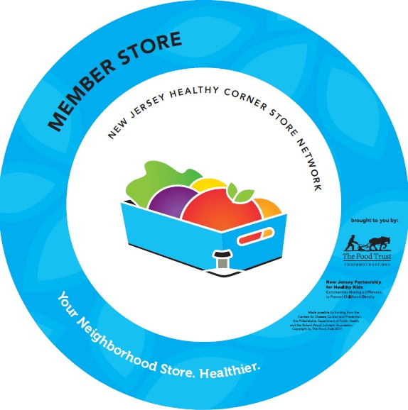
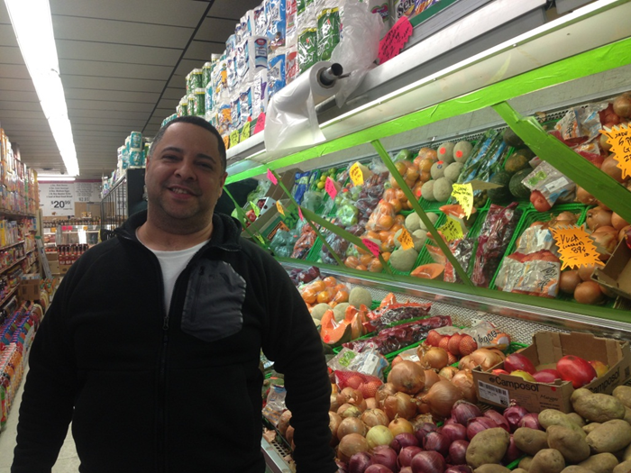
Healthy Corner Store Initiative

Slide 13
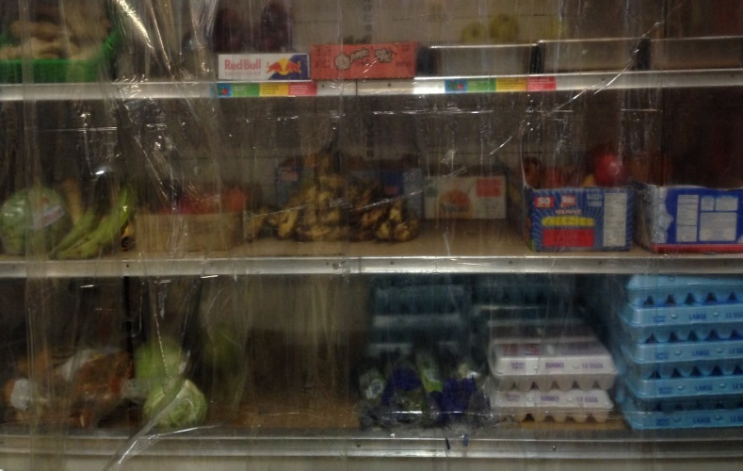
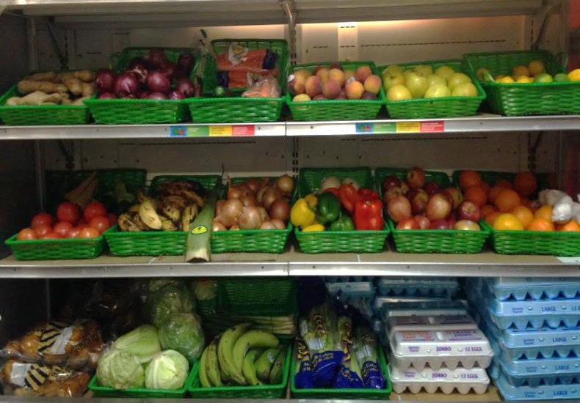
Before
After
Before
Boxes of produce on the ground
AFTER
After
Freddies Grocery, Camden, NJ
Wilcania Market, Garfield, NJ

Slide 14
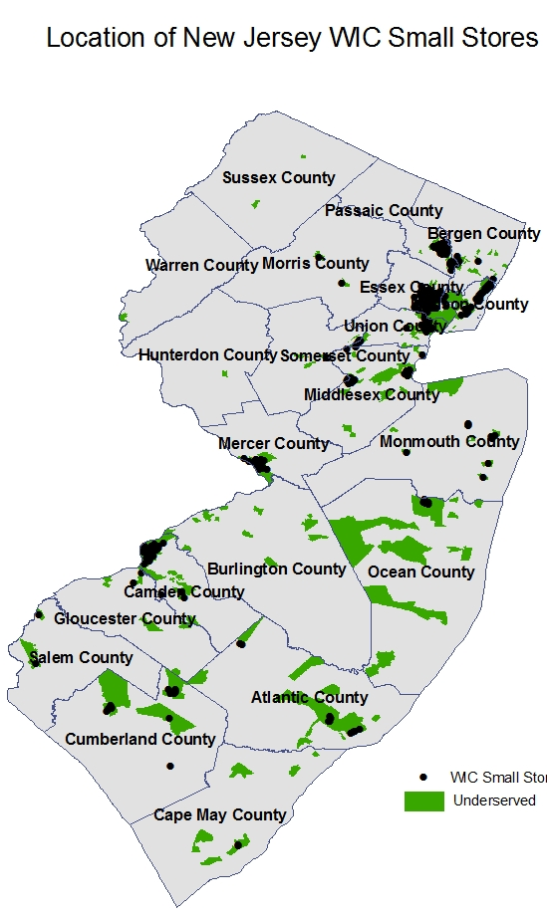
Statewide Reach
In Years 2-4 (2014-2017), 48 stores participated in the HCSI.
By reaching all 161 WIC small stores in underserved areas, the potential reach could be 530,029 residents representing 33% of all residents in underserved areas

Slide 15
Health Impact
Greater availability of convenience stores has been associated with higher BMI and overweight among US adolescents¹
Greater fresh vegetable availability within walking distance of urban households was found to be a positive predictor of vegetable intake²
Increased distance to supermarkets has been associated with increased likelihood of obesity and decreased fruit and vegetable consumption³
1. Powell LM, Auld MC, Chaloupka FJ, O'Malley PM, Johnston LD. Am J Prev Med. 2007.
2. Bodor JN, Rose D, Farley TA, Swalm C, Scott SK. Public Health Nutr. 2008.
3. Michimi A1 Wimberly MC. Int J Health Geogr. 2010.

Slide 16
Thank you
Questions?

