Slide 1
Peer Breastfeeding Support Advances Health Equity
Minnesota WIC Program
NWA Annual Education and Training Conference, April 24, 2018

Slide 2
MN WIC Demographics
To address health disparities, you need to identify them
Standard race/ethnicity categories are insufficient for distinguishing between diverse cultural groups

Slide 3
MN WIC Demographics
MN WIC’s efforts to identify groups:
Ask individuals who identify as “Black” or “Asian” to choose a cultural identity from a list
and
Link to BIRTH CERTIFICATES using names & DOB
…which provides Mother’s country of origin
Notes:
Other MRW states allocated by formula based on participation by agency. WI now moving to RFP.

Slide 4
Minnesota’s Growing Diversity
Infants born in Minnesota
Groups served by MN WIC
Notes:
Minnesota’s general population is not as diverse as its newest citizens (babies).
Currently 1/3 of MN births are infants of color.
Even more diverse, 60% of infants in WIC are non-white.
….. Note: WIC participants graph includes infants born outside Minnesota.
WIC serves about 25% of white infants, 60% of Hispanic infants, 70% of Hmong infants, and 90% of Black and American Indian infants

Slide 5
Disparities in BF Initiation – by Cultural Identity
HMONG infants:
about half are 2nd generation
infants of new immigrant mothers have even lower rates (56.1%)
BLACK infants:
about half have foreign-born mothers
overall high initiation rate for Black infants masks lower rates among African-American infants
Notes:
Other MRW states allocated by formula based on participation by agency. WI now moving to RFP.

Slide 6
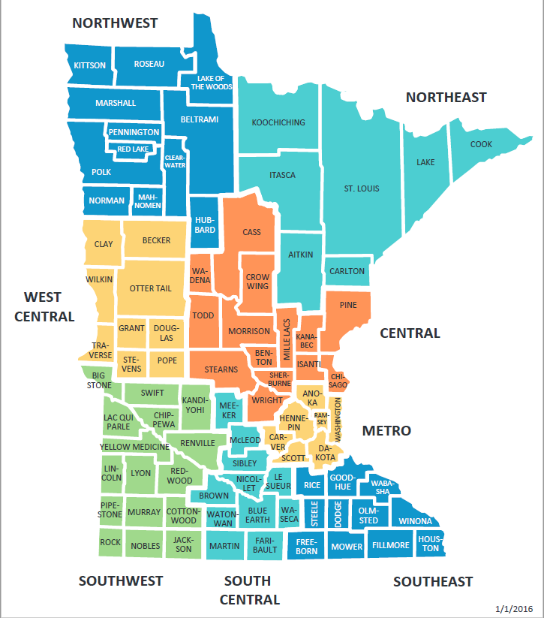
Disparities in BF Initiation – by Region
Notes:
Geographic disparities also an issue
Note Metro and Northeast – changes correspond to adoption of Baby-Friendly Steps?
Minnesota Breastfeeding Coalition and MDH held 4 Hospital summits from 2013 to 2016

Slide 7
Disparities in BF Exclusivity – by Region
Exclusivity data collected by most LAs
WIC Reports & Data
breastfeeding by race, cultural identity,
prenatal WIC participation, age
The Importance of Exclusive Breastfeeding during the Hospital Stay
Breastfeeding Exclusivity During Hospital Stay by Race/Ethnicity and Selected Cultural Identities
NE
SC
Central
SW
State
Metro
Notes:
NW & W-Central not enough data to report
Colors don’t match because map reuses the same colors
Southeast/South Central – Mayo consolidation?

Slide 8
Disparities in BF Exclusivity – by Race/Cultural Identity
Notes:
FIGURE 3 – disparate hospital feeding practices by Race/Cultural
FIGURE 4 – infants supplemented in hospital → BF fewer days
“Black” - Mother born in the United States, does not identify with another culture
** “East African” includes Somali, Sudanese, Ethiopian, Kenyan and Oromo

Slide 9
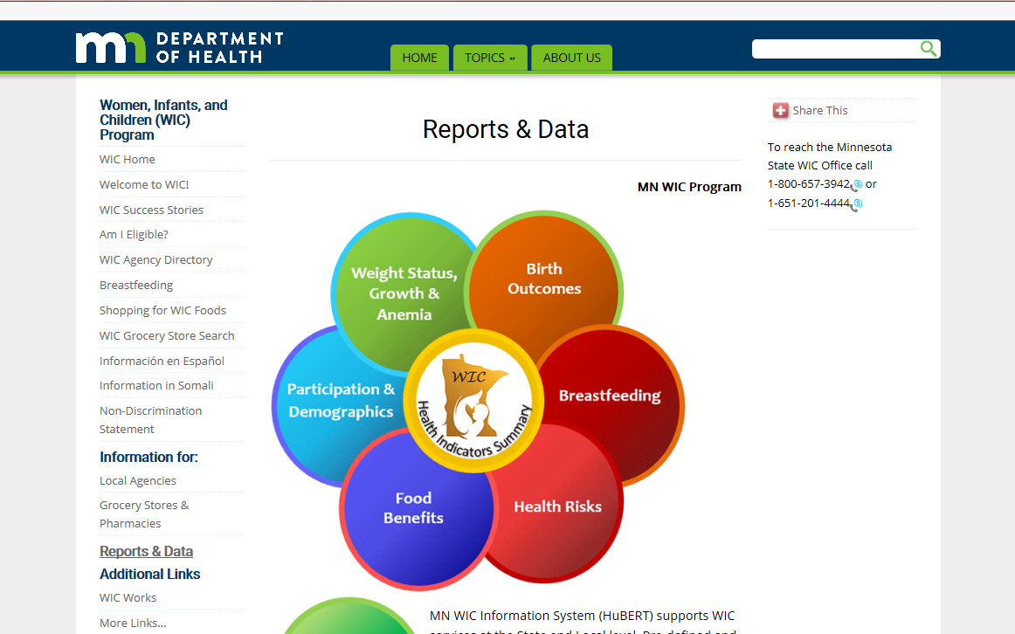
WIC BF Data on on MN WIC Website
Notes:
DATA available….
by year – county, Community Health Board & City
by Race & Ethnicity
for Black & Asians – by cultural identity

Slide 10
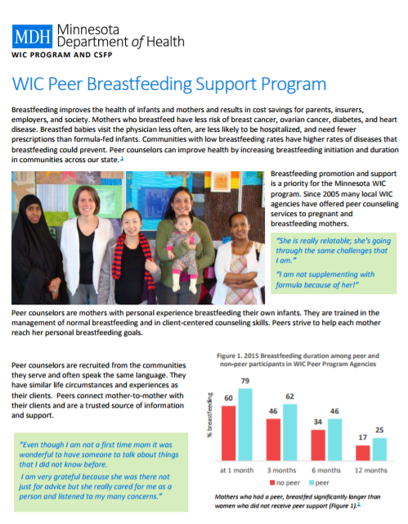
MN Peer Program Fact Sheet
Notes:
Available on MN WIC website

Slide 11
MN Peer BF Program
USDA Loving Support Model for Successful Peer Counseling Program
PEERS are like those being served:
Have BF at least one infant
Many have been WIC participants
Of the culture of those being served – share language, traditions, history
PEER ROLE:
Provide basic BF education & support to pregnant & postpartum WIC participants
Notes:
Other MRW states allocated funds across LAs based on participation (as MN WIC does w/ general WIC funds).
WI now moving to RFP.

Slide 12
MN Peer BF Program - Background
HISTORY
2005 – conducted pilots; competitive grants resulted in 4 programs
2010 – w/ significant funding increase from USDA, added 7 programs
2011 – added 3 grantees (= 8 counties)
2016 – added 2 grantees (= 6 counties)
Currently – 14 Peer Programs
Minnesota only state in Midwest Region that used competitive grant process
Notes:
Other MRW states allocated funds across LAs based on participation (as MN WIC does w/ general WIC funds).
WI now moving to RFP.

Slide 13
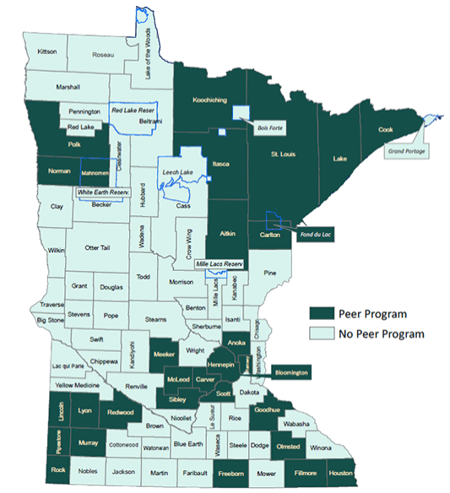
2018 Peer Programs
Hennepin
St. Paul/Ramsey
NE MN (7 counties)
Anoka
Bloomington
Fillmore Houston
Fond du Lac
Goodhue
Olmsted
Scott Carver CAP
Freeborn
SWHHS (6 counties)
Meeker McLeod Sibley
Polk Norman Mahnomen
http://www.health.state.mn.us/divs/fh/wic/bf/peermap.html
Notes:
Colors represent different times when started. Some programs have started and ended during this time. Douglas Otter Tail, Mille Lacs County, Grand Portage. Those listed are the current ones.

Slide 14
Participation in Peer BF Program
Notes:
Total participation has declined, but NUMBER of women (and PERCENT of BF women) receiving PEER services has INCREASED
Enrolled – of those offered a peer, those who said YES
Enrolled & Contacted – of those “enrolled”, those who were actually contacted by a peer
% enrolled = % of BF women????

Slide 15
Participation in Peer Program – by Race/Ethnicity
Notes:
Racial & ethnic makeup of infants in peer program agencies born in 2015 whose mothers enrolled in the peer program
QUESTION : WHAT are the percent??

Slide 16
BF Initiation & Duration – Peer Program
Women participating in peer services have significantly higher duration rates at all time points compared to those not participating.
MN WIC duration and HP 2020 goals are calculated as a percentage of all births. * p<0.001 at all time points
Notes:
peer: women who participated in the peer program, defined as having at least one peer program contact (telephone call, text exchange or face-to-face contact).
No peer: women who were not offered services OR who refused services OR who enrolled in the program but were not contacted.
HP 2020: Healthy People 2020 goals

Slide 17
Peer BF Support Programs Advance Health Equity
Rate between those who did & did not receive peer services differed significantly, p<0.001 in all groups, except East Africans
East African includes Somali, Ethiopian, Kenyan, Sudanese and Oromo NH: Non-Hispanic HP 2020: Healthy People 2020
Notes:
peer: women who participated in the peer program, defined as having at least one peer program contact (telephone call, text exchange or face-to-face contact).
No peer: women who were not offered services, who refused services or who enrolled in the program but were not contacted.
POINT OUT: Hmong vs Asian, no peer → peer
Black (AA) vs East African

Slide 18
Peer BF Support Programs Advance Health Equity
Rate between those who did & did not receive peer services differed significantly, p<0.001 in all groups, except East Africans
East African includes Somali, Ethiopian, Kenyan, Sudanese and Oromo NH: Non-Hispanic HP 2020: Healthy People 2020
Notes:
Disparities in exclusivity are also less among peer program participants.
Information on exclusivity was collected for WIC participants in some Minnesota WIC agencies. In 2015 collected on 24% of infants
peer: women who participated in the peer program, defined as having at least one peer program contact (telephone call, text exchange or face-to-face contact).
No peer: women who were not offered services, who refused services or who enrolled in the program but were not contacted.

Slide 19
Peer BF Program Evaluation
The numbers look good, but do we know the program is really making a difference?

Slide 20
Challenges in Evaluation
Selection Bias
“Women who accept a peer referral would breastfeed anyway”
If women w/ more peer contact BF longer, is it because the peer is helping, or are women who self-select to accept counseling just more motivated to breastfeed?
Selection bias is probably present whenever a study can’t be randomized. It is less likely but can still occur in randomized trials.
Why not conduct a randomized trial?
Cost
Feasibility: in clinic environment, not referring a woman who could benefit from counseling, for the purposes of study validity, is not ethical
So most randomized studies randomize agencies, rather than individuals, to have peer counseling.

Slide 21
MN Peer BF Program Evaluation
Inspiration for Evaluation
In 2012, we discovered that significant number of women who accepted peer referral were never assigned a peer
Found to be due to work flow issues, and
Appeared to occur randomly - it wasn’t more common for some CPAs than others
Resulted in development of new report to prevent incomplete referrals
This system flaw provided an opportunity for evaluation

Slide 22
MN Peer BF Program Evaluation
Retrospective Study was conducted
All women in the study had accepted a peer referral
Three groups were compared:
Women never assigned to a peer
Women assigned but never successfully contacted
Women successfully contacted by a peer at least once

Slide 23
MN Peer BF Program Evaluation - Data Analysis
Two Outcomes were Evaluated
Initiation
For this outcome, peer contact was defined as prenatal contact only
Used logistic regression for adjusted odds ratio of initiation
Breastfeeding cessation
For this outcome, prenatal & postpartum contacts were included
Only women who initiated BF were included
Used Cox regression for hazard ratio for complete cessation of breastfeeding during infant’s first year
McCoy MB, Geppert J, Dech L, Richardson M. Associations Between Peer Counseling and Breastfeeding Initiation and Duration: An Analysis of Minnesota Participants in the Special Supplemental Nutrition Program for Women, Infants, and Children (WIC). Matern Child Hlth J. 2017 Jul 28:1-1.

Slide 24
MN Peer BF Program Evaluation – Initiation Results
Women w/ Peer Contact significantly more likely to initiate BF than women without prenatal contact and women not assigned a peer.
89% of women w/ contact initiated BF, compared to 83% of those not successfully contacted and 81% of those not assigned to a peer.
Logistic Regression Models for BF Initiation
 | Prenatally Assigned a peer & Received PC services |  | Prenatally Assigned a peer but Did Not receive PC services
 | vs. peer not prenatally assigned |  | vs. peer not prenatally assigned
 | Odds Ratio | 95% CL | Odds Ratio | 95% CL
Unadjusted | 1.81** | (1.30-2.50) | 1.15 | (0.83-1.61)
Adjusted¹ | 1.66* | (1.19-2.32) | 1.13 | (0.80-1.58)
¹ adjusted for region
as a confounder
* =p<.01, ** =p<.001
Notes:
The difference between 81% and 83% was Not Statistically Significant.
It may be due to a small impact made by the unanswered messages and/or texts that the women received, OR due to incomplete data on contacts made, where some women marked as never contacted were, in fact, contacted

Slide 25
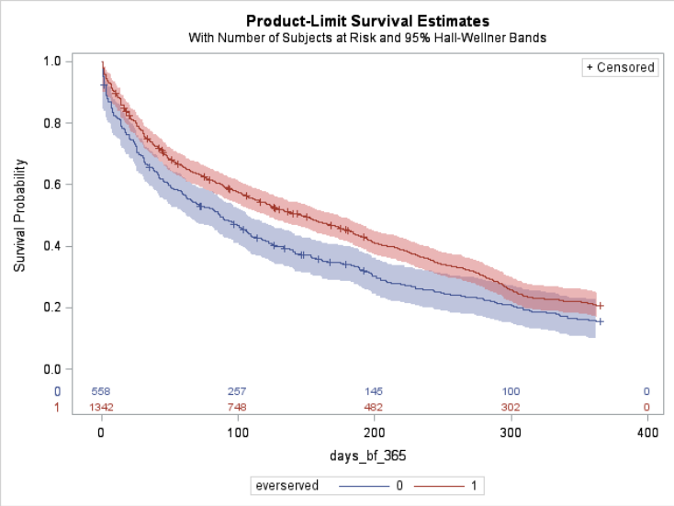
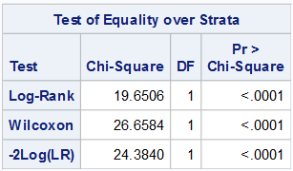
MN Peer BF Program Evaluation – Cessation Results
Unadjusted ‘Survival’ of Breastfeeding
With number of subjects at risk and 95% Hall-Wellner Bands
Survival Probability
Days breastfed
Received PC services
no
yes
Notes:
With the tests of significance

Slide 26
MN Peer BF Program Evaluation – Cessation Results
Women w/ peer contact at significantly lower risk of BF cessation than women without peer contact
Women w/out peer contact had more than twice the risk of weaning during 1st month and three times the risk of weaning during remainder of baby’s first year
Cox Regression Models for Discontinuation of BF
 | Ever Received PC services vs Never Received PC services
 | Hazard Ratio Month 1 | 95% CL | Hazard Ratio Months 2 → 12 | 95% CL
Unadjusted | 0.48** | (0.35-0.65) | 0.35** | (0.19-0.64)
Adjusted¹ | 0.45** | (0.33-0.61) | 0.33** | (0.18-0.60)
¹ adjusted for region as a confounder * =p<.01, ** =p<.001
Notes:
Not everyone likes the term “cessation” but a Hazard Analysis is about ‘risk’, and what is at risk here is the breastfeeding relationship

Slide 27
MN Peer BF Program Evaluation – Other Findings
Both associations were confounded by region
…….probably due to regional differences in initiation, duration and health care systems.
Although breastfeeding behavior is heavily influenced by culture,
the effect of peer services did not vary between races and ethnicities.
In other words, peers were equally effective regardless of the community of mothers they were serving.
One strength of this study is that US-born black and foreign-born black were modeled as separate race/ethnicities

Slide 28
MN Peer BF Program Evaluation – Other Findings
Other independent predictors for BF:
maternal age
prepregnancy BMI
smoking
gestational age (for initiation)
birth weight (for cessation)
Additional predictors had almost no influence on the association between peer services and breastfeeding outcomes
Sensitivity analyses were performed that reaffirmed study’s findings

Slide 29
MN WIC programs serve communities who are less likely to BF than the general population, with large diﬀerences in BF initiation & duration by race, ethnicity, and nativity. The WIC Peer Program is ideally situated to address these disparities.
In 2015, 17% of eligible women were enrolled in the peer program
Notes:
Nationwide, peer funding has not increased in several years, and has not been adjusted for inflation

Slide 30
MN WIC Peer BF Program
Contacts:
Linda Dech, MN WIC Peer Program Coordinator
linda.dech@state.mn.us / 651.201.3649
Marcia McCoy, MN WIC Epidemiologist
marcia.mccoy@state.mn.us / 651.201.4950
Pat Faulkner, MN WIC Breastfeeding Unit Supervisor
patricia.Faulkner@state.mn.us / 651.201.4402
Article available: Matern Child Hlth J. 2017 Jul 28:1-1
McCoy MB, Geppert J, Dech L, Richardson M. Associations Between Peer Counseling and Breastfeeding Initiation and Duration: An Analysis of Minnesota Participants in the Special Supplemental Nutrition Program for Women, Infants, and Children (WIC).

Slide 31
Thank you!
Minnesota WIC Program

