Slide 1
The Economics of Food Vendors Specialized to Serving the Women, Infants, and Children (WIC) Program
Patrick W. McLaughlin
USDA-Economic Research Service
Tina L. Saitone
University of California, Davis, Dept. of Ag & Resource Economics
Richard J. Sexton
University of California, Davis, Dept. of Ag & Resource Economics
The views expressed are those of the author(s) and should not be attributed to the Economic Research Service or USDA.

Slide 2
Motivation
Cost containment in part targets WIC vendors
Little known about the economics of vendors
  Study using WIC benefit redemption data
  E.G., assess the performance of a group in terms of geographic access or cost-effectiveness

Slide 3
Research Context
California WIC Program
  Paper voucher redemptions, Oct. 09 – March 12
  Large increase in number of vendors → moratorium on authorization in May 12
Vendor Types
  Large (5+ registers)
  Small (1-4 registers)
  A50 (>= 50% food sales from WIC)

Slide 4
Research Context
Geographic Food Access (USDA Food Access Research Access)
  Low-income, low-access: 1/3 of census tract residents ½ mile or more from nearest supermarket
  Versus Normal Access

Slide 5
Research Context
Entrant’s contribution to access by vendor type, food access status
  Two measures computed using redemption data
  Geographic focus: counties of Greater Los Angeles area
    Los Angeles, Orange, Riverside, San Bernardino, and Ventura Counties

Slide 6
Vendor Attrition
Definition: occurs when a WIC customer patronizes a vendor today but does not return for at least t months
What value for t?
  t=1 → propensity to shop around (opposite of store loyalty)
  t=3 → criticalness to participants’ WIC food access, highly correlated with never returning

Slide 7
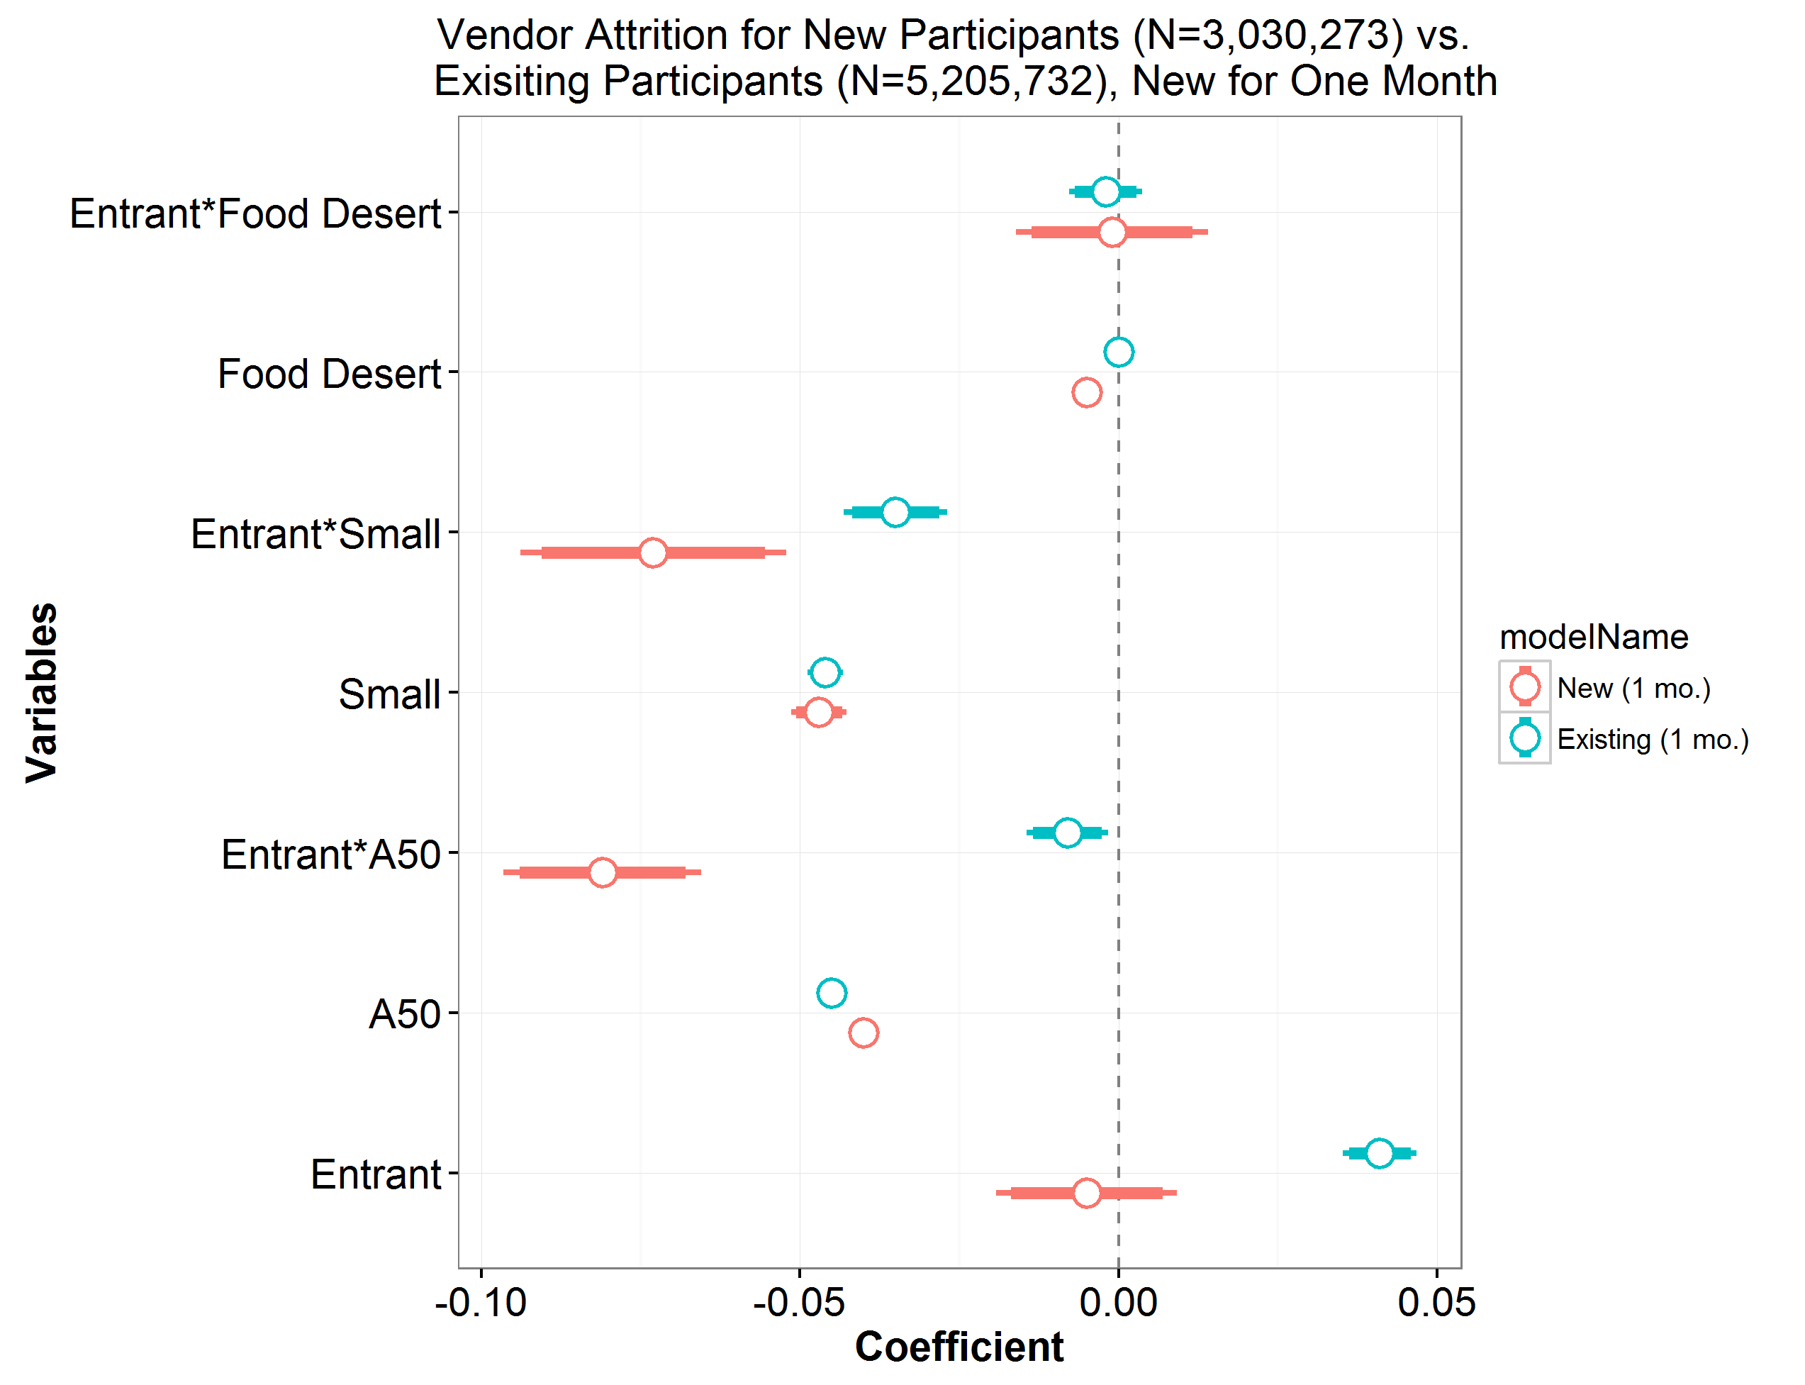
Vendor Attrition

Slide 8
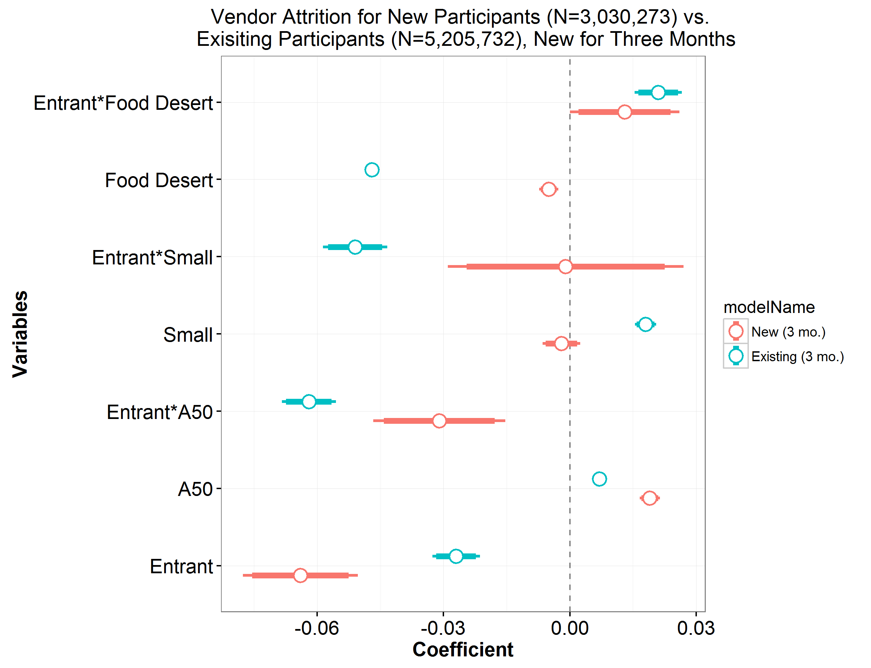
Vendor Attrition

Slide 9
De Novo Participant Ratio
Definition: a vendor’s ratio of new-to-WIC customers to all WIC customer
  How long is a participant “new”?
Purpose: did some (entrant) vendors cause participants to enroll compared to other vendors?
  Counter-factual is critical: vendors facing same broad participation trends
  All else equal, if entrants have higher proportion of new WIC customers then perhaps caused new enrollment

Slide 10
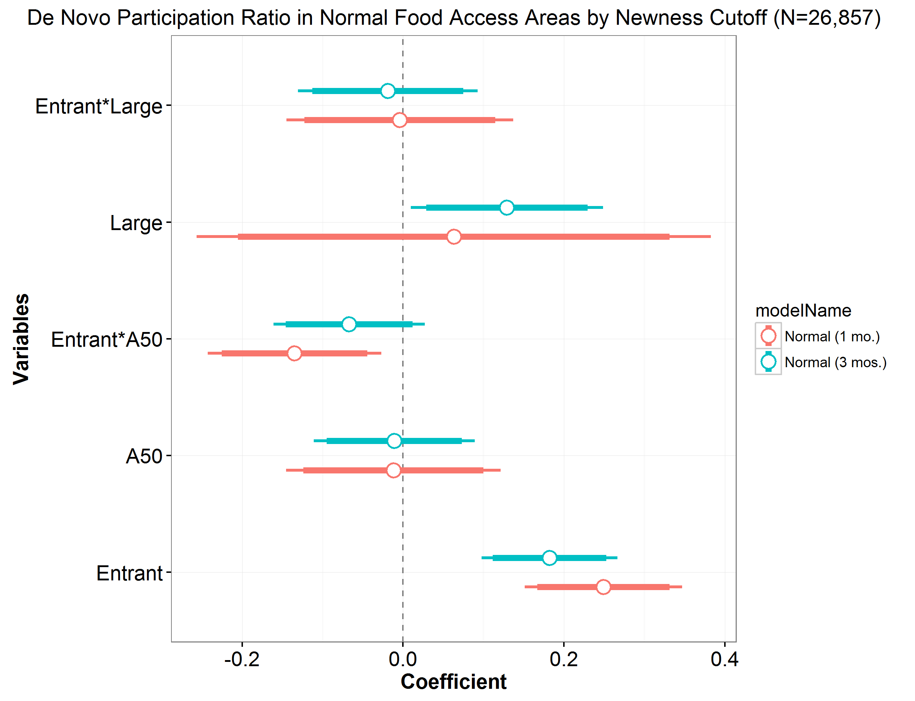
De Novo Participant Ratio

Slide 11
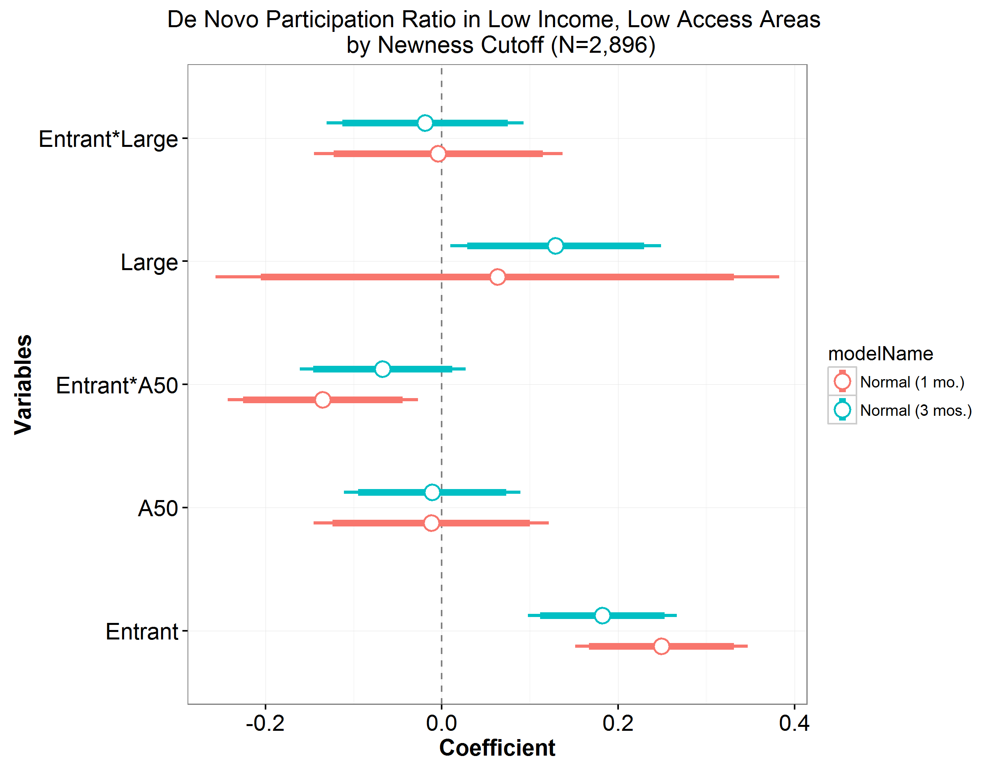
De Novo Participant Ratio

Slide 12
Takeaways
Entrants appear to do at least as well as incumbent vendors in attracting and retaining participants
  A50 vendors may have less attrition compared to large vendors
  Minimal difference in vendor types’ de novo participation ratios
Unclear impacts of entry in low-income, low-access areas

Slide 13
Not Featured
Relationship between WIC vendor market share and average redemption costs
Simulation of redemption costs and shopping trip travel distances if A50 vendors hypothetically removed from CA WIC vendor stock

Slide 14
Thank you!
Patrick McLaughlin
patrick.mclaughlin@ers.usda.gov

