Slide 1
Bridging the Gap: A Partnership Between a Hospital System and WIC Breastfeeding Peer Counselors and Staff
Cindy Galloway, RDN, LD, IBCLC
Cindi Faith Bennett, MN, RN, IBCLC

Slide 2
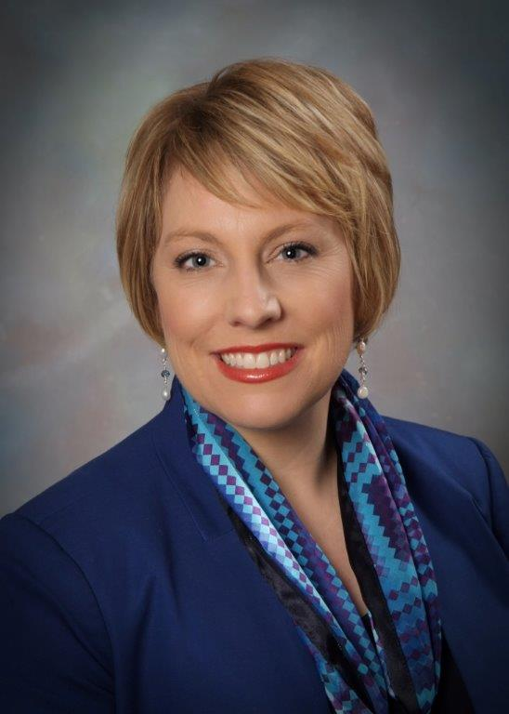
Acknowledgments
Dr. Jane Grassley, Boise State University & St. Luke’s Health System
Dixie K. Weber, MN, BSN, RN Women’s Service Line Administrator St. Luke’s Health System

Slide 3
Objectives
1. Participants will identify key components to developing a sustainable community partnership between a hospital and WIC breastfeeding peer counselors/staff to provide ongoing breastfeeding support in the hospital and after hospital discharge.
2. Participants will be able to explore developing a process for hospital visitation by WIC peer counselors/staff.
3. Participants will be able to discuss the process for WIC peer counselors to receive education on late preterm infants to provide referrals for improved breastfeeding support.
4. Participants will be able to define the steps to planning, implementing and evaluating a process to connect WIC breastfeeding peer counselors and staff before hospital discharge.

Slide 4
Idaho Breastfeeding Report Cards
cdc.gov/breastfeeding/data/reportcard.htm

Slide 5
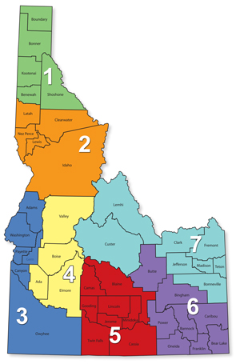
Idaho
Central District WIC:
Boise, Garden City, Kuna, Marian Pritchett, Terry Reilly, Meridian, Garden Valley, Horseshoe Bend, Idaho City, McCall, Cascade, Mtn. Home
&
Glenns Ferry

Slide 6
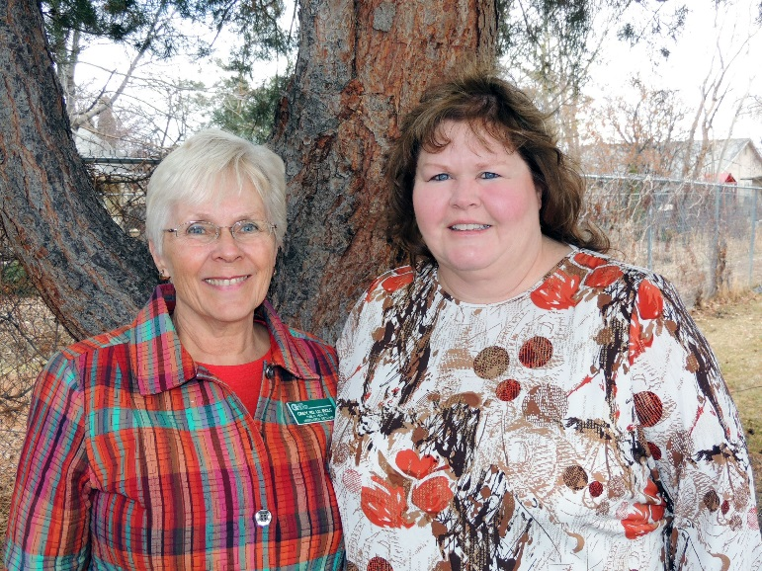
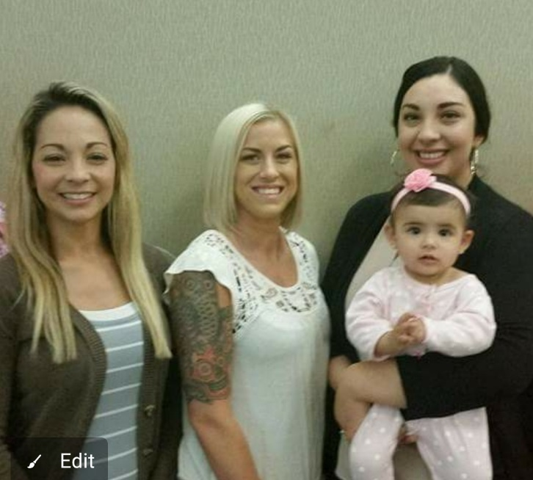
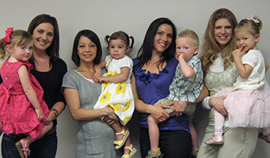
WHO: Central District Health Department WIC Program
Sachi, Deborah, Brenda
Cindy, IBCLC & Laurie, IBCLC
“Central District Health Department WIC program is pleased to provide an evidenced based Peer Counseling program to assist in breastfeeding promotion and support”

Slide 7
Where did we start?
Quarterly phone or in person local area Breastfeeding Coalition Meetings
WIC
Local Hospitals
University

Slide 8
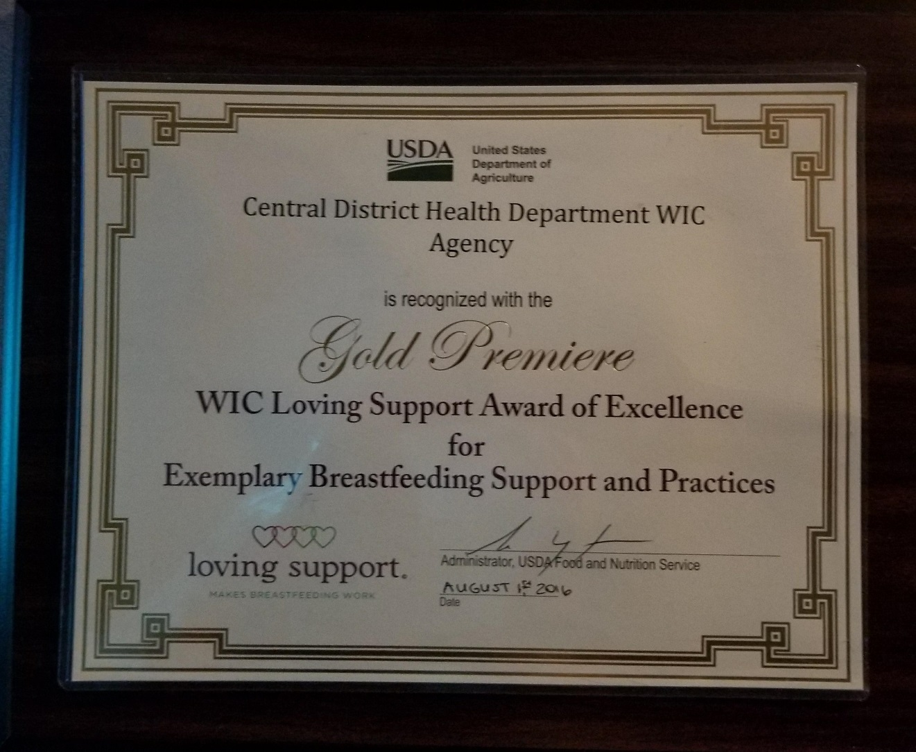
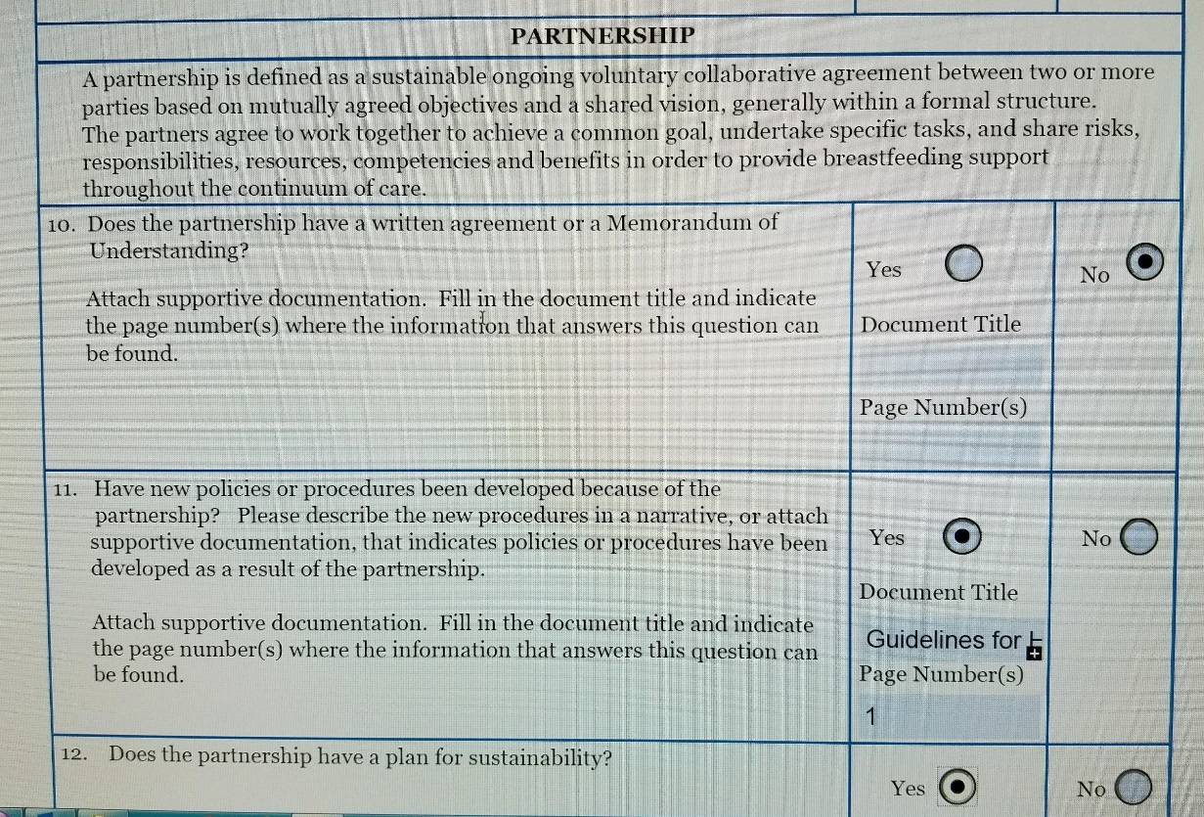

Slide 9
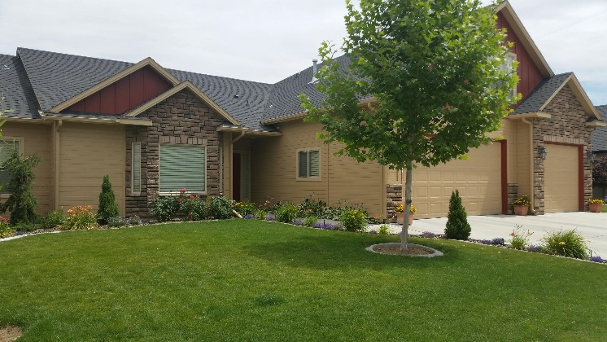
Bridging the Gap
HOSPITAL
TO
HOME

Slide 10
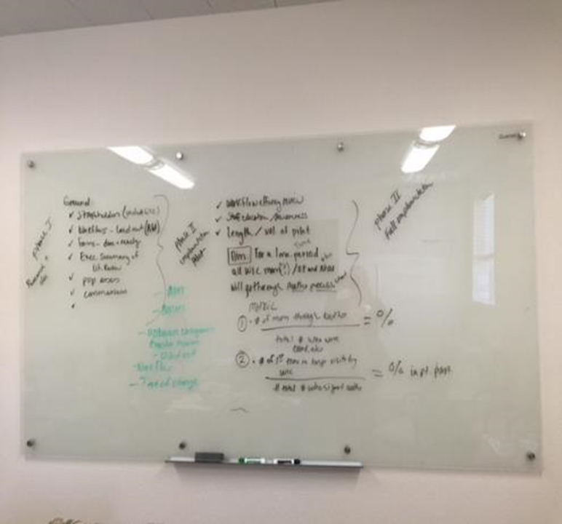
How: The Journey Begins
Phase 1: Engage Stakeholders
Phase 2:Create the Process
Phase 3:Diffuse the Process

Slide 11
WHAT: Normalize Breastfeeding Peer Counselors to the Hospital Setting

Slide 12
WHY: WIC Breastfeeding Peer Counselors
The Surgeon General’s Call to Action to Support Breastfeeding:
Advocates the need for partnerships between hospital and community-based organization
Reinforce programs that provide breastfeeding peer counseling
WIC Breastfeeding Peer counselors have a long history in the community:
Recruited and hired from WIC’s target population
Provide anticipatory guidance
Provided one on one support
Provide breastfeeding classes
Breastfeeding Peer Counselors improve:
Initiation, duration and exclusivity

Slide 13
HOW: Engage Stakeholders
Key Stakeholders | Needs, Wants & Expectations
Physicians and Other Care Givers NICU MDs, Administration Leadership, Nurses, Lactation Consultants, NICU Team, Central District Health WIC Breastfeeding Peer Counselors | Improved outcomes, improved care of the LPI breastfeeding dyad (Normalizing WIC BPCs into Hospital Setting)
Organizations St. Luke’s Children’s Hospital and CDHD Boise WIC | Enhanced efficiency, cost containment, community partnership, WIC BPC first visit with LPI in NICU
Patients Breastfeeding moms with a LPI in the NICU and on WIC | Improved patients’ experience with 1 initial visit in the hospital, continued support once infant is discharged home

Slide 14
HOW: Stakeholder Concerns
HOW: Create & Pilot the Process
Misunderstanding the role of the breastfeeding peer counselors in the hospital
Concerns about the breastfeeding peer counselors’ presence and role on the hospital unit
Concerns that WIC peer counselors are not IBCLCs
Will the process make work for us
Organizational Pathway Maps
Authorization Forms
Education of Staff
Education of WIC Peer Counselors
Scripting
Hospital tour with WIC Breastfeeding staff
Go live

Slide 15
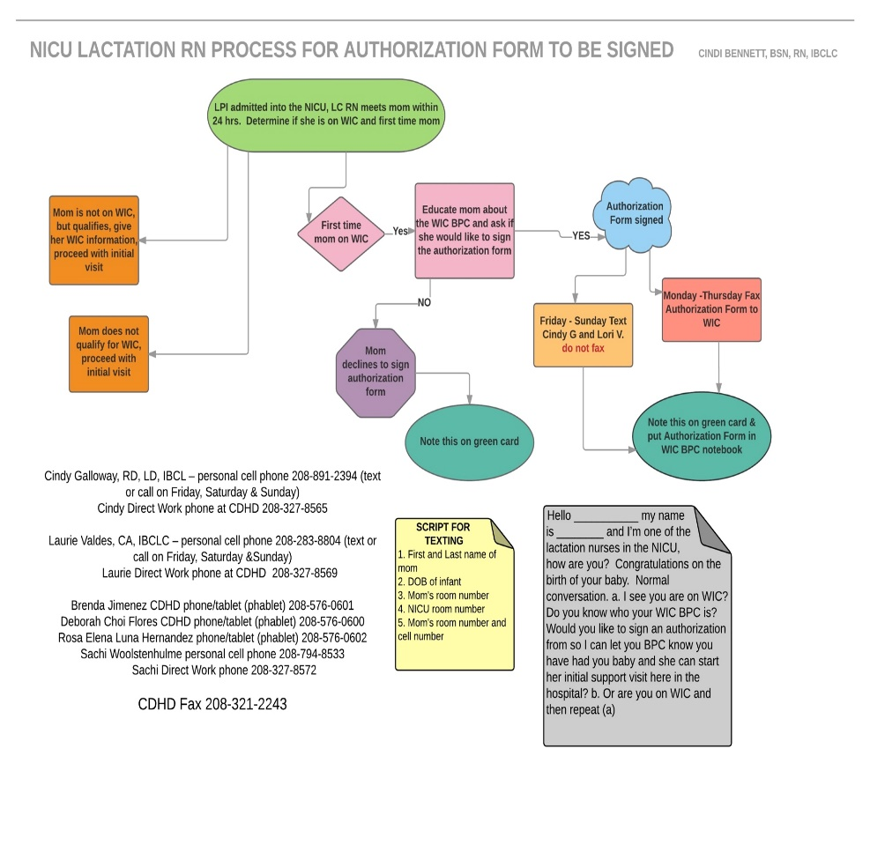
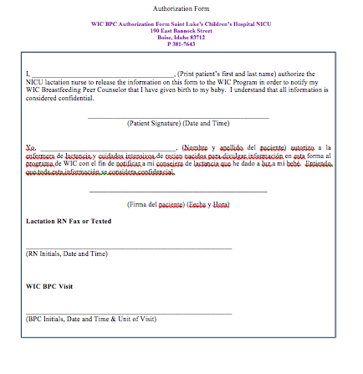
BUILDING A COMMUNICATION BRIDGE
Walk Thru
Introduction of the BPCs to hospital staff
Lactation office, supplies, communication binder
Role played with scripting
First time BPC visits Cindy or Laurie will accompany them
Casual dress with badges

Slide 16
Breastfeeding the Late Preterm Infant

Slide 17
Mother/Infant Breastfeeding Barriers
Less stamina
Less coordinated S/S/B
Less effective suckling
Less alert, awake periods
Insufficient breast stimulation
Incomplete emptying
Insufficient milk transfer
Insufficient milk supply
Hypoglycemia
Jaundice
Poor weight gain
Readmission
Supplementation
Separation from mother
Wight, Pediatric Annals 2003; 32:5

Slide 18
OUTCOMES
Central District WIC:
Boise, Garden City, Kuna, Marian Pritchett, Meridian, Garden Valley, Horseshoe Bend, Idaho City, McCall, Mtn. Home & Glenns Ferry
Southwest District WIC:
Nampa, Caldwell, Emmett, Homedale, Payette & Weiser
South Central District WIC:
Bellevue, Heyburn, Gooding, Jerome, Shoshone & Twin Falls

Slide 19
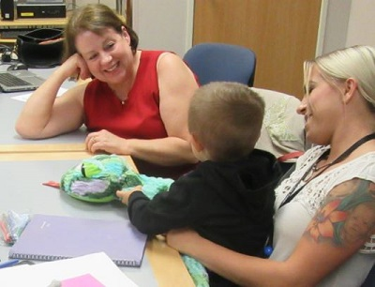
Conclusion

Slide 20
Thank You
Email:
Cindy Galloway
cgalloway@cdhd.Idaho.gov
and
Cindi Faith Bennett
bennettc@slhs.org
References on request

