Slide 1


Fruit and Vegetable Redemption Rates after Introduction of Electronic WIC Benefits
Susan M. Gross, PhD, MPH, RDN, LDN
Assistant Scientist
Ilene Cervantes del Toro, MSPH, RDN, LDN
Population Family and Reproductive Health
Maryland WIC Program at Johns Hopkins

Slide 2
Presenter Disclosure Statement
Susan Gross
The following personal financial relationships with commercial interests relevant to this presentation existed during the past 12 months:
NO RELATIONSHIPS TO DISCLOSE

Slide 3
Learning Objectives
At the end of the session attendees will be able to:
Describe the perceived benefits and challenges of using eWIC benefits for a select group of WIC participants from Baltimore.
Examine group differences in fruit and vegetable redemption rates by WIC participant category, number of WIC participants in the household and language.

Slide 4
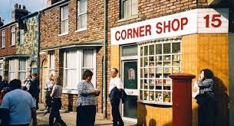
WIC Fruit and Vegetable Benefits
In 2009, the fruit and vegetable benefit was added to WIC food packages.¹
  Cash value vouchers
  Electronic Benefit
Increases fruit and vegetable consumption²
Improves access to healthy foods in urban areas³
Source: ¹McBride E, et al. (2007) Cash Value Voucher Report. Available at: http://www.fns.usda.gov/wic/cash-value-voucher-report. Accessed August 31, 2018.
²Herman DR, et al. (2008). Am J Public Health. 2008;98:98–105.
³Andreyeva T, et al. (2012). J Acad Nutr Diet. 2012;112:850–858.

Slide 5
Fruit and Vegetable Benefit Redemption in the WIC Population
Redemption rates are lower than expected
In 2015, Baltimore, only about 67% of WIC CVVs are redeemed for their full value¹
In 2015, in Virginia, 72% of WIC CVVs were redeemed. Black and SNAP participants with lower redemption rates²
In 2011, American Indian and Alaskan Native participants had the highest non-redemption and the lowest full redemption of FV benefits among all racial and ethnic groups in Wisconsin.³
In 2011, disparities in CVV redemption in Washington State for tribal reservation WIC clinics compared to non-tribal clinics⁴
Source:¹Paige, D. M., Gross, S.M, & Bondy, A. (2015). Baltimore City Needs Assessment May 15, 2015 (Rep.). Baltimore, MD.
²Zhang,Q. and Tang,C. (2016). Understanding WIC Fruits and Vegetables Redemption in Virginia http://www.nationalacademies.org/hmd/Activities/Nutrition/ReviewWICFoodPackages/2016-JUNE-29/Videos/Primary%20Session/6-Tang-Zhang-Video.aspx (Last accessed 08/31/18)
³Najjar S. Barriers to WIC Benefits Redemption Among Participants in Washington State [Masters Thesis]. Seattle, WA: University of Washingon; 2013.
⁴McLaury KC, et al (2016) https://doi.org/10.1080/19320248.2015.1112755 Blue Bird Jernigan V, Salvatore AL, Styne DM, Winkleby M. Addressing food insecurity
in a Native American reservation using community-based participatory research. Health Educ Res. 2012;27:645–655.
Notes:
Zhang,Q. and Tang,C. (2016). Understanding WIC Fruits and Vegetables Redemption in Virginia http://www.nationalacademies.org/hmd/Activities/Nutrition/ReviewWICFoodPackages/2016-JUNE-29/Videos/Primary%20Session/6-Tang-Zhang-Video.aspx (Last accessed 08/31/18)

Slide 6


Barriers to Fruit and Vegetable Benefit Redemption
Individual-level barriers:
Urban WIC participants difficulty with calculating benefit and unfamiliarity with fruits and vegetables
Time constraints
Food preferences
Zhang Q, Tang C, McLaughlin PW, Diggs L. Individual and Store Characteristics Associated with Brand Choices in Select Food Category Redemptions among WIC Participants in Virginia. Int J Environ Res Public Health. 2017 Mar 31;14(4).

Slide 7

Role of the Retail Environment on Benefit Redemption
Environmental barriers:
Absence of produce
Poor quality produce in stock in the stores accessed by participants
Price
Training of cashiers at store
Okeke JO, Ekanayake RM, Santorelli ML. Effects of a 2014 Statewide Policy Change on Cash-Value Voucher Redemptions for Fruits/Vegetables Among Participants in the Supplemental Nutrition Program for Women, Infants, and Children (WIC). Matern Child Health J. 2017 Oct;21(10):1874-1879.

Slide 8
Grocery Store Employee Perceptions: Challenges with WIC Voucher Redemption Study
Brown, E., Gross, S.M., and Payne, E.

Slide 9
Objectives of Study
The purpose of the study was to assess the perceptions of grocery store employees about experiences with Women, Infants, and Children (WIC) program voucher redemption.
Notes:
TALK ABOUT THE FRAMEWORK

Slide 10
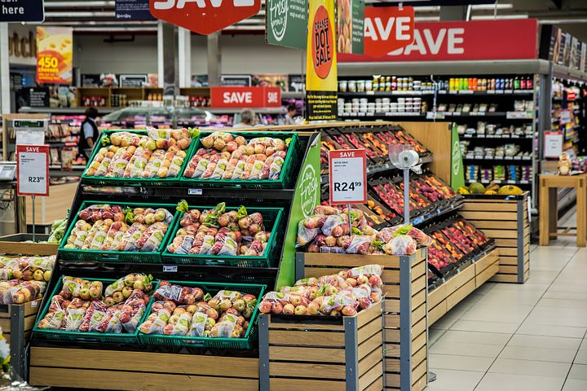
Methods
A volunteer sample of a partner grocery chain’s eight WIC-certified stores in Baltimore City was recruited to participate in the study
25 audio-recorded interviews (with guide) were conducted with 27 grocery store employees – 16 cashiers, 10 managers, and one produce manager
  Representative from corporate office sat in on manager interviews
Notes:
Interview guide topics included: level of knowledge of WIC CVVs, as appropriate to their employment role; costs and sales; staff training about WIC CVVs; and experiences with WIC participants using vouchers

Slide 11
Methods - Analysis
An inductive thematic analysis approach for the analysis based on the interview transcripts.
  An audit trail of codes, code definitions, and memos was kept throughout the process
The complete codebook contains 240 codes and 17 sub-categories covering perceptions of all aspects of grocery shopping and WIC voucher redemptions from the interviews.
Notes:
A separate research team member performed random checks of 20% of the transcripts (3 cashier interviews and 2 manager interviews).

Slide 12
Results - Check Redemption
57 reported instances in which customers redeemed WIC CVVs (whether under the amount, the exact amount, or over the amount)
  Over the amount 22 times (39%)
  Purchase was exactly the CVV value 17 times (30%)
  Under CVV amount 18 times (32%).
…it seemed like they don’t know. They don’t know when they be up there. It seem like they don’t know. Like they don’t know how much is going to be, or if it’s going to total out, if the total amount is going to be over or under. Its like they just be guessing. And then once they see it, then they be like oh no, just take that off, I’ll just use the $11 or you can keep that on, I’ll just pay the remaining balance. (Male Cashier)

Slide 13
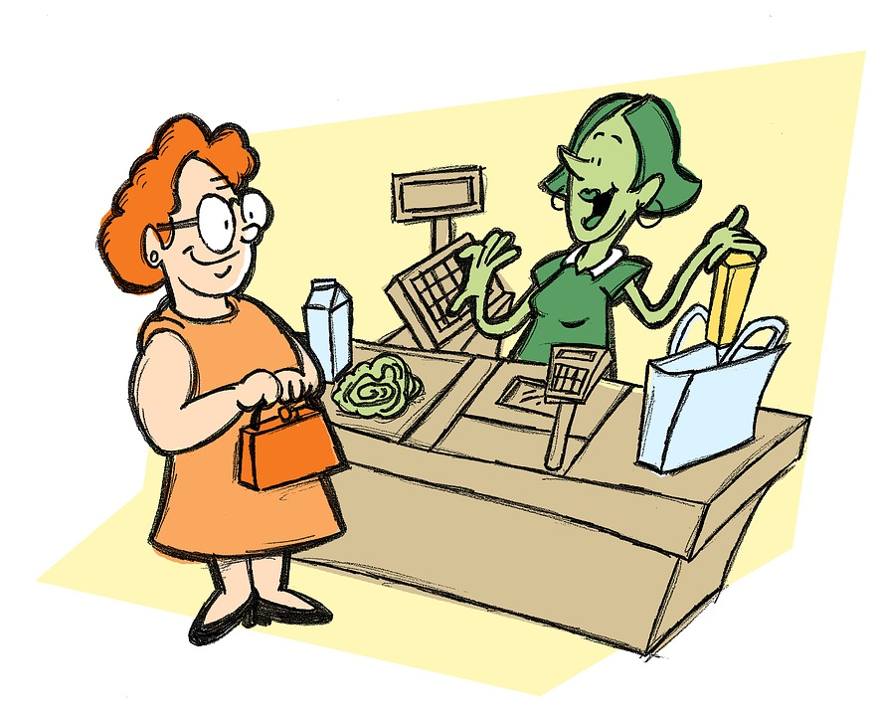
Results - Retail Inconsistencies
Employees were unclear about the logistics and reasoning behind the variance in WIC-eligible foods.
…one thing that, uh, I think a lot of us at the store are confused about, is, I know I think the store participates in different WIC items? Like it’ll carry, like for example, in a customer’s WIC book, they'll have, like, "you can get this kind of bread and this kind of, you know, it’ll say you can get Sara Lee bread", but then we don't participate in that here.
Interviewer: Right you don't have that brand of bread.
Well we have the brand, but I've been taught that we don't give that bread for WIC we give a certain, like, cause I think we have a list here of the certain items we participate in with WIC…And a lot of customers come in and they're confused about that, they say "Well my book says, I can get Sara Lee," and I’m, I have to say, "Well I have a packet that says 'these are the items that we participate in". (Male Manager)
Notes:
Customers were not the only ones with questions

Slide 14
Summary and Conclusion
Results highlight the present grocery store environment in which many WIC participants do produce shopping in Baltimore City
Transition to electronic WIC (eWIC) began in July 2017 for Baltimore City
Strengths: fills gap in current literature
  Patterns and gaps related to the employees’ respective roles in the WIC voucher provision and redemption process
Limitations:
  Partnership with food retailer and interview involvement
Notes:
Emphasized the coordination between WIC customers and vendors required for WIC voucher redemption

Slide 15

One Manager’s Final Thoughts:

Slide 16
Fruit and Vegetable Redemption among a select group of WIC participants from Baltimore Study

Slide 17
Objective
To assess WIC participant fruit and vegetable redemption and satisfaction with use of eWIC at a local Maryland WIC agency

Slide 18
Methods
Sample
  All local agency WIC Participants attending Benefits Pick Up during three designated weeks during Fall 2017
Data Collection
  Audit of all FV benefit redemption during month before survey administration for all families attending the identified Benefit Pick Up classes.
  Survey of all Participants during Benefit Pick Up the during three designated weeks of 2017

Slide 19
Methods – Audit Outcomes
% un-redeemed FV benefit
  un-redeemed FV benefit
      FV benefit completely expired
  %un-redeemed FV benefit
      #households with un-redeemed benefit/Total households
% under-redeemed FV benefit
  under-redeemed FV benefit
      ≥$0.20 expired benefit
  % under-redeemed FV benefit
      #households with under-redeemed benefit/Total households
% complete redemption of FV benefit
    complete redeemed FV benefit
      <$0.20 expired benefit
  % complete redemption of FV benefit
      #households with completely redeemed benefit/Total households

Slide 20
Results
Fruit and Vegetable Benefit Redemption Audit
Study Population
  N=194 families
 | Number of Households | %
Primary Language
Spanish | 104 | 53.6%
English | 83 | 42.8%
Other | 7 | 3.6%
Number of WIC participants in household
1 | 135 | 69.6%
2 | 45 | 23.2%
3+ | 14 | 7.2%

Slide 21
In 2015, prior to eWIC, 23% of participants were not redeeming their fruit and vegetable Cash Value Voucher (CVV).

Slide 22
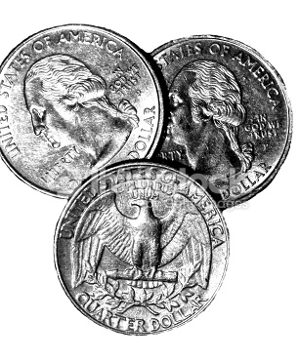
Under-Redemption
25% of participants under-redeemed their FV benefit.
Of the under-redeemers, over half (51.5%) had less than $0.75 that had expired.
The average amount that had expired was $2.12.

Slide 23
FV Benefit Redemption by Language
No significant differences between the redemption of eWIC F/V benefits by language spoken.
But there may be some language barriers to address for those who speak a language other than English or Spanish.

Slide 24
Redemption by Number of WIC Participants in Household
Notes:
The larger the family size (3 or more people), the less likely they were to fully redeem their benefits. (p < 0.01)

Slide 25
FV Benefit Redemption by WIC Category

Slide 26
Redemption by Category
When compared to other categories, households with pregnant women were 3.26 times more likely to under-redeem (p < 0.01).
Households with partially breastfeeding moms too were less likely to redeem their full benefits compared to households with this category (p = 0.05).

Slide 27
Frequency of the Number of Transactions
Notes:
The number of transactions for complete redemption of benefits vs. under-redemption was not statistically significant. The average number of transactions (excluding non-redeemers) was about 3.

Slide 28
Characteristics of Survey Sample (N=39)
Characteristics of Survey Sample | n(%)
Language
English | 13 (33%)
Spanish | 25 (64.1%)
Other | 0 (0%)
Unknown | 1 (2.6%)
Number of Participants in Household
1 WIC Participant | 26 (66.7%)
2 WIC Participants | 6 (15.4%)
3+ WIC Participants | 1 (2.6%)
Unknown # of Participants | 6 (15.4%)

Slide 29
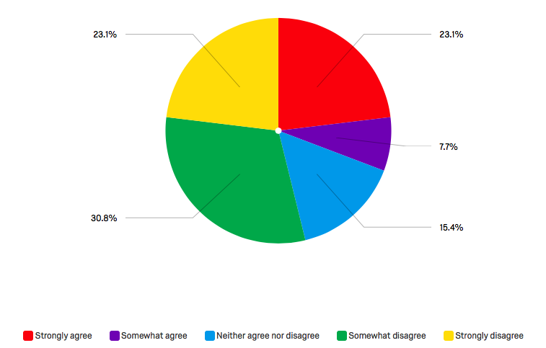
Statement: It is difficult to use all of my Fruit and Vegetable Benefit during the month.

Slide 30
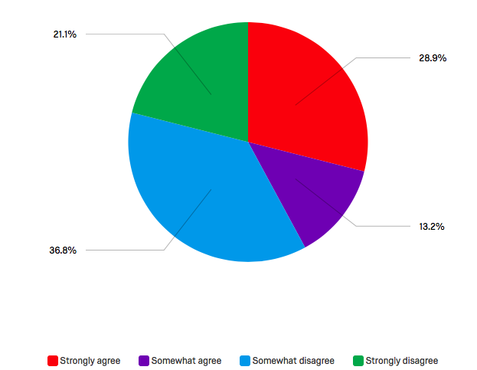
Statement: I find it hard to figure out how much an item costs when it’s priced per pound.

Slide 31
Suggestions from WIC Participants
“Specified list of items online for easier access”
Informed store employees (confusion about the qualified foods)
“Easier when you remember how much money is remaining, challenging when you don’t”
Ability to buy f/v in any store
Notes:
Most popular response was that the card was the easiest or that it is the easiest as is. (12/39 responses)

Slide 32
Potential Groups to Target and
How We Can Help
Potential Groups to Target:
  Larger families
  Pregnant and partially breastfeeding moms
Ways we can help:
  Help participants set up and use the phone application
  Provide food suggestions that will help them use up their remaining money

Slide 33
Lessons Learned
Education for participants and vendors about the check-out experience
  mock shopping scenarios
Use of new technologies
  create “push notifications”
    remaining benefits
    easy recipes that use F&Vs.
Track redemption patterns through the use of eWIC

Slide 34
Acknowledgments
BFHI Evaluation Team
Johns Hopkins
    Marycatherine Augustyn
    Patricia Bell-Waddy
    David Paige
    Johns Hopkins WIC staff
    WIC Participants
  Students
    Elizabeth Brown
    Emily Payne
    Dana Stretchberry
Baltimore Food Policy Initiative
    Alice Huang
    Kristin Dawson, and the rest of the Baltimore Food Policy Initiative
    Chon Tomlin and the participating grocery store employees
This study was supported by the Maryland State Department of Health and Mental Hygiene, the Maryland WIC Program, and the Johns Hopkins WIC Program in collaboration with the Office of Sustainability, Department of Planning, Baltimore City Health Department, and Baltimore Development Corporation.

