Slide 1
WIC Policy 201: Diving Deeper
Brian Dittmeier, Senior Public Policy Counsel National WIC Association
March 3, 2019

Slide 2
Session Outline
Snapshot of WIC in 2019
WIC Appropriations and Funding Trends
WIC Reauthorization: Opportunities and Threats
Immigration
Dietary Guidelines & Food Package
Additional Priorities
Advocacy vs. Lobbying

Slide 3
Snapshot: WIC in 2019
Serves about 7.3 million participants across the US, with caseload continuing to decline
WIC covers 52.7% of eligibles
Ongoing concerns from immigrant participants
2020 deadline for EBT transition approaches
47 state agencies are online
4 states in rollout, with several piloting this spring
Compared to other public benefit programs, WIC has not been the target of hostile legislative or regulatory efforts
WIC remained open during the government shutdown
WIC participation associated with positive health outcomes:
Reduces likelihood of adverse birth outcomes including VLBW babies and pre-term births
Increases breastfeeding initiation and duration rates
Leads to healthier diets and lower food insecurity
Leads to better dental health, higher immunization rates in children
WIC Participation (in thousands), 1974-2016

Slide 4
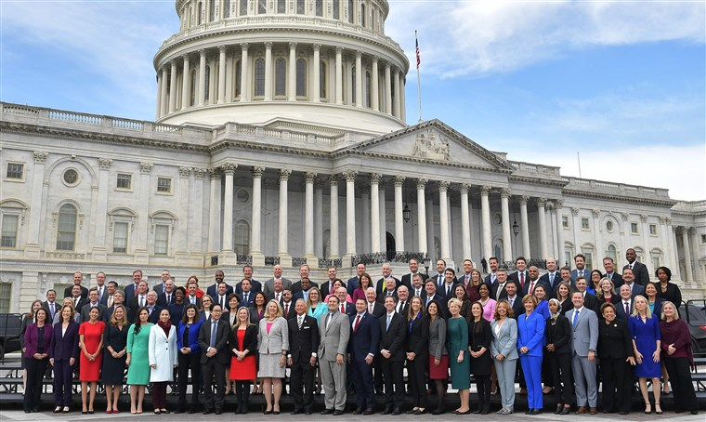
2019: New Congress,
New Opportunities
2018 elections results:
House of Representatives has changed control
Record number of women in Congress, including the first pediatrician
Chairman Roberts announced retirement in 2020
Source: NBC News
Notes:
Discretionary spending refers to the funds allocated each year in the annual appropriations bills that are set by Congress
Accounts for about 1/3 of the federal government’s total spending
WIC is a discretionary program, along with Head Start, CDC, and most defense, education, and transportation programs
Mandatory spending is enacted by law and does not depend on any annual appropriations bill.
Accounts for the remaining 2/3 of government spending
The government must by law pay out benefits to all eligible recipients of mandatory programs
Medicaid, Medicare, Social Security, and SNAP are examples of mandatory programs

Slide 5
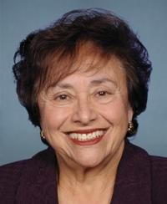
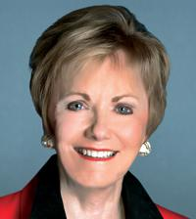
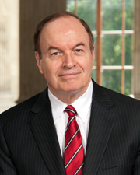
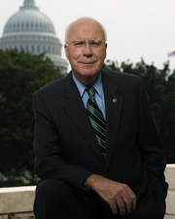
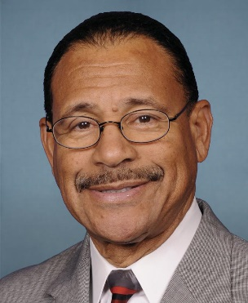
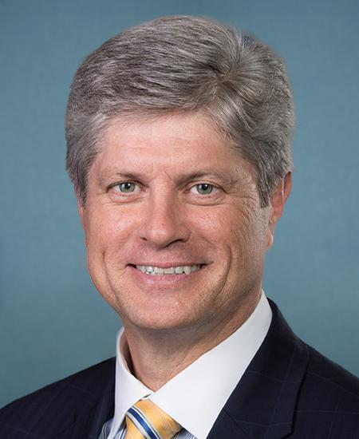
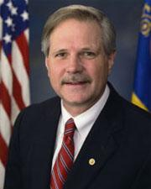
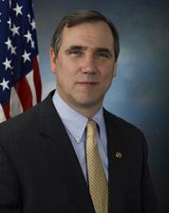
House
Senate
Appropriations Committee
Chair: Rep. Nita Ranking Member: Rep.
Lowey (D-NY) Kay Granger (R-TX)
Appropriations Committee
Chair: Sen. Richard Ranking Member: Sen.
Shelby (R-AL) Pat Leahy (D-VT)
Agriculture Subcommittee
Chair: Rep. San- Ranking Member: Rep.
Ford Bishop (D-GA) Jeff Fortenberry (R-NE)
Agriculture Subcommittee
Chair: Sen. John Ranking Member:
Hoeven (R-ND) Sen. Jeff Merkley (D-OR)
Source: https://www.congress.gov

Slide 6
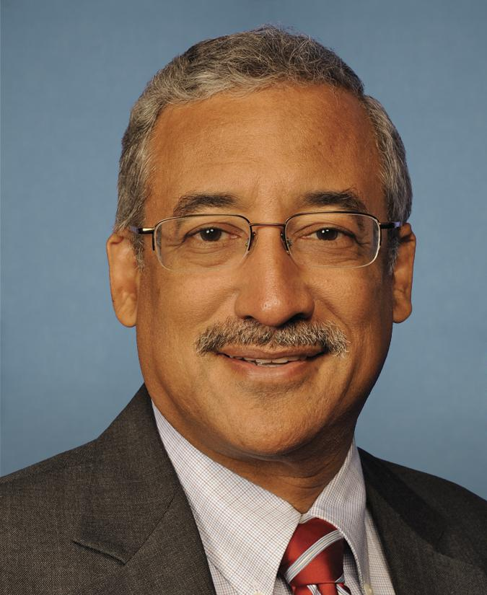
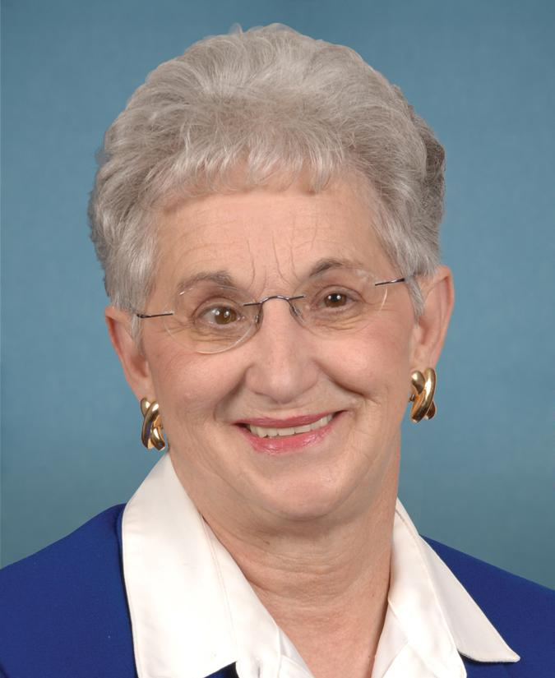
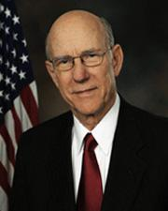
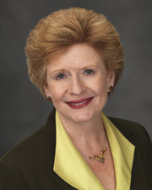
House
Senate
House Committee on Education and Labor
Chair: Rep. Bobby Ranking Member: Rep.
Scott (D-VA) Virginia Foxx (R-NC)
Senate Committee on Agriculture, Nutrition, & Forestry
Chair: Sen. Pat Ranking Member: Sen.
Roberts (R-KS) Debbie Stabenow (D-MI)
Source: https://www.congress.gov

Slide 7
Appropriations
On Feb. 15, Congress passed FY 2019 appropriations bills, including funding for USDA/WIC
After a three-week continuing resolution that ended a five-week shutdown
WIC was funded at a slightly lower level than last year: $6.075 billion compared to $6.175 billion in FY 2018
Should still be adequate to meet current caseload need
$500 million rescission of unspent funds
Flat funded peer counselors at $60 million
New $5 million set-aside for telehealth projects that support nutrition education or breastfeeding support

Slide 8
Effects of the Shutdown
WIC was one of several programs affected by the government shutdown, rooted in a funding dispute over the border wall.
WIC clinics remained operational in all states
Conflicting stories and misinformation fueled participant concerns, including some unfortunate reports of moms diluting or making homemade formula
SNAP is still recovering from its early issuance of benefits, which also led to confusion
Continuing resolutions and the threat of shutdowns have become more frequent in recent years
Notes:
Although this is how the federal appropriations process is supposed to work, rarely is work finished on all appropriations bills by October 1.
CRs have become the norm - the last time not a single CR was needed was in 1996 because Congress had enacted every one of the regular spending bills by the start of the new fiscal year on Oct. 1.

Slide 9
Next Steps: Appropriations
Congress must first consider the budget resolution, which must lift the caps on non-defense discretionary spending to avoid sequestration
Debt ceiling was hit yesterday – increased pressure for budget deal
After a budget deal, the next step is to define the 302(b) allocations between the different subcommittees
Notes:
Although this is how the federal appropriations process is supposed to work, rarely is work finished on all appropriations bills by October 1.
CRs have become the norm - the last time not a single CR was needed was in 1996 because Congress had enacted every one of the regular spending bills by the start of the new fiscal year on Oct. 1.

Slide 10
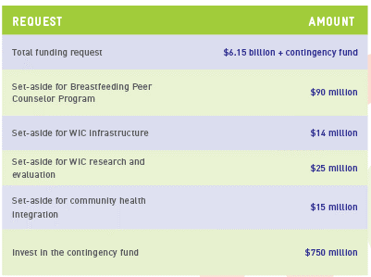
Looking Ahead to 2020: NWA’s FY 2020 Appropriations Asks
WIC-adjacent initiatives
WIC FMNP - $18.5 million
Adequate funding for DGAs P-24 months
Still waiting for President’s 2020 Budget – expected March 11
Congress is currently working on Budget Resolution for next 2 years; must raise budget caps set in Budget Control Act of 2011

Slide 11
Child Nutrition Reauthorization
Chairman Roberts has indicated interest in moving CNR through this year
Some of the same challenges remain from the 2015-16 reauthorization attempt; some dynamics have changed
NWA is consulting with the membership to develop a distinct CNR agenda – including later today!
CNR is a crucial process to improving WIC’s authorizing statute and implementing innovative ideas. Past examples of CNR successes include:
Language to review and update the food package every 10 years
The establishment of the Breastfeeding Peer Counselor Program
Mandate to get all states to EBT by 2020
The establishment of the use of adjunctive eligibility in WIC
Language that establishes funding levels for set asides like the Breastfeeding Peer Counselor Program, MIS/EBT, and Infrastructure

Slide 12
CNR: Potential WIC Provisions
Budget flexibility: expanding definition of food costs to include EBT costs
Eligibility and certification:
Extend eligibility to age six
Extend postpartum eligibility to two years
Extend certifications for infants to two years
Adjunctive eligibility
Food package
WIC Act to be introduced in House and Senate

Slide 13
Immigrant Access to WIC
Public Charge: WIC was not explicitly listed in the rule but, depending on the final rule, could still be affected. DHS is still drafting the final rule after over 266,000 comments.
2020 Census: The Supreme Court is currently reviewing whether a citizenship question can be included on the Census. Census data affects WIC’s funding formula.
State-level actions: A few state legislatures are taking steps to limit immigrant access to WIC and other prenatal medical services

Slide 14
Dietary Guidelines
USDA and HHS are in the process of developing the 2020-2025 Dietary Guidelines for Americans
For the first time, the DGAs will offer guidelines for pregnancy and children up to age 2
The process has been delayed, even before the shutdown. NWA continues to work with nutrition partners to actively monitor and comment on the process
March 2018: NWA initial comment on list of topics submitted
September 2018: USDA released refined list of topics and call for nominations
October 2018: NWA submitted nomination for Advisory Committee
February 2019: DGA Advisory Committee members announced

Slide 15
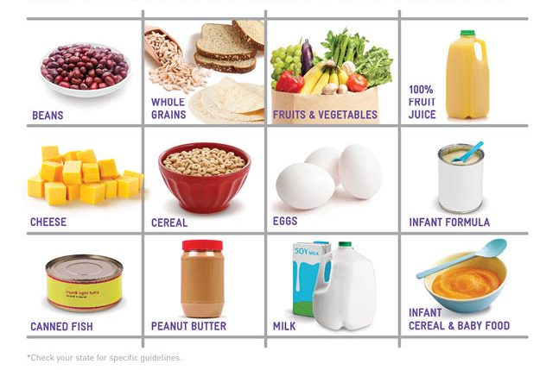
WIC Food Package
NASEM issued its report and recommendations in January 2017
USDA has signaled that it will not review the WIC food package until after completion of the DGAs
The delay could leave the food package open to threats from Congress

Slide 16
Brief Summary of NASEM Recommendations
NWA is very excited about, and supports, the recommendations. Highlights:
CVB amount should be increased across all food packages
Substitute infants fruits and vegetables with CVV
Reduce juice and allow CVV option
Reduce milk
More choice and flexibility around package sizes
Reduce amount of formula
Notes:
BRIEF SUMMARY OF RECOMMENDATIONS
CVV amount should be increased across all food packages, specifically to:
$15 for postpartum women
$25 for partially bf women
$35 for fully bf women
Reduce juice and allow CVV option
NASEM recommends offering participants the option to choose an additional $3 CVV in place of 64 oz. of juice
Juice is eliminated from FP VI (post partum women)
Reduce milk
NASEM recommends that the amount of dairy be reduced in most food packages since current amounts provide more than a supplemental amount of dairy
Allow substitution of infant fruits and vegetables with CVV
Participants are allowed to substitute half, or all, jarred infant fruits and vegetables with a CVV of comparable value.
Caregivers of infants ages 6 – 11 months should have the option to choose a $10 CVV plus 64 ounces of jarred infant fruits & vegetables or $20 CVV in place of all jarred infant fruits & vegetables.
Reduce the amount of formula
NASEM recommends the individual tailoring of infant food packages to best meet the needs of the mother-infant dyad. The opportunity for assessing baby’s formula needs helps reduce the amount that is given to participants.
Expand options to meet increasing number of diverse populations in WIC
NASEM recommends that USDA-FNS require states to offer additional options in food categories that support the culture food preferences of WIC participants
For example: additional forms of fruits and vegetables and a range of options and sizes for grains and yogurt

Slide 17
ERS Reorganization
In August 2018, USDA took steps to reorganize and relocate the Economic Research Service:
Reorganize ERS under the Office of the Chief Economist, within the Office of the Secretary.
Relocate ERS outside of the National Capital Region
These steps would undermine the independence, credibility, and expertise of ERS.
Bipartisan opposition in Congress – Feb. 15th report language calling for an “indefinite hold” on these actions
Rep. Pingree (D-ME) – Agricultural Research Integrity Act of 2019
Notes:
BRIEF SUMMARY OF RECOMMENDATIONS
CVV amount should be increased across all food packages, specifically to:
$15 for postpartum women
$25 for partially bf women
$35 for fully bf women
Reduce juice and allow CVV option
NASEM recommends offering participants the option to choose an additional $3 CVV in place of 64 oz. of juice
Juice is eliminated from FP VI (post partum women)
Reduce milk
NASEM recommends that the amount of dairy be reduced in most food packages since current amounts provide more than a supplemental amount of dairy
Allow substitution of infant fruits and vegetables with CVV
Participants are allowed to substitute half, or all, jarred infant fruits and vegetables with a CVV of comparable value.
Caregivers of infants ages 6 – 11 months should have the option to choose a $10 CVV plus 64 ounces of jarred infant fruits & vegetables or $20 CVV in place of all jarred infant fruits & vegetables.
Reduce the amount of formula
NASEM recommends the individual tailoring of infant food packages to best meet the needs of the mother-infant dyad. The opportunity for assessing baby’s formula needs helps reduce the amount that is given to participants.
Expand options to meet increasing number of diverse populations in WIC
NASEM recommends that USDA-FNS require states to offer additional options in food categories that support the culture food preferences of WIC participants
For example: additional forms of fruits and vegetables and a range of options and sizes for grains and yogurt

Slide 18
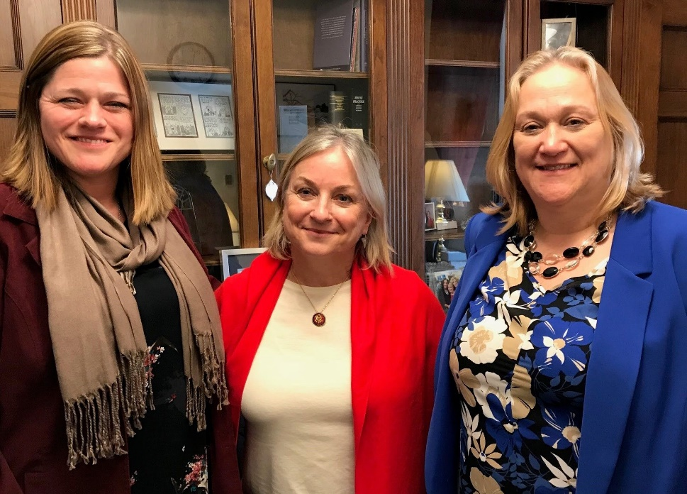
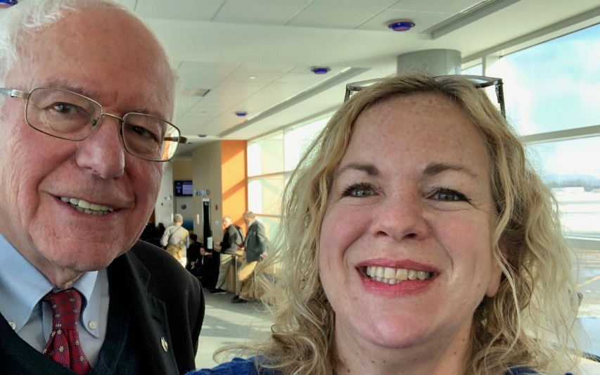
2019: An Important Year for WIC Advocacy
This year, there is potential to move key WIC priorities in both appropriations and reauthorization
We cannot do this alone! You must speak up on behalf of the program and the participants that we all serve

Slide 19
You Can Advocate (with Policymakers) without Lobbying!
Advocacy
Advocacy refers to speaking out on issues or supporting a proposal or cause (our cause is WIC!)
Lobbying
Lobbying is one type of advocacy legally defined by the Internal Revenue Service (IRS)
A lobbying communication:
Refers to specific legislation or measures in a piece of legislation,
Reflects a view on that legislation, AND
Involves a communication with any member or employee of a legislative body or any other government official or employee who may participate in the formulation of the legislation (direct
lobbying) OR encourages the recipient to contact a legislator, employee of a legislative body,
or any other government official or employee (grassroots lobbying)

Slide 20
Activity: Lobbying vs. Advocacy
The House is voting on a budget bill that would harm WIC, so you call your Congressman and tell him to vote against the bill.
You get an NWA action alert to sign a letter stating the benefits of WIC, so you click to email your member of Congress.
You do an interview with the local radio station on how funding shortfalls are influencing client services.

Slide 21
Activity: Lobbying vs. Advocacy
You host your district’s member of Congress at the clinic, explaining all the wonderful aspects of WIC. The Congresswoman ends up talking with a WIC client who is aware of a bill to cut funding for WIC. The client expresses her disapproval.
There’s a bill to restore funding to WIC, so you tell your friends to call their members of Congress and request support of the bill.
USDA puts out a request for public comment on the Dietary Guidelines. You submit a comment with a specific view on how USDA should approach complementary foods.

Slide 22
Stay Tuned for More Presentations at Washington Leadership Conference
Later Today:
Protecting Immigrants’ Access to WIC: Grassroots Efforts by State and Local Agencies and Other WIC Advocates
Leadership and Communication 101
Tomorrow:
A WIC Agenda for the New Congress
An Update on National Immigration Policy & Public Charge
Nailing your Hill Visit
Getting Ready to Charge the Hill—Hands-on Hill Visit Practice
Making it Easier to Shop for WIC Foods: A Panel Discussion

Slide 23
Questions?

