Slide 1
WIC Policy 101: Overview and
Current Issues
Elisabet Eppes, Program Innovation Manager
Darlena Birch, Senior Public Health Nutritionist National WIC Association
March 3, 2019

Slide 2
Session Outline
Importance of WIC Policy
3 Main Policy Areas
WIC Appropriations Overview and Update
WIC Reauthorization Overview and Update
WIC Food Packages Overview and Update
P-24 Dietary Guidelines
Importance of Advocacy
Advocacy vs. Lobbying
Different Ways to Advocate

Slide 3
We know why WIC is important…
Health outcomes—Participation in WIC:
Reduces likelihood of adverse birth outcomes including VLBW babies and pre-term births
Increases breastfeeding initiation and duration rates
Leads to healthier diets and lower food insecurity
Leads to better dental health, higher immunization rates in children
Wide reach: 7.3 million participants across the US
~50% of infants born in the US are enrolled in WIC
10,000 WIC clinics nationwide
Source: USDA WIC Image Gallery. https://wicworks.fns.usda.gov/resources/wic-image-gallery

Slide 4
Changes to WIC policy can help or hinder your ability to help clients achieve their goals.

Slide 5
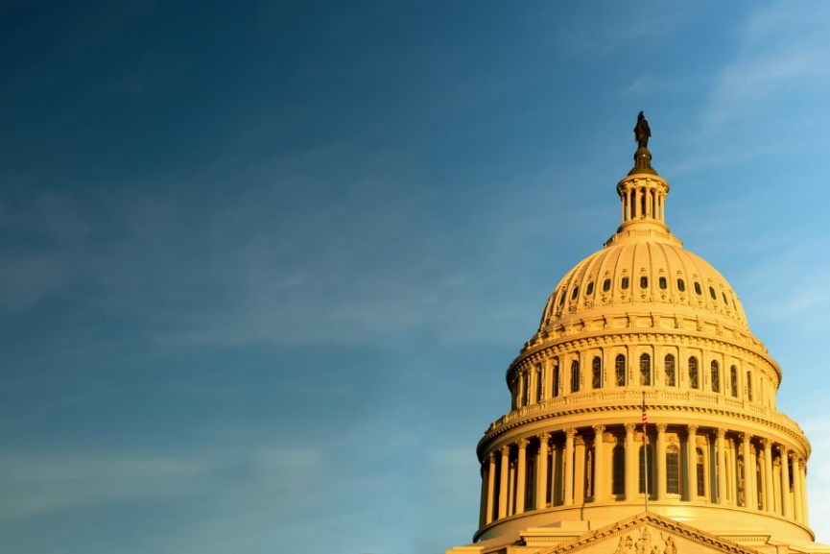
Three Main Policy Areas
Appropriations (legislative) 3. Food Package (regulatory)
2. Reauthorization (legislative)
Source: USDA. https://www.nrcs.usda.gov/wps/portal/nrcs/mt/newsroom/logos+and+design+guidelines/

Slide 6
WIC Appropriations

Slide 7
WIC Appropriations
WIC is a discretionary program (unlike mandatory programs), meaning Congress must fund WIC each year and funding is not guaranteed
Senate and House Appropriations Committees are responsible for setting funding – for WIC, it is the Subcommittees on Agriculture, Rural Development, FDA, and Related Agencies
These Committee and Subcommittee members, Chairs, and Ranking Members are *very* important when it comes to WIC advocacy!
Notes:
Discretionary spending refers to the funds allocated each year in the annual appropriations bills that are set by Congress
Accounts for about 1/3 of the federal government’s total spending
WIC is a discretionary program, along with Head Start, CDC, and most defense, education, and transportation programs
Mandatory spending is enacted by law and does not depend on any annual appropriations bill.
Accounts for the remaining 2/3 of government spending
The government must by law pay out benefits to all eligible recipients of mandatory programs
Medicaid, Medicare, Social Security, and SNAP are examples of mandatory programs

Slide 8
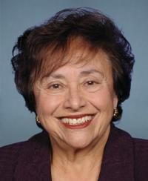
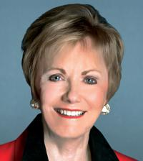
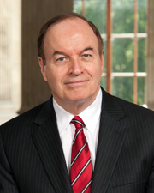
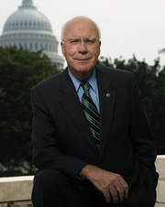
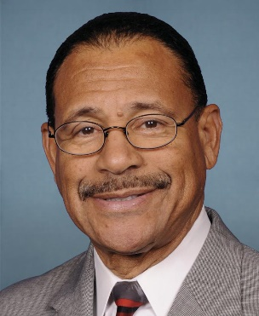
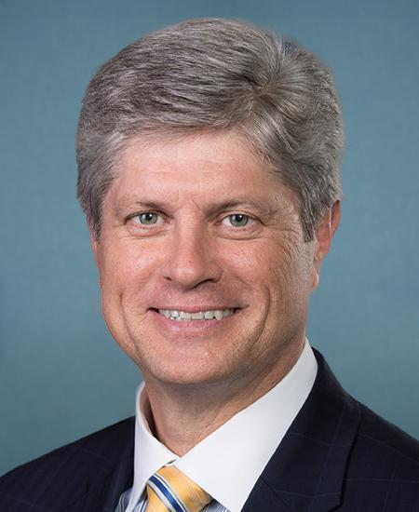
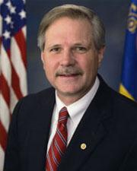
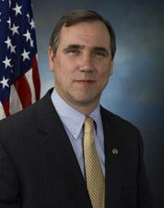
House
Senate
Appropriations Committee
Chair: Rep. Nita Ranking Member: Rep.
Lowey (D-NY) Kay Granger (R-TX)
Appropriations Committee
Chair: Sen. Richard Ranking Member: Sen.
Shelby (R-AL) Pat Leahy (D-VT)
Agriculture Subcommittee
Chair: Rep. San- Ranking Member: Rep.
Ford Bishop (D-GA) Jeff Fortenberry (R-NE)
Agriculture Subcommittee
Chair: Sen. John Ranking Member:
Hoeven (R-ND) Sen. Jeff Merkley (D-OR)
Source: https://www.congress.gov

Slide 9
Steps in the Appropriations Process

Slide 10
Notes:
President’s budget request sent to Congress each February (by the first Monday of the month) for the coming fiscal year, which begins on Oct. 1.
Typically delayed during presidential transitions like the one in 2017
Includes detailed spending levels for all programs
Reveals president’s belief of how much the federal government should be spending and taxing
Sets the president’s priorities for issues including education, defense, and health
Formally written up by the White House’s Office of Management and Budget (OMB)
Congressional Budget Act of 1974 directs that, after the president submits his or her budget request, the House and Senate Budget Committees (with help of Congressional Budget Office [CBO]) each write and vote on their own budget resolutions.
Resolutions serve as the general framework within which Congress makes its decisions about specific spending and taxing levels
Do not have the force of law and do not require president’s signature
Establish the structure of the budget – not specific programs, but rather targets
Based on input from administration officials and congressional committees
Sets what is called the 302(a) allocation
The Appropriations Committees in both the House and the Senate are responsible for determining the precise levels of budget authority, or allowed spending, for all discretionary programs.
302(b) sub-allocations – how Appropriations Committees divide up the 302(a) allocation between the 12 subcommittees
Subcommittees hold public hearings – consider last year’s spending and president’s request
After bills pass out of subcommittee, they are considered by full committee in both chambers – for debate, amendments, and a vote
Once bills have passed out of Appropriations committees, the full House and Senate debate, offer amendments, and vote
Typically, consideration begins in the House
House-passed bills then head to Senate
Once passed in Senate, conference committee must be formed to reconcile differences between Senate and House bills
Conference report then sent back to the full chambers
The president must sign each appropriations bill after it has passed Congress for the bill to become law.
When the president has signed all 12 appropriations bills, the budget process is complete.

Slide 11
Continuing Resolutions
If budget process is not complete by October 1, Congress may enact one or more continuing resolutions (CRs)
Short-term funding to avoid a government shutdown
CRs provide funding at the same level as the previous fiscal year and can last varying lengths of time (from a few weeks to a full year).
CRs make program planning challenging
While CRs are not ideal, they are better than letting the government shutdown!
Source: https://obamawhitehouse.archives.gov/blog/2014/09/19/what-s-continuing-resolution-and-why-does-it-matter
Notes:
Although this is how the federal appropriations process is supposed to work, rarely is work finished on all appropriations bills by October 1.
CRs have become the norm - the last time not a single CR was needed was in 1996 because Congress had enacted every one of the regular spending bills by the start of the new fiscal year on Oct. 1.

Slide 12
WIC Appropriations:
Where Are We Now?
On Feb. 15, Congress passed the remaining FY 2019 appropriations bills, including funding for USDA/WIC
After a three-week continuing resolution that ended a five-week shutdown
WIC was funded at a slightly lower level than last year: $6.075 billion compared to $6.175 billion in FY 2018
Should still be adequate to meet current caseload need
$500 million rescission of unspent funds
Flat funded peer counselors at $60 million
New $5 million set-aside for telehealth projects that support nutrition education or breastfeeding support

Slide 13
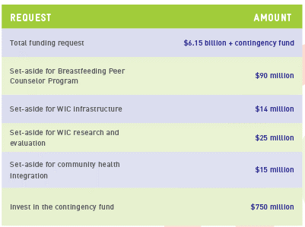
Looking Ahead to 2020: NWA’s FY 2020 Appropriations Asks
WIC-adjacent initiatives
WIC FMNP - $18.5 million
Adequate funding for DGAs P-24 months
Still waiting for President’s 2020 Budget – expected March 11
Congress is currently working on Budget Resolution for next 2 years; must raise budget caps set in Budget Control Act of 2011

Slide 14
WIC Reauthorization

Slide 15
WIC Reauthorization
Also known as Child Nutrition Reauthorization (or “CNR”) – part of Child Nutrition Act of 1966
Child Nutrition Act also authorizes the National School Lunch Program, CACFP, Summer Meals, etc.
Occurs every 5 years
Changes WIC Policy
Committees of Jurisdiction: House Committee on Education and Labor and Senate Committee on Agriculture, Nutrition, & Forestry
Again, these Committee members, Chairs, and Ranking Members are *very* important when it comes to WIC advocacy!

Slide 16
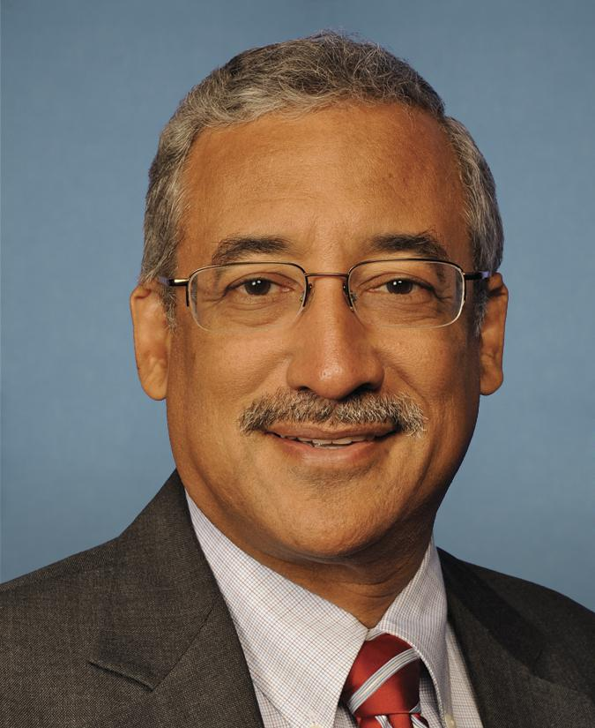
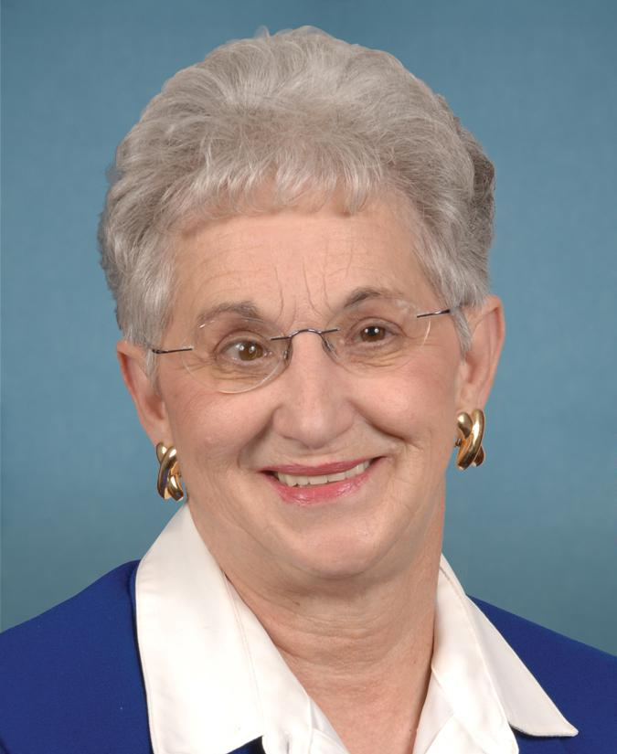
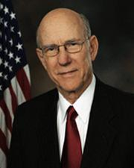
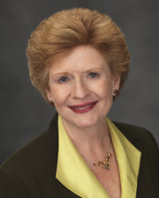
House
Senate
House Committee on Education and Labor
Chair: Rep. Bobby Ranking Member: Rep.
Scott (D-VA) Virginia Foxx (R-NC)
Senate Committee on Agriculture, Nutrition, & Forestry
Chair: Sen. Pat Ranking Member: Sen.
Roberts (R-KS) Debbie Stabenow (D-MI)
Source: https://www.congress.gov

Slide 17
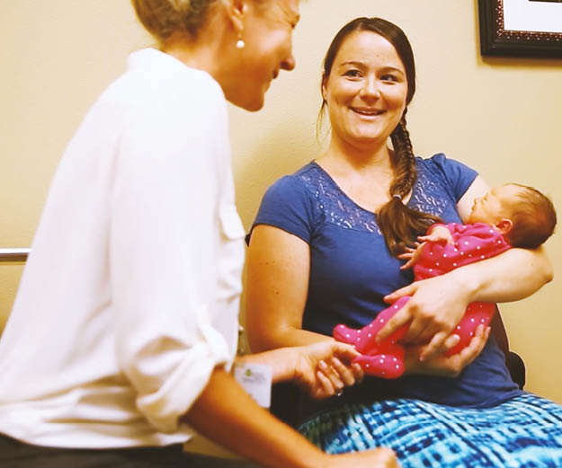
Examples of Past Reauthorization Changes
Language to review and update the food package every 10 years
The establishment of the Breastfeeding Peer Counselor Program
Mandate to get all states to EBT by 2020
The establishment of the use of adjunctive eligibility in WIC
Language that establishes funding levels for set asides like the Breastfeeding Peer Counselor Program, MIS/EBT, and Infrastructure

Slide 18
Current Status of Reauthorization
Still operating under 2010 Healthy, Hunger Free Kids Act
2015 Process
House and Senate Committees missed original deadline (September 30, 2015)
Senate Agriculture Committee passed bipartisan bill in January 2016
Contained several positive WIC provisions including WIC to Six, 2 year infant certifications
House Education and Workforce Committee passed partisan bill in April 2016
Bad for WIC and other child nutrition programs; no positive WIC provisions
Neither bill passed in the full chamber. Nothing happened in 2017 or 2018.
CNR will likely be taken up in 2019, as Senate Agriculture Committee completed work on Farm Bill in 2018
More to come about this later today!

Slide 19
WIC Policy Opportunities and Threats
Policy Opportunities:
Expanding definition of food costs to include EBT costs
Extend WIC eligibility to age six
Extend post-partum WIC eligibility to two years
Extend WIC certifications for all family members to two years
Policy Threats:
Immigrants’ access to WIC – on the national and state levels
Public charge – Department of Homeland Security proposed a rule to make it harder for immigrants to obtain public benefits, accepted comments last fall. Now must review comments before publishing final rule
WIC was not included in proposed rule
Will hear more about this later today and tomorrow
WIC Act to be introduced in House and Senate – Will hear more about this later

Slide 20
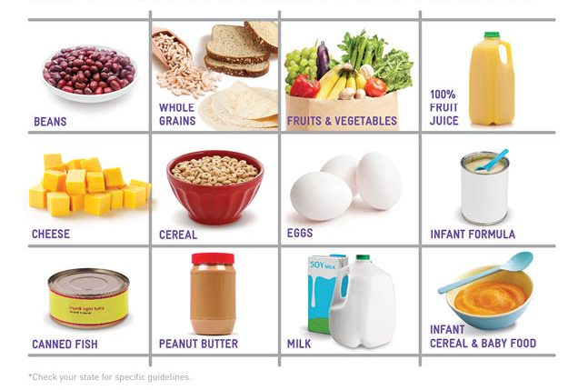
WIC Food Packages

Slide 21
Food Package Review Process
The review process is scientifically based
USDA commissions National Academies of Sciences, Engineering, and Medicine (NASEM, formerly the IOM)
Specifies the types and minimum nutritional requirements of foods in the WIC food package
Every 10 years as mandated by the Healthy Hunger-Free Kids Act 2010
Notes:
FOOD PACKAGE REVIEW PROCESS
As mandated by the Healthy Hunger-Free Kids Act 2010, the WIC food package is reviewed every 10 years
Central to the review is that recommendations are “grounded in the most recently available science.”
Based on the National Academy of Sciences, Engineering and Medicine (NASEM) expert committee’s review and subsequent recommendations, the USDA-FNS considers policy options that result in federal regulation.
The review process is scientifically based
These regulations specify the types and minimum nutritional requirements of foods to be included in the WIC food package
States are provided certain levels of flexibility on how they implement the regulations
Throughout the food package review process, NWA submitted comments on behalf of the WIC community

Slide 22
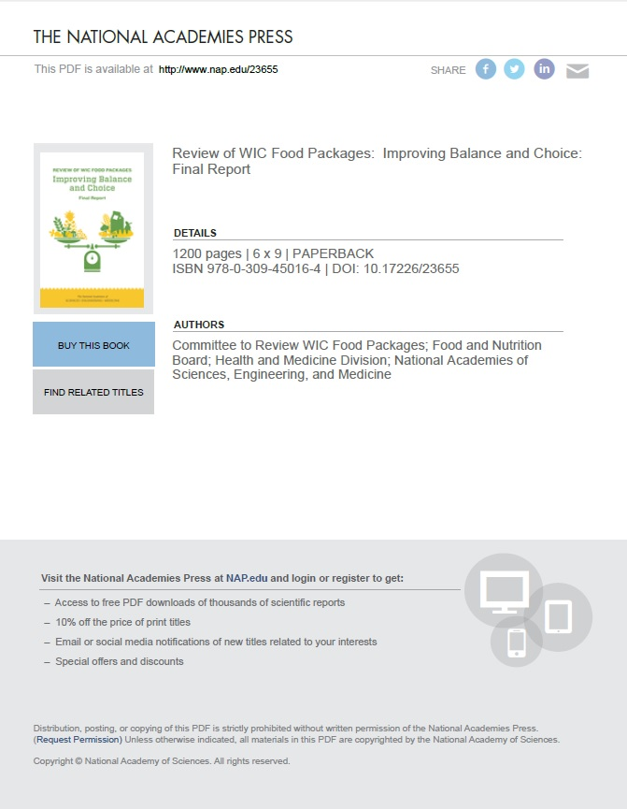
Food Package Review Process: Where are We Now?
NASEM released its report in Jan. 2017
USDA still reviewing recommendations
No requirement to act
Danger in action under this administration – could roll back progress
Congressional threats
Notes:
FOOD PACKAGE REVIEW PROCESS: WHERE ARE WE NOW?
NASEM recommendations are just that – RECOMMENDATIONS
NWA is excited about, and supports, the recommendations made by NASEM
In your folders, you received a copy of the side-by-side comparison
There are also copies of NASEM’s infographic available
However, this does not mean that they will be implemented
It’s up to FNS to determine which recommendations will be implemented
We don’t know how long this process will take

Slide 23
Brief Summary of Recommendations
NWA is very excited about, and supports, the recommendations. Highlights:
CVB amount should be increased across all food packages
Substitute infants fruits and vegetables with CVV
Reduce juice and allow CVV option
Reduce milk
More choice and flexibility around package sizes
Reduce amount of formula
Notes:
BRIEF SUMMARY OF RECOMMENDATIONS
CVV amount should be increased across all food packages, specifically to:
$15 for postpartum women
$25 for partially bf women
$35 for fully bf women
Reduce juice and allow CVV option
NASEM recommends offering participants the option to choose an additional $3 CVV in place of 64 oz. of juice
Juice is eliminated from FP VI (post partum women)
Reduce milk
NASEM recommends that the amount of dairy be reduced in most food packages since current amounts provide more than a supplemental amount of dairy
Allow substitution of infant fruits and vegetables with CVV
Participants are allowed to substitute half, or all, jarred infant fruits and vegetables with a CVV of comparable value.
Caregivers of infants ages 6 – 11 months should have the option to choose a $10 CVV plus 64 ounces of jarred infant fruits & vegetables or $20 CVV in place of all jarred infant fruits & vegetables.
Reduce the amount of formula
NASEM recommends the individual tailoring of infant food packages to best meet the needs of the mother-infant dyad. The opportunity for assessing baby’s formula needs helps reduce the amount that is given to participants.
Expand options to meet increasing number of diverse populations in WIC
NASEM recommends that USDA-FNS require states to offer additional options in food categories that support the culture food preferences of WIC participants
For example: additional forms of fruits and vegetables and a range of options and sizes for grains and yogurt

Slide 24
Steps Still Left in the USDA Rule-Making Process
USDA will publish interim rule and accept public comments
USDA will responds to all public comments and make any changes to food packages rule, considering comments
USDA will publish interim final rule and accept public comment
USDA will respond to all public comments and makes any changes to food packages rule, considering comments
USDA will publish final rule
Notes:
STEPS STILL LEFT IN THE USDA RULE-MAKING PROCESS
USDA will publish interim rule and accept public comments
USDA will responds to all public comments and make any changes to food packages rule, considering comments
USDA will publish interim final rule and accept public comment
USDA will respond to all public comments and makes any changes to food packages rule, considering comments
USDA will publish final rule

Slide 25
P/B-24 Dietary Guidelines
The 2020 – 2025 Dietary Guidelines for Americans
Will provide recommendations for pregnancy and birth through 24 months of age.
Timeline
March, 2018: NWA comment submitted
September, 2018: Refined list of topics & questions and call for nominations were released
October, 2018: NWA submitted nomination
February, 2019: DGA committee members announced
Notes:
P/B-24 DIETARY GUIDELINES
The 2020 – 2025 Dietary Guidelines for Americans
They will be the first to provide recommendations for pregnancy and birth through 24 months of age
Timeline
March, 2018: NWA submitted a comment regarding the topics and questions addressed in the DGAs
September, 2018: Refined list of topics & questions along with the Call for Nominations for the DGA Committee were released
October, 2018: NWA submitted a nomination to the DGA committee
February, 2019: DGA committee members announced

Slide 26
P/B-24 Dietary Guidelines
Moving Forward
Nutrition Services Section (NSS) provided feedback for NWA legislative & advocacy efforts.
NSS selected 1 – 3 topics/life stage of particular relevance to WIC.
NWA staff continue to meet with partners and will remain engaged throughout the DGA process
Notes:
P/B-24 DIETARY GUIDELINES
Moving Forward
NWA turned to its NSS Section for feedback regarding legislative and advocacy efforts surrounding the DGAs
NSS selected 1 – 3 topics per life stage that it felt was highly relevant to WIC per life stage & provided a couple talking points/recommendations for the DGA committee
This document will be used moving forward in NWA’s legislative and advocacy work to ensure that the voice of the WIC community is represented throughout the process.
NWA staff continue to meet with partners and will remain engaged throughout the DGA process.

Slide 27
Lifting Up Your WIC Voice
It is essential that we all work together to protect and strengthen WIC
Policymakers need to learn about the value of WIC from their constituents – much more powerful than hearing from us in D.C.!

Slide 28
You Can Advocate (with Policymakers) without Lobbying!
Advocacy
Advocacy refers to speaking out on issues or supporting a proposal or cause (our cause is WIC!)
Lobbying
Lobbying is one type of advocacy legally defined by the Internal Revenue Service (IRS)
A lobbying communication:
Refers to specific legislation or measures in a piece of legislation,
Reflects a view on that legislation, AND
Involves a communication with any member or employee of a legislative body or any other government official or employee who may participate in the formulation of the legislation (direct
lobbying) OR encourages the recipient to contact a legislator, employee of a legislative body,
or any other government official or employee (grassroots lobbying)

Slide 29
Activity: Lobbying vs. Advocacy
The House is voting on a budget bill that would harm WIC, so you call your Congressman and tell him to vote against the bill.
You get an NWA action alert to sign a letter stating the benefits of WIC, so you click to email your member of Congress.
You do an interview with the local radio station on how funding shortfalls are influencing client services.

Slide 30
Activity: Lobbying vs. Advocacy
You host your district’s member of Congress at the clinic, explaining all the wonderful aspects of WIC. The Congresswoman ends up talking with a WIC client who is aware of a bill to cut funding for WIC. The client expresses her disapproval.
There’s a bill to restore funding to WIC, so you tell your friends to call their members of Congress and request support of the bill.

Slide 31
You are Permitted and Encouraged to Lobby
It is your democratic right
Each state has specific laws for state employees about lobbying efforts while on the job
Private money can be used on lobbying, federal funds cannot
If you are confused…
Limit lobbying efforts to coffee breaks, lunch breaks, after hours and other times not considered “work time”
Focus your work time on educating about the value of WIC
During NWA’s Leadership Conference you will be educating and doing non-lobbying advocacy.

Slide 32
Advocacy Can Come in Many Different Forms

Slide 33
On the Federal Level
Educating federal legislators about WIC
Calling or visiting their Washington, DC or local office
Engaging with them on social media
Participating in NWA legislative actions!
https://www.nwica.org/advocacy
Notes:
Advocacy Toolkit section on this.

Slide 34
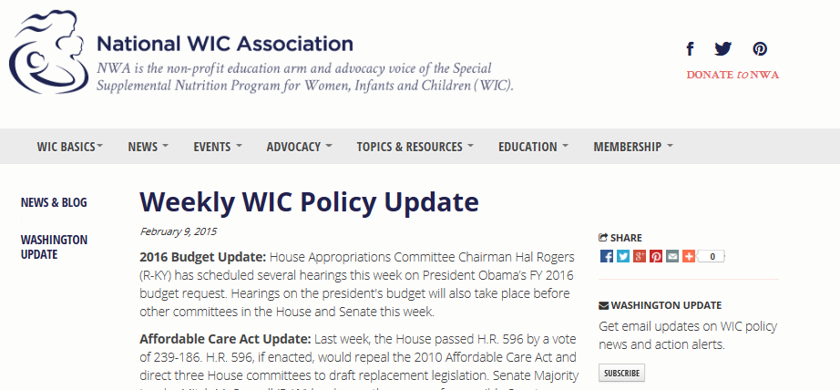
Key Aspect of Being a Good Federal Advocate: Staying Informed
Weekly Legislative Updates in NWA’s Monday Morning Report and Washington Updates
NWA’s blog: www.nwica.org/news
NWA’s Government Affairs counsel – Brian Dittmeier (bdittmeier@nwica.org)

Slide 35
On the State Level
Educating state policymakers such as state senators, representatives, and governors about WIC
Advocating for WIC with state health officials and other state-level stakeholders
Participating in state-level coalitions such as breastfeeding coalitions

Slide 36
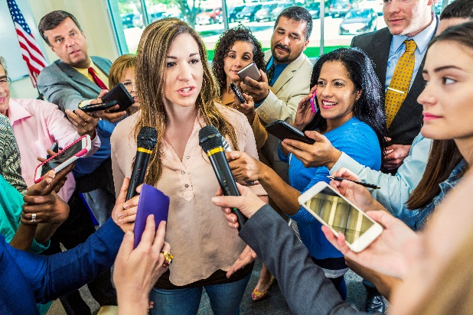
On the Local Level
Attending town hall meetings
Educating local policymakers such as mayors and city councilmembers about WIC
Participating on community coalitions
Hosting events that promote, celebrate, or inform about WIC
Meeting with other departments at your agency to make sure WIC is at the table in decision-making
Educating community residents about WIC
Highlighting WIC achievements in local newspapers, radio, and TV

Slide 37
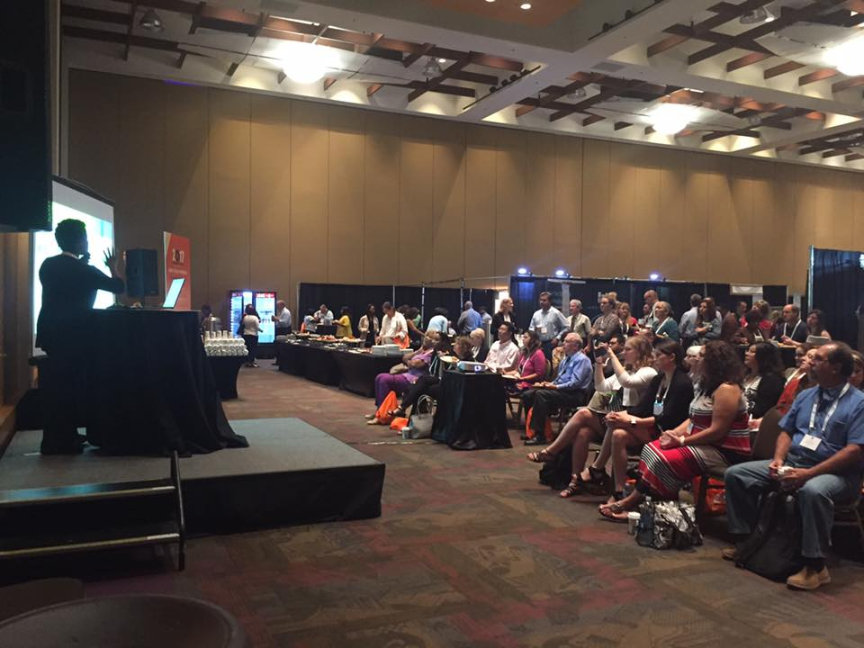
Engaging with NWA
Participating in NWA activities such as committees and task forces
Coming to NWA conferences
Attending NWA webinars
Utilizing NWA as a way to communicate issues and needs to USDA/FNS headquarters staff

Slide 38
NWA’s Advocacy Toolkit
NWA’s Advocacy Toolkit includes resources on advocacy basics, building partnerships at the local level, forming arguments, and engaging with the media: www.nwica.org/advocacy
Includes information on:
How to build strong advocacy messages and tell powerful stories
How to build support for WIC in your community
How to contact elected officials and how to advocate without lobbying
How to engage the media
How to use data in your advocacy
Other important advocacy skills

Slide 39
Stay Tuned for More Presentations and Workshops on How to be a Strong WIC
Advocate
Later Today:
Protecting Immigrants’ Access to WIC: Grassroots Efforts by State and Local Agencies and Other WIC Advocates
Leadership and Communication 101
Tomorrow:
A WIC Agenda for the New Congress
An Update on National Immigration Policy & Public Charge
Nailing your Hill Visit
Getting Ready to Charge the Hill—Hands-on Hill Visit Practice
Making it Easier to Shop for WIC Foods: A Panel Discussion

Slide 40
Questions?

